Slide 1
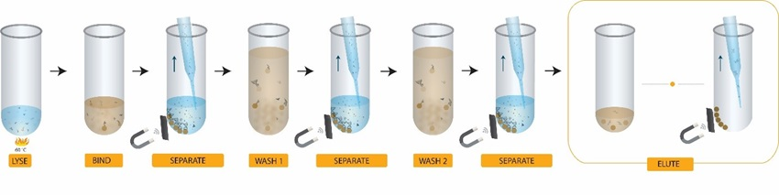
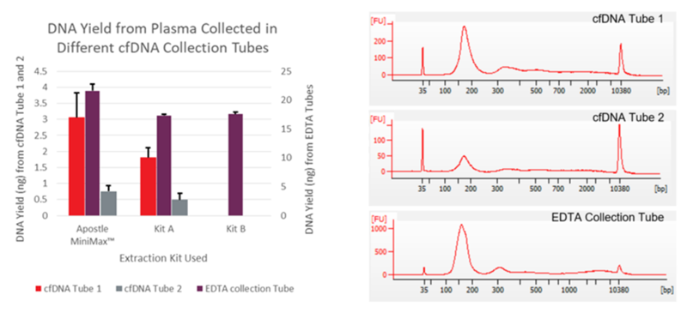
Visual Workflow
DNA size was analyzed on an Agilent Bioanalyzer 2100
https://www.beckman.com/reagents/genomic/dna-isolation/from-plasma/evaluate-apostle-minimax

