Slide 1
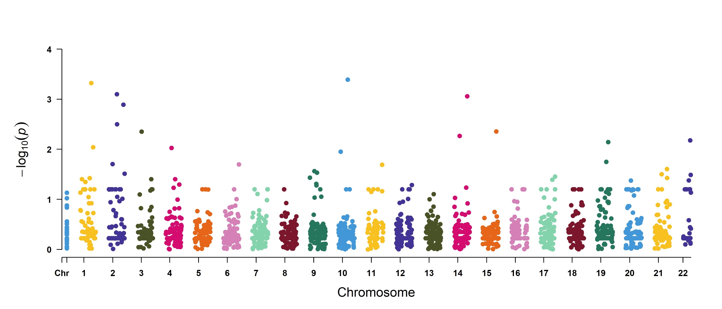
Figure 4. Manhattan plot to show the association between USA300 gene expression and severity
glpD
ptrP
pflB
dpV
pflA
bcP
adhE
gltD
hslV
narK
tpiA
murI
ald
arcC
Windows

Slide 2
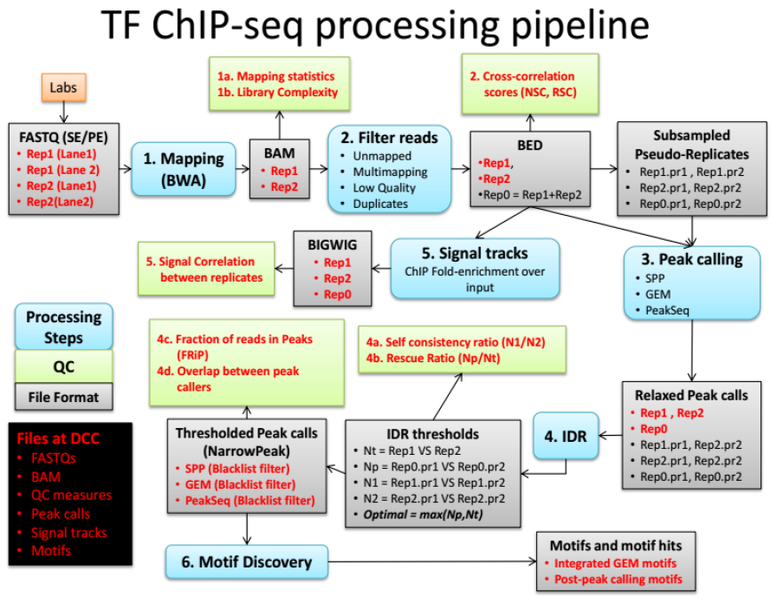
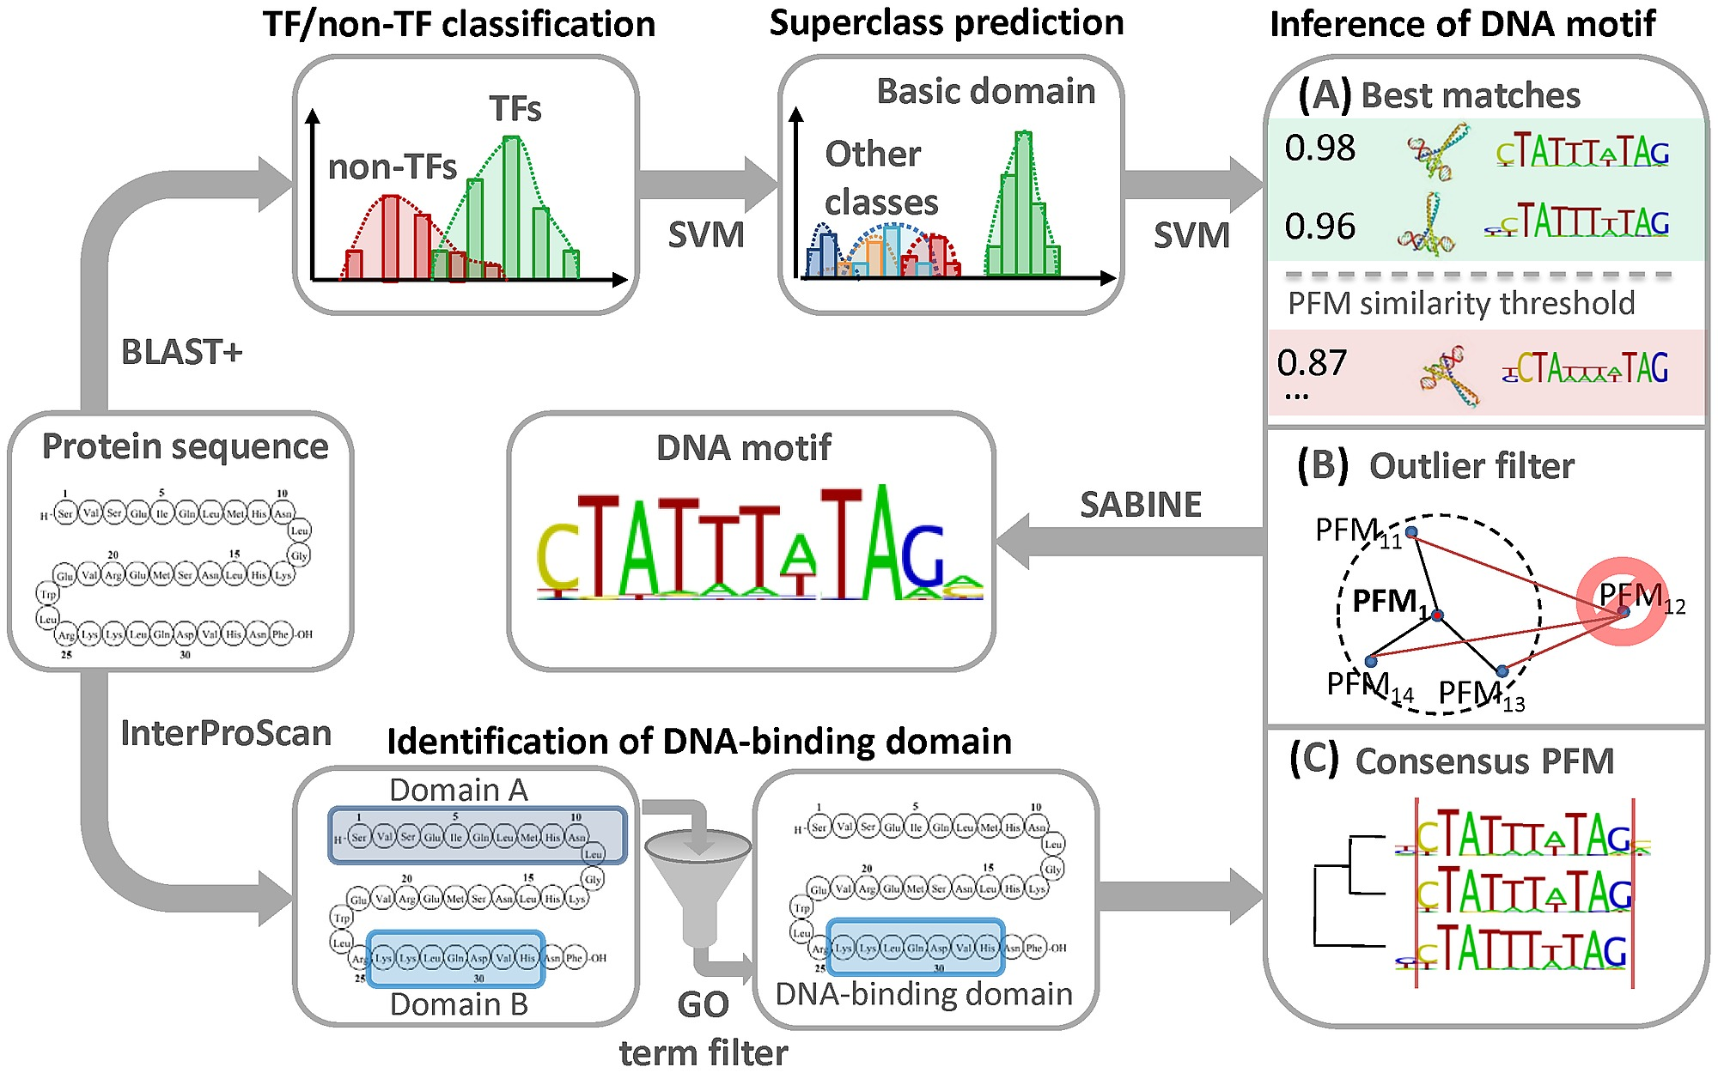

Slide 3
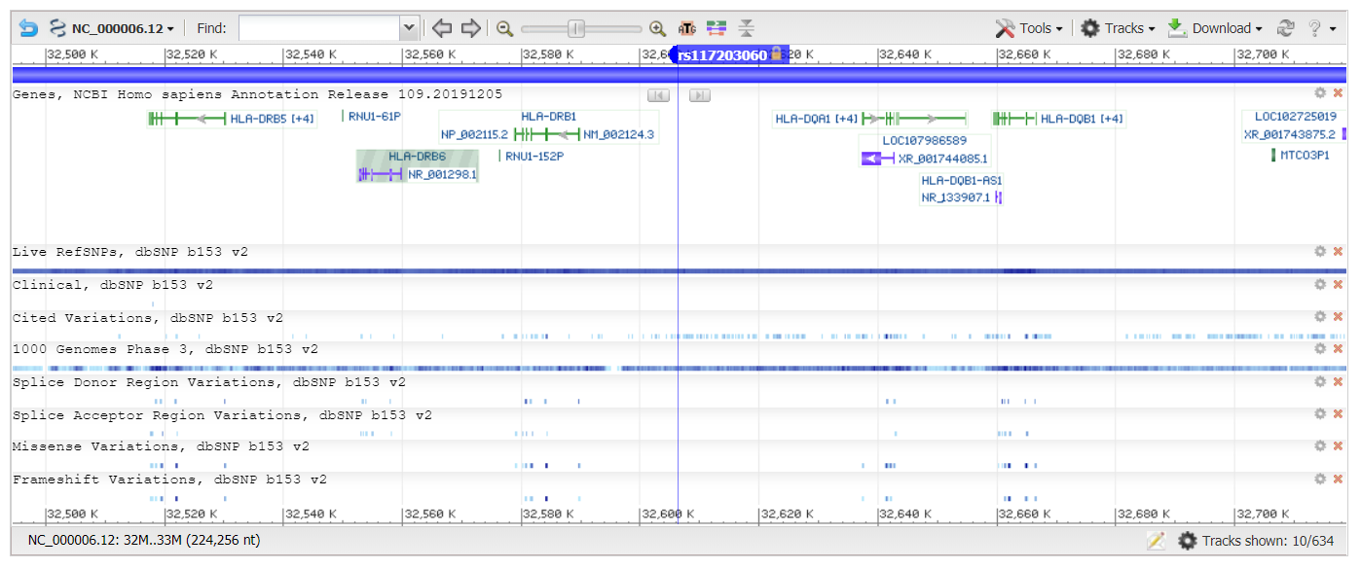

Slide 4
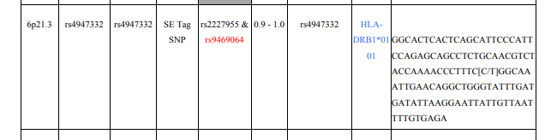
rs4947332
GGCACTCACTCAGCATTCCCATT CCAGAGCAGCCTCTGCAACGTCT ACCAAAACCCTTTC[C/T]GGCAA ATTGAACAGGCTGGGTATTTGAT GATATTAAGGAATTATTGTTAAT TTTGTGAGA

Slide 5
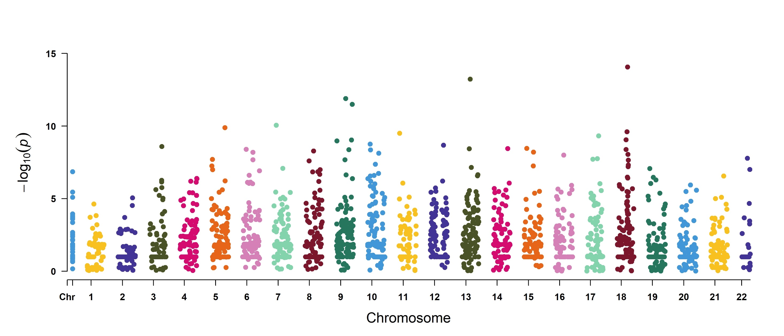
Figure 3. Manhattan plot to show the association between USA300 gene expression and Swab or Pubs
rpsT
rplE
csP
ftsA
fabD
adK
ssB
rpoE
parC
dnaK
metK
asbP
atl
Windows

Slide 6
miRBase
Relase 22
N= 2,283 miRNA
dbSNP153
N= 40,602 SNPs
Gnomad v2.1.1
Asian100K
N= 9,907 SNPs
N= 2,879 SNPs
MAF>1%
N= 328 SNPs
N= 250 SNPs
243 SNPs
R²<0.8
4 pSNPs
225 SNPs
4 nSNPs

