Slide 1
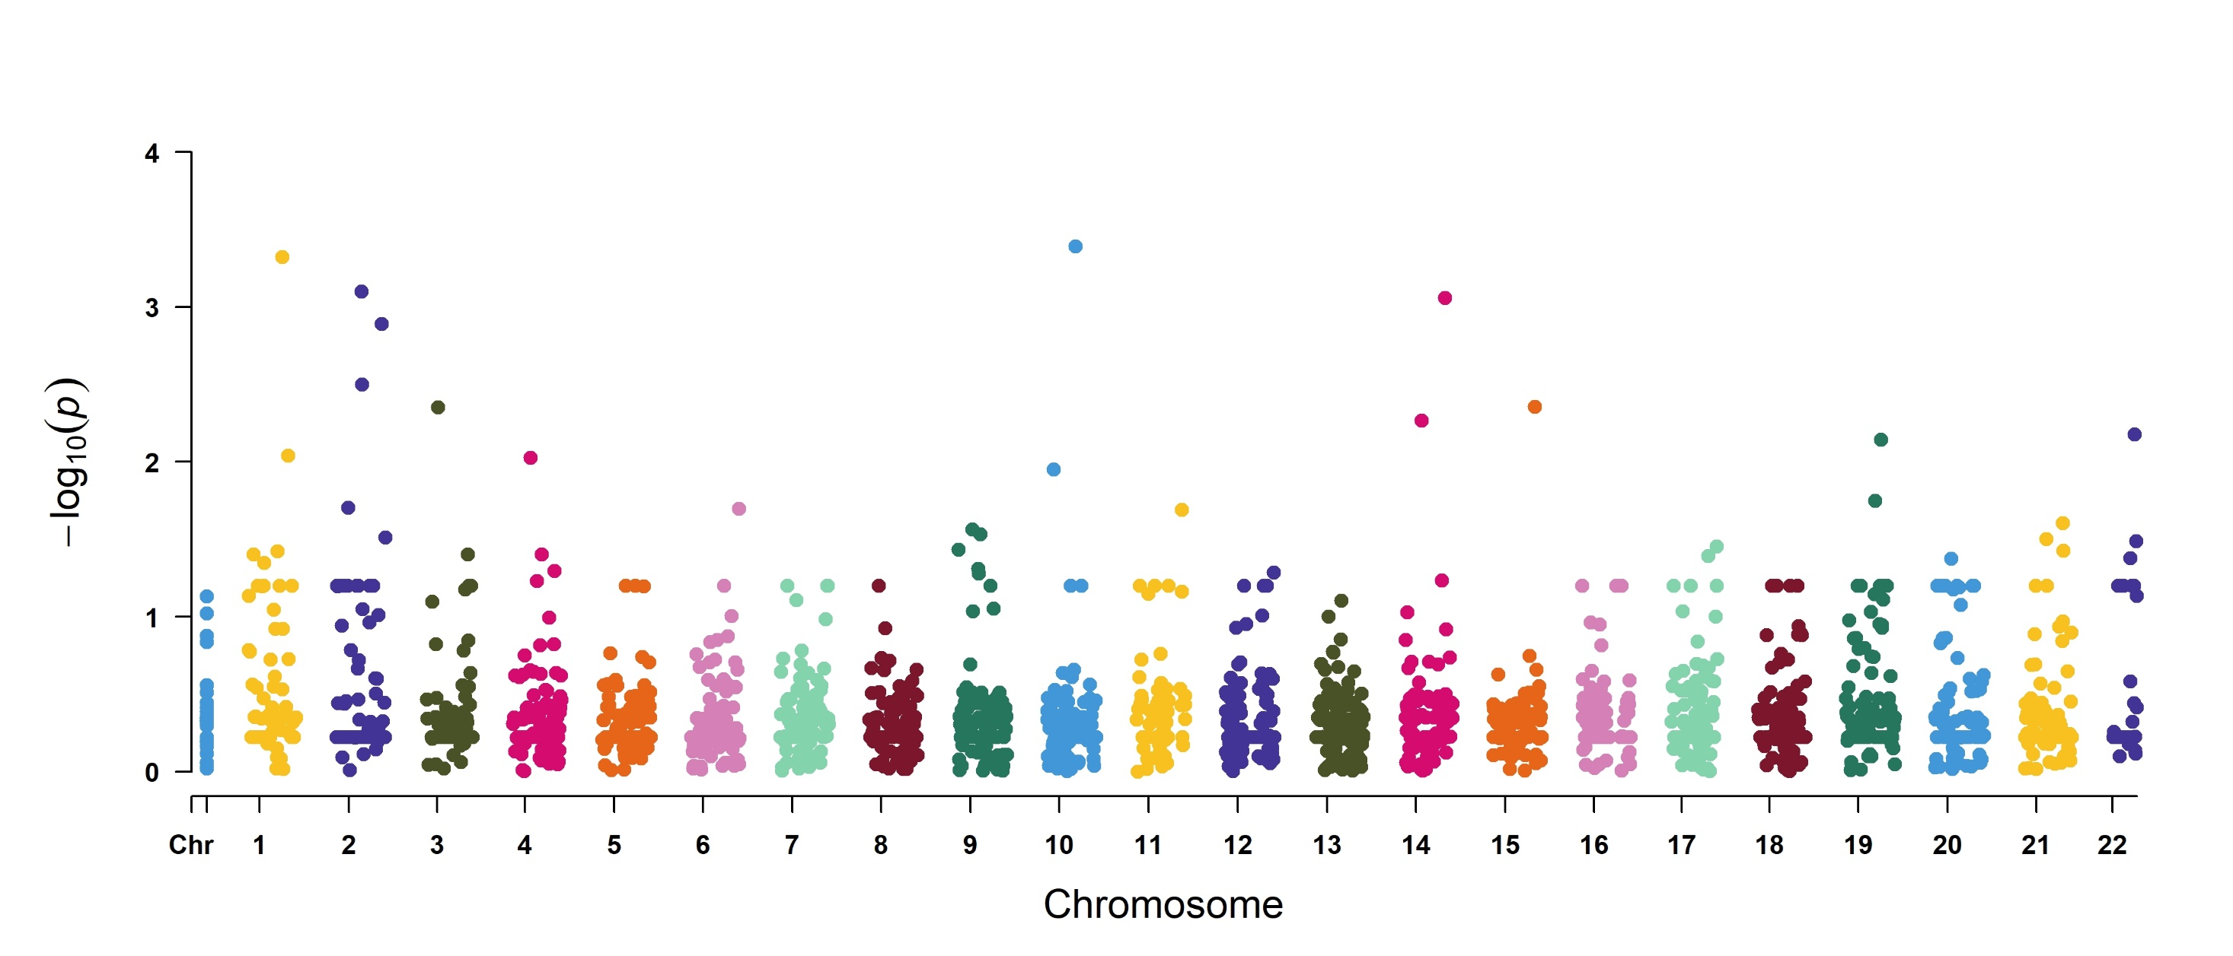
glpD
ptrP
pflB
dpV
pflA
bcP
adhE
gltD
hslV
narK
tpiA
murI
ald
arcC

Slide 2
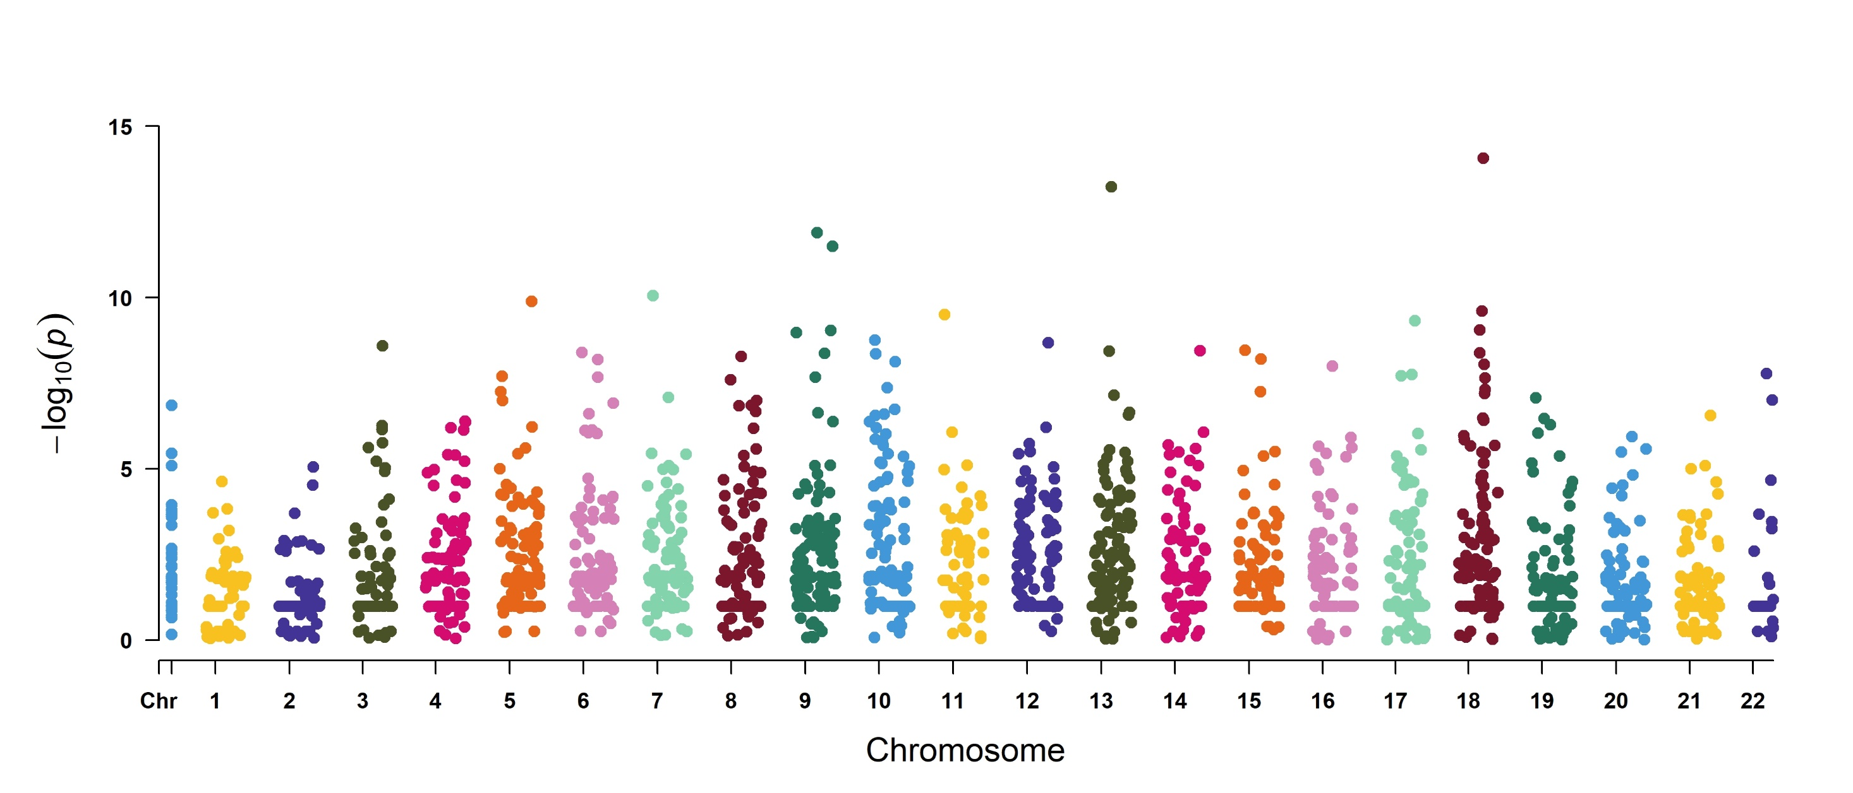
rpsT
rplE
csP
ftsA
fabD
adK
ssB
rpoE
parC
dnaK
metK
asbP
atl

