Slide 1
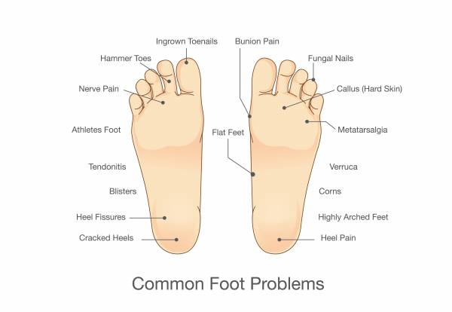
brachydactyly and synovial chondromatosis
Index toe
big toe
middle toe
fourth toe
fifth toe

