Slide 1
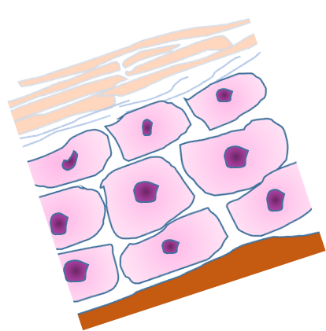
FGF6
Normal
Ferritin-iron
Colon
Hepcidin
Iron
Liver
Skin

Slide 2
Mutated FGF6
Iron overload
Ferritin-iron
X
Liver
X
Colon
Hepcidin
Iron
Skin

Slide 3
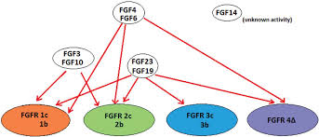

Slide 4
