Slide 1
The use of gene-based functional exome scans for compound heterozygosity with application to hemochromatosis
Shicheng Guo
Steven Schrodi
……..
2018/01/18
Nature Genetics (Letters / Technical Reports)

Slide 2
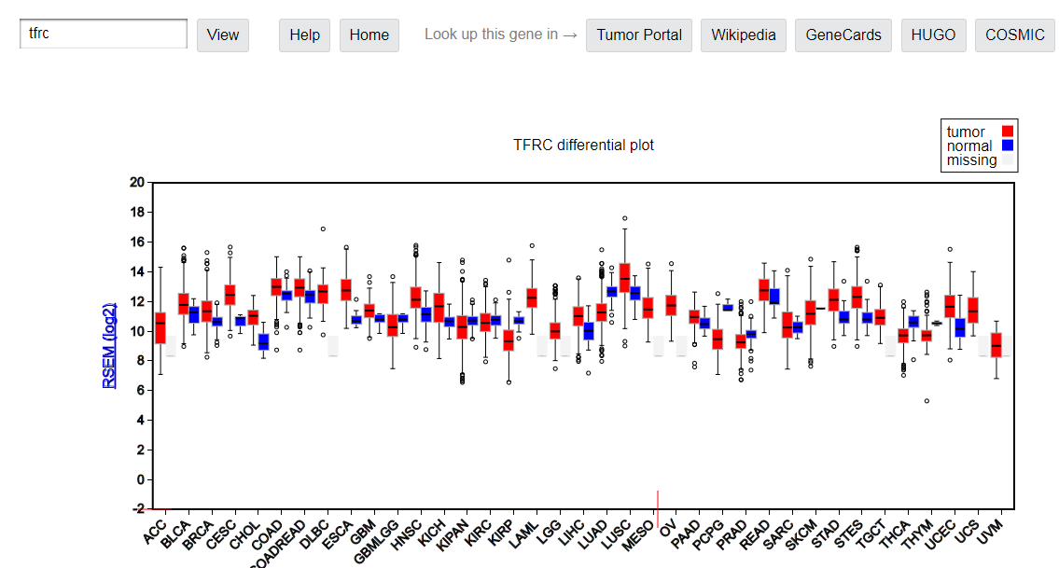
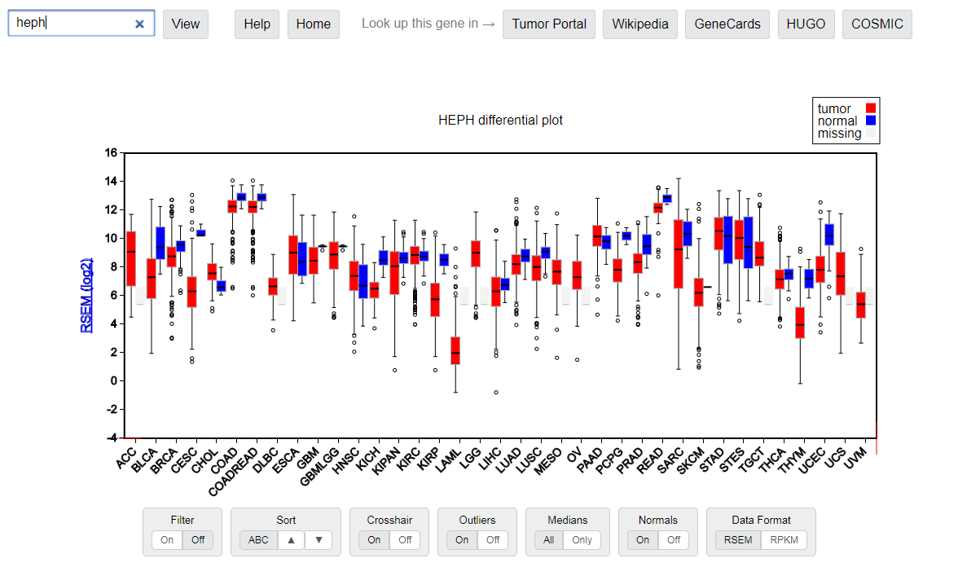

Slide 3
Result 1: Statistic part
Compound hetrogygosity scanning for hemochromatosis susceptibility genes
1, Power calculation
2, Significant novel susceptibility genes
FGF6
FGFR10P
MTAP
Meanwhile, mention FGF26 has been reported by PNAS.
3, Haplotype association details
most frequent haplotype
Table 1

Slide 4
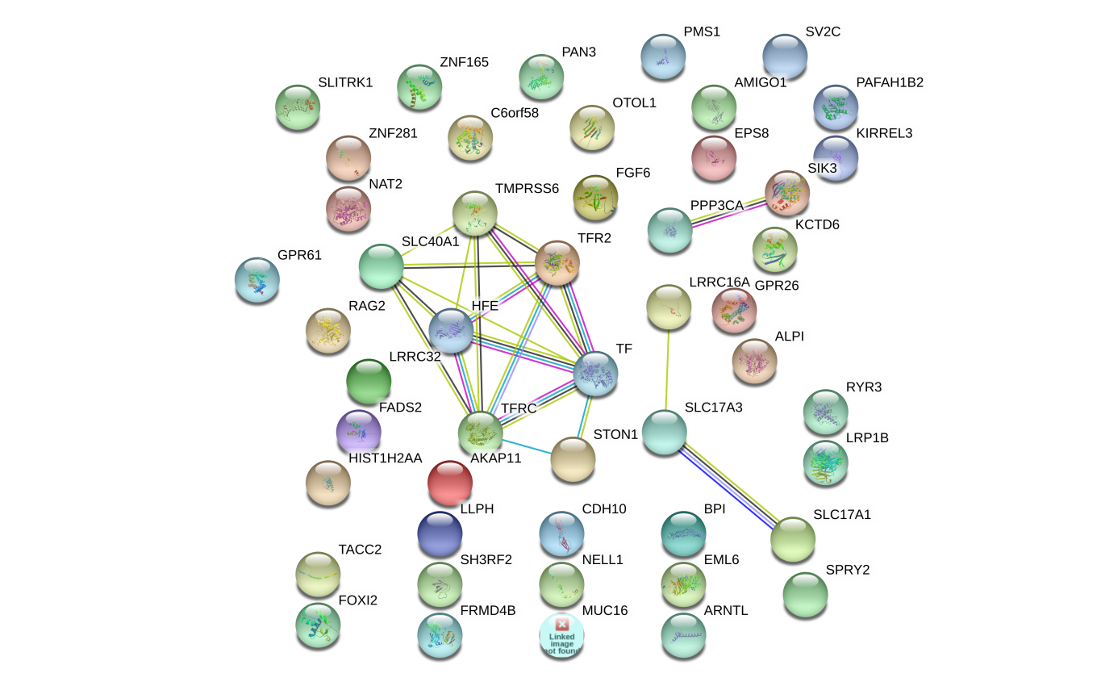
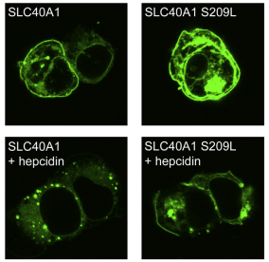
Result 2: In vitro cell study
FGF6 and FGF23: Biology Function in iron metabolism pathway
iron metabolism gene transcriptome network turbulence (regulator)
iron metabolism protein cell locating turbulence (Carrier)
Hemoglobin (HBA1, HBA2, and HBB)
Ferritin (FTH1)
Lactoferrin (LT/LFT)
transferrin (TF)
FGF6
FGF23
PPP3CA
SIK3
LRRC16A
SLC17A3
SLC17A1
TF
FPN
CDH10
SLC40A1
HFE
TMPRSS6
TFR2
STON1
Iron-binding proteins are carrier proteins and metalloproteins which play many important roles in metabolism. Iron is required by humans and bacteria for enzymes and metabolism to function properly. Iron-binding proteins bind iron tightly which make it unavailable for microbial use, limiting growth. Four iron-binding proteins are Hemoglobin, Ferritin, lactoferrin and transferrin. Hemoglobin is located in red blood cells. Transferrin is found in blood and tissue fluids. Lactoferrin is found in milk, blood, tears and saliva. Ferritin is found in every cell type.
https://string-db.org/
KEGG pathway(?)
SLC39A14
Another interaction network method.
Figure 1. (a): Network
Figure 1. (b): location

Slide 5
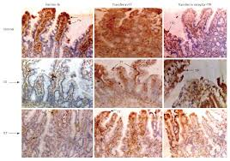
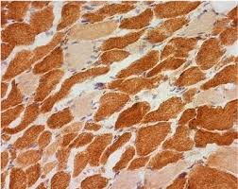
Result 3: FGF6 Gene knock-out mice model
Liver
Liver
Muscle
Figure 3: immunohistochemistry to show Iron quantification in different tissues
Answer the question:
FGF6 most significantly play iron overload roles in muscle or liver or both?

Slide 6
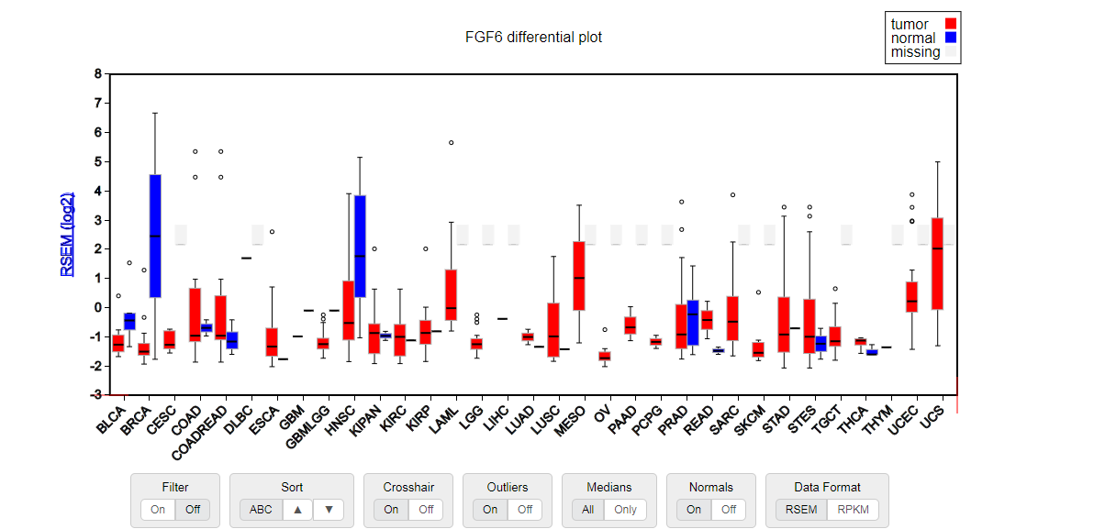
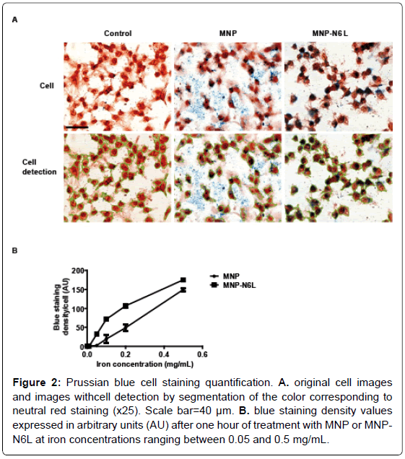
Result 4: FGF6 depression and cancer iron metabolism
FGF6 depression and cancer cellular nutrient
Immunohistochemistry for FGF6 and Iron at same time in Breast cancer and adjacent normal breast
Fe is an essential cellular nutrient that is critical for DNA synthesis and therefore cancer need more Fe
We found FGF6 is down-regulated (Loss-of-Function) in the majority cancer types which data is available.

Slide 7
Conclusion
1, We proposed a new compound heterozygosity method to identify loss-of-function variants
2, We identify new FGF6 causal genes for hemochromatosis

Slide 8
Other question:
The common C282Y mutation of the HFE gene is not found in Chinese Why?
Evolution view/role of FGF6 and any interesting story with this study.
Evolution: Fibroblast growth factors: from molecular evolution to roles in development, metabolism and disease

Slide 9
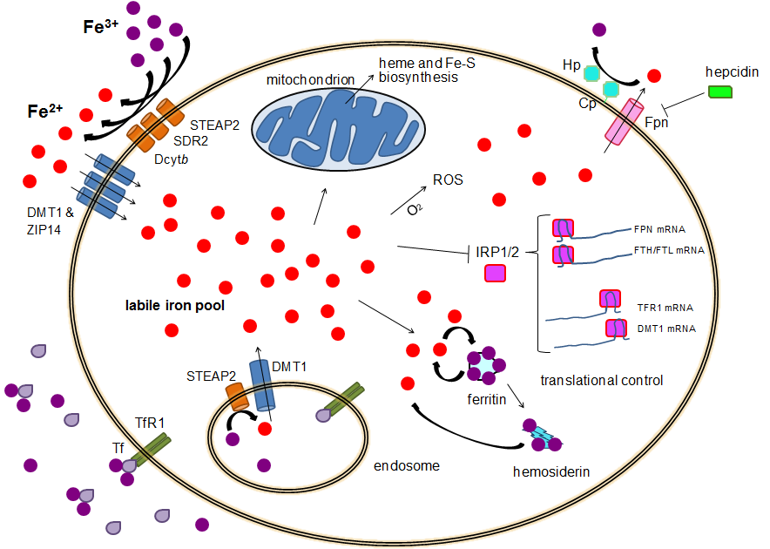
ferroxidases ceruloplasmin (CP) or hephaestin (HP).

Slide 10
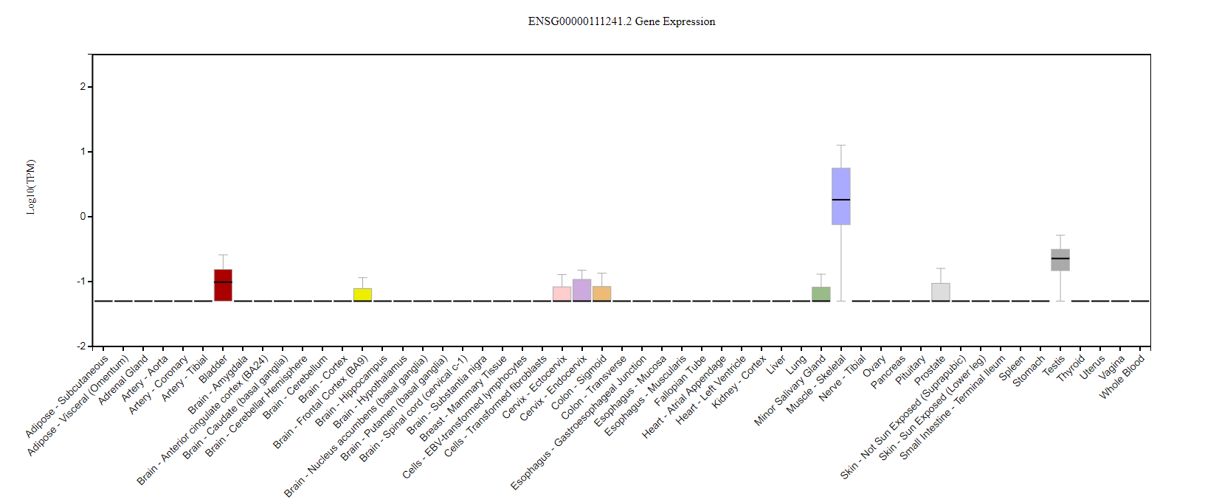

Slide 11
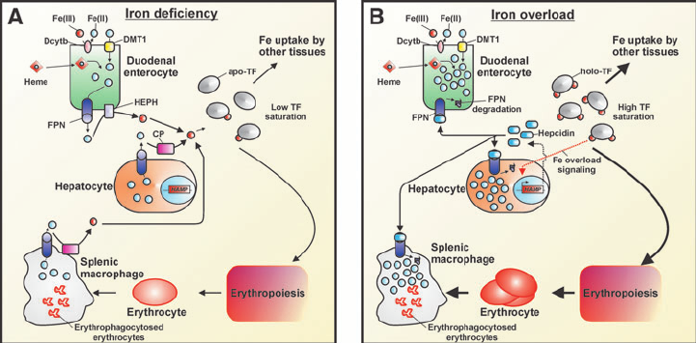

Slide 12
CHR | GENE | P | ORIG_SNP | NOHOM_SNP | X1 | X2 | X3 | X4
6 | HFE | 1.29E-08 | 14 | 10 | 8 | 10 | 189 | 6707
12 | FGF6 | 1.99E-06 | 10 | 6 | 6 | 12 | 153 | 6743
21 | KRTAP15-1 | 7.55E-05 | 5 | 2 | 11 | 7 | 1271 | 5625
20 | XKR7 | 0.000118 | 7 | 3 | 3 | 15 | 35 | 6861
20 | CABLES2 | 0.000128 | 7 | 5 | 3 | 15 | 36 | 6860
22 | THOC5 | 0.000138 | 9 | 6 | 13 | 5 | 1945 | 4951
18 | CABYR | 0.000254 | 17 | 10 | 5 | 13 | 229 | 6667
3 | CMSS1 | 0.000309 | 10 | 7 | 5 | 13 | 239 | 6657
5 | PCDHB2 | 0.000377 | 11 | 5 | 3 | 15 | 53 | 6843
9 | ZFP37 | 0.001067 | 16 | 7 | 9 | 9 | 1137 | 5759
3 | C3orf30 | 0.001156 | 28 | 12 | 13 | 5 | 2361 | 4535
12 | DENND5B | 0.001286 | 11 | 7 | 9 | 9 | 1166 | 5730
6 | MRS2 | 0.001299 | 10 | 8 | 4 | 14 | 188 | 6708
6 | BCLAF1 | 0.001686 | 29 | 20 | 4 | 14 | 202 | 6694
1 | NBPF3 | 0.001793 | 7 | 3 | 9 | 9 | 1220 | 5676
1 | BRDT | 0.002315 | 20 | 13 | 6 | 12 | 560 | 6336
17 | CAMKK1 | 0.002332 | 7 | 4 | 9 | 9 | 1265 | 5631
3 | CELSR3 | 0.002353 | 56 | 32 | 3 | 15 | 102 | 6794
12 | UHRF1BP1L | 0.002353 | 40 | 21 | 3 | 15 | 102 | 6794

Slide 13
FGF6 and FGF23: Biology Function in iron metabolism pathway
Another FGF genes
iron metabolism gene transcriptome network turbulence (regulator)
iron metabolism protein cell locating turbulence (Carrier)
FGF6
FGF23
PPP3CA
SIK3
LRRC16A
SLC17A3
SLC17A1
SLC40A1
LEAP1
TF
FPN
CDH10
HFE
TMPRSS6
TFR2
STON1
Hemoglobin (HBA1, HBA2, and HBB)
Ferritin (FTH1)
Lactoferrin (LT/LFT)
transferrin (TF)
Iron-binding proteins are carrier proteins and metalloproteins which play many important roles in metabolism. Iron is required by humans and bacteria for enzymes and metabolism to function properly. Iron-binding proteins bind iron tightly which make it unavailable for microbial use, limiting growth. Four iron-binding proteins are Hemoglobin, Ferritin, lactoferrin and transferrin. Hemoglobin is located in red blood cells. Transferrin is found in blood and tissue fluids. Lactoferrin is found in milk, blood, tears and saliva. Ferritin is found in every cell type.
https://string-db.org/
KEGG pathway(?)
Another interaction network method.

Slide 14
FGF6/FGF23 and Iron metabolism network
Step 1. Download all Liver RNA-seq data from TCGA with gdc-client
Do it in BIRCDEV13-LC (installed gdc-client)
Download confirmation file (LIHC and Kidney)
C:\Admin\gdc-client.exe
gdc-client.exe download -m gdc_manifest.2018-01-11T01_08_53.324183.txt -d
Step 2. collect all RNAseq data from rsem.genes.normalized_results
Notes:
gdc-client.exe download -m \\mcrfnas2\bigdata\Genetic\Projects\shg047\LIHC\gdc_manifest.2018-01-11T01_08_53.324183.txt -d \\mcrfnas2\bigdata\Genetic\Projects\shg047\LIHC\

Slide 15
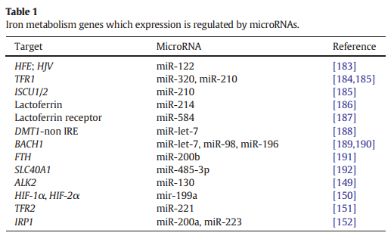
FGF6 and FGF23: Biology Function in iron metabolism pathway
and FGF23
hsa.miR.320a
hsa.miR.210.3p
hsa.miR.214.3p
hsa.miR.584.5p
hsa.miR.200b.3p
hsa.miR.485.3p
hsa.miR.221.3p
hsa.miR.200a.3p
hsa.miR.98.5p
hsa.miR.223.3p
hsa.miR.122.5p
(LTF)
Validate any miR-214-3p here target FGF6? We do it.
Validate any miR-122-5p here target FGF23? Yes. It is validated.
ComiR: Combinatorial miRNA target prediction tool

Slide 16
ENSEMBL_ID | GENE_ID | miR.320a | miR.210.3p | miR.214.3p | miR.584.5p | miR.200b.3p | miR.485.3p | miR.221.3p | miR.200a.3p | miR.98.5p | miR.223.3p | miR.122.5p
ENSG00000213066 | FGFR1OP | 1 | 0.8815 | 0.9996 | 0.826 | 0.93 | 1 | 1 | 1 | 0.9777 | 1 | 1
ENSG00000099810 | MTAP | 0.9617 | 0.8815 | 0.8725 | 0.962 | 0.93 | 0.8032 | 0.8491 | 0.8155 | 1 | 0.8565 | 0.984
ENSG00000124557 | BTN1A1 | 0.9912 | 0.8815 | 0.8725 | 0.826 | 0.767 | 0.8032 | 0.8491 | 0.8155 | 0.8519 | 0.8565 | 0.8757
ENSG00000171189 | GRIK1 | 0.8141 | 0.8815 | 0.8725 | 0.826 | 0.767 | 0.8032 | 0.8491 | 0.8155 | 0.8519 | 0.8565 | 0.8757
ENSG00000138675 | FGF5 | 0.8141 | 0.8815 | 0.8725 | 0.826 | 0.767 | 0.8032 | 0.9729 | 0.8155 | 0.9777 | 0.9762 | 0.984
ENSG00000186895 | FGF3 | 0.8141 | 0.8815 | 0.8725 | 0.826 | 0.767 | 0.8032 | 0.8491 | 0.8155 | 0.8519 | 0.8565 | 0.8757

Slide 17
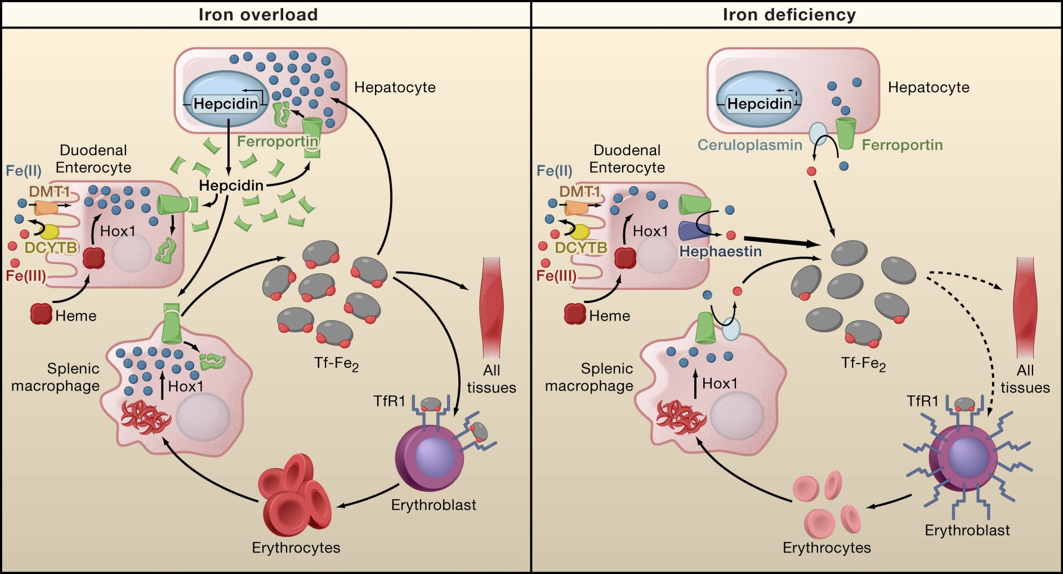

Slide 18
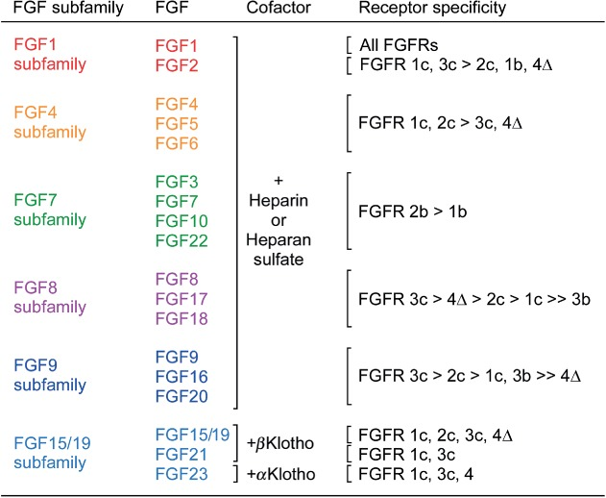
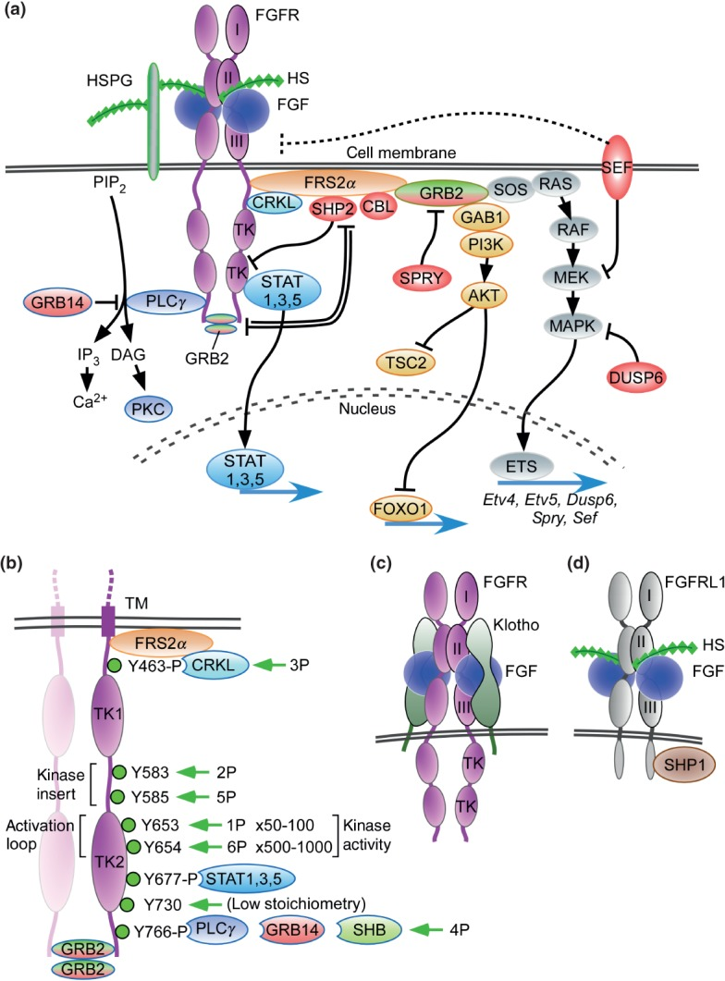
STAT1
STAT3
STAT5
FOXO1
ETV4
ETV5
DUSP6
SPRY
SEF
HAMP

Slide 19
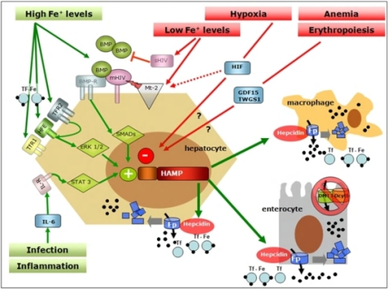
Paracrine FGF6 interacts with FGFR with Heparin or heparan sulphate proteoglycan (HPSG) as the cofactor to initial FGF pathway (Nobuyuki itoh, JBC, 2011). Activated FGFRs have the ability to phosphorylate specific tyrosine residues and activate RAS-MAPK pathway, PI3K-AKT pathway, PLCγ pathway and STAT pathway (Turner, Nature Review Cancer 2010). Iron overload, and inflammation could positively regulate hepcidin by BMP/Smad pathway (Ivana, JCI, 2007) and inflammatory IL-6/STAT3 pathways (Thomas, JCI, 2010 and Diedra, blood, 2006). However, loss-of-function mutation of FGF6 will silence FGF6-FGFR pathway and cause low expression of hapcidin which will decrease the inhibition of irons transfer from intestinal cell to blood.

Slide 20
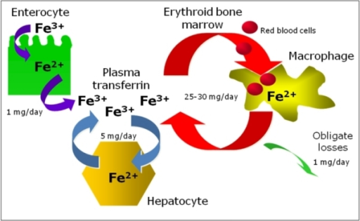
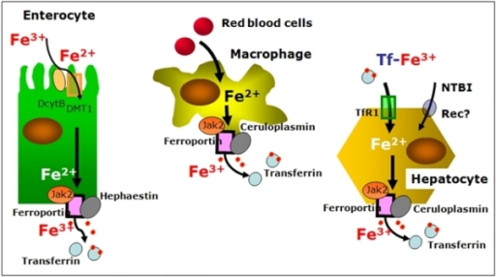

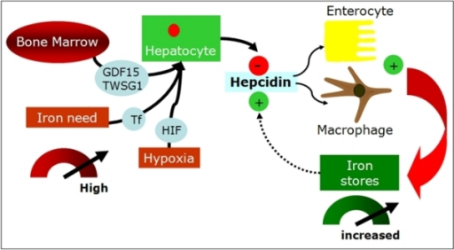
Notes:
f3-mjhid-1-1-e2009006: Signal pathways in systemic regulation of hepcidin. Many stimuli regulate expression of Hepcidin gene (HAMP) in the liver. One of the best known positive modulator is represented by Bone Morphogenetic Proteins (BMPs) that bind BMP-Receptor (BMP-R) on the surface of the hepatocyte resulting in SMAD-mediated induction of HAMP transcription. Hemojuvelin (mHJV) increases this signal acting as BMP co-receptor on the cell surface. In contrast, the soluble forms of HJV (sHJV), produced by HJV cleavage by furin at position 335, act as “decoy-receptor” competing with mHJV for the BMP ligand. Matriptase-2 (Mt2), which is activated by iron deficiency and by hypoxia, is the most potent inhibitor of hepcidin production by cleaving mHJV on hepatocyte surface and so preventing BMP-mediated hepcidin production. HAMP expression is also stimulated by inflammation, via the soluble mediator Interleukin-6 (IL6) and its specific membrane receptor (IL6-R) activating a STAT3-dependent signal pathway promoting HAMP transcription. HFE, TfR2 and TfR1 positively influence HAMP transcription in a ERK1/2 mediated way acting as a functional molecular complex on the cell surface playing a primary role in the hepatocyte sensing of circulating iron levels. Erythropoiesis, via the soluble mediator Growth Differentiation Factor 15 (GDF15) and Twisted Gastrulation (TWSG) 1, and hypoxia, via Hypoxia Inducible Factor (HIF), decrease HAMP expression (see text for further explanation).

Slide 21
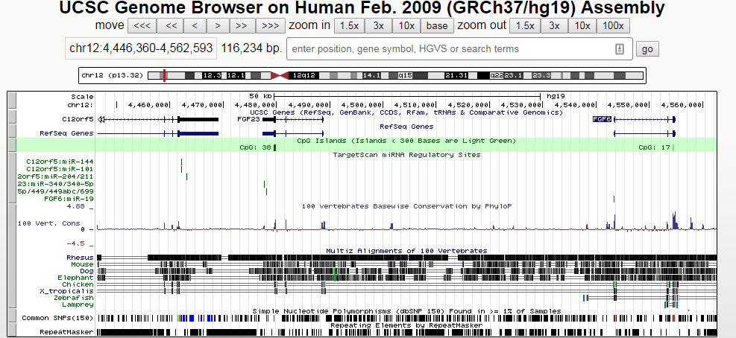
polycistronic miRNA cluster (miR-17,18,19 and 92)
Ferroportin (FPN) is the only known mammalian iron exporter. FPN expression is regulated at the transcriptional level by hypoxia-inducible factor-2alpha (HIF2α).
miR-19 promotes angiogenesis by directly targeting thrombospondin 1 (TSP-1) and connective tissue growth factor (CTGF)

Slide 22
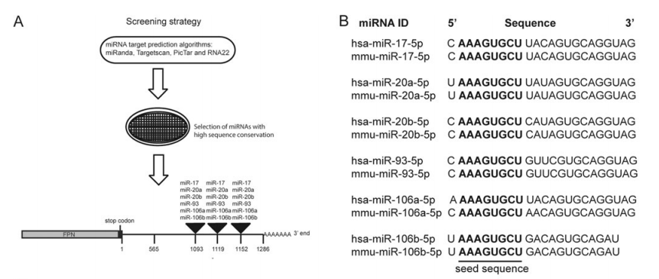

Slide 23
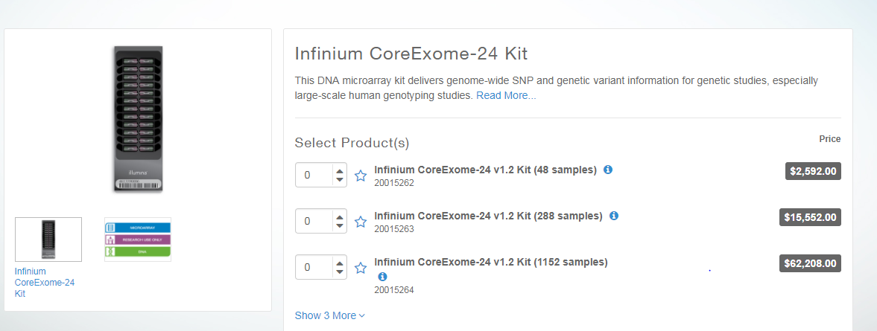
Find the annotation file and design the probes, including probe regions
Infinium CoreExome-24 v1.2 Support Files (hg19 human genome)
https://support.illumina.com/downloads/infinium-coreexome-24-v1-2-support-files.html

Slide 24

FGF6: Exon 1
>hg19_dna range=chr12:4543246-4543643 5'pad=0 3'pad=0 strand=+ repeatMasking=none
AAACAACTGAGGTCTCCCCAAGCACAGGATAAGCCTGATTCAGAAGCCAT GGAGGGCAAGGGGAATTCTTCGCTGGTGCAAAATTTCAATCGAACAGATG ATGCTTTAAATCTGTGAGCCTTCTTTTGTGGGTCCTTAGATCCTGGGAAG GAAATGAGTGACAGTCATGATCGGGGACACCTTGCTGCCCCGCTTTACCC GTCCGTATTTGCTCAGGGCAATGTAGGTCCCTTGGTACAAGTCTGACTCG TAGGCATTGTAATTGTTGGGCAGGAGGGTTTCTCTGAACTTGCATTCTTC TTGGAAGCTGGGCTGTGGAAGACATGGGCAAACAGCAGAGACTGGGTTAC AAATGAGGAGTGCTGCAGATGCCAGCTGGGCCGCAGAGAGTAGGCCCC
>hg19_dna range=chr12:4553194-4553510 5'pad=0 3'pad=0 strand=+ repeatMasking=none CCATTTAGATAGTCACTTCTCTACTCAGGACTTCATATTATTTTCTTCAA CTGTGTAAGCATCAAGCCTTGTAAACCTGGCACTTCCCCGGCCTGGTGAA CTCACCGTTGCGTACAATCTTCCTTTACTGTTCATGGCAACGAAGAGGGC ACTTCTCACTCCAAAGAGACTCACCACGCCTCGCTCCACAGTGGAAATTT CCAGCAGGCCTGACAAGGAAAGGGGGGCCACATTACCTAAGGCTTGTGCA AATCAGAGTGGGAACTTGAGCCGACAAGGGCATCTCAGTCCATCCCCCTT CTCCTAGAAAGCCAGAC
>hg19_dna range=chr12:4554200-4554846 5'pad=0 3'pad=0 strand=+ repeatMasking=none CACCAGGATGCTTGGACCGCAGTATATTGAGCTTGCACCCAGGCAGGGTC ACGTGGAATCATCTAAGTGGTGAGCAGCATTTCTGCCCCCTTTATCGTGC ATCCTGTCCGCTAGAGCAGGGCCCCTTCACCTTTTAGCCCTGCATGAGCC CAAACCCCCAAGCGTCCCGACTGGCTGCAGCTGGCACTCACTGTAGGGGT TCTCCTCGTGGGTCCCGCTGATCCGGCCGTCGGGGAGCACCTGGAGGTGA AAGCCGATGCCCACGTTGCAGTAGAGCCTCCGCTGCCGCTTGATCCCCAC CAAATAGCCACTTTCCCAGTTCACCCCGGCAATCTCTCCAGCTAGCCCGG CGCGAGACCTGGACAGCAGGGTGCCCCAGCCCCTCGAGTCCAGCAGCGTG TTGTTGGCACGGGTGCCTGCAGGCGAGGGCACCACCATGCCCACTAGGAT GCCTAGGAAGACGAGAGCCCACAGCGTGCCCTGCAGACGTCCTGCTCCCC GGGACATAGTGATGAACAGTTTCTGTCCCAGGGCCATCCACCTTGCCTCT CAGGCACGTGGTCAGAATTAATGGCCCTAAAAATACCGCCCTTCTTGTTT TTCTCCCTCCGGCATGGCGGCAGGGGCTTATTTTTGGAAGGCAGATG

Slide 25
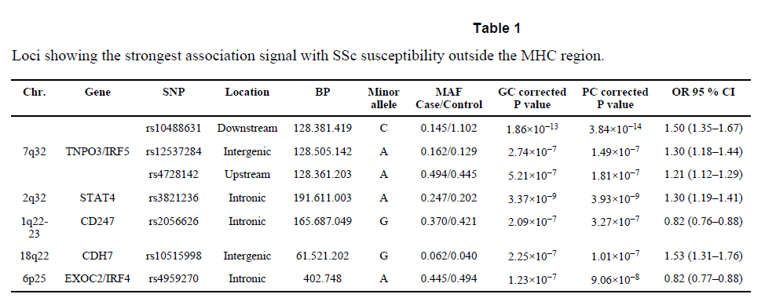
Nature genetics: first GWAS for SSc.
http://exac.broadinstitute.org/variant/4-186320906-C-G

Slide 26
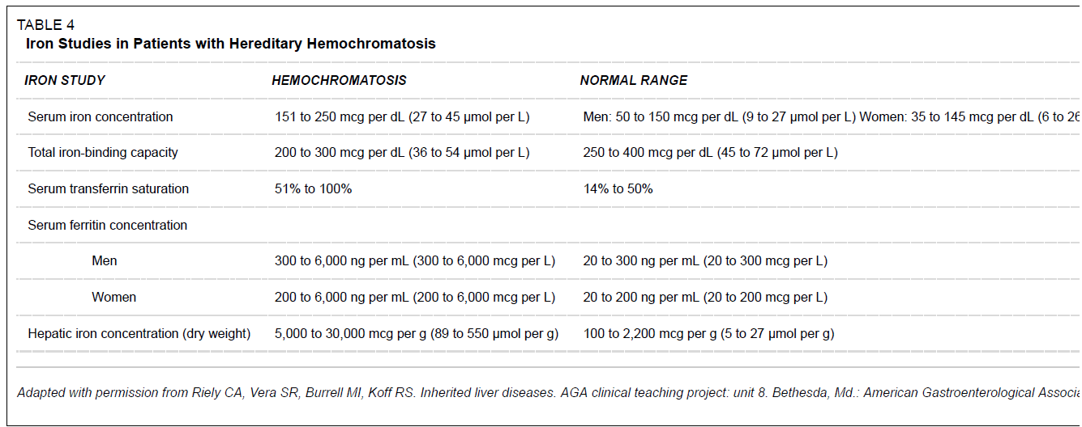
Inclusion criteria: Hemochromatosis
Serum transferrin saturation(STS) >45%
Serum ferritin levels >300 ng/mL in males and >200 ng/mL in females
Brandhagen, D.J., V.F. Fairbanks, and W. Baldus, Recognition and management of hereditary hemochromatosis. Am Fam Physician, 2002. 65(5): p. 853-60.

Slide 27
# Select all items from asian and european
grep rs7574865 ssc.gwas.txt
grep rs76285340 ssc.gwas.txt
grep rs146891517 ssc.gwas.txt
grep rs75287745 ssc.gwas.txt
grep rs45471499 ssc.gwas.txt
grep rs4317244 ssc.gwas.txt
grep rs114778719 ssc.gwas.txt
grep rs10488631 ssc.gwas.txt
grep rs12537284 ssc.gwas.txt
grep rs4728142 ssc.gwas.txt
grep rs3821236 ssc.gwas.txt
grep rs2056626 ssc.gwas.txt
grep rs10515998 ssc.gwas.txt
grep rs4959270 ssc.gwas.txt
#

Slide 28
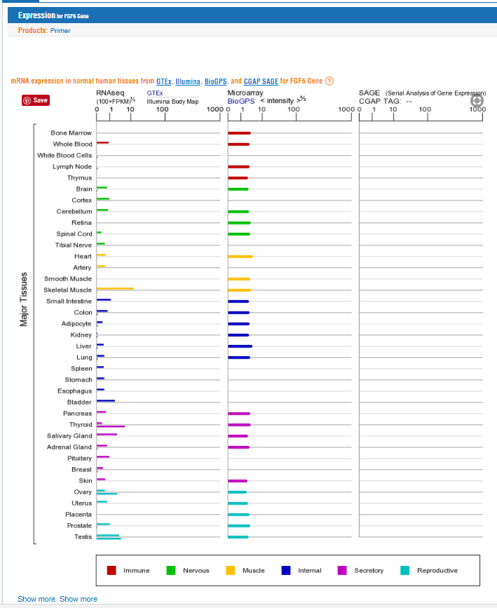
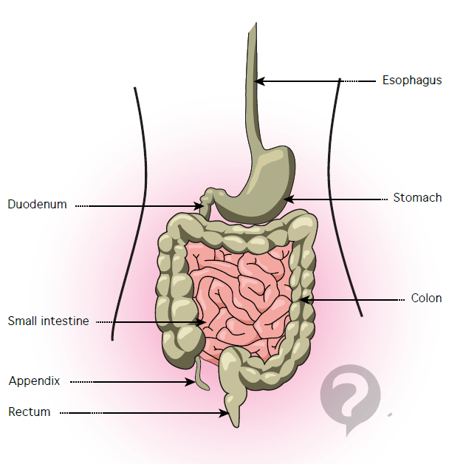
The portion of the small intestine called the duodenum is the chief area where iron absorption takes place. There may be a second minor absorption site near the end of the small intestinal tract. Once iron is absorbed it is carried (transported) by a protein called transferrin.

