Slide 1
The use of gene-based functional exome scans for compound heterozygosity with application to hemochromatosis

Slide 2
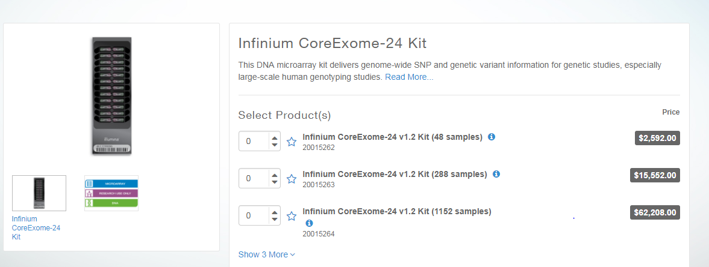
Find the annotation file and design the probes, including probe regions
Infinium CoreExome-24 v1.2 Support Files (hg19 human genome)
https://support.illumina.com/downloads/infinium-coreexome-24-v1-2-support-files.html

Slide 3

FGF6: Exon 1
>hg19_dna range=chr12:4543246-4543643 5'pad=0 3'pad=0 strand=+ repeatMasking=none
AAACAACTGAGGTCTCCCCAAGCACAGGATAAGCCTGATTCAGAAGCCAT GGAGGGCAAGGGGAATTCTTCGCTGGTGCAAAATTTCAATCGAACAGATG ATGCTTTAAATCTGTGAGCCTTCTTTTGTGGGTCCTTAGATCCTGGGAAG GAAATGAGTGACAGTCATGATCGGGGACACCTTGCTGCCCCGCTTTACCC GTCCGTATTTGCTCAGGGCAATGTAGGTCCCTTGGTACAAGTCTGACTCG TAGGCATTGTAATTGTTGGGCAGGAGGGTTTCTCTGAACTTGCATTCTTC TTGGAAGCTGGGCTGTGGAAGACATGGGCAAACAGCAGAGACTGGGTTAC AAATGAGGAGTGCTGCAGATGCCAGCTGGGCCGCAGAGAGTAGGCCCC
>hg19_dna range=chr12:4553194-4553510 5'pad=0 3'pad=0 strand=+ repeatMasking=none CCATTTAGATAGTCACTTCTCTACTCAGGACTTCATATTATTTTCTTCAA CTGTGTAAGCATCAAGCCTTGTAAACCTGGCACTTCCCCGGCCTGGTGAA CTCACCGTTGCGTACAATCTTCCTTTACTGTTCATGGCAACGAAGAGGGC ACTTCTCACTCCAAAGAGACTCACCACGCCTCGCTCCACAGTGGAAATTT CCAGCAGGCCTGACAAGGAAAGGGGGGCCACATTACCTAAGGCTTGTGCA AATCAGAGTGGGAACTTGAGCCGACAAGGGCATCTCAGTCCATCCCCCTT CTCCTAGAAAGCCAGAC
>hg19_dna range=chr12:4554200-4554846 5'pad=0 3'pad=0 strand=+ repeatMasking=none CACCAGGATGCTTGGACCGCAGTATATTGAGCTTGCACCCAGGCAGGGTC ACGTGGAATCATCTAAGTGGTGAGCAGCATTTCTGCCCCCTTTATCGTGC ATCCTGTCCGCTAGAGCAGGGCCCCTTCACCTTTTAGCCCTGCATGAGCC CAAACCCCCAAGCGTCCCGACTGGCTGCAGCTGGCACTCACTGTAGGGGT TCTCCTCGTGGGTCCCGCTGATCCGGCCGTCGGGGAGCACCTGGAGGTGA AAGCCGATGCCCACGTTGCAGTAGAGCCTCCGCTGCCGCTTGATCCCCAC CAAATAGCCACTTTCCCAGTTCACCCCGGCAATCTCTCCAGCTAGCCCGG CGCGAGACCTGGACAGCAGGGTGCCCCAGCCCCTCGAGTCCAGCAGCGTG TTGTTGGCACGGGTGCCTGCAGGCGAGGGCACCACCATGCCCACTAGGAT GCCTAGGAAGACGAGAGCCCACAGCGTGCCCTGCAGACGTCCTGCTCCCC GGGACATAGTGATGAACAGTTTCTGTCCCAGGGCCATCCACCTTGCCTCT CAGGCACGTGGTCAGAATTAATGGCCCTAAAAATACCGCCCTTCTTGTTT TTCTCCCTCCGGCATGGCGGCAGGGGCTTATTTTTGGAAGGCAGATG

Slide 4
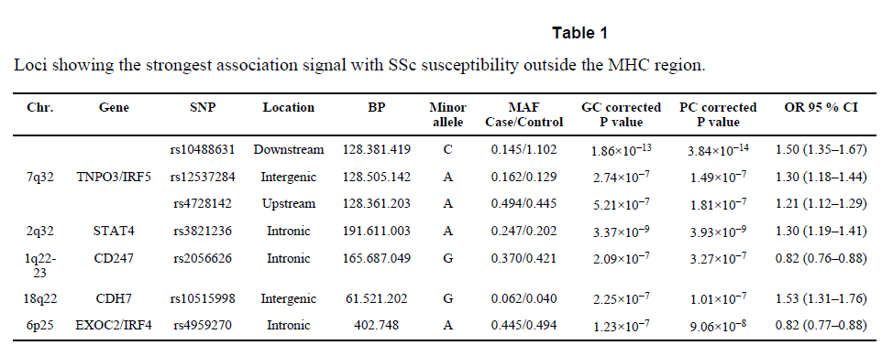
Nature genetics: first GWAS for SSc.
http://exac.broadinstitute.org/variant/4-186320906-C-G

Slide 5
# Select all items from asian and european
grep rs7574865 ssc.gwas.txt
grep rs76285340 ssc.gwas.txt
grep rs146891517 ssc.gwas.txt
grep rs75287745 ssc.gwas.txt
grep rs45471499 ssc.gwas.txt
grep rs4317244 ssc.gwas.txt
grep rs114778719 ssc.gwas.txt
grep rs10488631 ssc.gwas.txt
grep rs12537284 ssc.gwas.txt
grep rs4728142 ssc.gwas.txt
grep rs3821236 ssc.gwas.txt
grep rs2056626 ssc.gwas.txt
grep rs10515998 ssc.gwas.txt
grep rs4959270 ssc.gwas.txt
#

Slide 6
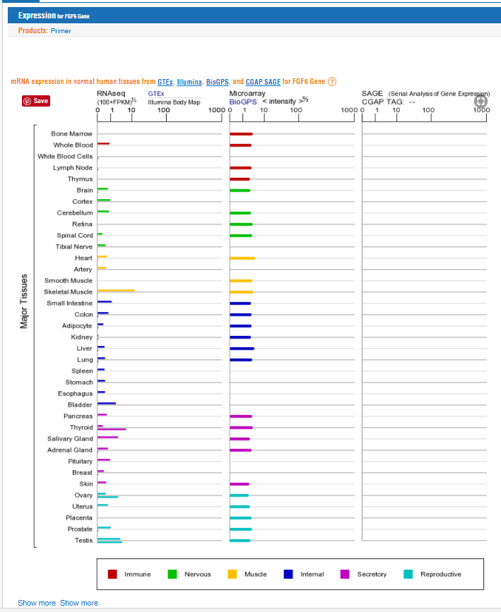
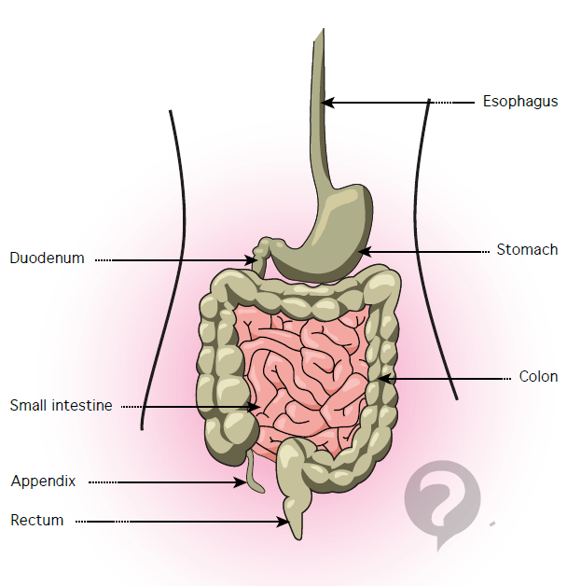
The portion of the small intestine called the duodenum is the chief area where iron absorption takes place. There may be a second minor absorption site near the end of the small intestinal tract. Once iron is absorbed it is carried (transported) by a protein called transferrin.

Slide 8
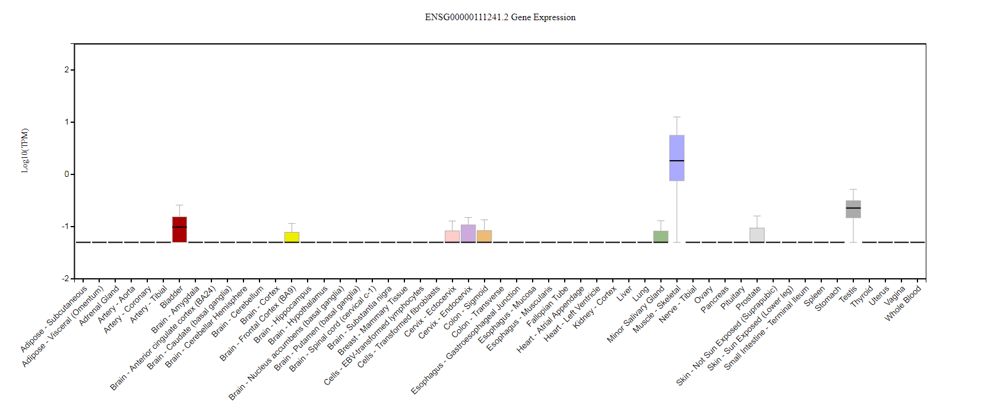

Slide 9
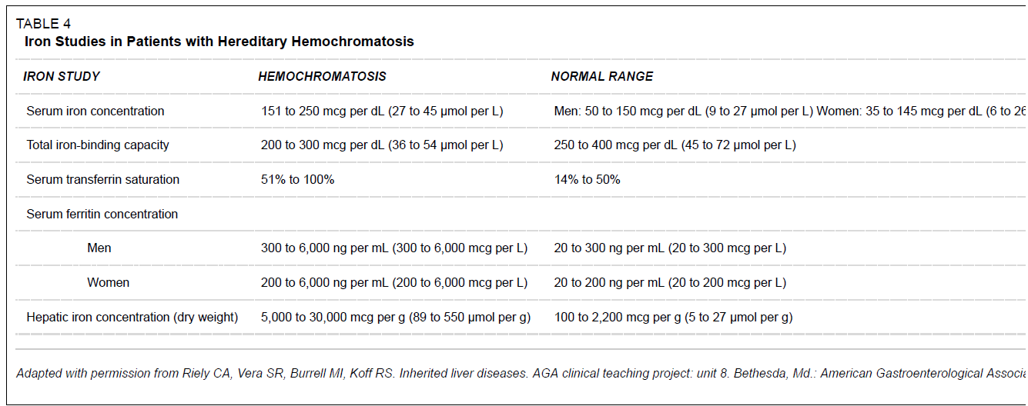
Inclusion criteria: Hemochromatosis
Serum transferrin saturation(STS) >45%
Serum ferritin levels >300 ng/mL in males and >200 ng/mL in females
Brandhagen, D.J., V.F. Fairbanks, and W. Baldus, Recognition and management of hereditary hemochromatosis. Am Fam Physician, 2002. 65(5): p. 853-60.

Slide 10
CHR | GENE | P | ORIG_SNP | NOHOM_SNP | X1 | X2 | X3 | X4
6 | HFE | 1.29E-08 | 14 | 10 | 8 | 10 | 189 | 6707
12 | FGF6 | 1.99E-06 | 10 | 6 | 6 | 12 | 153 | 6743
21 | KRTAP15-1 | 7.55E-05 | 5 | 2 | 11 | 7 | 1271 | 5625
20 | XKR7 | 0.000118 | 7 | 3 | 3 | 15 | 35 | 6861
20 | CABLES2 | 0.000128 | 7 | 5 | 3 | 15 | 36 | 6860
22 | THOC5 | 0.000138 | 9 | 6 | 13 | 5 | 1945 | 4951
18 | CABYR | 0.000254 | 17 | 10 | 5 | 13 | 229 | 6667
3 | CMSS1 | 0.000309 | 10 | 7 | 5 | 13 | 239 | 6657
5 | PCDHB2 | 0.000377 | 11 | 5 | 3 | 15 | 53 | 6843
9 | ZFP37 | 0.001067 | 16 | 7 | 9 | 9 | 1137 | 5759
3 | C3orf30 | 0.001156 | 28 | 12 | 13 | 5 | 2361 | 4535
12 | DENND5B | 0.001286 | 11 | 7 | 9 | 9 | 1166 | 5730
6 | MRS2 | 0.001299 | 10 | 8 | 4 | 14 | 188 | 6708
6 | BCLAF1 | 0.001686 | 29 | 20 | 4 | 14 | 202 | 6694
1 | NBPF3 | 0.001793 | 7 | 3 | 9 | 9 | 1220 | 5676
1 | BRDT | 0.002315 | 20 | 13 | 6 | 12 | 560 | 6336
17 | CAMKK1 | 0.002332 | 7 | 4 | 9 | 9 | 1265 | 5631
3 | CELSR3 | 0.002353 | 56 | 32 | 3 | 15 | 102 | 6794
12 | UHRF1BP1L | 0.002353 | 40 | 21 | 3 | 15 | 102 | 6794

Slide 11
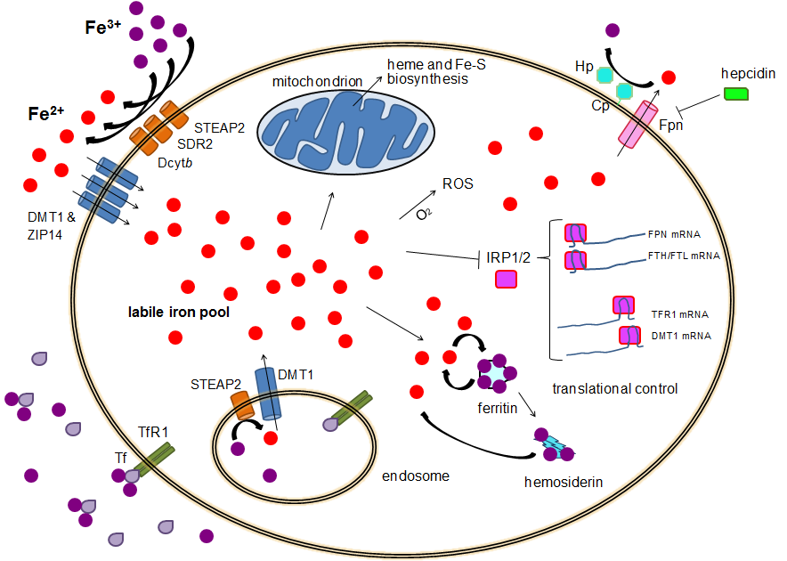

Slide 12
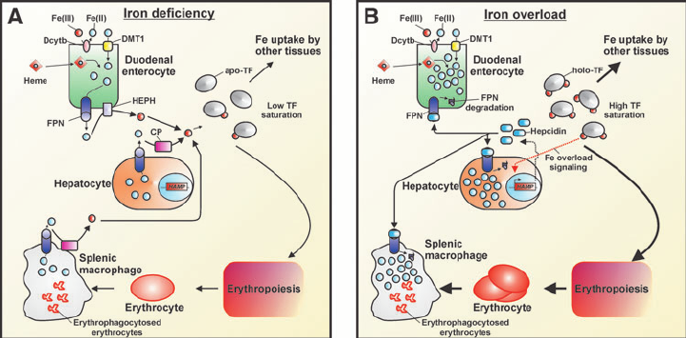

Slide 13
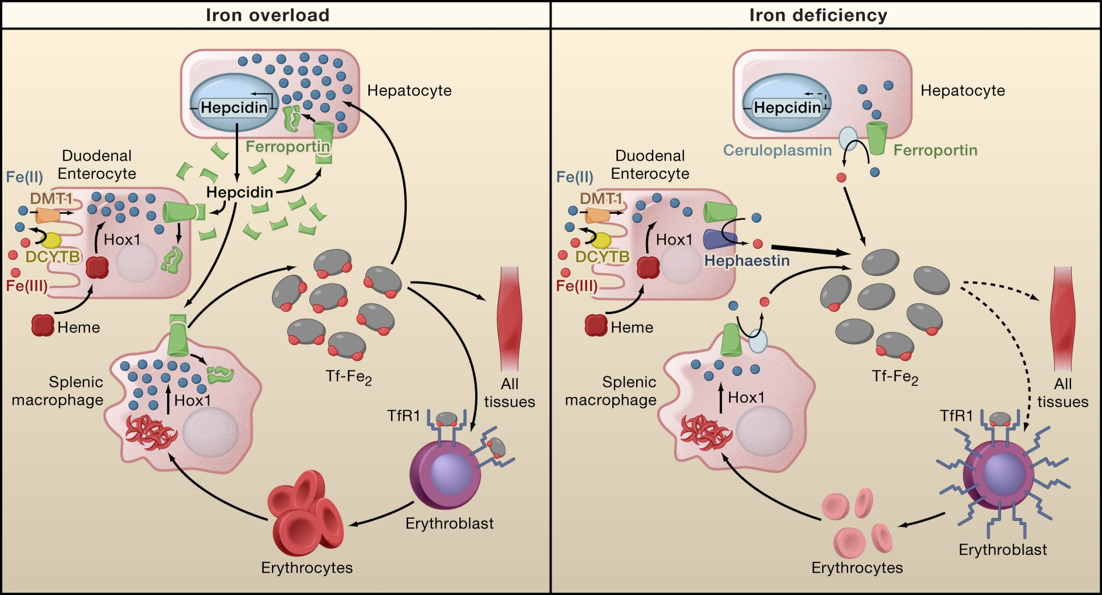

Slide 14
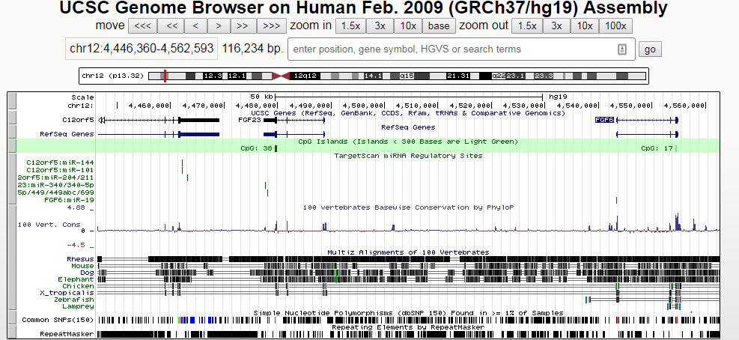
polycistronic miRNA cluster (miR-17,18,19 and 92)
Ferroportin (FPN) is the only known mammalian iron exporter. FPN expression is regulated at the transcriptional level by hypoxia-inducible factor-2alpha (HIF2α).
miR-19 promotes angiogenesis by directly targeting thrombospondin 1 (TSP-1) and connective tissue growth factor (CTGF)

Slide 15
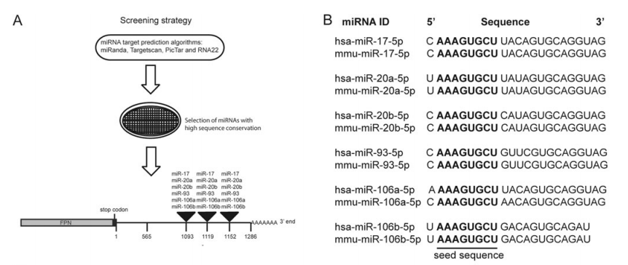

Slide 16
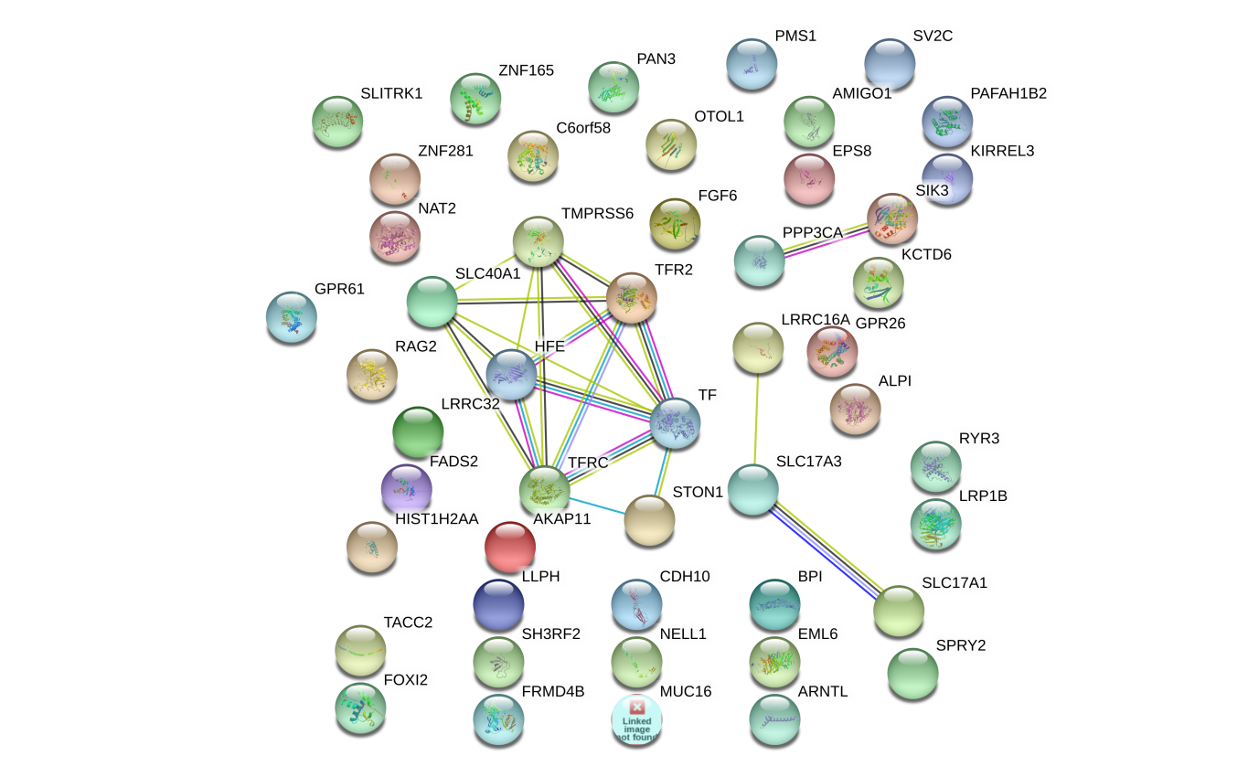
FGF6 and FGF23: Biology Function in iron metabolism pathway
Another FGF genes
iron metabolism gene transcriptome network turbulence (regulator)
iron metabolism protein cell locating turbulence (Carrier)
HAMP
Hemoglobin (HBA1, HBA2, and HBB)
Ferritin (FTH1)
Lactoferrin (LT/LFT)
transferrin (TF)
FGF6
FGF23
PPP3CA
SIK3
LRRC16A
SLC17A3
SLC17A1
TF
FPN
CDH10
SLC40A1
HFE
TMPRSS6
TFR2
STON1
Iron-binding proteins are carrier proteins and metalloproteins which play many important roles in metabolism. Iron is required by humans and bacteria for enzymes and metabolism to function properly. Iron-binding proteins bind iron tightly which make it unavailable for microbial use, limiting growth. Four iron-binding proteins are Hemoglobin, Ferritin, lactoferrin and transferrin. Hemoglobin is located in red blood cells. Transferrin is found in blood and tissue fluids. Lactoferrin is found in milk, blood, tears and saliva. Ferritin is found in every cell type.
https://string-db.org/
KEGG pathway(?)
Another interaction network method.

Slide 17
Pathogenic variants definition extension
1, Initial definition
SIFT, ClinVar, PloyPhen scores(see the codes)
2. Gene network of FGF6 in liver, colon and T cells.
HNF4A
"DRD2"
"HNF4A"
"KCNH6"
Liver cell: "CYP2B6" "HBA1" "ITGA2B" "NEDD8"

Slide 18
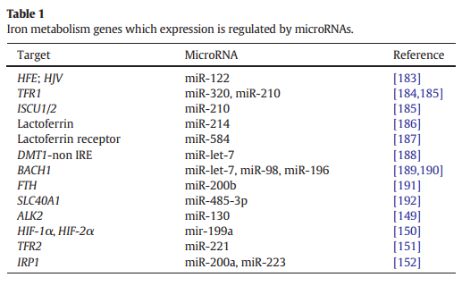
FGF6 and FGF23: Biology Function in iron metabolism pathway
and FGF23
hsa.miR.320a
hsa.miR.210.3p
hsa.miR.214.3p
hsa.miR.584.5p
hsa.miR.200b.3p
hsa.miR.485.3p
hsa.miR.221.3p
hsa.miR.200a.3p
hsa.miR.98.5p
hsa.miR.223.3p
hsa.miR.122.5p
(LTF)
Validate any miR-214-3p here target FGF6? We do it.
Validate any miR-122-5p here target FGF23? Yes. It is validated.
ComiR: Combinatorial miRNA target prediction tool

Slide 19
ENSEMBL_ID | GENE_ID | miR.320a | miR.210.3p | miR.214.3p | miR.584.5p | miR.200b.3p | miR.485.3p | miR.221.3p | miR.200a.3p | miR.98.5p | miR.223.3p | miR.122.5p
ENSG00000213066 | FGFR1OP | 1 | 0.8815 | 0.9996 | 0.826 | 0.93 | 1 | 1 | 1 | 0.9777 | 1 | 1
ENSG00000099810 | MTAP | 0.9617 | 0.8815 | 0.8725 | 0.962 | 0.93 | 0.8032 | 0.8491 | 0.8155 | 1 | 0.8565 | 0.984
ENSG00000124557 | BTN1A1 | 0.9912 | 0.8815 | 0.8725 | 0.826 | 0.767 | 0.8032 | 0.8491 | 0.8155 | 0.8519 | 0.8565 | 0.8757
ENSG00000171189 | GRIK1 | 0.8141 | 0.8815 | 0.8725 | 0.826 | 0.767 | 0.8032 | 0.8491 | 0.8155 | 0.8519 | 0.8565 | 0.8757
ENSG00000138675 | FGF5 | 0.8141 | 0.8815 | 0.8725 | 0.826 | 0.767 | 0.8032 | 0.9729 | 0.8155 | 0.9777 | 0.9762 | 0.984
ENSG00000186895 | FGF3 | 0.8141 | 0.8815 | 0.8725 | 0.826 | 0.767 | 0.8032 | 0.8491 | 0.8155 | 0.8519 | 0.8565 | 0.8757

Slide 20
DNA methylation signal of FGF6 in CD3 antibody (Caucasian)
GSM554417
cg01731341 0.8145007
cg21902327 0.6646968

