Slide 1
The use of gene-based functional exome scans for compound heterozygosity with application to hemochromatosis
Shicheng Guo
Steven Schrodi
Jiucun Wang

Slide 2
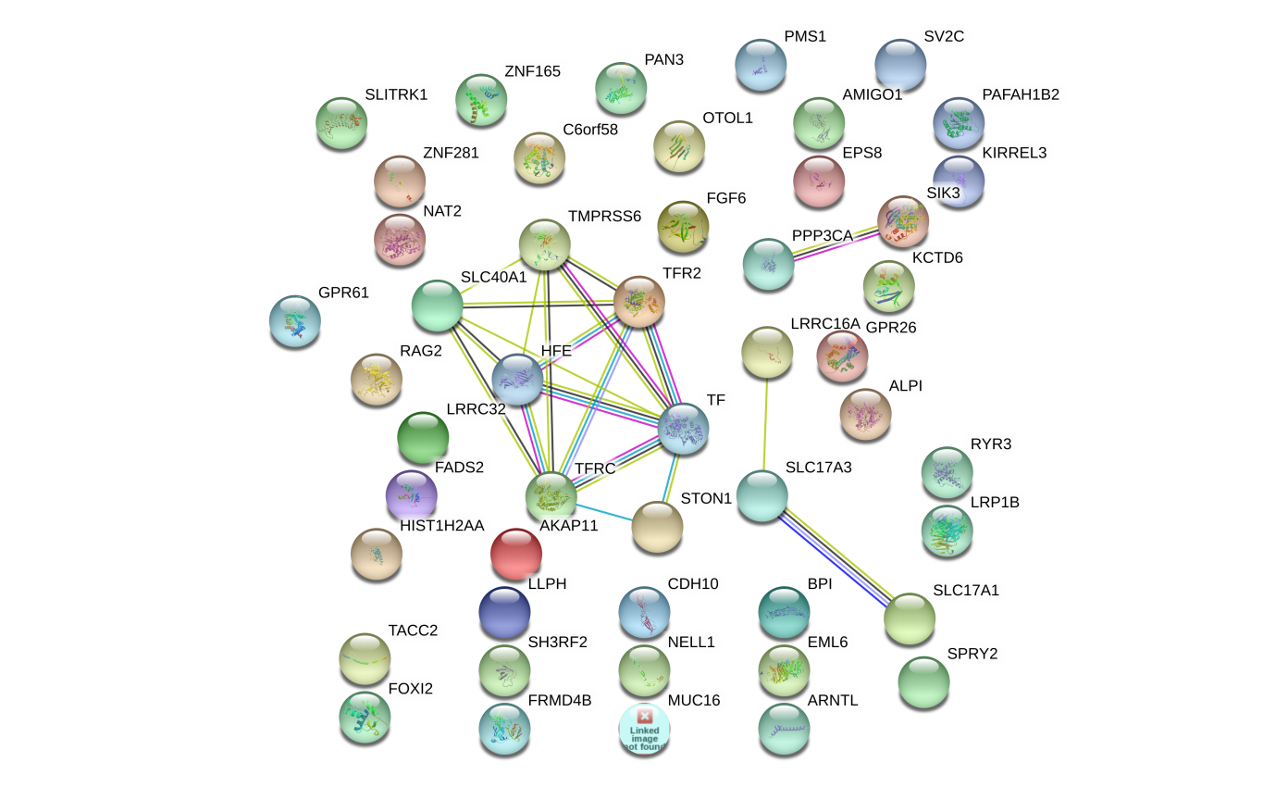
FGF6 and FGF23: Biology Function in iron metabolism pathway
Another FGF genes
iron metabolism gene transcriptome network turbulence (regulator)
iron metabolism protein cell locating turbulence (Carrier)
Hemoglobin (HBA1, HBA2, and HBB)
Ferritin (FTH1)
Lactoferrin (LT/LFT)
transferrin (TF)
FGF6
FGF23
PPP3CA
SIK3
LRRC16A
SLC17A3
SLC17A1
TF
FPN
CDH10
SLC40A1
HFE
TMPRSS6
TFR2
STON1
Iron-binding proteins are carrier proteins and metalloproteins which play many important roles in metabolism. Iron is required by humans and bacteria for enzymes and metabolism to function properly. Iron-binding proteins bind iron tightly which make it unavailable for microbial use, limiting growth. Four iron-binding proteins are Hemoglobin, Ferritin, lactoferrin and transferrin. Hemoglobin is located in red blood cells. Transferrin is found in blood and tissue fluids. Lactoferrin is found in milk, blood, tears and saliva. Ferritin is found in every cell type.
https://string-db.org/
KEGG pathway(?)
Another interaction network method.

