Slide 1
No-invasive DNA methylation based pancreatic cancer biomarker validation
Shicheng Guo
April 6th 2017

Slide 2
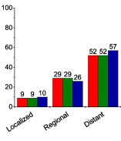
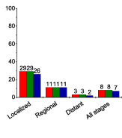
Pancreatic Cancer Clinical Characteristic Require Early Diagnosis
A B
10 times survival ratio
Percent
Percent
A: Stage Distribution by Race, United States, 2006 to 2012.
B: Five-Year Relative Survival Rates by Stage at Diagnosis and Race, US, 2006 to 2012.
80-90% pancreatic cancer patient diagnosed at regional and distant metastasis stage. While there are ~30% 5 year survival rates if they are diagnosed at localized stage.
Reality:
1, Early stage PC is hard to collected.
2, We still have chance to get some IIA, IIB, IIIA or IIIB samples
3, Compare II,III with IV samples to inference methylation occurred in early stage

Slide 3
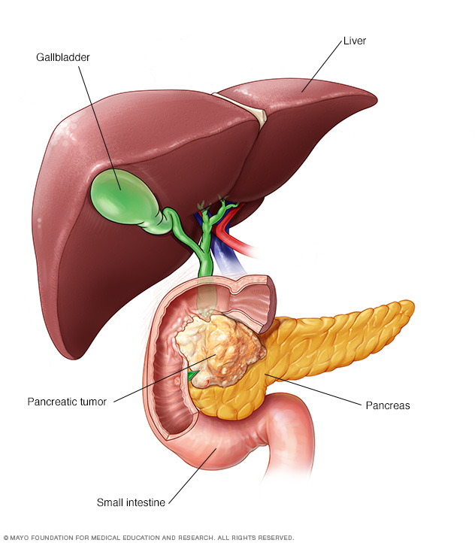
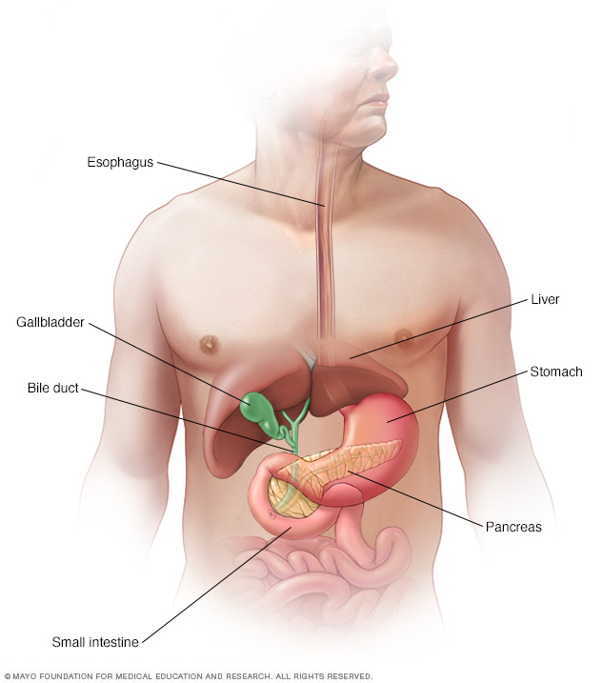
Pancreatic Cancer Metastasis Mode: adjacent and romote
Stomach, Spleen, Small intestine => Liver, Lung
1, Signatures for these 5 tissues as reference.
2, Primary and Metastasis Pancreatic cancer prediction.

Slide 4
Pancreatic Cancer Biomarker Enrollment and Optimization
Largest Pancreatic Cancer Data Collection:
Total: Cancer and Normal
450K Microarray
TCGA: 185 PC and 10 NP
PBMC:
OTC:
Sequencing:
WGBS (GSE67205): 11 PC, 2 NP and 3 Pancreatitis
MethylCap-seq(GSE54854): 18 PC vs 18 NP
BSPP:
RRBS (Plasma):
Other Control
MONOD dataset：
NCI-60 (colon, lung, liver):
Notes:
13 WGBS: GSE67205
MethylCap-seq: GSE54854

Slide 5
Sequencing Based Pancreas and Pancreatic Cancer Biomarker Identification
WGBS (GSE67205): 11 PC, 2 NP and 3 Pancreatitis
MethylCap-seq (GSE54854): 18 PC vs 18 NP
Normal Pancreas: 1 ENCODE, 1 N37
BSPP (Plasma):
RRBS (Plasma):

Slide 6
Microarray Based Pancreas and Pancreatic Cancer Biomarker Identification
TCGA: 185 PC and 10 NP
GEO: 20 PDAC cell lines
PBMC: 1254 Normal PBMC (beta<0.2)
OTC: 8826 Cancers and 736 Normal Tissues
33 different cancer types and corresponding adjacent normal tissue

Slide 7
WGBS (Pancreatic Cancer + Pancreas)
Normal Pancreas: ENCODE, N37, Roadmap
Pancreatic Cancer tissue: WGBS, MethylCap-seq
Pancreatic Cancer cell line: GEO, MethylCap-seq
Other Normal Tissues: ENCODE, N37, Roadmap
Normal PBMC: WGBS, MethylCap-seq
Other Cancer types: WGBS, GEO, MethylCap-seq
Pancreas Tissue Specific Hyper-Methylation Biomarkers
Pancreatic Cancer Specific Hyper-Methylation Biomarker
Pancreas Low Expressing Genes (mRNA)
Pancreas Non-Expressing Genes (Protein)
Non-invasive Diagnosis and Screening Methylation Panel
Stage Evaluation
Early Stage Late Stage
Surgical Operation
Heterogeneity
Subtype
Chemotherapy

Slide 8
Pancreas and Pancreatic Cancer Biomarker Evaluation
1, False Negative Evaluation
2, False Positive Evaluation
MONOD dataset：
NCI-60 (colon, lung, liver):

