Slide 1
CCP LCP NCP
Colon Lung WBC CT

Slide 2
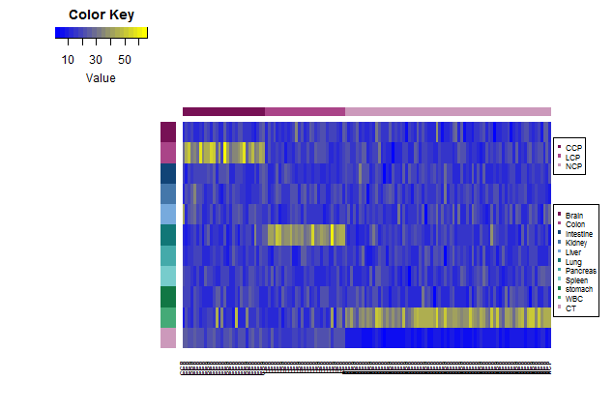

Slide 3
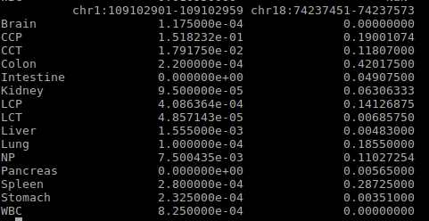
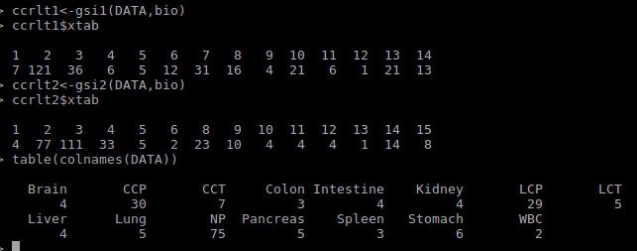
We have 77 cloln specfic marker which are only belong to colon plasma. So I need to remove some samples which make these 77 markers become to colon specfic markers.

