Slide 1
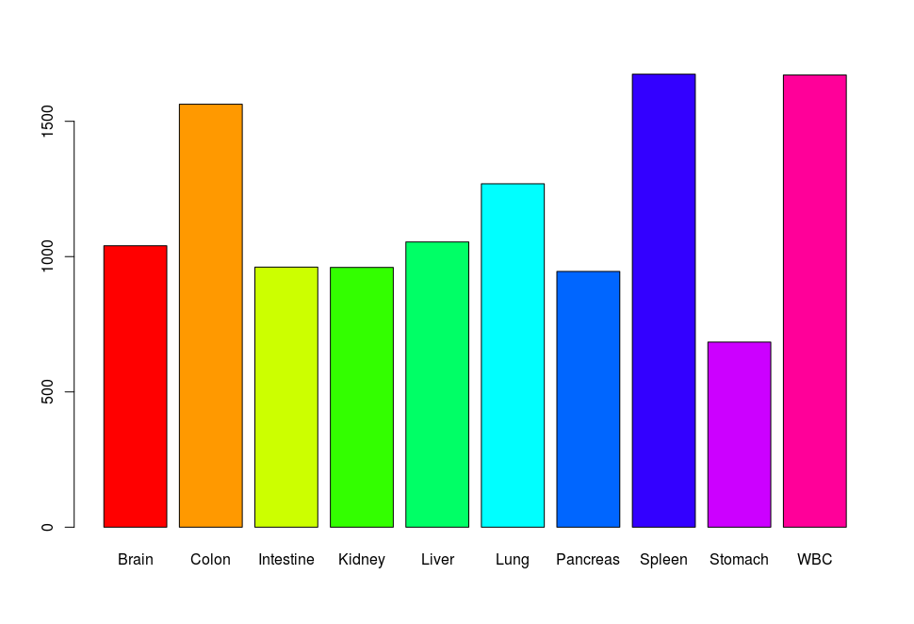
Multiple assignment (1 regions to multiple tissues)
Counts
2691 genomic regions/tissue specific MHL regions

