Slide 1
No-invasive DNA methylation based pancreatic cancer biomarker Identification and validation
Shicheng Guo
April 6th 2017

Slide 2
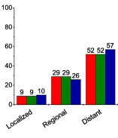
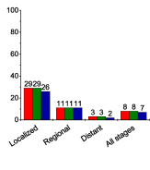
Pancreatic Cancer Clinical Characteristic Require Early Diagnosis
A B
10 times survival ratio
Percent
Percent
A: Stage Distribution by Race, United States, 2006 to 2012.
B: Five-Year Relative Survival Rates by Stage at Diagnosis and Race, US, 2006 to 2012.
80-90% pancreatic cancer patient diagnosed at regional and distant metastasis stage. While there are ~30% 5 year survival rates if they are diagnosed at localized stage.
Reality:
1, Early stage PC is hard to collected.
2, We still have chance to get some IIA, IIB, IIIA or IIIB samples
3, Compare II,III with IV samples to inference methylation occurred in early stage

Slide 3
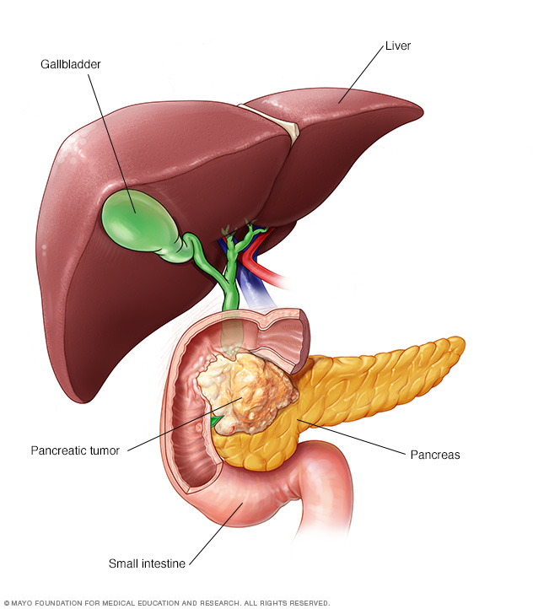
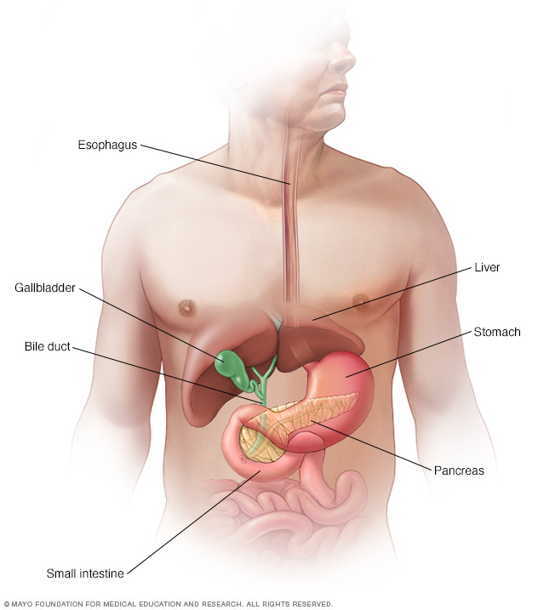
Pancreatic Cancer Metastasis Mode: adjacent and romote
Stomach, Spleen, Small intestine => Liver, Lung
1, Signatures for these 5 tissues as reference.
2, Primary and Metastasis Pancreatic cancer prediction.

Slide 4
Pancreatic Cancer Biomarker Enrollment and Optimization
Largest Pancreatic Cancer Methylation Dataset:
Pancreatic Cancer: N=219
Sequencing:
WGBS (GSE67205): 11 PC, 2 NP and 3 Pancreatitis
MethylCap-seq(GSE54854): 18 PC vs 18 NP
BSPP/Cap-seq: 10 samples
RRBS (Plasma): 10 PC and 75 Normal Plasma
WGBS (Plasma): 32 Normal Plasma
450K Microarray
TCGA: 185 PC and 10 NP
PBMC: 985 Normal PMBC (False Positive Control)
OTC: 8,826 Cancers and 736 Normal Tissues (Type>30)
Other Control
NCI-60 (colon, lung, liver): 60 cancer cells
MONOD: 51 WGBS
Blueprint Project: WGBS WBC Control (N>96)
Notes:
13 WGBS: GSE67205
MethylCap-seq: GSE54854

Slide 5
Sequencing Based Pancreas and Pancreatic Cancer Biomarker Identification
WGBS (GSE67205): 11 PC, 2 NP and 3 Pancreatitis
MethylCap-seq (GSE54854): 18 PC vs 18 NP
Normal Pancreas: 1 ENCODE, 1 N37
BSPP (Plasma): 10 PC
Cap-seq (Plasma): 10 PC
RRBS (Plasma): MONOD (10)
1, Pancreas Tissue Specific Hyper-Methylation Biomarkers
2, Pancreatic Cancer Specific Hyper-Methylation Biomarker
Combination and Optimization Prediction Panels

Slide 6
Microarray Based Pancreas and Pancreatic Cancer Biomarker Identification
TCGA: 185 PC and 10 NP
GEO: 20 PDAC cell lines
PBMC: 1254 Normal PBMC (beta<0.2)
OTC: 8826 Cancers and 736 Normal Tissues
33 different cancer types and corresponding adjacent normal tissue

Slide 7
WGBS (Pancreatic Cancer + Pancreas)
Normal Pancreas: ENCODE, N37, Roadmap
Few Pancreatic cancer samples
Pancreatic Cancer tissue: WGBS, MethylCap-seq
Pancreatic Cancer cell line: GEO, MethylCap-seq
Other Normal Tissues: ENCODE, N37, Roadmap
Normal PBMC: WGBS, MethylCap-seq
Other Cancer types: WGBS, GEO, MethylCap-seq
Pancreas Tissue Specific Hyper-Methylation Biomarkers
Pancreatic Cancer Specific Hyper-Methylation Biomarker
？Pancreas Low Expressing Genes (mRNA) > 450
？Pancreas Non-Expressing Genes (Protein)
BSPP (Plasma): MONOD
RRBS (Plasma): MONOD
Non-invasive Diagnosis and Screening Methylation Panel
Tissue-of-origin mapping efficiency
20? 50? 100? 300?
Stage Evaluation
TCGA (+ clinical information)
Early Stage signature Late Stage signature
Surgical Operation
Subtype
Heterogeneity(methylation haplotype)
Chemotherapy

Slide 8
Pancreas and Pancreatic Cancer Biomarker Evaluation
Concerns:
1, Power Estimation
How many samples we need to collect to guarantee prediction performance?
2, False Negative Evaluation
3, False Positive Evaluation
Task:
1. repeat pancreatic cancer analysis like monod
2, Capseq data is most important
3, Figure 4c. Sensitive power go up
4, Don’t touch array dataset

Slide 9
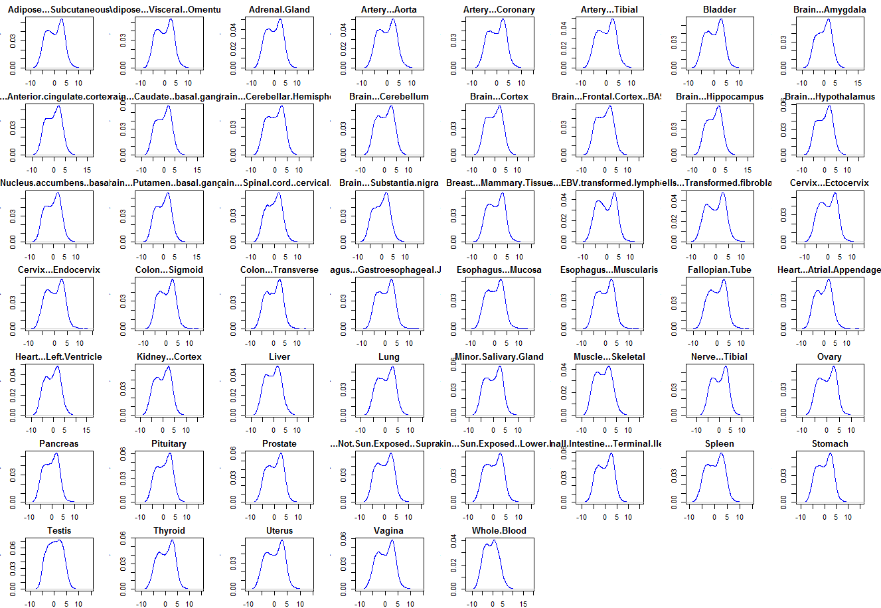
Genome-wide transcript distribution in 54 different cell types
Testis and WBC is fitted as Normal Distribution while other tissues is fitted as Beta-distribution.

Slide 10
We develop a novel analysis method for WGBS data that allows us to measure diverse aspects of methylation information genome-wide. Overall design: modeling of WGBS data for a diverse set of samples. BAM files for data generated in this study can be found in SRP072078 (PRJNA315696), SRP072071 (PRJNA315694), SRP072075 (PRJNA315695) and SRP072141 (PRJNA315903). The rest of the data was downloaded from other studies: GSE46644, GSE49629, GSE52972, GSE31742. For the latter, N/As have been used in BioSample and instrument model fields.Less...

