Slide 1
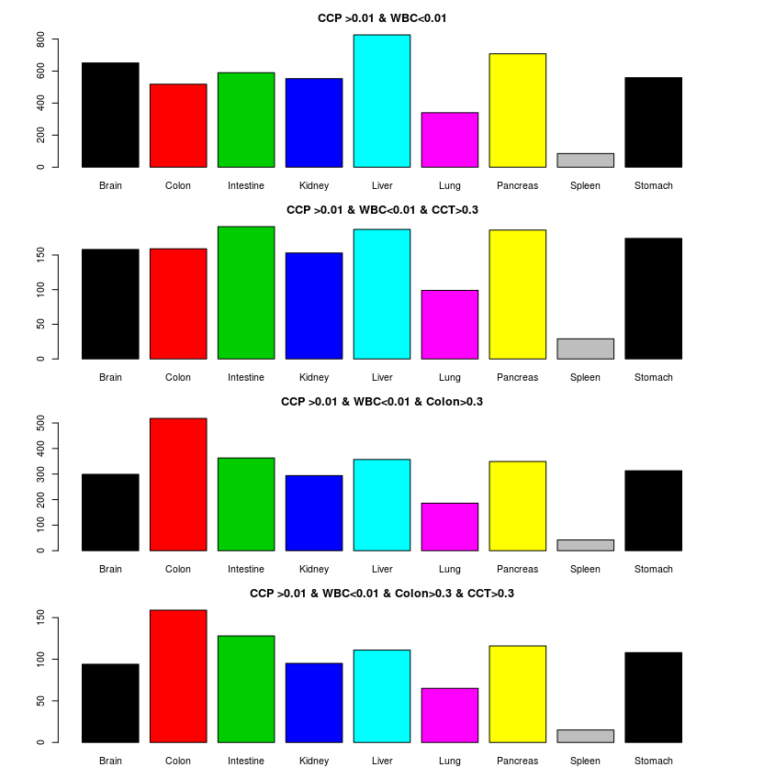
The distribution of the colon cancer plasma high MHL regions in tissue-of-origin references
a)
regions
1, select CCP high MHL vs WBC
2, check these high MHL distribution in 10 reference
a) CCP>0.01 and WBC<0.01
b) CCP>0.01, WBC<0.01 and CCT>0.3
c) CCP>0.01, WBC<0.01 and Colon>0.3
d) CCP>0.01, WBC<0.01, both CCT, Colon>0.3
We can observe that Colon specific regions are enriched
when we require CCT or Colon high MHL, indicating these high
MHL regions were caused by colon or CCT
Code see bottom
b)
regions
c)
518 regions
regions
d)
regions
Notes:
install.packages("~/monod_1.1.tar.gz")
library("monod")
library("ggplot2")
library("reshape2")
setwd("/media/NAS1/shg047/monod/hapinfo")
#system("scp shg047@tscc-login.sdsc.edu:/home/shg047/oasis/monod/saminfo/N37Salk.saminfo ./")
#system("scp shg047@tscc-login.sdsc.edu:/home/shg047/oasis/monod/hapinfo/MHL4.RData ./")
#data1<-read.table("/media/Home_Raid1/shg047/NAS1/monod/mhl/mhl.mhbs",head=T,row.names=1)
#rownames(data1)<-colon2hyphen(rownames(data1))
load("./MHL4.RData")
colnames(data)<-gsub(".sorted.clipped.bam.hapInfo.txt.hap","",colnames(data))
colnames(data)<-gsub(".hapInfo.txt.hap","",colnames(data))
saminfo<-read.table("/media/NAS1/shg047/monod/hapinfo/N37Salk.saminfo",sep="\t")
load("gsirlt.RData") # selected biomarker for each reference
nrow(gsirlt)
gsirlt1<-subset(gsirlt,refMax>0.3 & GSI>0.6)
gsirlt1$group<-as.character(gsirlt1$group)
nrow(gsirlt1)
bio<-gsi2bio(gsirlt1)
Data=data[,grep("STL|N37|age|ENC|new|centenarian|CTT|HCT|X7.T|X6.T|X6.P|RRBS.6P|X7.P|RRBS.7P|NC.P",colnames(data))]
colnames(Data)[grep(".",colnames(Data))]<-unlist(lapply(colnames(Data)[grep(".",colnames(Data))],function(x) unlist(strsplit(x,".hapInfo|.sorted"))[1]))
colnames(Data)[grep("age|new|centenarian|WB|middle",colnames(Data))]<-"WBC"
Data<-rename(Data)
colnames(Data)[grep("age|new|centenarian|WB|middle",colnames(Data))]<-"WBC"
colnames(Data)<-unlist(lapply(colnames(Data),function(x) unlist(strsplit(x,"[.|-]"))[1]))
input<-data.frame(t(apply(Data,1,function(x) tapply(x,colnames(Data),function(x) mean(x,na.rm=T)))))
# for colon cancer plasma
par(mfrow=c(6,1),mar=c(2,5,3,5))
zz<-subset(input, CCP >0.01 & WBC<0.01)
nrow(zz)
colon<-bio[na.omit(match(rownames(zz),rownames(bio))),]
xtt<-table(unlist(lapply(colon$group,function(x) unlist(strsplit(x,"[,]")))))
xtt
barplot(xtt,col=1:10,main="CCP >0.01 & WBC<0.01")
zz<-subset(input, CCP >0.01 & WBC<0.01 & CCT>0.3)
nrow(zz)
colon<-bio[na.omit(match(rownames(zz),rownames(bio))),]
xtt<-table(unlist(lapply(colon$group,function(x) unlist(strsplit(x,"[,]")))))
xtt
barplot(xtt,col=1:10,main="CCP >0.01 & WBC<0.01 & CCT>0.3")
zz<-subset(input, CCP >0.01 & WBC<0.01 & Colon>0.3)
nrow(zz)
colon<-bio[na.omit(match(rownames(zz),rownames(bio))),]
xtt<-table(unlist(lapply(colon$group,function(x) unlist(strsplit(x,"[,]")))))
xtt
barplot(xtt,col=1:10,main="CCP >0.01 & WBC<0.01 & Colon>0.3")
zz<-subset(input, CCP >0.01 & WBC<0.01 & Colon>0.3 & CCT>0.3)
nrow(zz)
colon<-bio[na.omit(match(rownames(zz),rownames(bio))),]
xtt<-table(unlist(lapply(colon$group,function(x) unlist(strsplit(x,"[,]")))))
xtt
barplot(xtt,col=1:10,main="CCP >0.01 & WBC<0.01 & Colon>0.3 & CCT>0.3")
zz<-subset(input, CCP >0.01 & WBC<0.01 & Colon>0.3 & CCT<0.01)
nrow(zz)
colon<-bio[na.omit(match(rownames(zz),rownames(bio))),]
xtt<-table(unlist(lapply(colon$group,function(x) unlist(strsplit(x,"[,]")))))
xtt
barplot(xtt,col=1:10,main="CCP >0.01 & WBC<0.01 & Colon>0.3 & CCT<0.01")
zz<-subset(input, CCP >0.01 & WBC<0.01 & CCT<0.01)
nrow(zz)
colon<-bio[na.omit(match(rownames(zz),rownames(bio))),]
xtt<-table(unlist(lapply(colon$group,function(x) unlist(strsplit(x,"[,]")))))
xtt
barplot(xtt,col=1:10,main="CCP >0.01 & WBC<0.01 & CCT<0.01")
# for lung cancer plasma
par(mfrow=c(4,1),mar=c(2,5,3,5))
zz<-subset(input, LCP >0.01 & WBC<0.01)
nrow(zz)
colon<-bio[na.omit(match(rownames(zz),rownames(bio))),]
xtt<-table(unlist(lapply(colon$group,function(x) unlist(strsplit(x,"[,]")))))
xtt
barplot(xtt,col=1:10,main="LCP >0.01 & WBC<0.01")
zz<-subset(input, LCP >0.01 & WBC<0.01 & LCT>0.3)
nrow(zz)
colon<-bio[na.omit(match(rownames(zz),rownames(bio))),]
xtt<-table(unlist(lapply(colon$group,function(x) unlist(strsplit(x,"[,]")))))
xtt
barplot(xtt,col=1:10,main="LCP >0.01 & WBC<0.01 & LCT>0.3")
zz<-subset(input, LCP >0.01 & WBC<0.01 & Lung>0.3)
nrow(zz)
colon<-bio[na.omit(match(rownames(zz),rownames(bio))),]
xtt<-table(unlist(lapply(colon$group,function(x) unlist(strsplit(x,"[,]")))))
xtt
barplot(xtt,col=1:10,main="LCP >0.01 & WBC<0.01 & Lung>0.3")
zz<-subset(input, LCP >0.01 & WBC<0.01 & Lung>0.3 & LCT>0.3)
nrow(zz)
colon<-bio[na.omit(match(rownames(zz),rownames(bio))),]
xtt<-table(unlist(lapply(colon$group,function(x) unlist(strsplit(x,"[,]")))))
xtt
barplot(xtt,col=1:10,main="LCP >0.01 & WBC<0.01 & Lung>0.3 & LCT>0.3")
getwd()

Slide 2
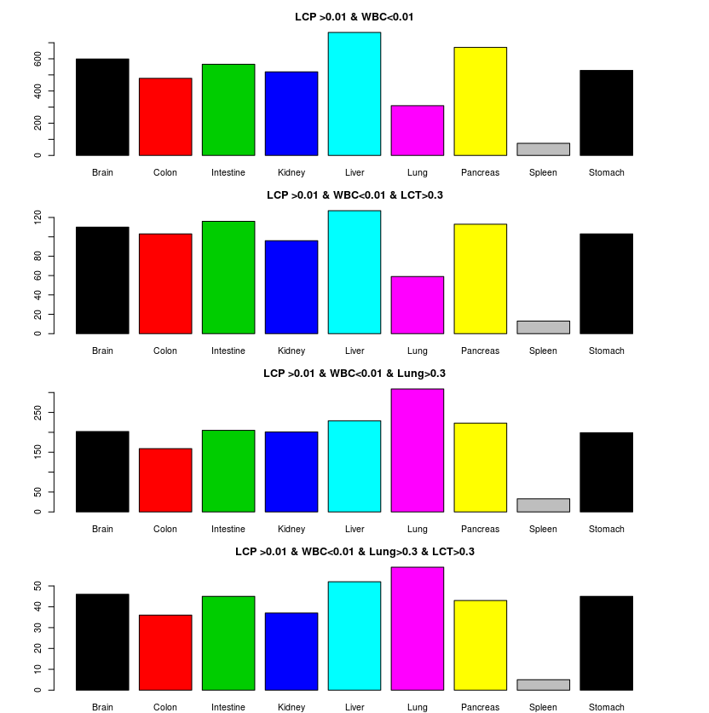
The distribution of the colon cancer plasma high MHL regions in tissue-of-origin references
1, select LCP high MHL vs WBC
2, check these high MHL distribution in 10 reference
a) LCP>0.01 and WBC<0.01
b) LCP>0.01, WBC<0.01 and LCT>0.3
c) LCP>0.01, WBC<0.01 and Lung>0.3
d) LCP>0.01, WBC<0.01, both LCT, Lung>0.3
We can observe that Lung specific regions are enriched
when we require LCT or Lung high MHL, indicating these high
MHL regions were caused by colon or LCT
Code see bottom
regions
regions
regions
regions
Notes:
install.packages("~/monod_1.1.tar.gz")
library("monod")
library("ggplot2")
library("reshape2")
setwd("/media/NAS1/shg047/monod/hapinfo")
#system("scp shg047@tscc-login.sdsc.edu:/home/shg047/oasis/monod/saminfo/N37Salk.saminfo ./")
#system("scp shg047@tscc-login.sdsc.edu:/home/shg047/oasis/monod/hapinfo/MHL4.RData ./")
#data1<-read.table("/media/Home_Raid1/shg047/NAS1/monod/mhl/mhl.mhbs",head=T,row.names=1)
#rownames(data1)<-colon2hyphen(rownames(data1))
load("./MHL4.RData")
colnames(data)<-gsub(".sorted.clipped.bam.hapInfo.txt.hap","",colnames(data))
colnames(data)<-gsub(".hapInfo.txt.hap","",colnames(data))
saminfo<-read.table("/media/NAS1/shg047/monod/hapinfo/N37Salk.saminfo",sep="\t")
load("gsirlt.RData") # selected biomarker for each reference
nrow(gsirlt)
gsirlt1<-subset(gsirlt,refMax>0.3 & GSI>0.6)
gsirlt1$group<-as.character(gsirlt1$group)
nrow(gsirlt1)
bio<-gsi2bio(gsirlt1)
Data=data[,grep("STL|N37|age|ENC|new|centenarian|CTT|HCT|X7.T|X6.T|X6.P|RRBS.6P|X7.P|RRBS.7P|NC.P",colnames(data))]
colnames(Data)[grep(".",colnames(Data))]<-unlist(lapply(colnames(Data)[grep(".",colnames(Data))],function(x) unlist(strsplit(x,".hapInfo|.sorted"))[1]))
colnames(Data)[grep("age|new|centenarian|WB|middle",colnames(Data))]<-"WBC"
Data<-rename(Data)
colnames(Data)[grep("age|new|centenarian|WB|middle",colnames(Data))]<-"WBC"
colnames(Data)<-unlist(lapply(colnames(Data),function(x) unlist(strsplit(x,"[.|-]"))[1]))
input<-data.frame(t(apply(Data,1,function(x) tapply(x,colnames(Data),function(x) mean(x,na.rm=T)))))
# for colon cancer plasma
par(mfrow=c(4,1),mar=c(2,5,3,5))
zz<-subset(input, CCP >0.01 & WBC<0.01)
nrow(zz)
colon<-bio[na.omit(match(rownames(zz),rownames(bio))),]
xtt<-table(unlist(lapply(colon$group,function(x) unlist(strsplit(x,"[,]")))))
xtt
barplot(xtt,col=1:10,main="CCP >0.01 & WBC<0.01")
zz<-subset(input, CCP >0.01 & WBC<0.01 & CCT>0.3)
nrow(zz)
colon<-bio[na.omit(match(rownames(zz),rownames(bio))),]
xtt<-table(unlist(lapply(colon$group,function(x) unlist(strsplit(x,"[,]")))))
xtt
barplot(xtt,col=1:10,main="CCP >0.01 & WBC<0.01 & CCT>0.3")
zz<-subset(input, CCP >0.01 & WBC<0.01 & Colon>0.3)
nrow(zz)
colon<-bio[na.omit(match(rownames(zz),rownames(bio))),]
xtt<-table(unlist(lapply(colon$group,function(x) unlist(strsplit(x,"[,]")))))
xtt
barplot(xtt,col=1:10,main="CCP >0.01 & WBC<0.01 & Colon>0.3")
zz<-subset(input, CCP >0.01 & WBC<0.01 & Colon>0.3 & CCT>0.3)
nrow(zz)
colon<-bio[na.omit(match(rownames(zz),rownames(bio))),]
xtt<-table(unlist(lapply(colon$group,function(x) unlist(strsplit(x,"[,]")))))
xtt
barplot(xtt,col=1:10,main="CCP >0.01 & WBC<0.01 & Colon>0.3 & CCT>0.3")
# for lung cancer plasma
par(mfrow=c(4,1),mar=c(2,5,3,5))
zz<-subset(input, LCP >0.01 & WBC<0.01)
nrow(zz)
colon<-bio[na.omit(match(rownames(zz),rownames(bio))),]
xtt<-table(unlist(lapply(colon$group,function(x) unlist(strsplit(x,"[,]")))))
xtt
barplot(xtt,col=1:10,main="LCP >0.01 & WBC<0.01")
zz<-subset(input, LCP >0.01 & WBC<0.01 & LCT>0.3)
nrow(zz)
colon<-bio[na.omit(match(rownames(zz),rownames(bio))),]
xtt<-table(unlist(lapply(colon$group,function(x) unlist(strsplit(x,"[,]")))))
xtt
barplot(xtt,col=1:10,main="LCP >0.01 & WBC<0.01 & LCT>0.3")
zz<-subset(input, LCP >0.01 & WBC<0.01 & Lung>0.3)
nrow(zz)
colon<-bio[na.omit(match(rownames(zz),rownames(bio))),]
xtt<-table(unlist(lapply(colon$group,function(x) unlist(strsplit(x,"[,]")))))
xtt
barplot(xtt,col=1:10,main="LCP >0.01 & WBC<0.01 & Lung>0.3")
zz<-subset(input, LCP >0.01 & WBC<0.01 & Lung>0.3 & LCT>0.3)
nrow(zz)
colon<-bio[na.omit(match(rownames(zz),rownames(bio))),]
xtt<-table(unlist(lapply(colon$group,function(x) unlist(strsplit(x,"[,]")))))
xtt
barplot(xtt,col=1:10,main="LCP >0.01 & WBC<0.01 & Lung>0.3 & LCT>0.3")

Slide 3
