Slide 1
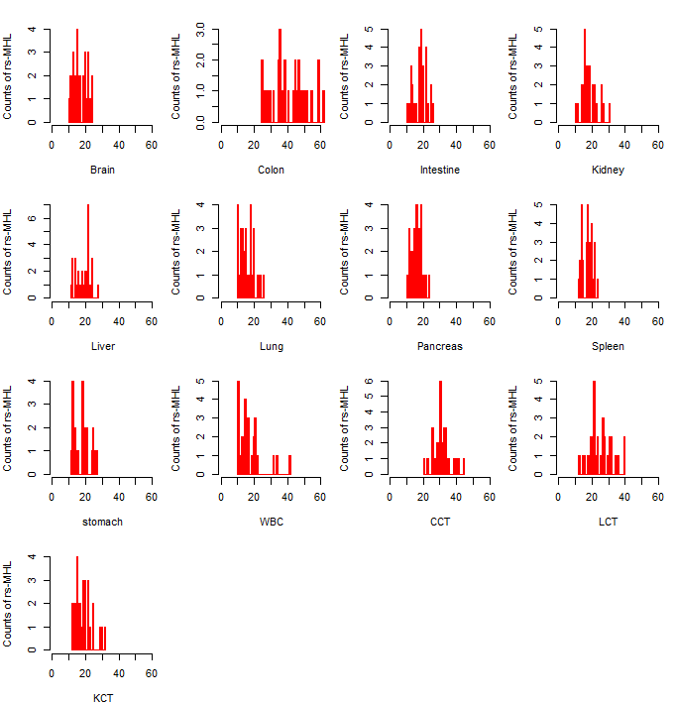
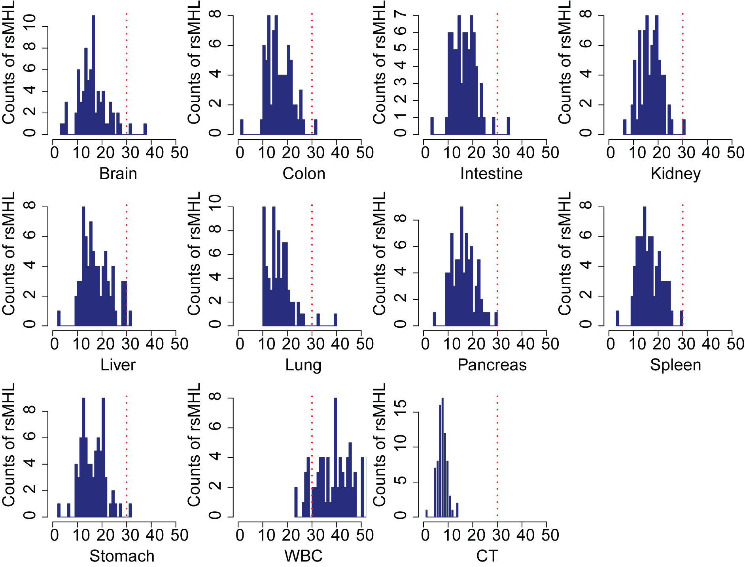
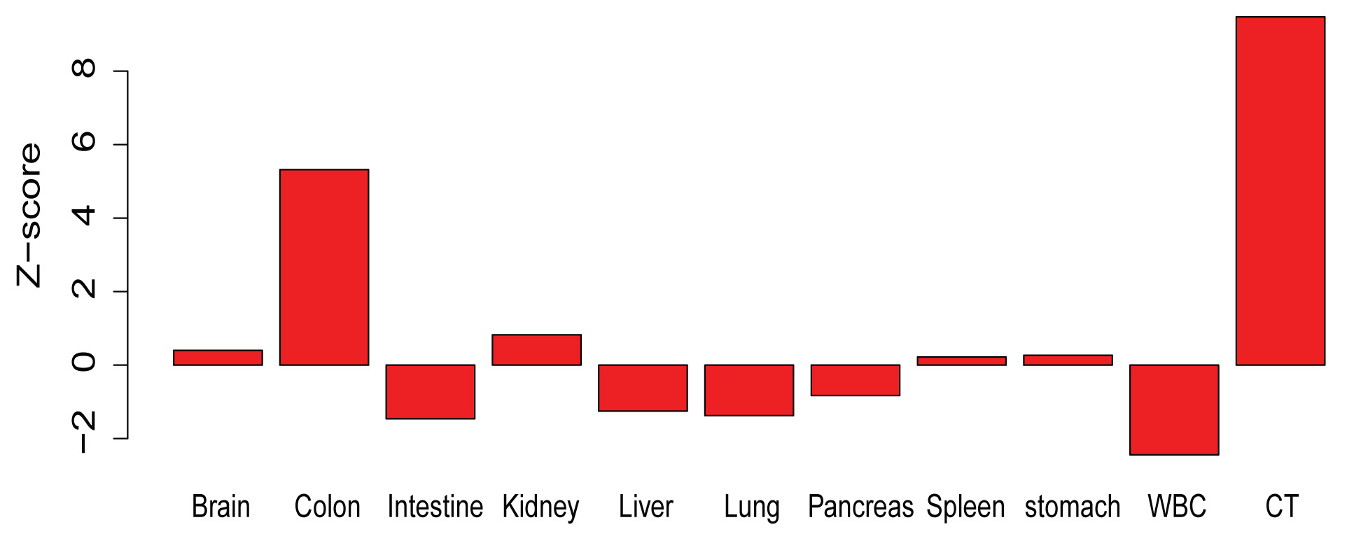
Figure 6
a
b
30 colon cancer plasma
75 Normal Plasma
c
d
Area=0.81
Area=0.90

Slide 2
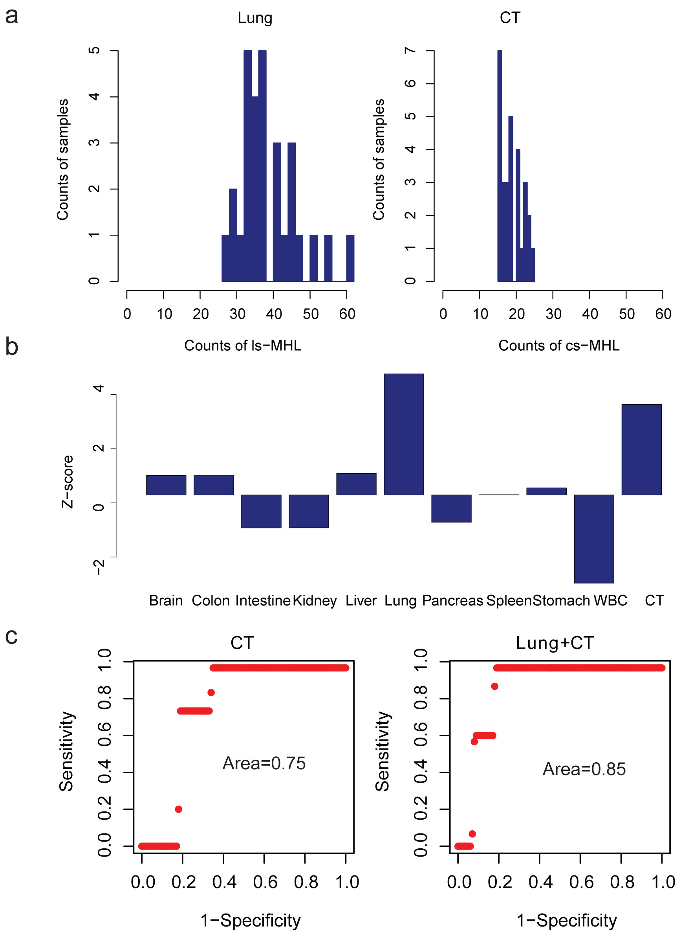
Supplementary Figure 12
Supplementary Figure 12. Unified analytical framework for lung cancer plasma samples tissue-of-origin prediction based on empirical background distribution of the tissue-specific MHL in normal human plasma. a) distribution of lung and cancer-related (mixture of CRC, LC, and KC) MHLs in LC plasma samples. c) example to show the Z-score distribution for one lung cancer plasma for each reference-specific features. significant enrichment of colon and cancer specific features indicating its origin sources. d) distinguish performance of Z-score based method controlling Type-I error (FDR). With normal plasma as the background, different threshold Z-score could be applied to distinguish the enrichment or not for certain reference. Combing normal lung and tumor related biomarkers could provide better performance for tissue-of-origin mapping and pathology

Slide 3
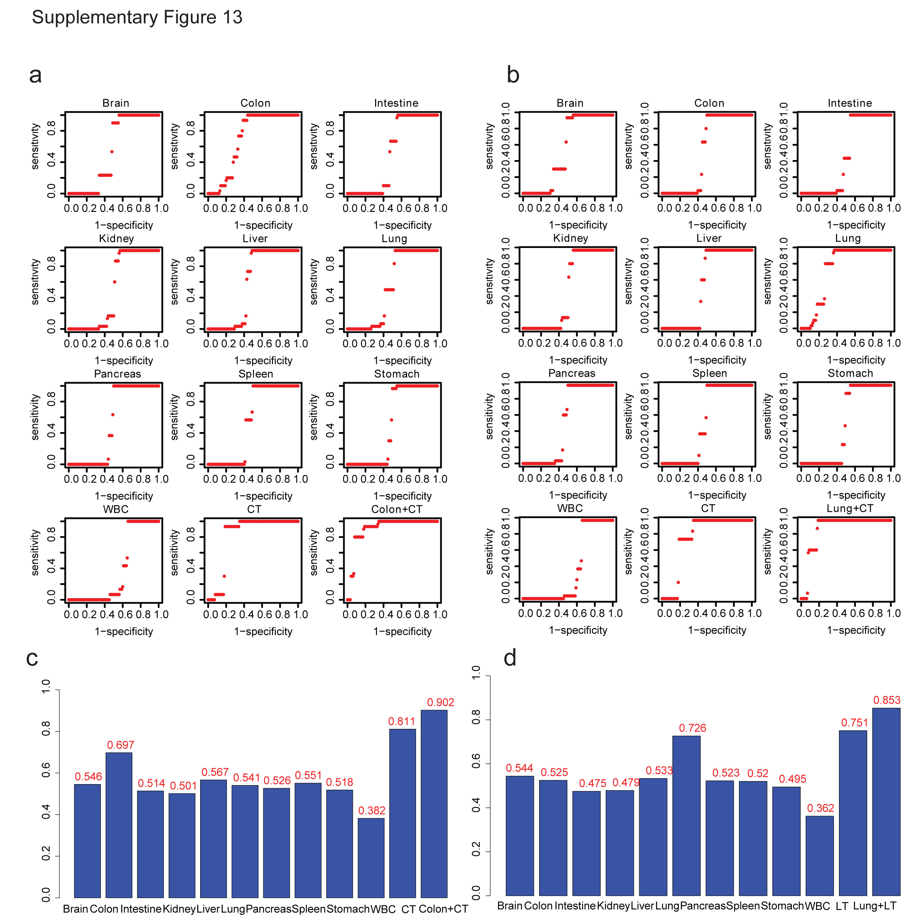
Supplementary Figure 13
Supplementary Figure 13. Performance of distinguish to CRC and LC plasma samples based on each tissue reference. (a) colon cancer plasma (b) lung cancer plasma. Background distribution of each reference in normal plasma were constructed based on 75 normal plasma samples. With different Z-score threshold, sensitivity and specificity for the tissue-of-origin were collected and ROC curves were build. Meanwhile, Type-1 error could be estimated by leave-one cross-validation. C) and d) Area under ROC curve (AUC) were estimated by approximation for CRC and LC plasma samples.

