Slide 1
Methylation Haplotype Analysis Tools (Extension)
Shicheng
March 1st 2017

Slide 2
Methylation Haplotype based Analysis Extension
In population genetics, Haplotype based association is expected to have higher power to identify disease disposing variations (MacLean, AJHG, 2000)
Segments WGBS methylomes into blocks of co-methylation could recover ∼30% of the lost DMS（Stephan Beck, Nature Communications, 2017）
High linkage methylation block regions provide useful biomarker for cancer diagnosis and tissue-of-origin prediction. (Guo, Diep., Nature Genetics, 2017)
RRBS
BSPP
MCTA-Seq
Functional Differentially Methylated Regions (fDMRs)
BS-SMOOTHING
COMETS
Technique:
Analysis:

Slide 3
Methylation Haplotype based Analysis Extension
R Package: MethHapType (MHT)
S4 Class: MethtypeSet (ExpressionSet)
Slots:
Samplesheet(…)
Methylationhapltype(…)
Method:
Methtype2mf()
Methtype2mhl()
Methtype2mhb()
Methtype2R2()
Methtype2DMR()
Methtype2entropy()
Methtype2epipoly()
Methtype2bedgraph()
Methtype2smoothwig()
Methtype2methykit()
Methtype2comet()
FastQ
Bisreadmapper bismark
BRM-Bam bisBam
MethylationHaptype
Methylation Bedgraph
MHB/MHL
Linkage R-square
Methykit
COHCAP
coMet
DSS
MethylMix
MethylationEntropy

Slide 4
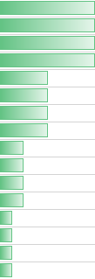
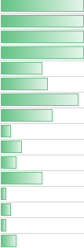
Methylation Haplotype based Analysis Extension
Methylation Haplotype: Integrate bulk methylation data and single cell RNA-seq data
Dataset:
Whole Genome Bisulfite
Sequencing
Methylation Haplotype
Linkage R² ~ Variation mRNA
Cells in serum culture medium
Single-cell RNA capture using Chromium
Gene Expression
SCNT 3
SCNT 11
miPS 1E12S5
miPS 2
Methtype2R2 & scRNA-seq

Slide 5
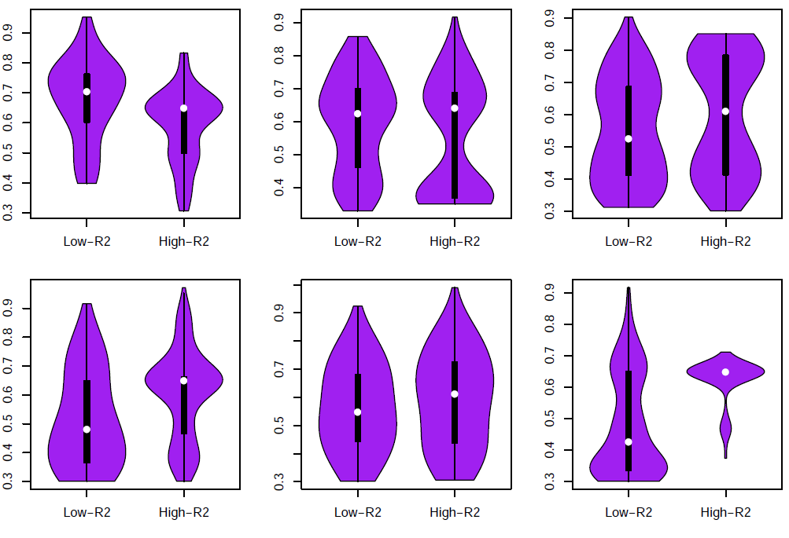
DNA methylation Haplotype Linkage and Gene Expression Variation
Mouse: 17 somatic cells and 23 ES like cells
MHB: 46,675 (R²> 0.5)
Enhancer Promoter 5-UTR
Mouse:
SCNT 3
SCNT 11
miPS 1E12S5
miPS 2
Entropy
Exon Intron 3-UTR
Entropy
* All P-values<10⁻³
Conclusion: DNA methylation haplotype linkage in regulation regions negatively correlated with gene expression complexity while positively correlated with complexity in gene body regions
Notes:
MHB and entropy in scRNA-seq
LD R2 vs gene expression entropy
R2>0.3, Entropy>0.3, OV>30
Cell number: 166 304 537 925 2172 324
3.7*10-6(enhancer),7.2*10-3(promoter)
Linkage affact to mRNA also have different way in promoter and enhancer, compared with gene body. high LD will caused low mRNA complicity in enhancer and promoter regions

Slide 7
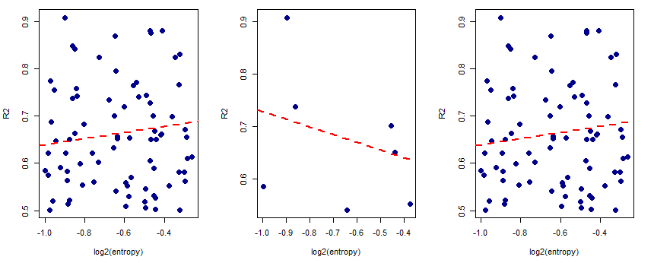
DNA methylation haplotype linkage negative correlated with gene expression complexity in regulation regions
iPS higher R2 regions (vs SCNT)
Gene
Enhancer & Promoter
Gene-body
R=0.12
R=-0.37
R=0.16
P=0.07
P=0.04
P=0.02
Conclusion: DNA methylation haplotype linkage in regulation regions negatively correlated with gene expression complexity

Slide 8
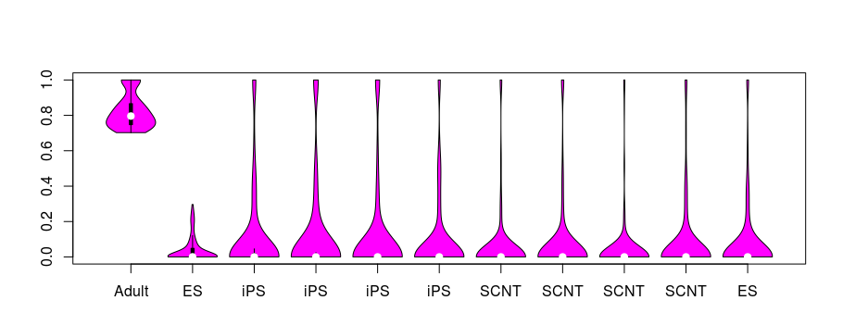
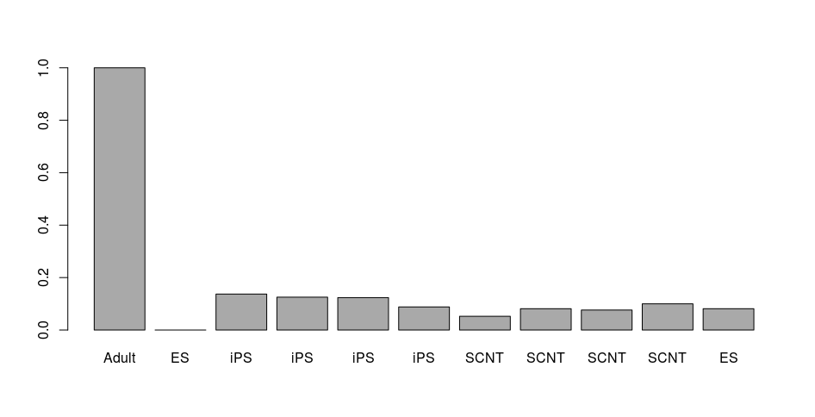
Methylation Haplotype Linkage (R²) based Heterogeneous Cell Estimation
Random differentiation Relevant Regions
Linkage disequilibrium
R2
Fraction of differentiation cells
~10%
Possible reason: Differentiation cells or other heterogeneous cell during the generation and culture of iPS will bring high linkage methylation blocks randomly distributed in human genome

Slide 9
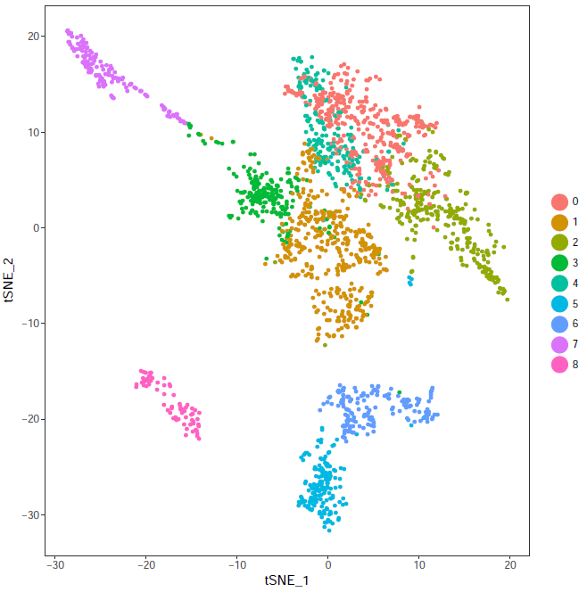
Heterogeneous Cell Estimated by sc-RNA-seq Dataset
 | sc-RNAseq | LD-R2
iPS-1 | 24.40% | 13.70%
iPS-2 | 11.40% | 12.50%
SCNT-1 | 9.12% | 7.60%
SCNT-2 | 8.65% | 9.90%
Conclusion: Methylation Haplotype Linkage (R²) could be auxiliary method to make differentiation estimation for iPS generation. In adition, iPS seems have higher differentiation ratio compared with SCNT.

Slide 10
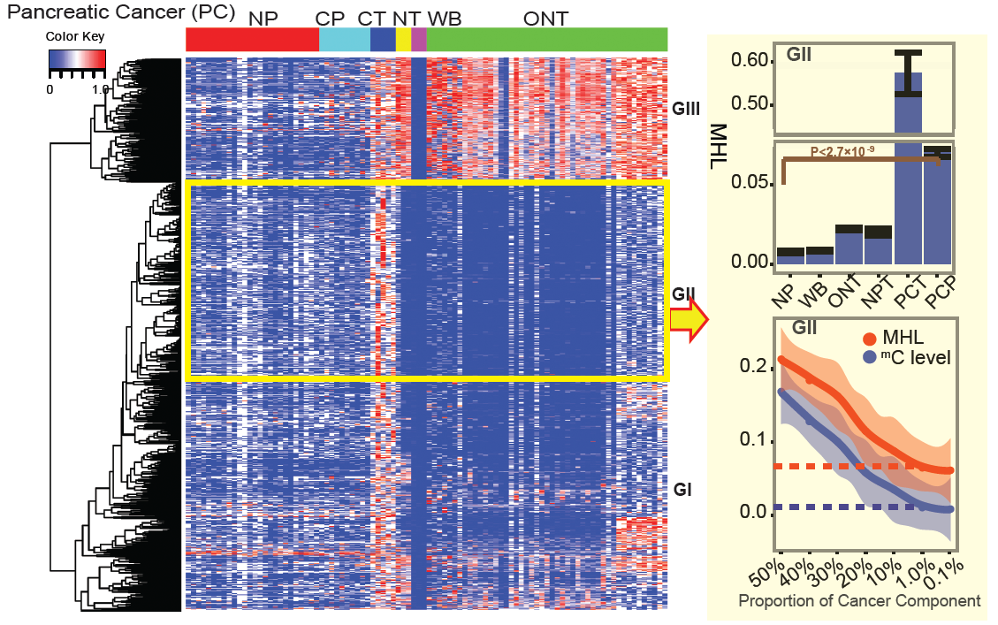
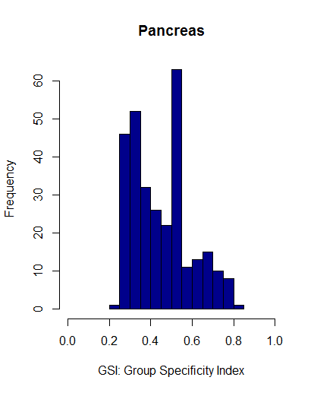
Pancreatic cancer plasma tissue-of-origin mapping analysis
~300 p-MHLs
Pancreatic tissue and cancer associated MHL biomarkers identified by group specificity index (GSI) compared with 10 normal tissues.

Slide 11
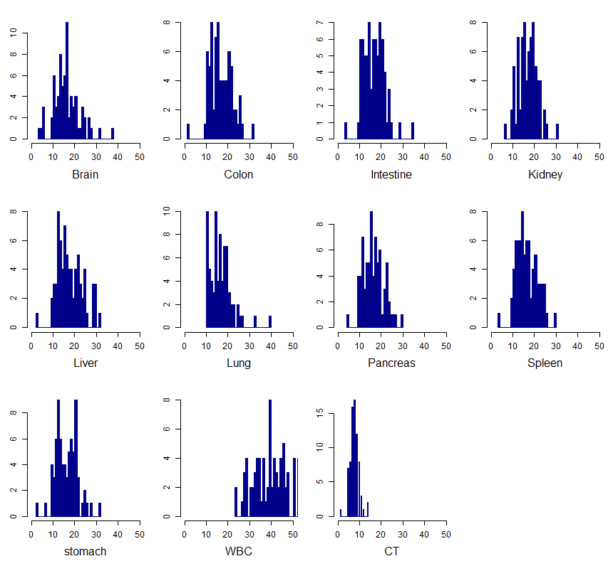
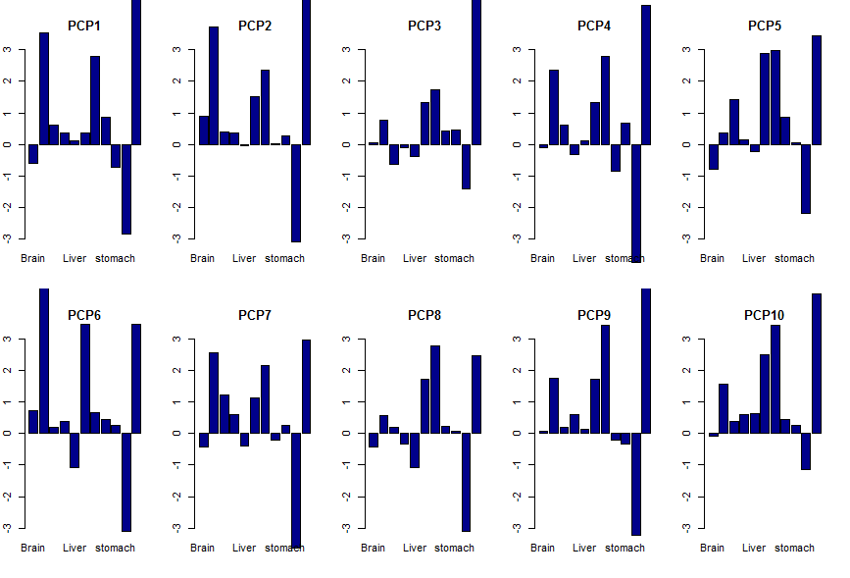
Distribution of Tissue-specific MHLs in Normal Plasma and Cancer Plasma
Background distribution of tissue-specific MHL markers in Normal Plasmas
Cancer specific MHLs assignment: 8/10=90% (6,8)
Pancreas specific MHLs assignment : 6/10=80% (1, 2,6,7)

Slide 12
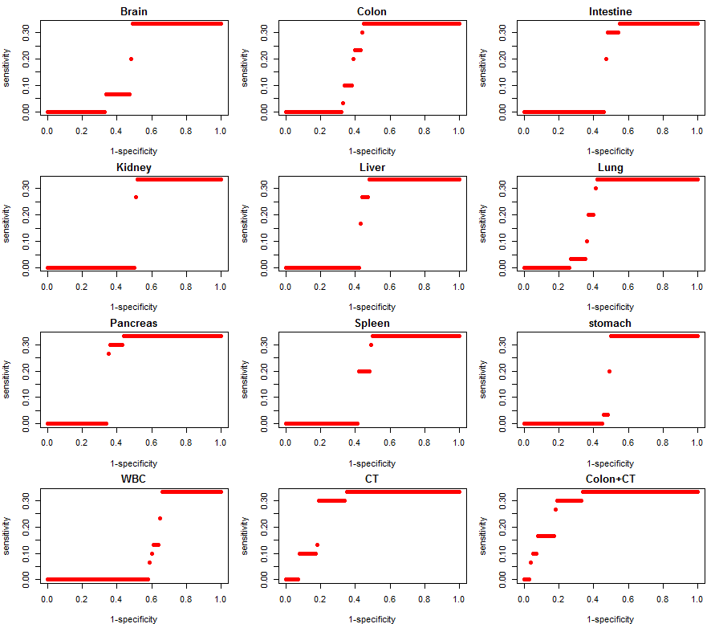
Tissue-of-Origin mapping performance based on Z-score system to Pancreatic Cancer Plasma
AUC=0.634
AUC=0.719
AUC=0.803
It seems the performance to pancreatic cancer is little worse than LCP and CCP. It might be biased by small sample size.

Slide 13
Future work
Finish all the methods of R package MethHapType and submit it to journal of Bioinformatics and Bioconductor.
CapSeq dataset: 31 cancer 24 normal samples were included. Check the methylation status of the prediction biomarker from MONOND in these dataset.
Make more inference between bulk methylome and single-cell RNA-seq dataset, such as

Slide 14
Thanks

