Slide 1
Deconvolution of epigenetic heterogeneity by tightly coupled CpG methylation
Shicheng Guo @ Zhang Lab
March 7 2016
Notes:
Hello, everyone, today I will introduce the progress of the mond project which is shorted for Methylation Haplotype in non-invasive Cancer Diagnosis

Slide 3
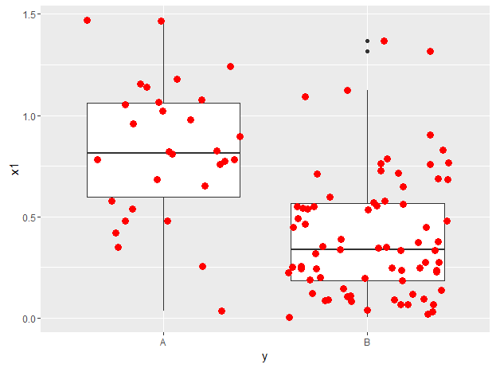
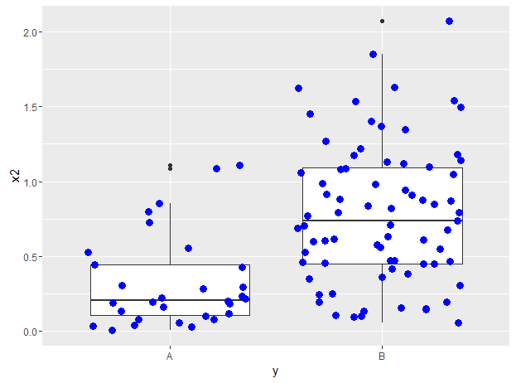
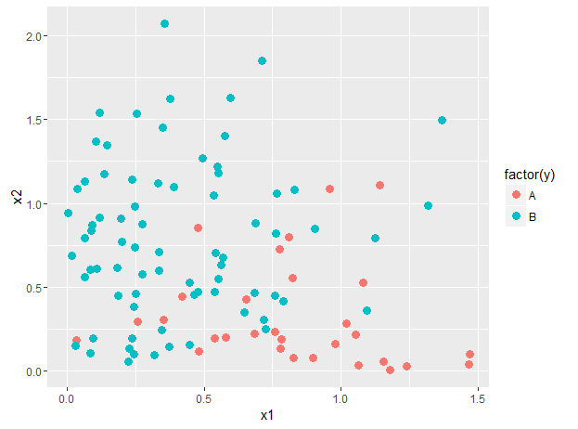
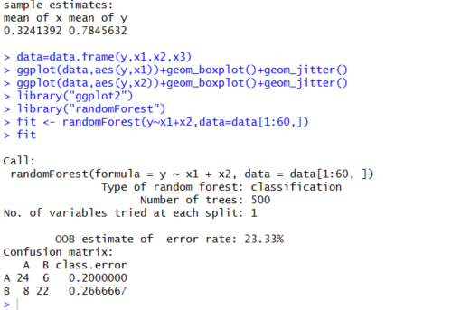
Simulation of Random Forest Prediction
y<-c(rep("A",30),rep("B",75))
x1<-c(abs(rnorm(30,0.8,0.5)),abs(rnorm(75,0.1,0.5)))
x2<-c(abs(rnorm(30,0.1,0.5)),abs(rnorm(75,0.8,0.5)))
t.test(x1[1:30],x1[31:106])
t.test(x2[1:30],x2[31:106])
data=data.frame(y,x1,x2,x3)
ggplot(data,aes(y,x1))+geom_boxplot()+geom_jitter()
ggplot(data,aes(y,x2))+geom_boxplot()+geom_jitter()
library("ggplot2")
library("randomForest")
fit <- randomForest(y~x1+x2,data=data[1:60,])
fit
Sensitivity=80%
Sensitivity=80%
Specificity=75%

Slide 4
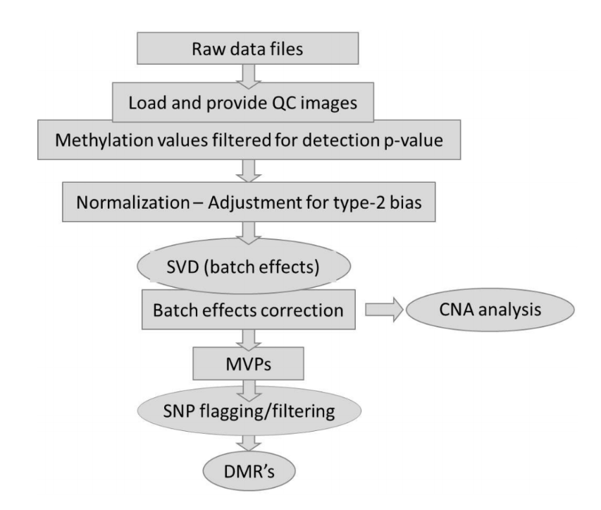

Slide 5
Methyaltion 450K entenciall fiteration
Filtering probes with a detection p-value above 0.01 in one or more samples has removed 1800 probes from the analysis.
Filtering probes with a beadcount <3 in at least 5% of samples, has removed 2542 from the analysis.
Filtering probes with SNPs as identified in Nordlund et al, has removed 28753 from the analysis.
Filtering probes that align to multiple locations as identified in Nordlund et al, has removed 8478 from the analysis.
Filtering probes on the X or Y chromosome has removed 11147 from the analysis.
The analysis will proceed with 432792 probes and 12 samples.

