Slide 2
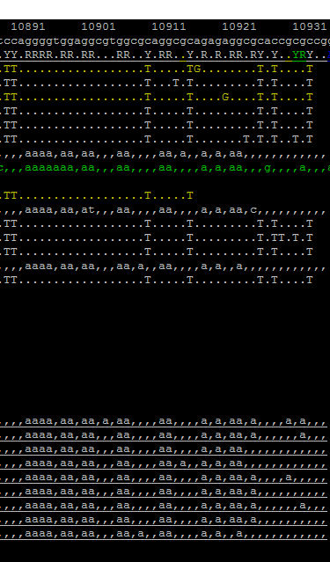
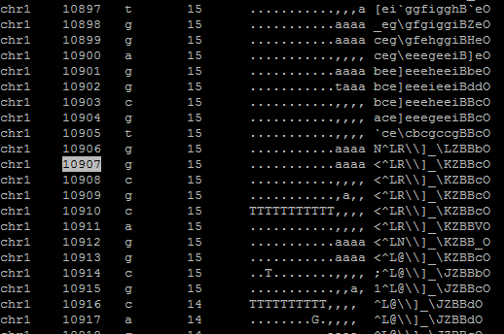

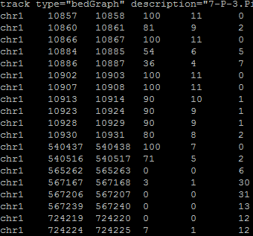
Samtools tview
Samtools depth
Samtools mpileup
PileOMeth extract bedGraph
10914

Slide 3
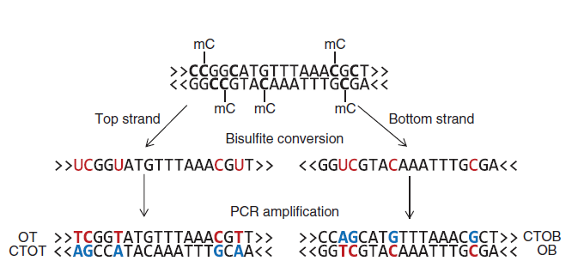
OT and CTOB

