Slide 1
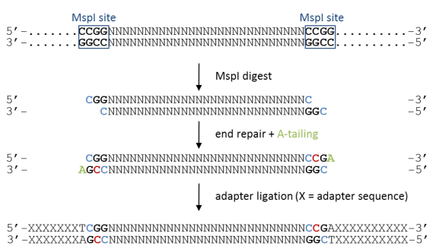
biocode
ilAdap Methyl PE1 (5-ACACTCTTTCCCTACACGACGCTCTTCCGATC*T-3)
ilAdap Methyl PE2 (5-GATCGGAAGAGCGGTTCAGCAGGAATGCCGA*G-3)
ilAdap Methyl PE1 (5-ACACTCTTTCCCTACACGACGCTCTTCCGATC*T-3)
ilAdap Methyl PE2 (5-GATCGGAAGAGCGGTTCAGCAGGAATGCCGA*G-3)

