Slide 1
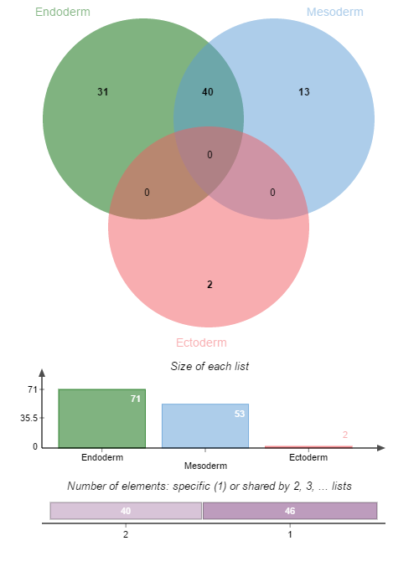
Transcript factors which binding to layer specific MHBs with hypo-MHL
ARID3A
ATF3
BATF
BCL3
CEBPD
ELK1
ESR1
FOSL2
FOXA2
GABPA
GATA3
HDAC2
HNF4A
HNF4G
IRF4
KAP1
MAFK
MBD4
MXI1
MYBL2
NFYB
RFX5
RXRA
SIX5
SMC3
SRF
TBP
TEAD4
TFAP2C
ZBTB33
ZNF217
ATF2
BCLAF1
CBX3
CTBP2
E2F4
E2F6
MAZ
PML
RBBP5
SIRT6
TBL1XR1
USF2
ZNF263
31 Endoderm specific MHBs of hypo-MHL , 13 Mesoderm specific MHBs of hypo-MHL and 2 Ectoderm specific MHBs of hypo-MHL were identified (ANOVA, P<9.2*10-7)
Gene ontology analysis to these TFs shown that TFs binding to Endoderm specific MHBs of hypo-MHL were enriched in positive regulation elements. However, for Mesoderm, negative regulation TFs were enriched. (P<0.05 after FDR)
See wiki:
http://genome-tech.ucsd.edu/LabNotes/index.php/Shicheng:Calendar/NOTES/2016-2-24#Layer_specific_hypo-MHL_regions
CHD2
ZBTB7A
Negative regulation
I think it should be make sense. Since endoderm are mainly function organs while mesoderm are mainly muscles.
Positive regulation

Slide 2
Merge MHBs of layer specific hyper-MHL and hypo-MHL
1, get help from song, is there any layer specific TFs?
2, not watch TFBS, check promoter regulation.

