Slide 1
MONOD: Methylation Haplotype in non-invasive Cancer Diagnosis and tissue mapping of plasma DNA
Shicheng Guo @ Zhang Lab
March 6 2016
Notes:
Hello, everyone, today I will introduce the progress of the mond project which is shorted for Methylation Haplotype in non-invasive Cancer Diagnosis

Slide 2
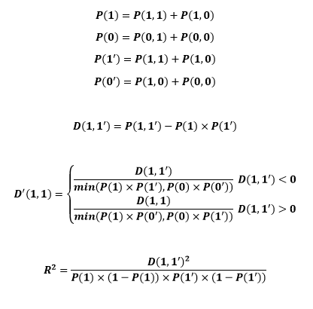
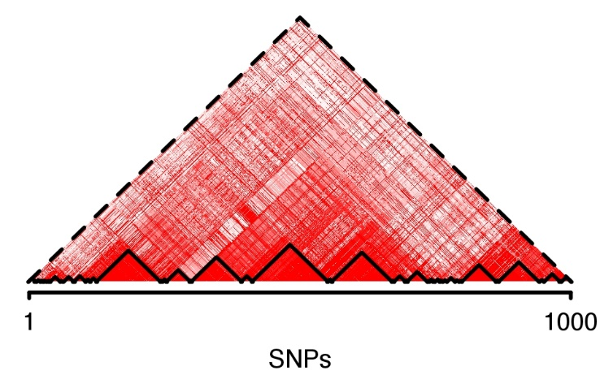
Methylation haplotype and block in individual level
 |  | CpG B
 |  | Meth(1) | Unmeth(0)
CpG A | Meth(1) | P(1,1) | P(1,0)
 | Unmeth(0) | P(0,1) | P(0,0)
Bulk BS-Seq data
CTCTCTCTCTCTCTCTCT
CTCTTCTCTTCTCTTCTC
CTCTTTTCTTCTCTTCTT
TTTTTCTTTTCTCTTCTC
CTTTTTTCTTCTCTTCTC
R²
Methylations haplotype blocks

Slide 3
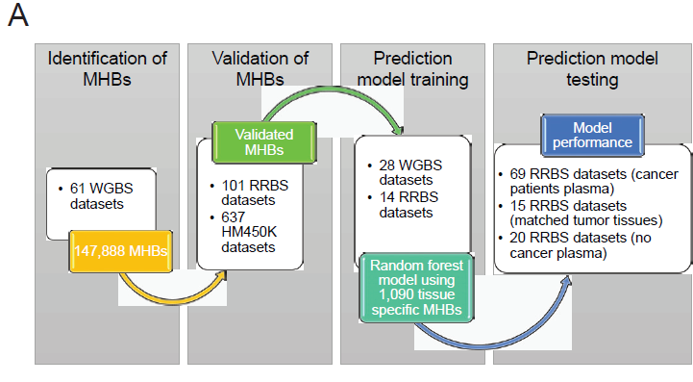
Workflow diagram for methylation haplotype calling and its application in cancer diagnosis and tumor-of-origin prediction for cancer plasma

Slide 4
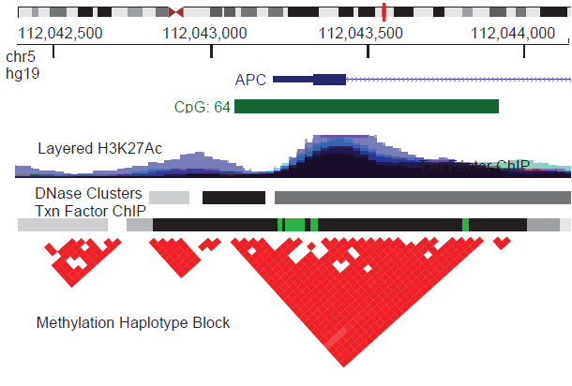
Methylation haplotype in real WGBS data
61 WGBS samples (10 N37, 36 SALK, 10 H1, 3 WBC and 2 Cancer)
(MHB)
Shoemaker et a. GR, 2011

Slide 5
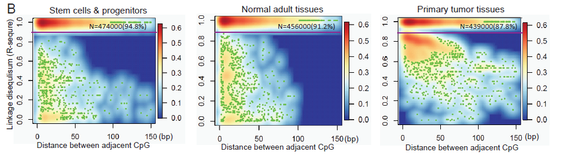
Linkage disequilibrium and distance of the CpG
Sampling: 500,000 CpG pairs
LD extends further along the DNA in stem cells and progenitors, compared with normal adult tissue, both in the fraction of tightly coupled CpG pairs (94.8% versus 91.2%). (Shoemaker, Deng et al. Genome Res 2010
Shao et al. reported that iPS-cell have lower methylation entropy compared with its adult cells (Shao et al. BMC Genomics 2014)
In primary tumor tissues, we observed a reduction of perfectly coupled CpG pairs, which could be related to the pattern of discordant methylation that has been reported in AML (Landau, Clement et al. Cancer Cell 2014)

Slide 6
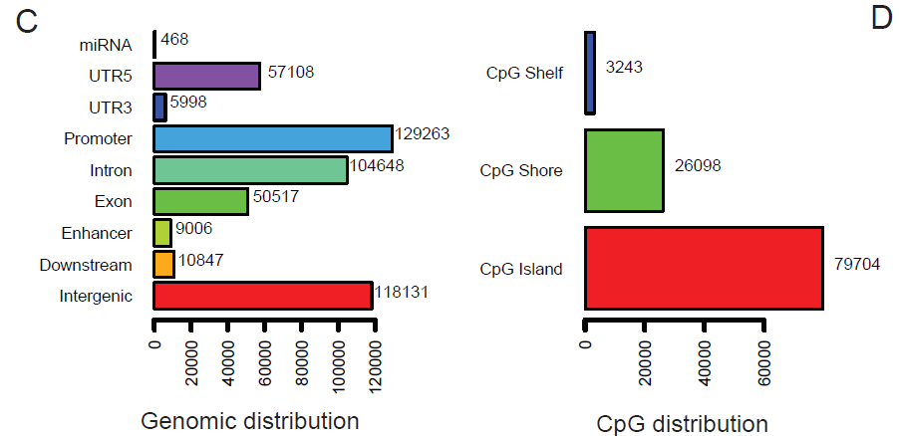
Methylation Haplotype Blocks
61 WGBS samples (10 N37, 36 SALK, 10 H1, 3 WBC and 2 Cancer)
R²>=0.5, N=147,888
Methylation blocks widely disperse in human genome.
represent a distinct type of genomic feature that partially overlaps with well-documented genomic elements
Enriched in CpG island, imprinted gene regions, Enhancer, Super Enhancer, Promoter regions.
Enrichment in VMR indicate MHB might be helpful in cancer prediction.
Negative related with LAD and LOCK.

Slide 7
Methylation Haplotype Blocks Validation
637 sets HM450K
110 sets RRBS
Pairwise correlation coefficient >0.5
2,212
147,888
56.8%
60.3%
1258
8,920
MHB represents a distinct class of genomic feature where local CpG methylation is established or removed in a highly coordinated manner at the level of single DNA molecules, presumably due to the processive activities of related enzymes.

Slide 8
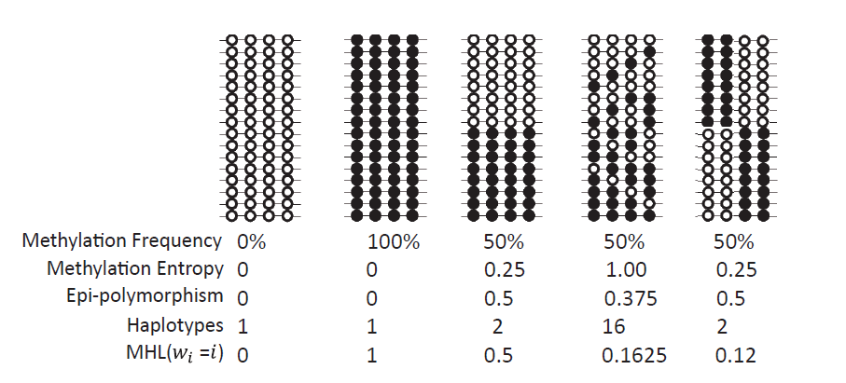
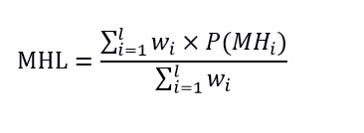
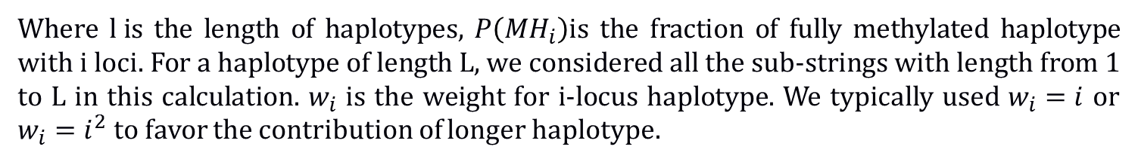
Methylation Haplotype Load Definition
Give different weight to the CpG in each haplotype
Where $l i$s the length of haplotypes, $P\left({MH}_{i}\right)$is the fraction of fully methylated haplotype with i loci. For a haplotype of length L, we considered all the sub-strings with length from 1 to L in this calculation. $w_{i}$ is the weight for i-locus haplotype. We typically used $w_{i}=i$ or $w_{i}=i^{2}$ to favor the contribution of longer haplotype.
Methylation level and pattern of co-methylation (complexity)

Slide 9
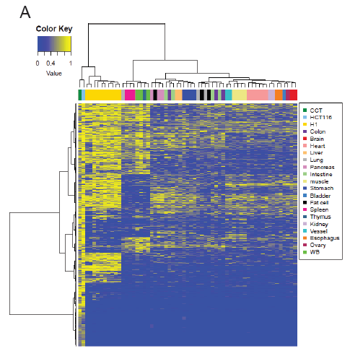
Genome-wide MHL could represent the tissue similarity
61 WGBS samples (10 N37, 36 SALK, 10 H1, 3 WBC and 2 Cancer)
Quantile Normalize and Batch effect elimination
Samples of the same tissue origin clustered together
Cancer and Stem cell are quite different with adult normal tissues.
Tissue Mapping and Cancer Diagnosis
Top 15% most variable MHBs

Slide 10
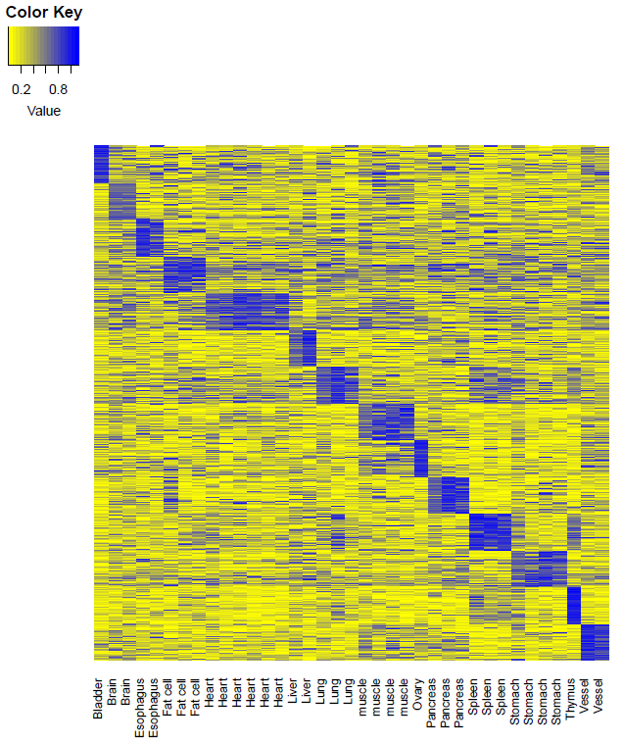
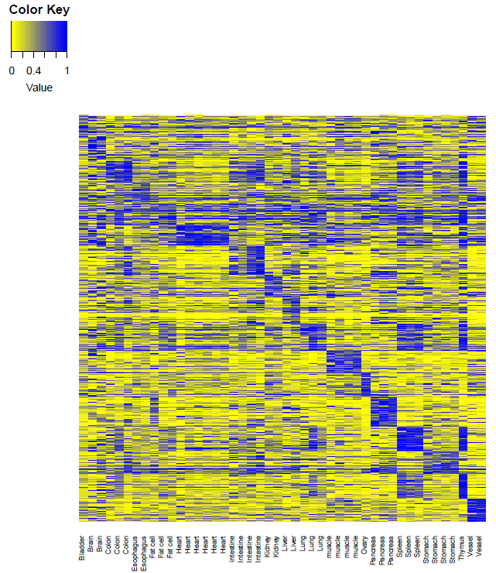
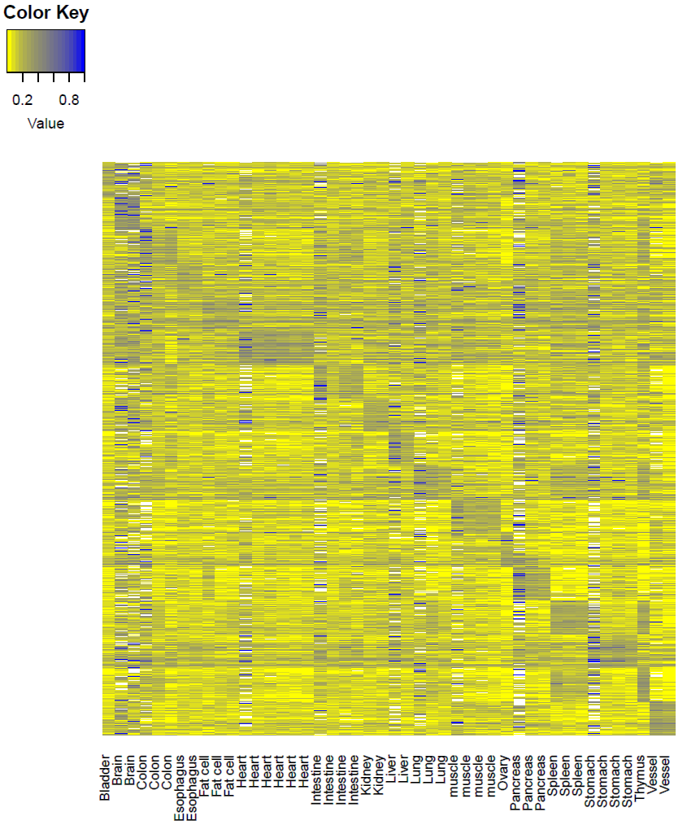
Tissue specific hyper-methylation MHB regions show tissue specificity
MFs
MHL
AMS
AMF
7647
Data extracting
Tissue specific value: 0.89 (95%CI: 0.84-0.93)
Background value: 0.29 (95%CI: 0.23-0.35)
Contrast: 0.60
Tissue specific value: 0.91(95%CI: 0.85-0.97)
Background value: 0.40 (95%CI: 0.32-0.48)
Contrast: 0.51
Tissue specific value: 0.64 (95%CI：0.55-0.73)
Background value: 0.32(95%CI: 0.29-0.35)
Contrast: 0.32
MHL was a stronger characteristic which can be applied for plasma DNA tissue mapping

Slide 11
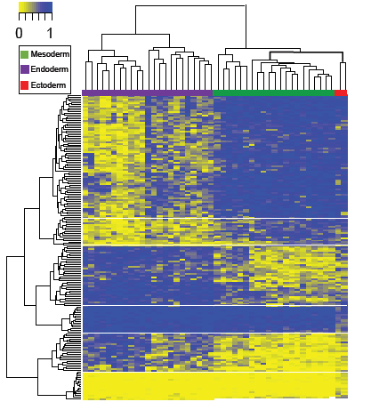
MHBs could reveal epigenetic insights on germ layer speciation
ANOVA, P-value< 9.2×10⁻⁷
31 ectoderm specific MHBs
(16 hyper- and 15 hypo-methylated)
49 endoderm specific MHBs
(34 hyper and 15 hypo-methylated)
124 mesoderm specific MHBs
(109 hyper and 15 hypo-methylated)
TFBS
TFs

Slide 12
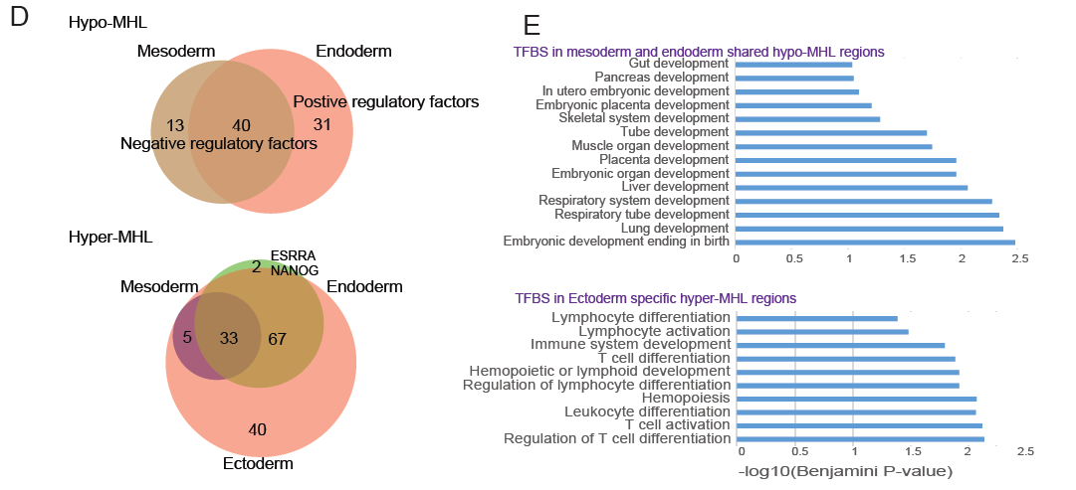
Germ layer speciation consistent with Function of TFs
Endoderm specific MHBs of hypo-MHL were enriched in positive regulation elements. However, for Mesoderm, negative regulation TFs were enriched. (P<0.05 after FDR)
Endoderm and Mesoderm shared hypo-MHL were enriched organ development
Ectoderm specific MHBs with hyper-MHL enriched in immune system development

Slide 13
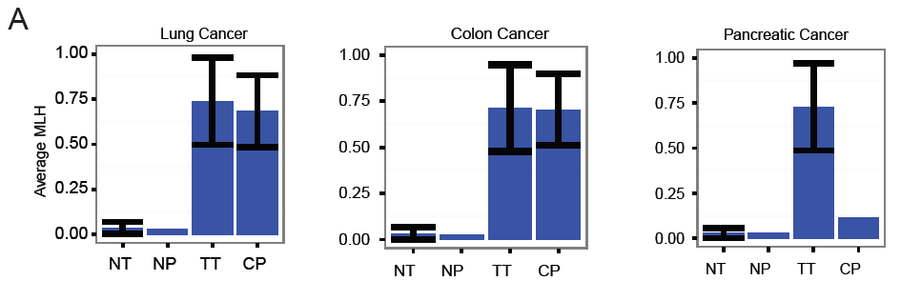
Methylation haplotype in Cancer plasma
We hypothesis that cancer specific hyper-methylated haplotype would be released to plasma randomly, therefore, MHL signals for these regions would be significant higher for cancer plasma than normal plasmas.
1963 regions
1260 regions
818 regions
MHB regions whose MHL were positive in cancer tissues and negative in normal tissues and normal plasma. We found the MHL signals were significantly higher in cancer plasma compared with normal plasma

Slide 14
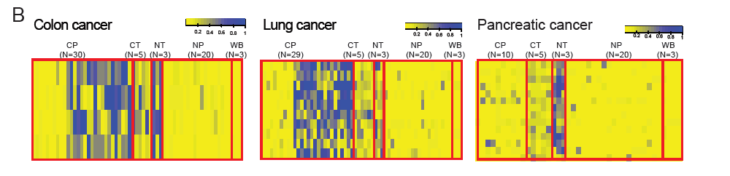
Methylation haplotype signals of tissue in Cancer plasma
Tissue-of-origin prediction require tissue specific signals were released to the plasma
Meanwhile, through scanning positive MHL signals in cancer plasma, cancer tissues, normal tissues, and negative signals in normal plasma as well as WB cells, we found large number of tissue derived signals would be passed on from normal tissue, cancer tissue to the plasmas in the cancer patients and therefore could be used for non-invasive diagnosis based on DNA methylation in plasma

Slide 15
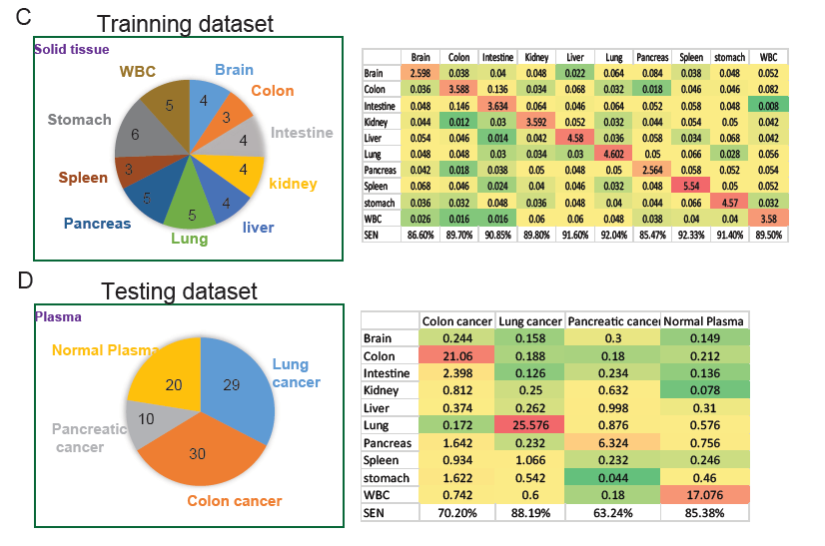
Prediction of tumor-of-origin from circulating DNA based on tissue-specific MHBs.
(43 tissue samples from 10 tissues)
Random Forest Model
1090 tissue specific MHBs
Sensitivity: 85%-92%
Random Forest Model
49 tissue specific MHBs
Sensitivity: 63.3%-88%
Random Forest based tissue specific MHBs could predict the tumor-of-origin for patients plasma

Slide 16
Discussion
We defined

Slide 18
Prediction for Full tissues based on Random Forest Model
43 samples from 10 tissues
(samples for each tissue>=3)
Sample ID | Format | Tissue | Lab
ENCFF000LUQ | RRBS | Brain | Haib
ENCFF000LUU | RRBS | Brain | Haib
N37-Cerebellum (CRBL) | WGBS | Brain | N37
N37-Frontal lobe(FL) | WGBS | Brain | N39
STL001SG-01 | WGBS | Colon | Salk
STL003SG-01 | WGBS | Colon | Salk
N37-Colon | WGBS | Colon | N38
STL001SB-01 | WGBS | Intestine | Salk
STL002SB-01 | WGBS | Intestine | Salk
STL003SB-01 | WGBS | Intestine | Salk
N37-Small intestine(SI) | WGBS | Intestine | N41
ENCFF000LVA | RRBS | kidney | Haib
ENCFF000LVB | RRBS | kidney | Haib
STL002AD-01 | WGBS | Kidney | Salk
STL003AD-01 | WGBS | Kidney | Salk
ENCFF000LVJ | RRBS | liver | Haib
ENCFF000LVN | RRBS | liver | Haib
STL011LI-01 | WGBS | Liver | Salk
N37-Liver | WGBS | Liver | N42
ENCFF000LVO | RRBS | Lung | Haib
ENCFF000LVR | RRBS | Lung | Haib
STL001LG-01 | WGBS | Lung | Salk
STL002LG-01 | WGBS | Lung | Salk
N37-Lung | WGBS | Lung | N43
ENCFF000LVU | RRBS | Pancreas | Haib
ENCFF000LVW | RRBS | Pancreas | Haib
STL002PA-01 | WGBS | Pancreas | Salk
STL003PA-01 | WGBS | Pancreas | Salk
N37-Pancreas | WGBS | Pancreas | N45
STL001SX-01 | WGBS | Spleen | Salk
STL002SX-01 | WGBS | Spleen | Salk
STL003SX-01 | WGBS | Spleen | Salk
STL001GA-01 | WGBS | Stomach | Salk
STL003GA-01 | WGBS | Stomach | Salk
ENCFF000LWS | RRBS | Stomach | Haib
ENCFF000LWW | RRBS | Stomach | Haib
STL002GA-01 | WGBS | Stomach | Salk
N37-Stomach | WGBS | Stomach | N46
ENCFF000LVI | RRBS | WBC | Haib
ENCFF000LVK | RRBS | WBC | Haib
WB_centenarian.mld_blocks_r2-0.5 | WBC | WBC | Age
WB_middle-age.mld_blocks_r2-0.5 | WBC | WBC | Age
WB_new-born.mld_blocks_r2-0.5 | WBC | WBC | Age
 | Colon | Lung | Pancreas | WBS
Brain | 0.243 | 0.159 | 0.3 | 0.149
Colon | 21.06 | 0.188 | 0.17 | 0.213
Intestine | 2.398 | 0.126 | 0.234 | 0.136
kidney | 0.811 | 0.946 | 0.632 | 0.079
liver | 0.373 | 0.263 | 0.997 | 0.31
Lung | 0.173 | 25.577 | 0.875 | 0.576
Pancreas | 0.643 | 0.232 | 6.324 | 0.756
Spleen | 0.935 | 1.067 | 0.231 | 0.245
Stomach | 1.222 | 0.542 | 0.209 | 0.46
WBC | 0.742 | 0.6 | 0.18 | 17.075
Sensitivity | 0.726207 | 0.852567 | 0.6324 | 0.85375
1000 iteration, 69 predictors
95% confidence interval will be calculated after all the iteration finished.

Slide 20
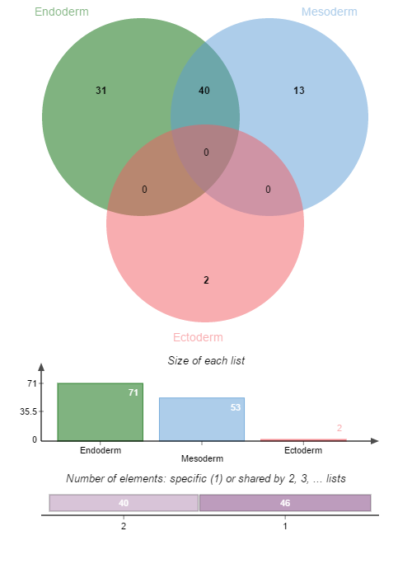
Transcript factors which binding to layer specific MHBs with hypo-MHL
ARID3A
ATF3
BATF
BCL3
CEBPD
ELK1
ESR1
FOSL2
FOXA2
GABPA
GATA3
HDAC2
HNF4A
HNF4G
IRF4
KAP1
MAFK
MBD4
MXI1
MYBL2
NFYB
RFX5
RXRA
SIX5
SMC3
SRF
TBP
TEAD4
TFAP2C
ZBTB33
ZNF217
ATF2
BCLAF1
CBX3
CTBP2
E2F4
E2F6
MAZ
PML
RBBP5
SIRT6
TBL1XR1
USF2
ZNF263
31 Endoderm specific MHBs of hypo-MHL , 13 Mesoderm specific MHBs of hypo-MHL and 2 Ectoderm specific MHBs of hypo-MHL were identified (ANOVA, P<9.2*10-7)
Gene ontology analysis to these TFs shown that TFs binding to Endoderm specific MHBs of hypo-MHL were enriched in positive regulation elements. However, for Mesoderm, negative regulation TFs were enriched. (P<0.05 after FDR)
See wiki:
http://genome-tech.ucsd.edu/LabNotes/index.php/Shicheng:Calendar/NOTES/2016-2-24#Layer_specific_hypo-MHL_regions
CHD2
ZBTB7A
Negative regulation
I think it should be make sense. Since endoderm are mainly function organs while mesoderm are mainly muscles.
Positive regulation

Slide 21
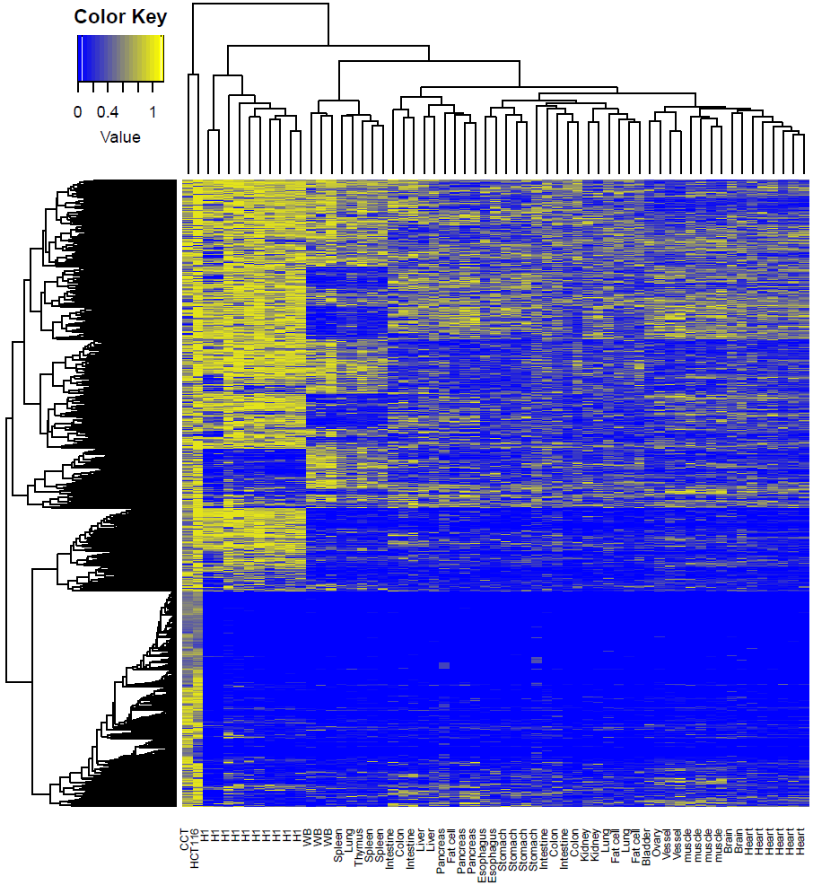
Genome-wide MHL could represent the tissue similarity
Tissues from same source cluster together
Tissue mapping
Cancer tissues and H1 cells have large number high MHL regions
Cancer diagnosis
H1 + Cancer + N37+ SALK

Slide 22
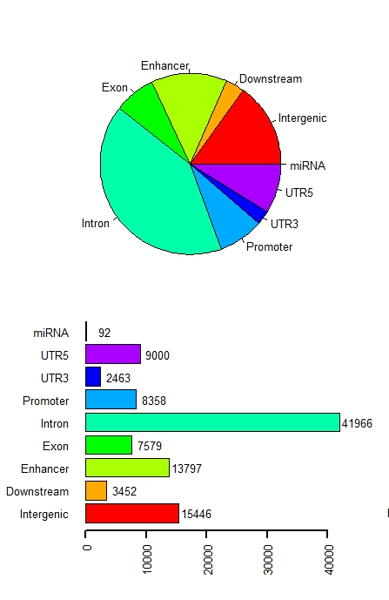
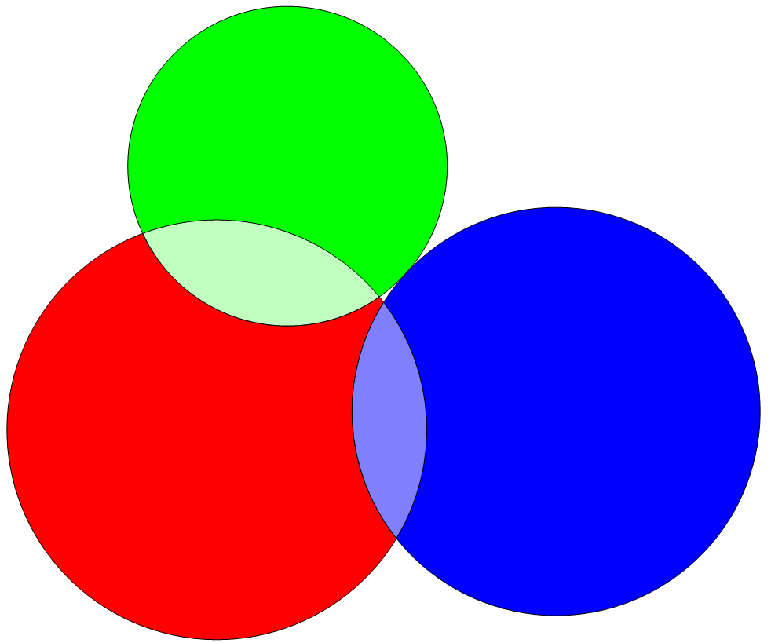
Distribution of Methylation block in human genomics
CpG island
58%
16,886
CpG Shore
16,164
147782
34%
Methylation block
3,243
CpG Shelf
7%
Methylation blocks widely disperse in human genome, especially in gene regulation and body region.
Methylation blocks prefer CpG island regions compared with CpG shore and CpG shelf
Notes:
Calculate the fold change

Slide 23
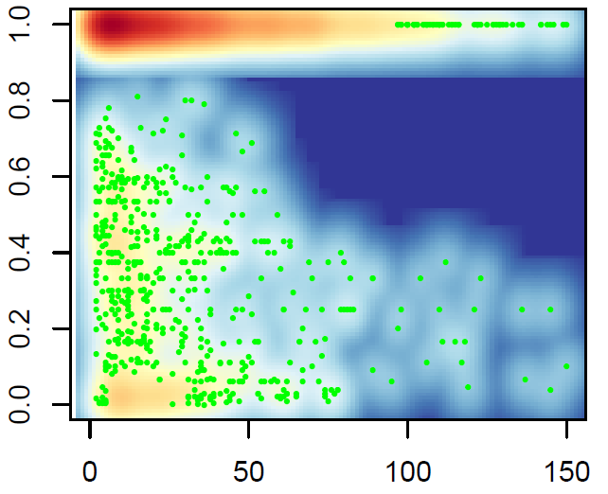
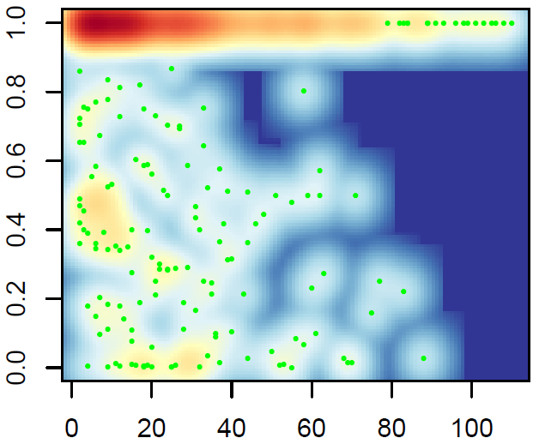
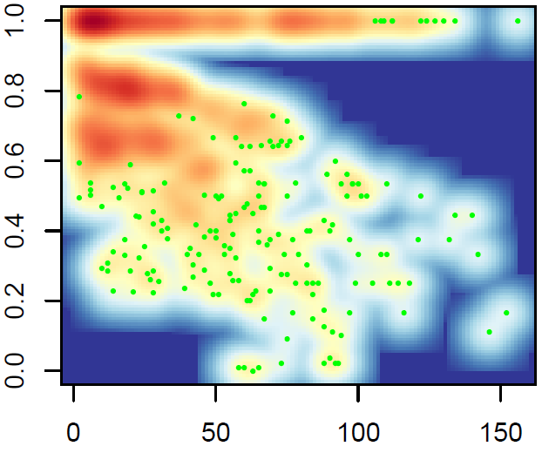
Relationship between R² and Absolute Distance Between Pair-wise CpGs
Coef= -0.00079
P-value= 8.39×10⁻¹³
Coef= -0.0011
P-value=3.4×10⁻³
Coef= -0.0016
P-value<2.0×10⁻¹⁶
Stem cells (H1)
Normal Tissue
Cancer
Linkage disequilibrium (R²) of methylation status between pair-wise CpG loci within the methylation blocks
Linkage disequilibrium (R²) for pair-wised CpG loci within the methylation blocks were calculated. There are two kinds of methylation block in human genomes,
1) low variation within the methylation block (92%)
2) high variation methylation block(8%)
Compared with the R2 decay trend, we can find cancer cells decay stronger than stem cell and normal cells.
In the next slice, we can also find cancer start to decay in nearby neighbor CpGs compared with normal and stem cell

Slide 25
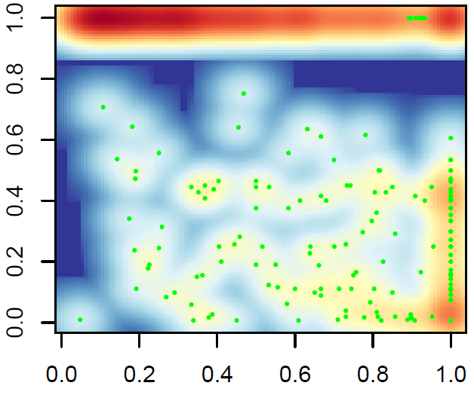
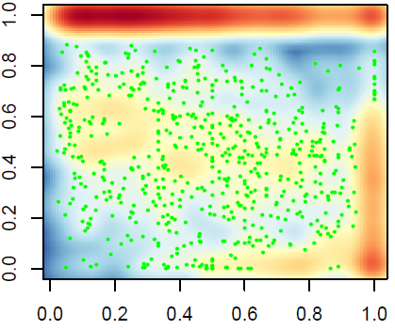
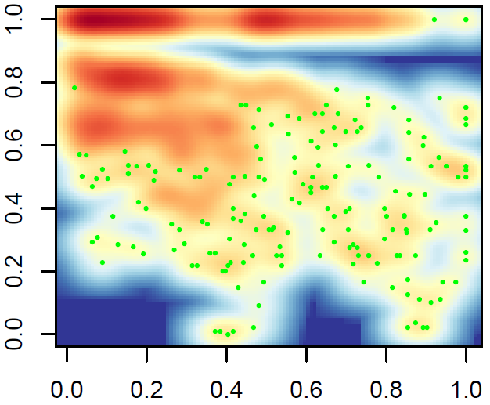
Relationship between R² and Relative Distance Between Pair-wise CpGs
(adjusted by length of MethyBlock)
Coef= -0.43
P-value<2.0×10⁻¹⁶
Coef= -0.25
P-value<2.0×10⁻¹⁶
Coef= -0.51
P-value<2.0×10⁻¹⁶
Stem cells (H1)
Normal Tissue
Cancer
We can find Linkage disequilibrium (R²) begins to decay from very nearby neighbor CpGs therefore the decay coefficient is large than normal and stem cells. In contrast, stem cell and normal seems to decay at far CpGs therefore the decay coefficient is smaller.
Notes:
Calculate the entropy of the figures

Slide 26
Methylation block: an independent function element
 | Observation | Expectation | Ratio | Fold change | P-value*
Virable methylation region (VMR) | 48 | 2 | 0.001 | 21.40 | < 1e-04
CpG island (CpGI) | 5845 | 379 | 0.118 | 15.43 | < 1e-04
Differentail Methylation Regions (DMR) | 2216 | 160 | 0.045 | 13.89 | < 1e-04
CpG shore (CpGsr) | 4269 | 1600 | 0.086 | 2.67 | < 1e-04
Hi-C common boundary (IMR90 and hESC) | 6322 | 4356 | 0.128 | 1.45 | < 1e-04
Hi-C topological.domain(IMR90) | 44794 | 41037 | 0.904 | 1.09 | < 1e-04
Hi-C topological.domain(hESC) | 44806 | 41808 | 0.904 | 1.07 | < 1e-04
Large organized chromatin K9 (LOCK) | 131 | 217 | 0.003 | 0.60 | < 1e-04
Lamina-associated domains (LAD) | 10639 | 18330 | 0.215 | 0.58 | < 1e-04
*Sampling 10,000 times and empirical P-value to show the significance.
Result:
Methylation block is significantly enriched in CpGI, Shore, VMR and DMR regions, while it is negatively correlated with LOCK and LAD regions. Widely correlation with all kinds of important biological function domains indicate the methylation block might play some roles in different functions.
Conclusion：
Methylation block might be an independent functional domain

Slide 27
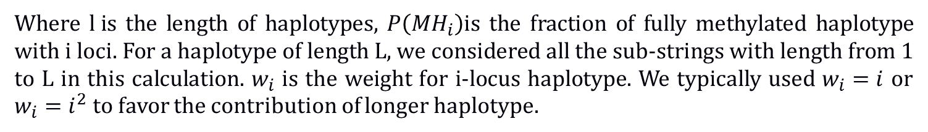
Quantitative measurement of DNA methylation level and complexity
1, Average methylation: Non-weighted average methylation values within a genomic region
2, Methylation entropy: measure the complexity of the DNA methylation within a genomic region
None any metric: Methylation Level and complexity
Give different weight to the CpG in each haplotype
Where $l i$s the length of haplotypes, $P\left({MH}_{i}\right)$is the fraction of fully methylated haplotype with i loci. For a haplotype of length L, we considered all the sub-strings with length from 1 to L in this calculation. $w_{i}$ is the weight for i-locus haplotype. We typically used $w_{i}=i$ or $w_{i}=i^{2}$ to favor the contribution of longer haplotype.

Slide 28

MHL : New proposed quantitation of DNA methylation
R²=1 R²=1 R²=1 R²=0 R²=-1
Methylation level
0% 100% 50% 50% 50%
Methylation entropy
0 0 0.25 1 0.25
1 1 2 16 2
0 1 0.5 0.1625 0.12
Haplotypes
MHL($w_{i}$ =$i$ )
Theoretically, MHL can detect each situation accurately
Long continuous methylated DNA fragment (LCMDF)

Slide 29
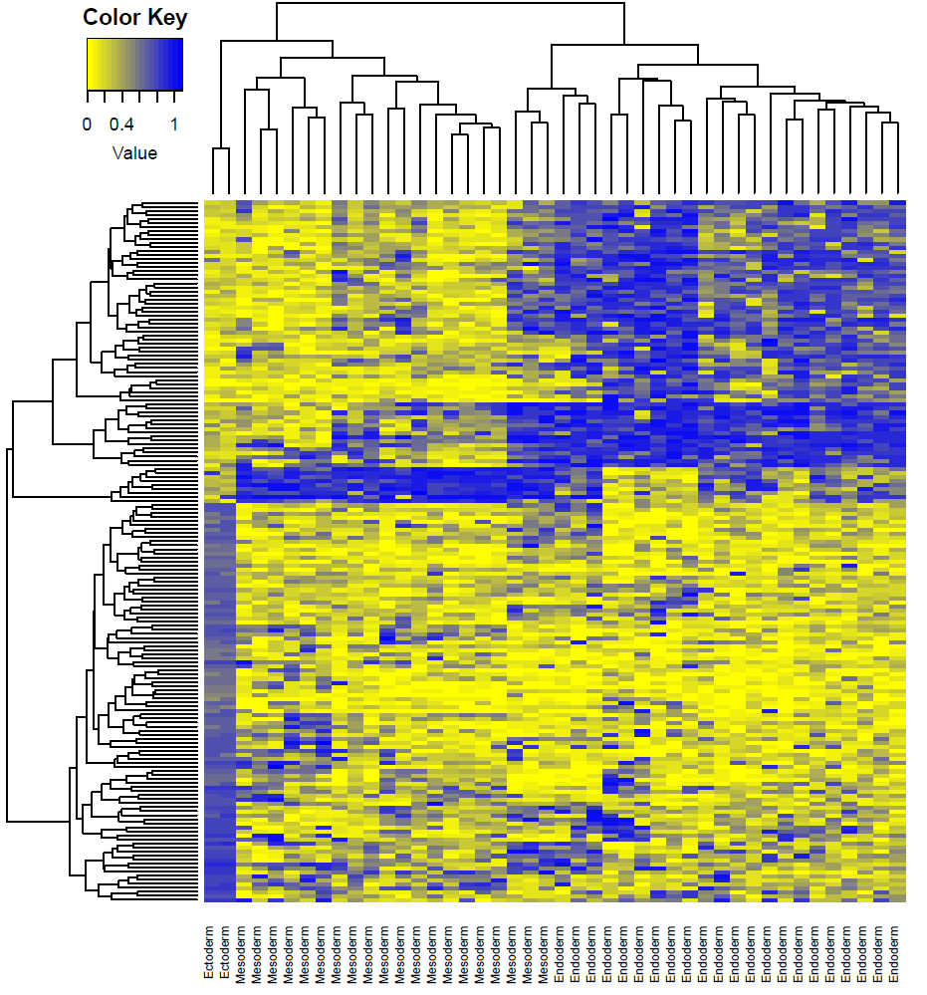
Methylation haplotype load distinguish the layer of the development
The development layers would be separated by layer specific methylation haplotype regions.
Especially, ectoderm have completely different MHL regions compared with endoderm
Several tissues were mixed in different groups. And we think it is called heterogeneity of the organs which usually have mixture of different kinds of cells
I
II
III
ectoderm
Mesoderm
Endoderm

Slide 30
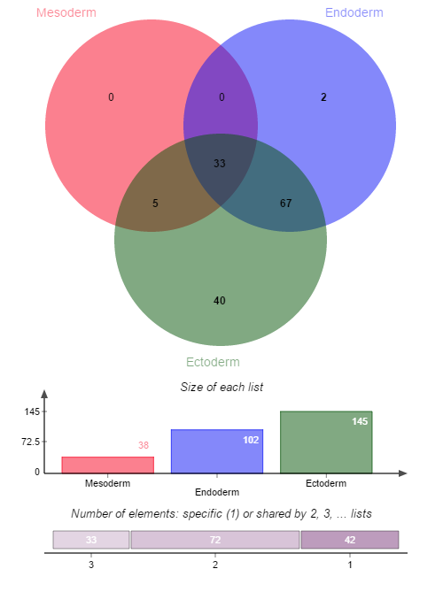
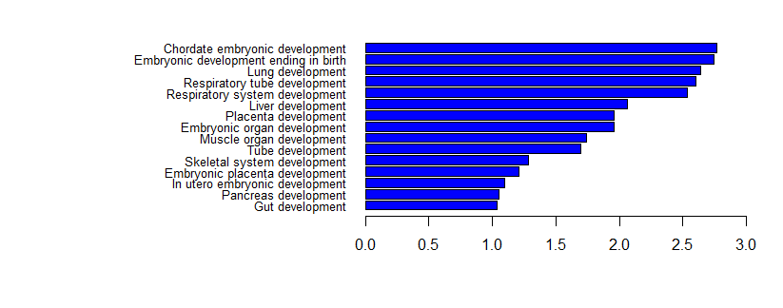
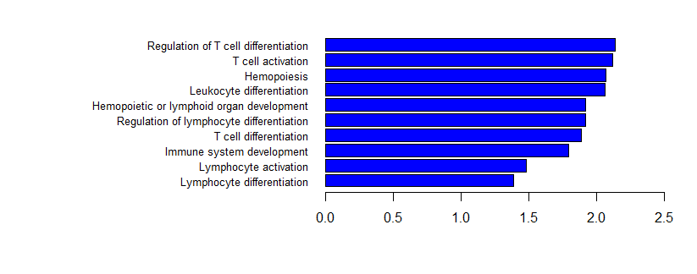
Function annotation to the Layer specific MHL regions
In the absence of Nanog, mouse embryonic stem cells differentiate into visceral/parietal endoderm.^{[1][2]}
Mesoderm and Endoderm shared hypo-MHL regions play the role to induce the development
ESRRA
NANOG
-log10(Benjamini P value)
Ectoderm specific hyper-MHL regions impress the immune system to
induce the ectoderm development
-log10(Benjamini P value)

Slide 31
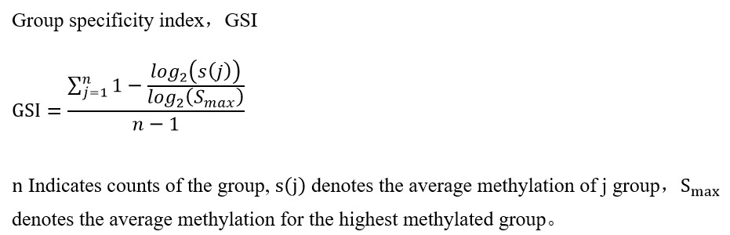
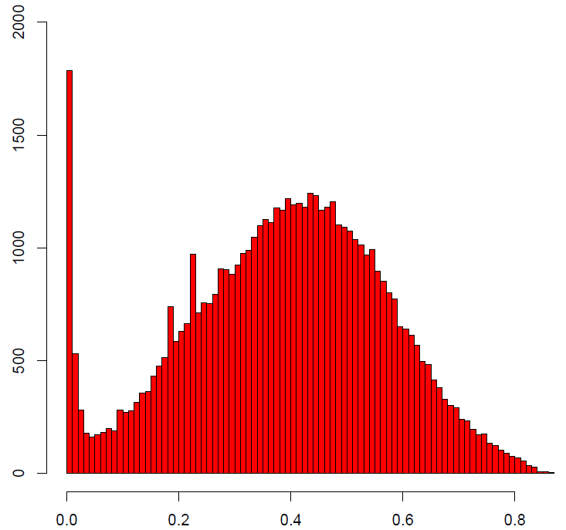
Identification of Tissue specific hyper-methylation haplotype regions
43 samples derived from 17 human normal tissues
ID | Tissue | Sample Size
1 | Bladder | 1
2 | Brain | 2
3 | Colon | 3
4 | Esophagus | 2
6 | Gastric | 2
7 | Heart | 6
8 | Intestine | 4
9 | Kidney | 2
10 | Liver | 2
11 | Lung | 3
12 | muscle | 4
13 | Ovary | 1
14 | Pancreas | 3
15 | Spleen | 3
16 | Stomach | 2
17 | Thymus | 1
18 | Vessel | 2
Tissue | Sample Size | No | Layer
Bladder | 1 | 292 | Endoterm
Brain | 2 | 34 | Ectoderm
Colon | 3 | 78 | Endoterm
Esophagus | 2 | 79 | Endoderm
Fat cell | 2 | 15 | Endoterm
Heart | 6 | 19 | Mesoderm
Intestine | 4 | 92 | Endoterm
Kidney | 2 | 186 | Mesoderm
Liver | 2 | 306 | Endoterm
Lung | 3 | 26 | Endoterm
muscle | 4 | 160 | Mesoderm
Ovary | 1 | 584 | Mesoderm
Pancreas | 3 | 559 | Endoterm
Spleen | 3 | 487 | Mesoderm
Stomach | 4 | 52 | Endoterm
Thymus | 1 | 2671 | Endoterm
Vessel | 2 | 626 | Mesoderm
0.6
6266
Sample size/Coverage
Result: large number of tissue specific hyper MHL regions were identified. These regions can be considered as basis for the deconvolution (tissue tracking)

Slide 32
Tissue specific hyper-methylation haplotype regions to predict cancer origin
MFs
MHL
AMS
AMF
1360
1360
7539
7647
Data extracting
Tissue specific value: 0.89 (95%CI: 0.84-0.93)
Background value: 0.29 (95%CI: 0.23-0.35)
Contrast: 3.06
Tissue specific value: 0.91(95%CI: 0.85-0.97)
Background value: 0.40 (95%CI: 0.32-0.48)
Contrast: 2.78
Tissue specific value: 0.64 (95%CI：0.55-0.73)
Background value: 0.32(95%CI: 0.29-0.35)
Contrast: 2.0
MHL was a stronger characteristic which can be applied for plasma DNA tissue mapping
Notes:
Calculate the fold-change

Slide 33
Tissue specific hyper-methylation haplotype regions to predict cancer origin
RRBS dataset: 49 regions overlapped with high GSI regions
 | Colon | Lung | Pancrease | Normal Plasma
Colon | 7 | 1 | 2 | -
Lung | 1 | 8 | 1 | -
Pancrease | 2 | 1 | 7 | -
Normal Plasma | 1 | 0 | 0 | 8
Dataset 1
Sen: 70.0%
Sen: 80.0%
Sen: 70.0%
Random Forest： 500 tree, 447 predictors, diagonal
RRBS dataset: regions overlapped with high GSI regions
 | Colon | Lung | Pancrease | Normal Plasma
Colon
Lung
Pancrease
Normal Plasma
Sen:
Sen:
Sen:
Dataset 2
Random Forest:
Result: methylation haplotype load could be used for the mapping of the plasma DNA

Slide 34
Thanks

Slide 35
16 data from 8 tissues in ENCODE
(samples for each tissue>=3)
ENCFF000LVO | RRBS | lung | adult | female | 83 year | 36bp | Illumina Genome Analyzer IIx
ENCFF000LVR | RRBS | lung | adult | female | 83 year | 36bp | Illumina Genome Analyzer IIx
ENCFF000LVA | RRBS | kidney | adult | female | 83 year | 36bp | Illumina Genome Analyzer IIx
ENCFF000LVB | RRBS | kidney | adult | female | 83 year | 36bp | Illumina Genome Analyzer IIx
ENCFF000LUT | RRBS | breast | adult | female | 21 year | 36bp | Illumina Genome Analyzer IIx
ENCFF000LUV | RRBS | breast | adult | female | 21 year | 36bp | Illumina Genome Analyzer IIx
ENCFF000LUQ | RRBS | brain | adult | male | 66 year | 36bp | Illumina Genome Analyzer IIx
ENCFF000LUU | RRBS | brain | adult | male | 66 year | 36bp | Illumina Genome Analyzer IIx
ENCFF000LWS | RRBS | stomach | adult | female | 83 year | 36bp | Illumina Genome Analyzer IIx
ENCFF000LWW | RRBS | stomach | adult | female | 83 year | 36bp | Illumina Genome Analyzer IIx
ENCFF000LVU | RRBS | pancreas | adult | male | 71 year | 36bp | Illumina Genome Analyzer IIx
ENCFF000LVW | RRBS | pancreas | adult | male | 71 year | 36bp | Illumina Genome Analyzer IIx
ENCFF000LVI | RRBS | mononuclear cell | adult | unknown | 54 year | 36bp | Illumina Genome Analyzer IIx
ENCFF000LVK | RRBS | mononuclear cell | adult | unknown | 54 year | 36bp | Illumina Genome Analyzer IIx
ENCFF000LVJ | RRBS | liver | adult | female | 83 year | 36bp | Illumina Genome Analyzer IIx
ENCFF000LVN | RRBS | liver | adult | female | 83 year | 36bp | Illumina Genome Analyzer IIx

Slide 36
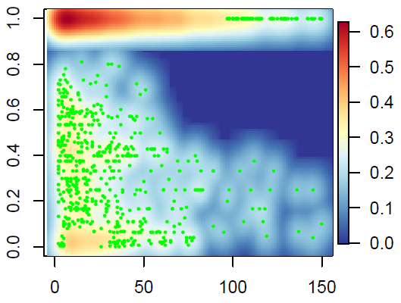
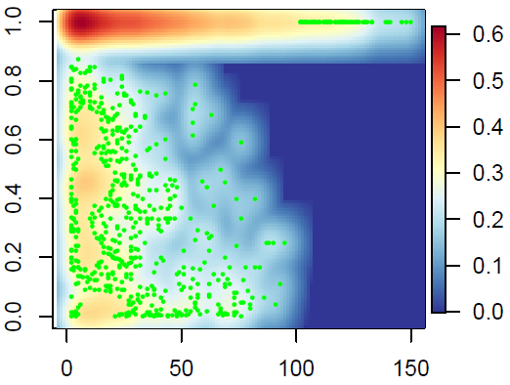
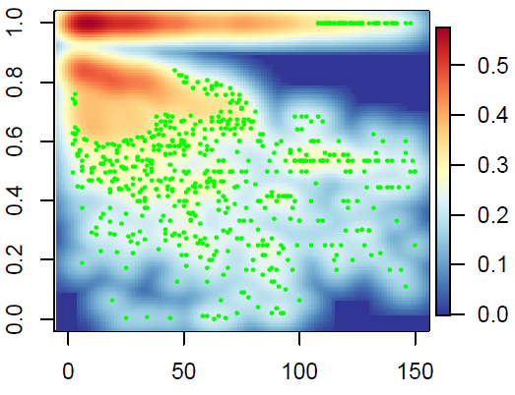
Relationship between R² and Absolute Distance Between Pair-wise CpGs
Coef= -0.00079
P-value= 8.39×10⁻¹³
Coef= -0.0011
P-value=3.4×10⁻³
Coef= -0.0016
P-value<2.0×10⁻¹⁶
Stem cells (H1)
Normal Tissue
Cancer
Linkage disequilibrium (R²) of methylation status between pair-wise CpG loci within the methylation blocks
Method: Linkage disequilibrium (R²) for pair-wised CpG loci within the methylation blocks were calculated. There are two kinds of methylation block in human genomes,
1) low variation within the methylation block (92%)
2) high variation methylation block(8%)
Compared with the R2 decay trend, we can find cancer cells decay stronger than stem cell and normal cells.
In the next slice, we can also find cancer start to decay in nearby neighbor CpGs compared with normal and stem cell

Slide 37
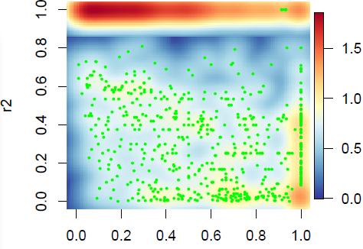
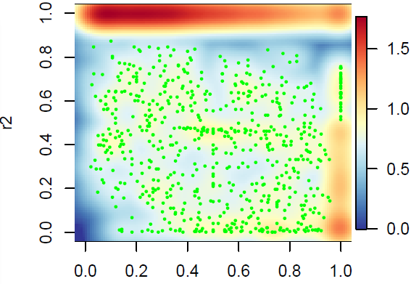
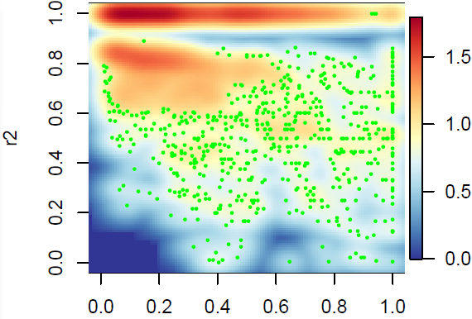
Relationship between R² and Relative Distance Between Pair-wise CpGs (adjusted by length of MethyBlock)
Coef= -0.43
P-value<2.0×10⁻¹⁶
Coef= -0.25
P-value<2.0×10⁻¹⁶
Coef= -0.51
P-value<2.0×10⁻¹⁶
Stem cells (H1)
Normal Tissue
Cancer
On the other side, we can find Linkage disequilibrium (R²) begins to decay from very nearby neighbor CpGs therefore the decay coefficient is large than normal and stem cells. In contrast, stem cell and normal seems to decay at far CpGs therefore the decay coefficient is smaller.

Slide 38
Differential methylation haplotype regions between cancers and normals

Slide 39
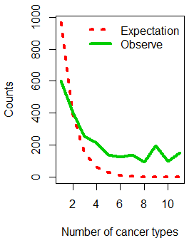
Methylation block conservation among 11 human normal tissues
2421 methylation block regions (59.97% in WGBS) were collected from 11 tissues. The probability of the number occurred in different tissues would be in a exponential decay as the red lines showed (P=0.4). However, we found a regions significantly deviate from the theoretical distribution (P<2.2 × 10⁻¹⁶,chi-square test) and therefore, the methylation block have strong conservation in different tissues.
Exponential decay
Conservation
P=length(blocks)/(length(uniqueblock)*event.time)

