Slide 1
Possible questions to Review and Find more evidence to support our conclusion and approach
Deconvolution of epigenetic heterogeneity in human tissues and plasma DNA by tightly coupled CpG methylation.
Nature Genetics, SEP 24th/2016

Slide 2
Previous Story
Linkage disequilibrium analysis identified genome-wide methylation haplotype blocks
Methylation haplotype block shown significantly epigenetic regulatory functions
Methylation haplotype load reflect methylation level and complexity simultaneously
Methylation haplotype load have powerful distinguish ability to tissues and layers
Deconvolution analysis to MHL shown higher tumor component in cancer plasma
Tissue-specific MHBs provide accurate tumor-of-origin mapping for cancer plasma

Slide 3
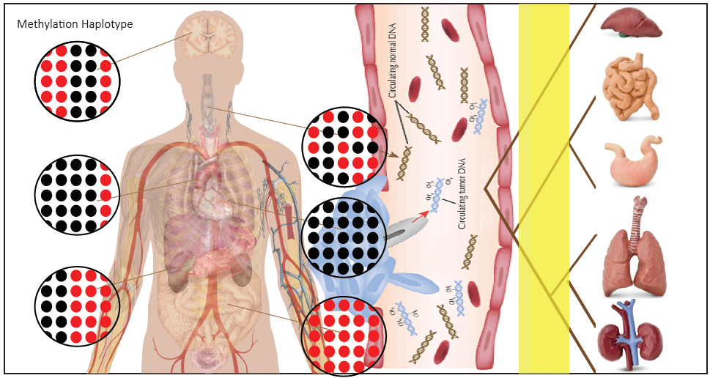
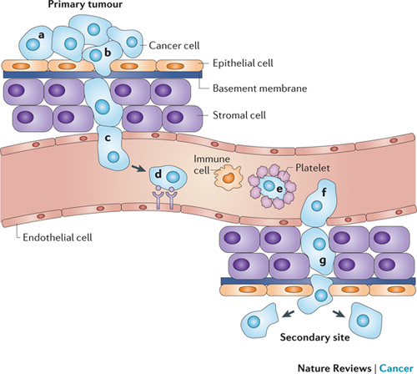
Epigenome: tools to tracking cells for its origin
Methylation haplotype based tissue specific DNA methylation indicating cell origin in the plasma for cancers.
Maybe it could be used to indicate the primary tissue origin for metastatic cancers??
Notes:
Metastasis requires several steps, each of which presents an opportunity for new therapies. First, metastatic cells must break free from the primary tumour. To accomplish this, cancer cells (a) reduce adhesion to neighbouring cells and (b) clear a path for migration into the vasculature-rich stroma^{210, 211, 212, 213}. Once at the vasculature, cells can freely enter the bloodstream if the vasculature is discontinuous, such as in certain regions of the liver, bone marrow and kidneys. Intravasation (c) is required if the vasculature is continuous; cells either cause endothelial cell retraction by releasing compounds such as vascular endothelial growth factor (VEGF) or endothelial cell death by releasing reactive oxygen species and factors including matrix metalloproteinases (MMPs)^{214, 215}. In the bloodstream, cancer cell distribution is determined by blood flow and interactions between cancer cells and the secondary organs that they colonize: cells can get trapped in narrow capillary beds, such as those of the lung and liver, and can also express receptors that bind to metastasis-supporting sites (d) or to platelets (e), which protect the cancer cells from the immune system^{216, 217, 218, 219, 220}. Cancer cells can circulate for more than 2 hours, suggesting that they do not always become lodged in the first capillary beds that they reach²²¹. After reaching the secondary site, cancer cells can exit the bloodstream (f) by inducing endothelial cell retraction or death^{222,223}. To proliferate in the secondary site, cancer cells co-opt the local environment by releasing pro-inflammatory compounds and proteinases that induce their neighbours to release growth factors^{224, 225} (g).

Slide 4
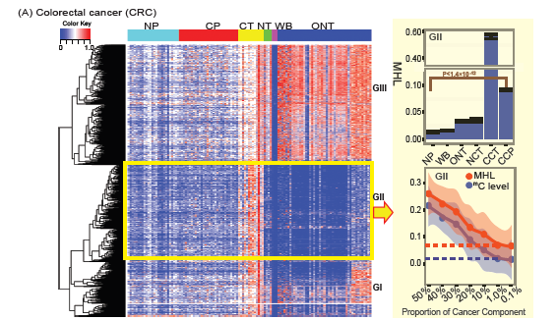
Methylation haplotype load based signatures indicating tissue-of-origin
2782
Estimate cancer plasma composition by methylation-haplotype load
Standard curve between average MHL and cancer component established by sampling with different proportion of cancer and WB samples

Slide 5
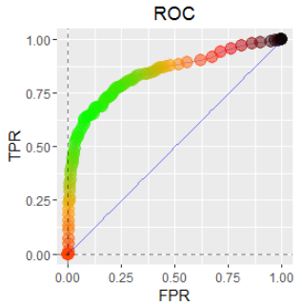
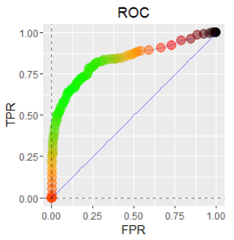
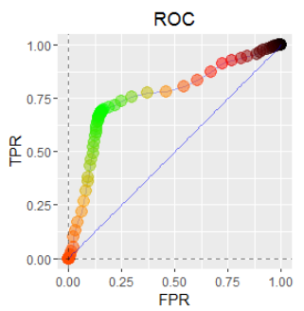
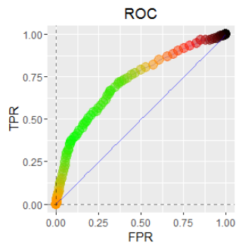
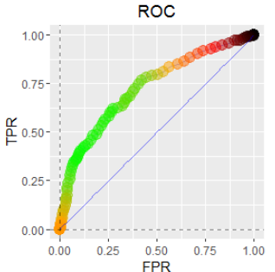
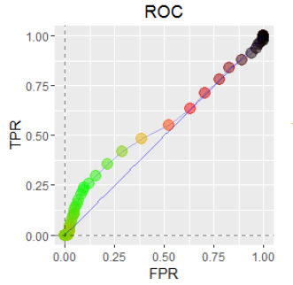
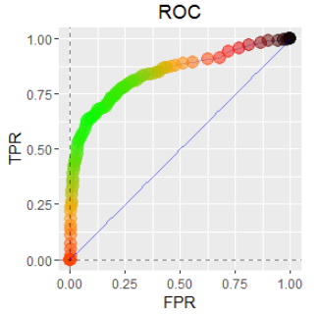
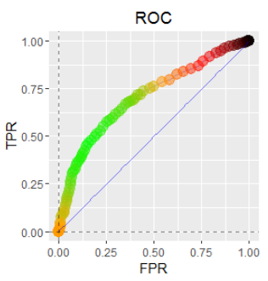
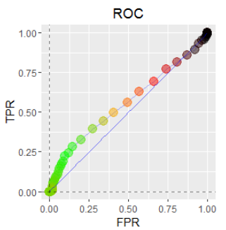
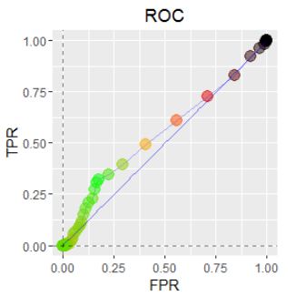
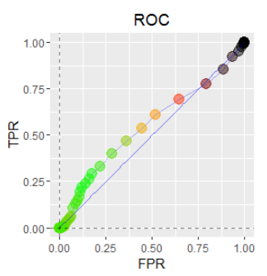
Determine how low (percentage of tumor DNA in blood) ROC curve
10%
5%
1%
0.5%
0.1%
0.01%
AUC: 0.843(0.791-0.895)
AUC: 0.810(0.742-0.878)
AUC: 0.771(0.742-0.80)
AUC: 0.671(0.641-0.705)
AUC: 0.650(0.526-0.695)
AUC: 0.541(0.447-0.643)
AUC: 0.850(0.712-0.898)
AUC: 0.710(0.620-0.812)
AUC: 0.69(0.612-0.778)
AUC: 0.540(0.412-0.778)
AUC: 0.520(0.452-0.618)
AUC: 0.51 (0.482-0.578)
2782 regions/100 sampling and then average ROC curve
1, MHL is more sensitive than 5mC when DNA fragment is > 0.01%
2, The cut-off threshold is ~0.001%
3, Sensitivity is better than specify when the cancer DNA fragment is less

Slide 6
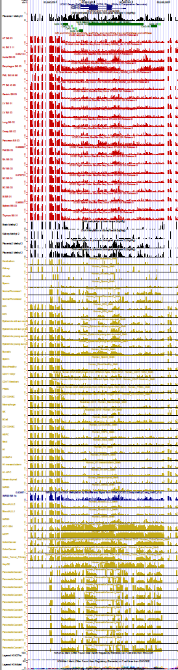
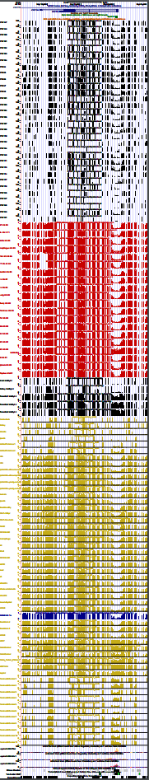
Tissue specific MHB regions and its performance in cancer distinguish
DMRTA2 (ESO)
ZNF154 (colon)
We tissue specific MHBs and these MHB showed highly specificity in difference tissues and these regions showed low methylation in blood cell types. We found these MHBs were also show high level MHL in tumor tissues.
Esophogus
Normal
Tissue
Placental
ZNF154 have been reported in the previous study to be promising methylation biomarker for Pan-cancers (Margolin G, 2016)
DMRTA2 is firstly shown as highly Esophagus specific hyper-methylation.
Colon
Blood
Provide a supplementary with most powerful
Tissue specific MHB regions so that they could be taken as reference for each tissue for further biomarker/mapping research.
Cancers

Slide 7
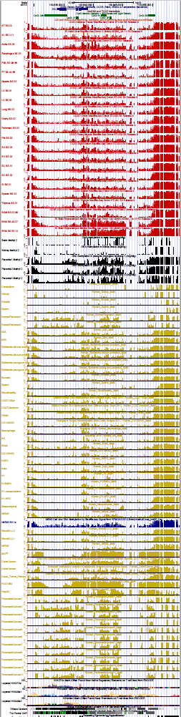
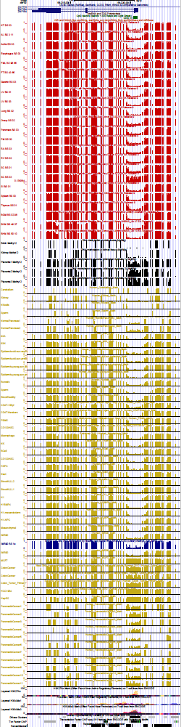
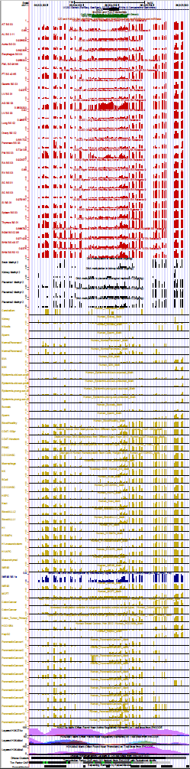
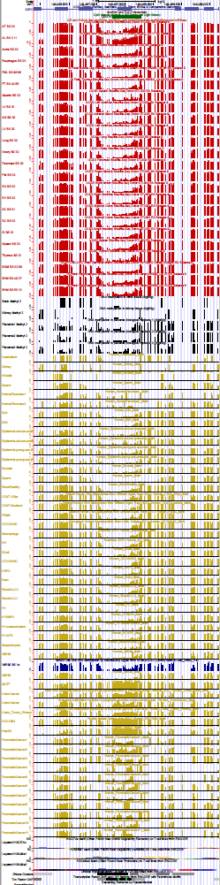
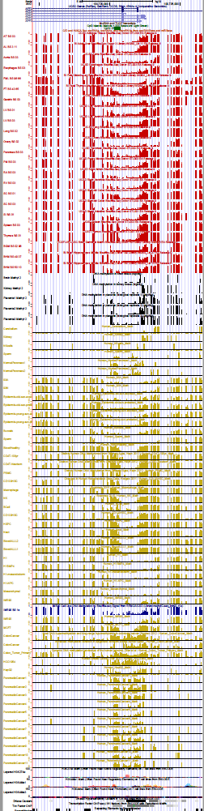
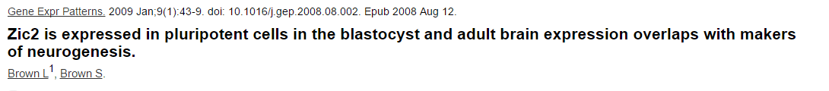
Gold standard tissue specific DNA methylation regions
ZIC2 (Brain)
ZNF154 (colon)
RHOD (Kidney)
SSPO (Liver)
AFF3 (WBC)
Brain
Placental
Tissue specific methylation regions could be up to 2K bp
Genomic flanking regions of MHL have similar methylation profile (since linkage)

Slide 8
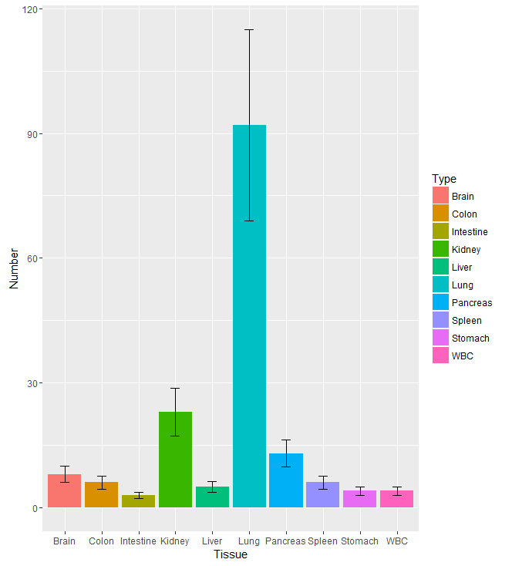
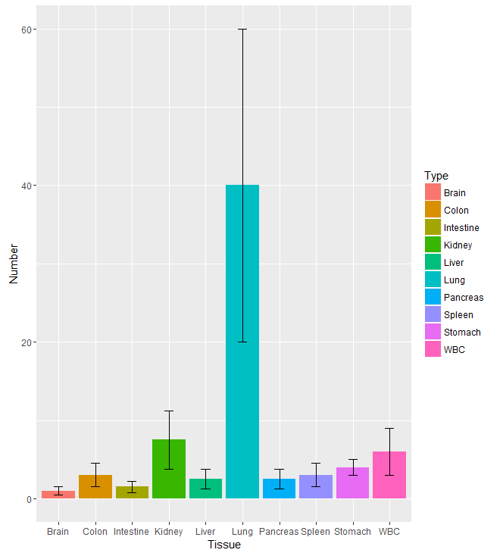
Validation our model with other dataset and estimate is advantage to solid tissue
Xliu2014’s dataset (WGBS: 5 lung cancer vs 5 normal lung)
Cancer
Normal
With our mapping model, 100% solid tissue samples will be mapping to Lung tissue. Meanwhile, we can observe the roles of hyper-methylated regions could separate cancer and normal tissues.
Notes:
We downloaded the fastq, make the alignment and then get the hapinfo and corresponding methylation haplotype load matrix and with our tissue-of-origin mapping model, we can try to predict which kind of tissue it is

Slide 9
Apply tissue-of-origin mapping to metastasis cancers
Holger2016’s dataset (11 primary tumors, 2 metastases)
GSI | TYPE | # Tissue-of-Origin | OTHER | Feature1 | Feature2 | Feature3
 |  | Fragment
GSM1279516 | Brain_white matter | 30 | <6 | Normal | sample type: Primary | Brain_W
GSM1279517 | Breast_normal | 32 | <11 | Normal | sample type: Primary | Breast
GSM1279518 | Blood_B-cells_CD19 | 41 | <9 | Normal | sample type: Primary | CD19
GSM1279519 | Colon_normal | 61 | <16 | Normal | sample type: Primary | Colon
GSM1279520 | Colon_metastasis | Colon(79): Liver(58) | <58 | Metastasis | sample type: Primary | Colon_M
 |  |  | (58 Liver)
GSM1279521 | Colon_cancer | Colon(45) | <7 | Cancer | sample type: Primary | Colon
GSM1279522 | Lung_H1437 | 106 | <12 | Adenocarcinoma | sample type: Cell line | H1437
GSM1279523 | Lung_H157 | 98 | <5 | Squamous cell cancer | sample type: Cell line | H157
GSM1279524 | Lung_H1672 | 110 | <22 | Small cell lung cancer | sample type: Cell line | H1672
GSM1279527 | Lung_normali | 42 | <5 | Normal | sample type: Primary | Lung
GSM1279532 | Brain_U87MG | 70 | <15 | Glioma | sample type: Cell line | U87MG
GSM1279514 | BREAST-Cancer | 52 | <13 | Breast Cancer | sample type: Cell line | RREAST
GSM1279513 | BREAST_metastasis | Breast(46): Lung (24) | <24 | Metastasis | sample type: Cell line | BREAST_M
 |  |  | (24 Lung)
Quite interesting metastatic samples have more heterogeneity and own some other tissue's characteristics

Slide 10
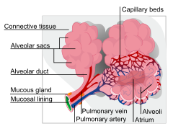
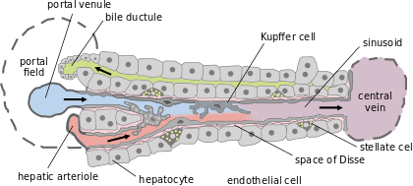
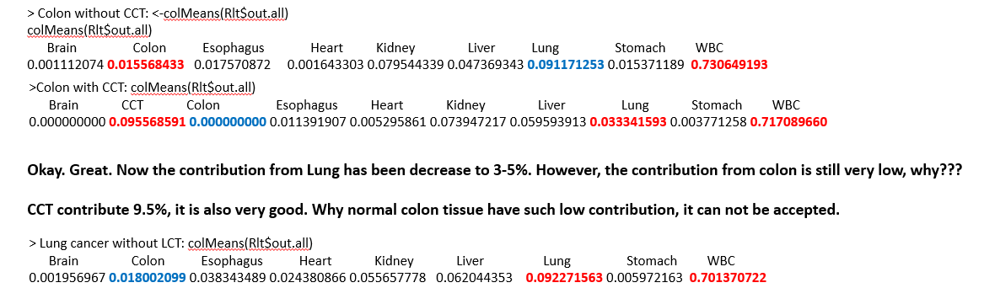
Future work
Single Cell Methylome for Human Lung or Liver?
Human Tissues Are tremendous Cell Mixture
Bronchioles and alveoli epithelial cells, smooth muscle cells (40+ different kinds cells)
Liver: 60% hepatocyte and 40% other cells
1, Sparse dataset for plasma RRBS
2, Reference is not clear
3, Reference is actually mixtures
Notes:
the respiratory tract uses approximately 40 different resident cell types (Table 1)

Slide 11
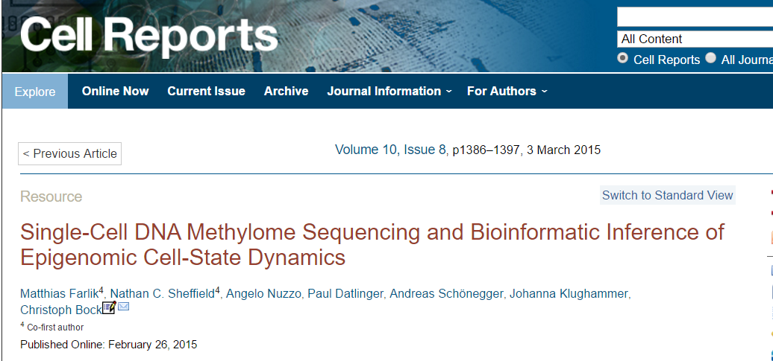
Future work
Single cell methylome technique has been reported.
ESC

Slide 12
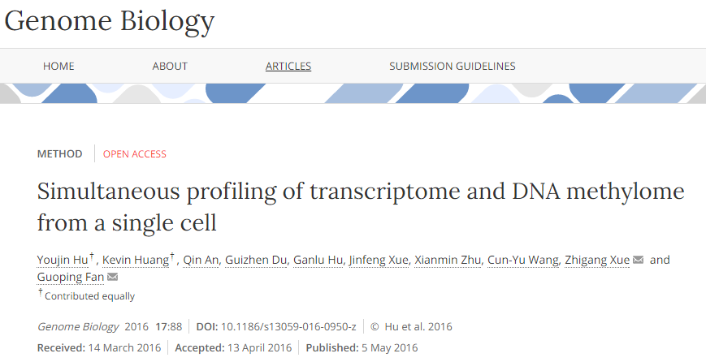
Future work
sensory neurons

Slide 13
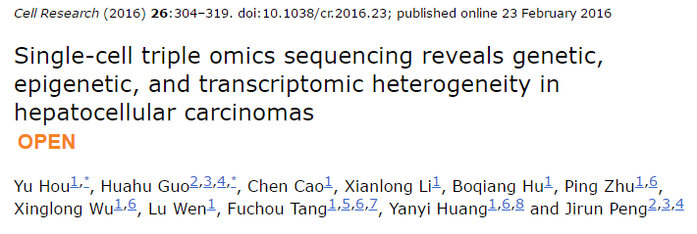
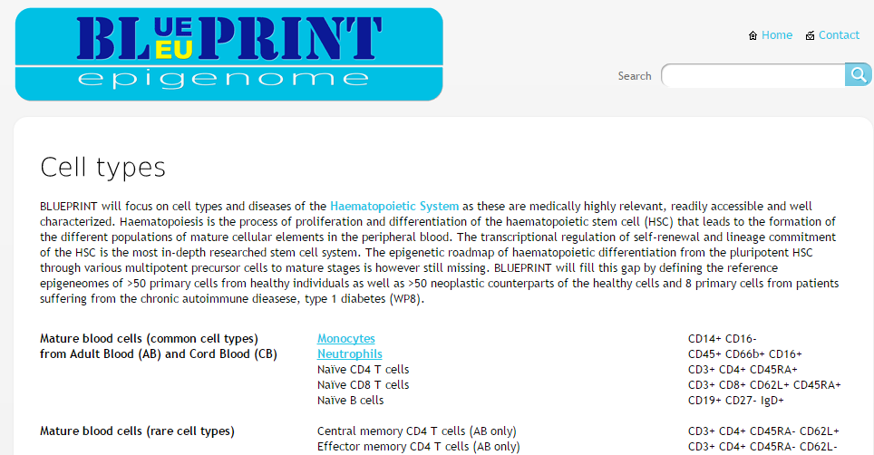
Liver Cancer scRRBS： With scRRBS and only in HCC, not in normal liver
BLUE Print Project: only focus on cell types of the Haematopoietic System

Slide 14
Thanks

Slide 15
Future work
Twin’s Data: What can we do:
1, collected all the twin’s methylation data
2, Validate previous conclusion
3, Do more inference and validate with more other data
4, Deconvolution ??

Slide 16
Yes. It is what I am thinking about.
1, to try different deconvolution method and compare them
3, to try take single-cell RNA-seq (our science paper) of brain for neurogenic disease

