Slide 1
Deconvolution Analysis to Plasma Methylome

Slide 2
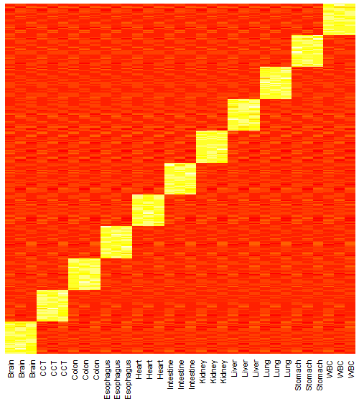
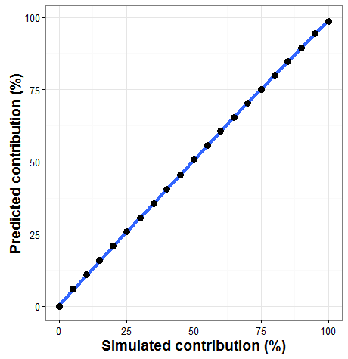
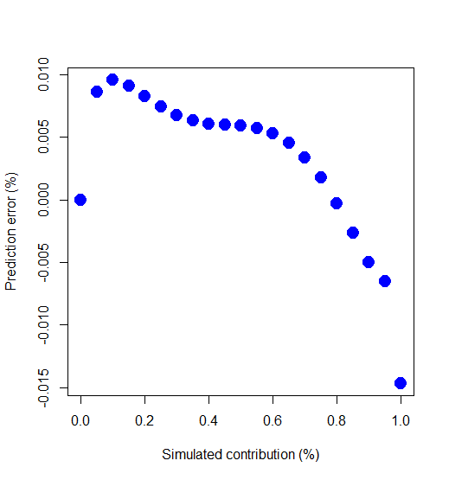
Simulation 1. 20 tsMHL for 11 tissues with normal distribution (2 component)
Decovolution mixture by 2 component with gradient
Logit transform data preprocessing.
11 tissue, 20 tissue specific MHL for each tissue.
Mixture cancer primary tissue with WB
R-sequre=0.99
Abs(error) < 1.5%
Notes:
library("DeconRNASeq")
k=11 # 11 reference tissue
s=3 # each tissue own 3 samples
p=30 # number of tissue specific probe for each tissue
signatures<-c()
tissue=c("Brain","CCT","Colon","Esophagus","Heart","Intestine","Kidney","Liver","Lung","Stomach","WBC")
signatures<-abs(matrix(rnorm(p*k*s,0.1,0.1),p*k,k*s))
for(i in 1:k){
signatures[(p*(i-1)+1):(p*i),(s*(i-1)+1):(s*i)]=matrix(rnorm(p*s,0.9,0.1),p,s)
}
signatures[signatures>1]<-1
colnames(signatures)=rep(tissue,each=3)
rownames(signatures)=paste("cg00",1:nrow(signatures),sep="")
barplot(colMeans(signatures))
barplot(rowMeans(signatures))
heatmap(signatures,Rowv=NA,Colv=NA)
? heatmap
gsi<-data.frame(GSI(signatures))
group<-as.character(unique(gsi$group))
# tissue specific MHL selectin
rlt<-c()
rank<-c(rep(20,length(group)))
for (i in 1:length(group)){
subset=gsi[which(gsi$group==group[i]),]
subset=subset[order(subset[,3],decreasing=T)[1:rank[i]],]
rlt<-rbind(rlt,subset)
}
# prepare signatures for QR
signaturesQR<-AverageWithGroup(signatures) # QR
# prepare signatures for cibersort
signaturesCS<-(signatures) # QR
# Simulation mixture for 2 componment
VirtualMatrix<-c()
for(F1 in seq(0,1,by=0.05)){
VirtualSample<-F1*(signaturesQR[,grep("CCT",colnames(signaturesQR))])+(1-F1)*(signaturesQR[,grep("WB",colnames(signaturesQR))])
VirtualMatrix<-cbind(VirtualMatrix,VirtualSample)
}
VirtualMatrix<-data.frame(VirtualMatrix)
colnames(VirtualMatrix)=paste("VM",seq(0,1,by=0.05),sep="")
dim(VirtualMatrix)
DeconData<-data.frame(VirtualMatrix,signaturesQR)
VirtualMatrix=data.frame(DeconData[,grep("VM",colnames(DeconData))])
Signatures=data.frame(DeconData[,-grep("VM",colnames(DeconData))])
library("car")
library("DeconRNASeq")
plot(density(as.numeric(unlist(VirtualMatrix))))
plot(density(as.numeric(unlist(logit(VirtualMatrix)))))
VirtualMatrix=logit(VirtualMatrix)
Signatures=logit(Signatures)
Rlt<-DeconRNASeq(VirtualMatrix, Signatures,checksig=FALSE,known.prop = F, use.scale = TRUE, fig = TRUE)
rlt<-Rlt$out.all
output<-data.frame(CCTInput=seq(0,1,by=0.05),rlt)
plot(output[,1],output[,3])
lines(x = c(0,1), y = c(0,1))
plot(output[,1],output[,3]-output[,1],xlab="Simulated contribution (%)",ylab="Prediction error (%)",pch=19,cex=2,col="blue",lty=2)
# Figure parepartion
library("ggplot2")
Fig<-data.frame(seq(0,1,by=0.05),Rlt$out.all[,grep("CCT",colnames(Rlt$out.all))],Rlt$out.all[,grep("WB",colnames(Rlt$out.all))])
colnames(Fig)<-c("Simulated","CCT","WB")
Fig<-100*Fig
c <- ggplot(Fig, aes(Simulated,CCT))
c <- c + xlab("Simulated contribution (%)")+ylab("Predicted contribution (%)")
c <- c + stat_smooth(se = TRUE,n=10,size=1.5) + geom_point(size=3)
c <- c + stat_smooth(se = TRUE,n=10,size=1.5) + geom_point(size=3)
c <- c + theme_bw()
c <- c + theme(axis.text=element_text(size=10), axis.title=element_text(size=14,face="bold"))
print(c)
ggsave(c,file="coloncancer-deconvolution.simultaion-2.pdf")
abline()

Slide 3
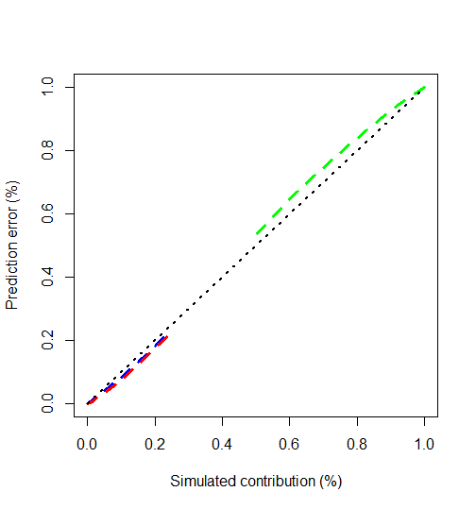
Simulation 1. 20 tsMHL for 11 tissues with normal distribution (3 component)
P(CCT)= P(Colon)
P(WBC)=1-P(CCT)-P(Colon)
Here, MHL is simulated with binomial distribution (next slide is real MHL)
Decovolution mixture by 3 component with gradient
11 tissue, 20 tissue specific MHL for each tissue.
Mixture cancer primary tissue, normal colon, WB
R-sequre > 0.99
Abs(error) < 1.0%

Slide 4
Real data simulation: 100 tsMHL for 11 tissues with different gradient(3 component)
 | CCTInput | Brain | CCT | Colon | Esophagus | Heart | Intestine | Kidney | Liver | Lung | Stomach | WBC
1 | 0 | 0 | 0 | 0 | 0 | 0 | 0 | 0 | 0 | 0 | 0 | 1
2 | 0.05 | 0 | 0.021608 | 0.026752 | 0 | 0 | 0 | 0 | 0 | 0 | 0 | 0.95164
3 | 0.1 | 0 | 0.043057 | 0.049231 | 0 | 0 | 0 | 0 | 0 | 0 | 0 | 0.907712
4 | 0.15 | 0 | 0.06457 | 0.070375 | 0 | 0 | 0 | 0 | 0 | 0 | 0 | 0.865055
5 | 0.2 | 0 | 0.086469 | 0.091229 | 0 | 0 | 0 | 0 | 0 | 0 | 0 | 0.822301
6 | 0.25 | 0 | 0.109004 | 0.112326 | 0 | 0 | 0 | 0 | 0 | 0 | 0 | 0.77867
7 | 0.3 | 0 | 0.132363 | 0.13399 | 0 | 0 | 0 | 0 | 0 | 0 | 0 | 0.733646
8 | 0.35 | 0 | 0.156694 | 0.156443 | 0 | 0 | 0 | 0 | 0 | 0 | 0 | 0.686863
9 | 0.4 | 0 | 0.182106 | 0.179841 | 0 | 0 | 0 | 0 | 0 | 0 | 0 | 0.638053
10 | 0.45 | 0 | 0.208678 | 0.204298 | 0 | 0 | 0 | 0 | 0 | 0 | 0 | 0.587025
11 | 0.5 | 0 | 0.236454 | 0.229888 | 0 | 0 | 0 | 0 | 0 | 0 | 0 | 0.533658
12 | 0.55 | 0 | 0.26545 | 0.256653 | 0 | 0 | 0 | 0 | 0 | 0 | 0 | 0.477898
13 | 0.6 | 0 | 0.295641 | 0.284601 | 0 | 0 | 0 | 0 | 0 | 0 | 0 | 0.419757
14 | 0.65 | 0 | 0.326971 | 0.313711 | 0 | 0 | 0 | 0 | 0 | 0 | 0 | 0.359318
15 | 0.7 | 0 | 0.359348 | 0.343931 | 0 | 0 | 0 | 0 | 0 | 0 | 0 | 0.296721
16 | 0.75 | 0 | 0.392648 | 0.375188 | 0 | 0 | 0 | 0 | 0 | 0 | 0 | 0.232164
17 | 0.8 | 0 | 0.426729 | 0.407398 | 0 | 0 | 0 | 0 | 0 | 0 | 0 | 0.165873
18 | 0.85 | 0 | 0.461446 | 0.440485 | 0 | 0 | 0 | 0 | 0 | 0 | 0 | 0.098069
19 | 0.9 | 0 | 0.496687 | 0.474422 | 0 | 0 | 0 | 0 | 0 | 0 | 0 | 0.028891
20 | 0.95 | 0 | 0.515064 | 0.484936 | 0 | 0 | 0 | 0 | 0 | 0 | 0 | 0
21 | 1 | 0 | 0.521327 | 0.478673 | 0 | 0 | 0 | 0 | 0 | 0 | 0 | 0
11 tissue, 100 tissue specific MHL for each tissue.
Mixture cancer primary tissue and WB
R-sequre > 0.98
Abs(error) < 5.0%

Slide 5
Colon cancer Plasma
Lung cancer Plasma
Normal Plasma
? Whether lung reference wrong??
Replace lung reference one by one, still contribute 20%
Ok then do deconvolution for lung tissue
Brain Colon Esophagus Heart Intestine Kidney Liver Stomach WBC
0.00638 0.00000 0.13871 0.28910 0.04010 0.02142 0.00540 0.07535 0.42354
Lung tissue and heart contaminate? Try some other tissue, such as kidney
colMeans(Rlt$out.all)
Brain Colon Esophagus Heart Intestine Liver Lung Stomach WBC
0.0867 0.0668 0.1115 0.4563 0.0470 0.0248 0.0744 0.0359 0.0966
Deconvolution to heart tissue
> colMeans(Rlt$out.all)
Brain Colon Esophagus Intestine Kidney Liver Lung Stomach WBC
0.1319 0.0000 0.1954 0.0000 0.2465 0.0808 0.2640 0.0813 0
Lung tissue have highly heterogeneity and own signals from WBC and heart.

Slide 6
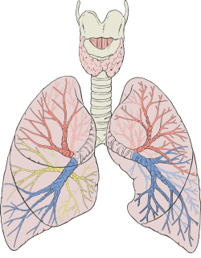
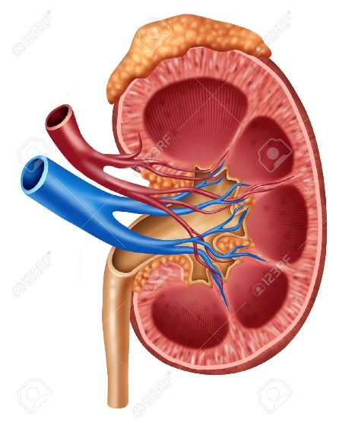
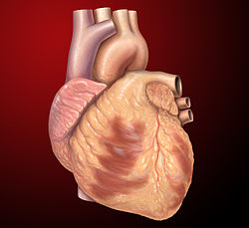
colMeans(Rlt$out.all)
Brain Colon Esophagus Heart Intestine Kidney Liver Stomach WBC
0.00638 0.00000 0.13871 0.28910 0.04010 0.02142 0.00540 0.07535 0.42354
colMeans(Rlt$out.all)
Brain Colon Esophagus Heart Intestine Liver Lung Stomach WBC
0.0867 0.0668 0.1115 0.4563 0.0470 0.0248 0.0744 0.0359 0.0966
> colMeans(Rlt$out.all)
Brain Colon Esophagus Intestine Kidney Liver Lung Stomach WBC
0.1319 0.0000 0.1954 0.0000 0.2465 0.0808 0.2640 0.0813 0

Slide 7
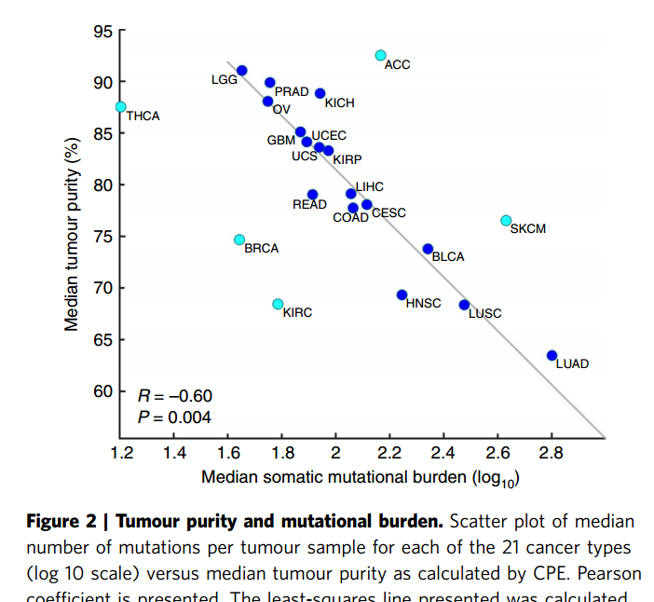
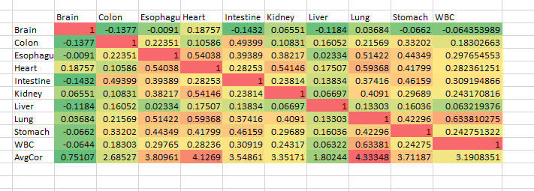
Correlation between different tissues
Lung and Heart have largest correction with other tissues, indicating they are highly mixture organ
Aran, Dvir, Marina Sirota, and Atul J. Butte. "Systematic pan-cancer analysis of tumour purity." Nature communications 6 (2015).

Slide 8
1, How about only appling NT, CT and WB as the reference?
Great. Fix it ! Combine all other tissues as OTH, I think colinearity will cause our previous problem. That means in the future PCA decomposition tissues to independent cell-type composition will be a good choice to do deconvolution.
COLON CANCER PLASMA:
Colon Cancer: TOP30TSI<-colMeans(Rlt$out.all)
CCT Colon OTH WBC
0.1153 0.0287 0.0386 0.8174
Lung Cancer: TOP5TSI<-colMeans(Rlt$out.all)
LCT Lung OTH WBC
[1,] 0.094884 0.0503 0.0262 0.829
2, How about deconvoltion of cancer plasma with normal plasma as the reference (without cancer tissue) ?
Lung<-colMeans(Rlt$out.all)
Brain Colon Esophagus Heart Intestine Kidney Liver Lung NCP Stomach
0.033415 0.003560 0.000285 0.065979 0.026837 0.000000 0.057508 0.098485 0.696444 0.017487
Colon > colMeans(Rlt$out.all)
Brain Colon Esophagus Heart Intestine Kidney Liver Lung NCP Stomach
0.03543 0.01723 0.00301 0.02091 0.01089 0.01046 0.04366 0.04554 0.77824 0.03464

Slide 9
2, How about de-convoltion of normal plasma with normal plasma as the reference (without cancer tissue) ?
Lung cancer plasma<-colMeans(Rlt$out.all)
Brain Colon Esophagus Heart Intestine Kidney Liver Lung Stomach WBC
0.00340 0.00221 0.00000 0.03665 0.03302 0.03826 0.07518 0.22762 0.00257 0.58109
Colon cancer plasma <- colMeans(Rlt$out.all)
Brain Colon Esophagus Heart Intestine Kidney Liver Lung Stomach WBC
0.00154 0.00329 0.00000 0.00329 0.02109 0.06930 0.05008 0.16205 0.02354 0.66582
Normal<- colMeans(Rlt$out.all)
Brain Colon Esophagus Heart Intestine Kidney Liver Lung Stomach WBC
0.004 0.014 0.021 0.000 0.013 0.033 0.027 0.239 0.001 0.649

Slide 10
So it looks like many data sets from solid human tissues might contain some blood signatures, which is expected because these tissues all contain blood vessels and blood cells. Therefore, in selecting tissue-specific MHBs, perhaps we need a more stringent requirement that the informative MHBs for all the solid tissues should have zero or near zero MHL in the WB samples.
Quite right. It’s great idea. I update the Tissue-specific MHL selection strategy and add this criterion into the code. (MHL<0.05 in WBC)
> Colon without CCT: <-colMeans(Rlt$out.all)
colMeans(Rlt$out.all)
Brain Colon Esophagus Heart Kidney Liver Lung Stomach WBC
0.001112074 0.015568433 0.017570872 0.001643303 0.079544339 0.047369343 0.091171253 0.015371189 0.730649193
>Colon with CCT: colMeans(Rlt$out.all)
Brain CCT Colon Esophagus Heart Kidney Liver Lung Stomach WBC
0.000000000 0.095568591 0.000000000 0.011391907 0.005295861 0.073947217 0.059593913 0.033341593 0.003771258 0.717089660
Okay. Great. Now the contribution from Lung has been decrease to 3-5%. However, the contribution from colon is still very low, why???
CCT contribute 9.5%, it is also very good. Why normal colon tissue have such low contribution, it can not be accepted.
> Lung cancer without LCT: colMeans(Rlt$out.all)
Brain Colon Esophagus Heart Kidney Liver Lung Stomach WBC
0.001956967 0.018002099 0.038343489 0.024380866 0.055657778 0.062044353 0.092271563 0.005972163 0.701370722
(MHL<0.01 in WBC), what a pity, none feature were selected out.
Notes:
#!/bin/csh
#PBS -N test
#PBS -q pdafm
#PBS -l nodes=1:ppn=1
#PBS -l walltime=14:00:00
#PBS -o test
#PBS -e test
#PBS -V
#PBS -M shihcheng.guo@gmail.com
#PBS -m abe
#PBS -A k4zhang-group
Rscript --vanilla /home/shg047/oasis/monod/hapinfo/lungcancer.updateGSI.withoutLCT.R

Slide 11
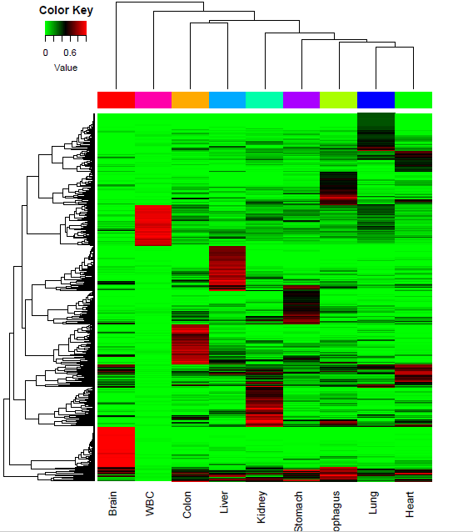
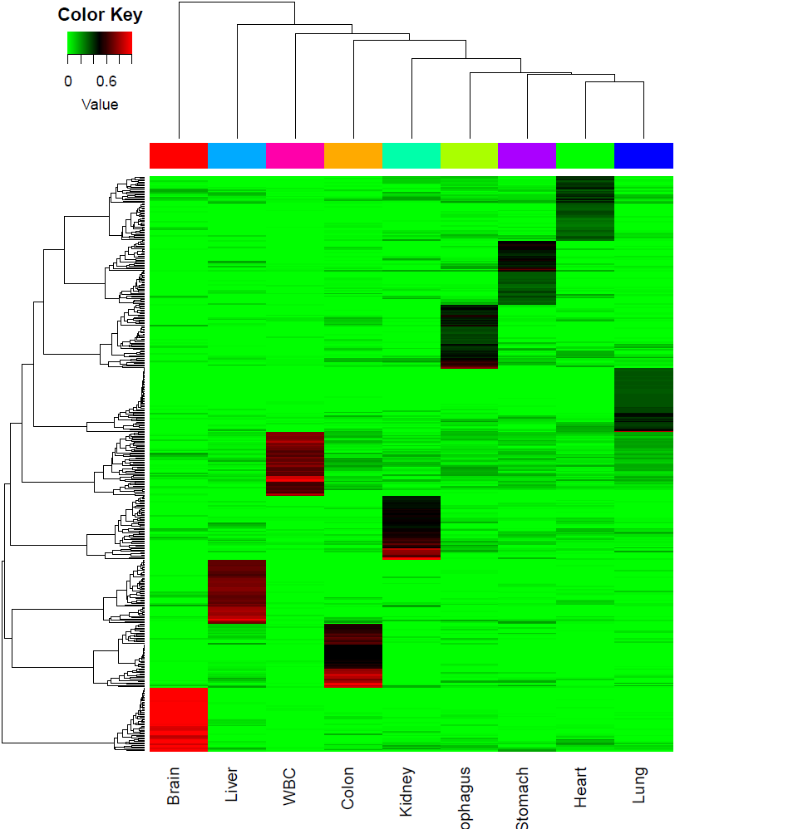
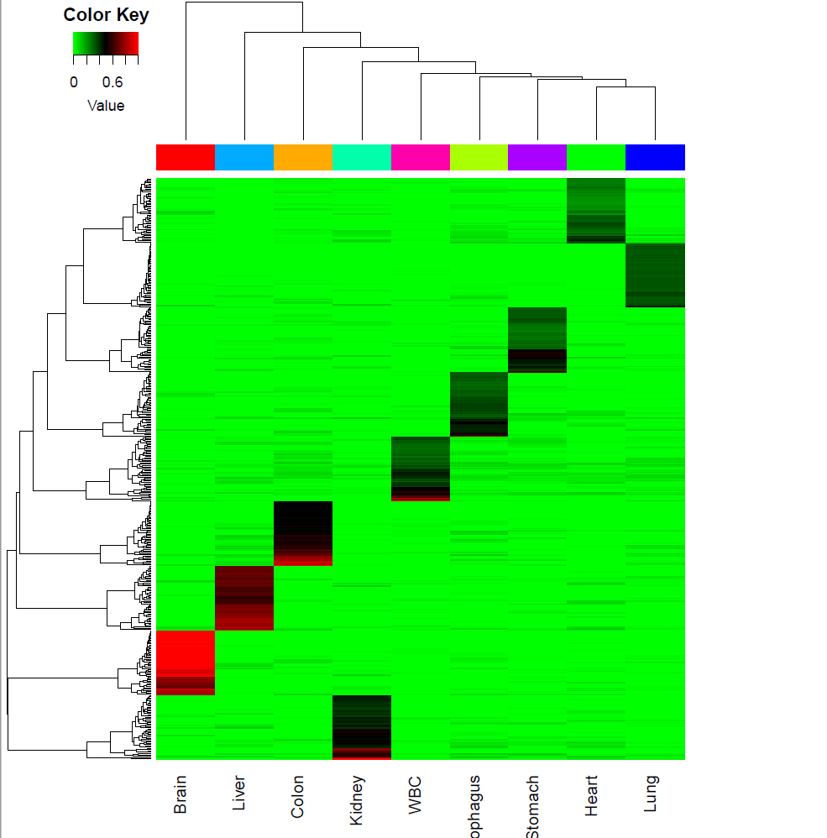
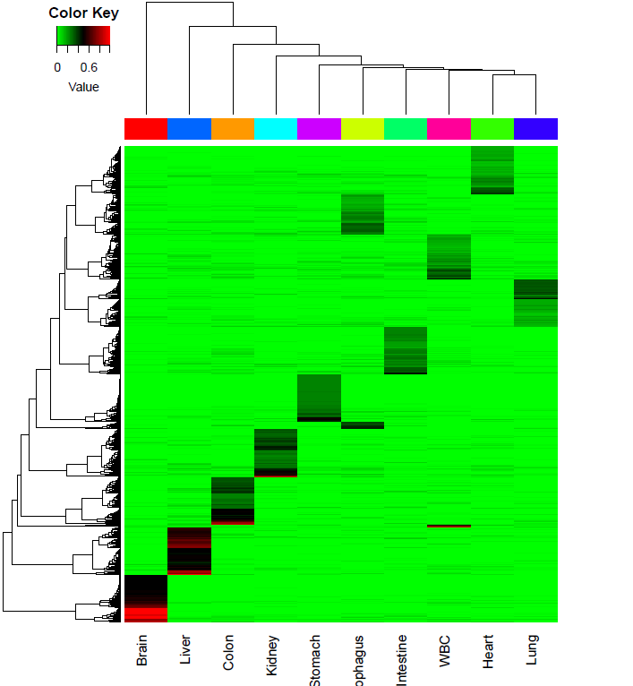
Previous features
MHL<0.2
MHL<0.1

Slide 12
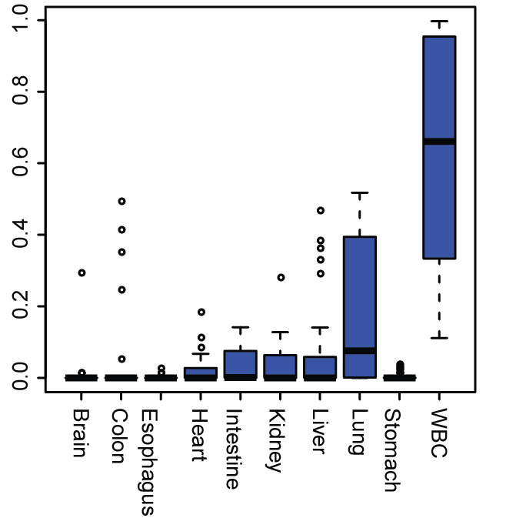
Normal Plasma Deconvolution
 | Contribution
Brain | 0.005913466
Colon | 0.031099806
Esophagus | 0.00030414
Heart | 0.018507674
Intestine | 0.036953873
Kidney | 0.031199878
Liver | 0.051782279
Lung | 0.191508989
Stomach | 0.002584207
WBC | 0.630145688

Slide 13
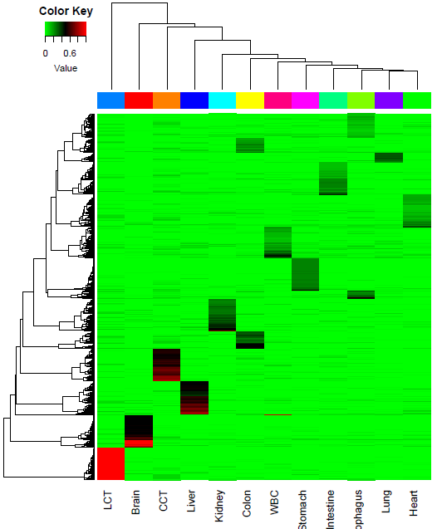
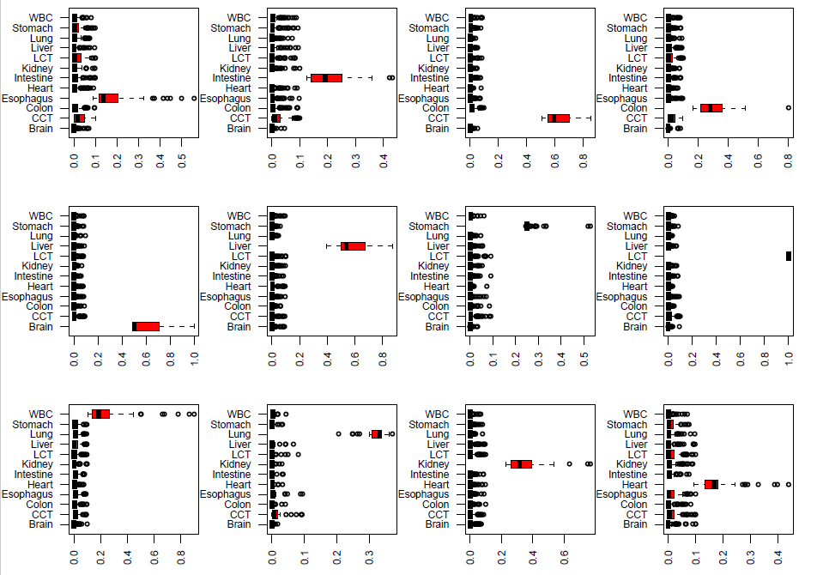

Slide 14
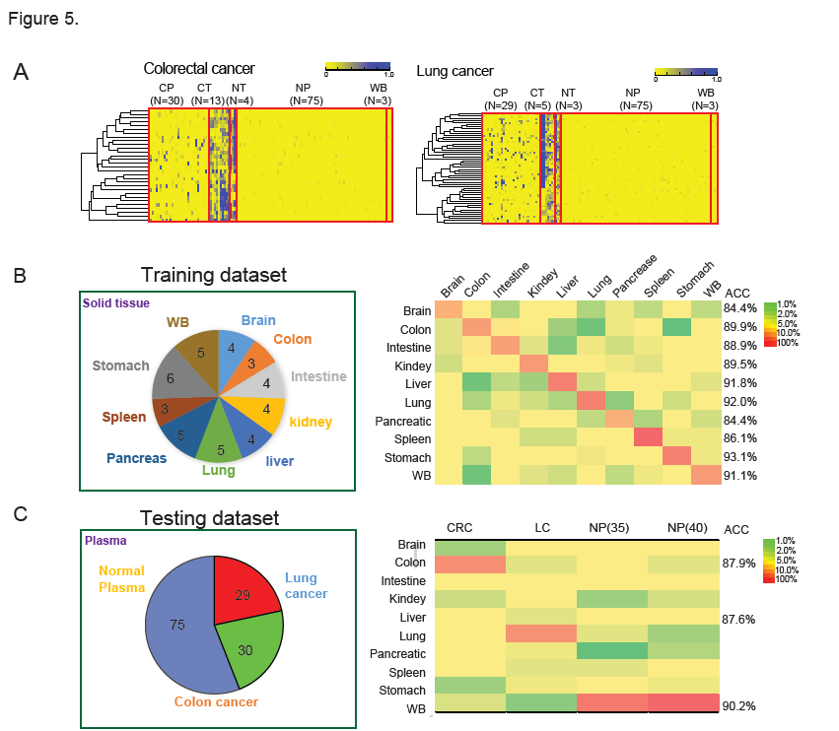
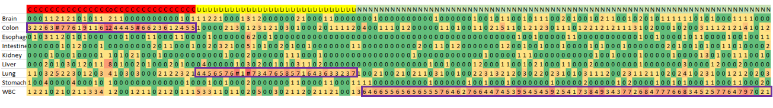
Unknow Plasma Mapping based on Tissue-specific MHB Fragment Load
1, increase/decrease the specificity
2, decreasing missing proportion (30%->10%)
3, require WBC <0.1
4, increase difference between tissues
5, sparse matrix
……………
Random Forest Model
1090 tissue specific MHBs
Tissue-specific MHB fragment load
Maximum：
Sensitivity: 39.8%
Sensitivity: 42.3%
Specificity: 29.6%
Deconvolution
ACC=37.9%
How many ts-MHB fragment in plasma?
Random Forest Model
52 tissue specific MHBs
Random:10%
Sensitivity: 87.9%
Sensitivity: 87.6%
Specificity: 90.2%
Tissue-of-origin could be assigned as the maximum ts-MHBs fragment occurrence
Sensitivity Colon: 86.7%
Sensitivity Lung: 89.7%
Specificity Normal: 92.2%

Slide 15
Unknow Plasma Mapping based on Tissue-specific MHB Fragment Load
Colon Cancer Plasma Lung Cancer Plasma Normal Plasma
Sensitivity Colon: 86.7%
Sensitivity Lung: 89.7%
Specificity Normal: 93.3%
Colon => Intestine
Normal => Liver
Normal => Lung
Lung => Normal
Tissue-specific features: 50 for each tissue
MHL>0.3
Find clinical information to give possible reason
1, Low frequency detection for ts-MHB fragment : Mean=5.16 (10.32%): indicate: 10.32% ts-MHBs could be identified in the plasma for each patients
2, Overlapping detection of ts-MHB fragment: large number of ts-MHBs could be found in Liver, Intestine
Advantage:
1, biomarker and model is explicitly (no sampling process)
2, user friendly.
3, threshold changeable (MHL ? Postive: Negative)
Disadvantage:
1, don’t have cross-validation
2, Still based on reference
Notes:
4, ROC (multi-class, however not monotonous)

Slide 18
Deconvolution to normal plasma with different number of tsMHL

Slide 19
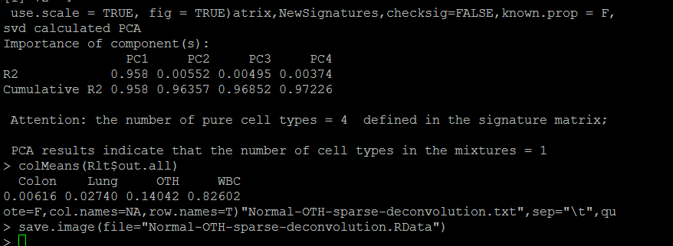
Table S11. Cancer Plasma Deconvolution |  |  |  |  |  |  |  | Colon | Lung | OTH | WBC
 | CT | NT | OTH | WBC |  |  | NCP1 | 0.000299 | 0.009051 | 0.160797 | 0.829853
CCP1 | 0.156 | 0.011 | 0.047 | 0.786 |  |  | NCP2 | 0.011348 | 0 | 0.147975 | 0.840677
CCP2 | 0.101318 | 0.0473 | 0 | 0.851382 |  |  | NCP3 | 0.012542 | 0 | 0.162681 | 0.824777
CCP3 | 0.09514 | 0.020343 | 0.07447 | 0.810047 |  |  | NCP4 | 0 | 0.017943 | 0.157548 | 0.824509
CCP4 | 0.114513 | 0 | 0.105486 | 0.78 |  |  | NCP5 | 0.00122 | 0.028097 | 0.177648 | 0.793035
CCP5 | 0.118086 | 0 | 0.131292 | 0.750622 |  |  | NCP6 | 0.012509 | 0.037376 | 0.126947 | 0.823168
CCP6 | 0.106938 | 0.017583 | 0.020518 | 0.854961 |  |  | NCP7 | 0.003946 | 0.033444 | 0.14943 | 0.81318
CCP7 | 0.093753 | 0.07298 | 0 | 0.833267 |  |  | NCP8 | 0.002157 | 0.029981 | 0.125915 | 0.841947
CCP8 | 0.12744 | 0.056464 | 0.000186 | 0.81591 |  |  | NCP9 | 0 | 0.055325 | 0.111004 | 0.833671
CCP9 | 0.117737 | 0 | 0.080136 | 0.802127 |  |  | NCP10 | 0 | 0.034937 | 0.149739 | 0.815324
CCP10 | 0.0909 | 0.032272 | 0.061139 | 0.815689 |  |  | NCP11 | 0.031129 | 0 | 0.117083 | 0.851787
CCP11 | 0.145032 | 0.024552 | 0.065953 | 0.764463 |  |  | NCP12 | 0.002481 | 0.001181 | 0.172156 | 0.824181
CCP12 | 0.113154 | 0.078066 | 0.063019 | 0.745762 |  |  | NCP13 | 0 | 0 | 0.191455 | 0.808545
CCP13 | 0.10812 | 0 | 0.075067 | 0.816812 |  |  | NCP14 | 0 | 0.049849 | 0.116485 | 0.833666
CCP14 | 0.103221 | 0.031599 | 0.044646 | 0.820534 |  |  | NCP15 | 0 | 0.042156 | 0.141327 | 0.816517
CCP15 | 0.160714 | 0 | 0.097619 | 0.741667 |  |  | NCP16 | 0 | 0.06013 | 0.099209 | 0.84066
CCP16 | 0.067909 | 0.041737 | 0.039871 | 0.850483 |  |  | NCP17 | 0 | 0.069211 | 0.09524 | 0.835549
CCP17 | 0.109355 | 0 | 0.119726 | 0.770918 |  |  | NCP18 | 0 | 0.061499 | 0.144136 | 0.794365
CCP18 | 0.169864 | 0 | 0.114632 | 0.715504 |  |  | NCP19 | 0 | 0.025733 | 0.188651 | 0.785616
CCP19 | 0.152813 | 0 | 0.092793 | 0.754393 |  |  | NCP20 | 0.007806 | 0.002157 | 0.159631 | 0.830406
CCP20 | 0.133774 | 0.056837 | 0.045054 | 0.764335 |  |  | NCP21 | 0 | 0.04029 | 0.129751 | 0.82996
CCP21 | 0.105171 | 0.006578 | 0.037212 | 0.851039 |  |  | NCP22 | 0.004386 | 0.02347 | 0.123382 | 0.848762
CCP22 | 0.109252 | 0.038071 | 0 | 0.852677 |  |  | NCP23 | 0 | 0.057738 | 0.136248 | 0.806014
CCP23 | 0.098423 | 0.042737 | 0.052824 | 0.806015 |  |  | NCP24 | 0.029427 | 0.023662 | 0.101996 | 0.844916
CCP24 | 0.179759 | 0 | 0.155509 | 0.664731 |  |  | NCP25 | 0.016603 | 0.093656 | 0.044048 | 0.845692
CCP25 | 0.110174 | 0.025844 | 0.066247 | 0.797735 |  |  | NCP26 | 9.70E-05 | 0.060501 | 0.125153 | 0.814249
CCP26 | 0.109956 | 0 | 0.022764 | 0.86728 |  |  | NCP27 | 0.026392 | 0 | 0.121015 | 0.852592
CCP27 | 0.109848 | 0.024416 | 0.022427 | 0.84331 |  |  | NCP28 | 0 | 0.020678 | 0.171934 | 0.807388
CCP28 | 0.09708 | 0 | 0.070976 | 0.831944 |  |  | NCP29 | 0 | 0.045627 | 0.123116 | 0.831257
CCP29 | 0.16275 | 0.033 | 0.104234 | 0.700017 |  |  | NCP30 | 0.019531 | 0 | 0.133183 | 0.847285
CCP30 | 0.099947 | 0.018666 | 0.043677 | 0.83771 |  |  | NCP31 | 0 | 0.054216 | 0.120861 | 0.824923
LCP1 | 0.152045 | 0 | 0.043941 | 0.804014 |  |  | NCP32 | 0.021957 | 0.017245 | 0.127622 | 0.833176
LCP2 | 0.215712 | 0 | 0.020221 | 0.764068 |  |  | NCP33 | 0.008211 | 0 | 0.164766 | 0.827024
LCP3 | 0.081784 | 0.015275 | 0 | 0.902941 |  |  | NCP34 | 0.017127 | 0 | 0.155479 | 0.827394
LCP4 | 0 | 0.109816 | 0 | 0.890184 |  |  | NCP35 | 0.021272 | 0.01907 | 0.115557 | 0.844101
LCP5 | 0 | 0.135007 | 0 | 0.864993 |  |  | NCP36 | 0.001602 | 0.025849 | 0.125516 | 0.847032
LCP6 | 0.102382 | 0 | 0 | 0.897618 |  |  | NCP37 | 0 | 0.064372 | 0.113106 | 0.822521
LCP7 | 0.10873 | 0 | 0.051526 | 0.839745 |  |  | NCP38 | 0.011363 | 0 | 0.147278 | 0.841359
LCP8 | 0.06987 | 0 | 0.030949 | 0.899181 |  |  | NCP39 | 0 | 0.020479 | 0.170401 | 0.80912
LCP9 | 0 | 0.145335 | 0 | 0.854665 |  |  | NCP40 | 0 | 0.016798 | 0.157236 | 0.825967
LCP10 | 0.383997 | 0 | 0.251289 | 0.364714 |  |  | NCP41 | 0 | 0.030803 | 0.114024 | 0.855172
LCP11 | 0 | 0.098682 | 0 | 0.901318 |  |  | NCP42 | 0.00498 | 0.018906 | 0.147318 | 0.828795
LCP12 | 0 | 0.079596 | 0 | 0.920404 |  |  | NCP43 | 0 | 0 | 0.201592 | 0.798408
LCP13 | 0.385277 | 0 | 0.23389 | 0.380833 |  |  | NCP44 | 0.001482 | 0.013943 | 0.164356 | 0.820219
LCP14 | 0.18993 | 0 | 0 | 0.81007 |  |  | NCP45 | 0 | 0.014767 | 0.161157 | 0.824076
LCP15 | 0 | 0.099735 | 0 | 0.900265 |  |  | NCP46 | 0 | 0.042468 | 0.131619 | 0.825913
LCP16 | 0 | 0.107667 | 0 | 0.892333 |  |  | NCP47 | 0.033287 | 0.019399 | 0.104494 | 0.84282
LCP17 | 0.526444 | 0 | 0.202769 | 0.270786 |  |  | NCP48 | 0.00857 | 0.036213 | 0.157113 | 0.798103
LCP18 | 0.194906 | 0 | 0.054351 | 0.750743 |  |  | NCP49 | 0.003027 | 0.008889 | 0.167576 | 0.820507
LCP19 | 0.04868 | 0.029544 | 0 | 0.921777 |  |  | NCP50 | 0 | 0 | 0.198914 | 0.801086
LCP20 | 0.166245 | 0 | 0.002114 | 0.831641 |  |  | NCP51 | 0 | 0.041585 | 0.1556 | 0.802815
LCP21 | 0 | 0.049884 | 0 | 0.950116 |  |  | NCP52 | 0 | 0.005675 | 0.191224 | 0.803101
LCP22 | 0 | 0.09612 | 0 | 0.90388 |  |  | NCP53 | 0.01574 | 0.055379 | 0.07698 | 0.8519
LCP23 | 0.140871 | 0 | 0 | 0.859129 |  |  | NCP54 | 0.015988 | 0.058077 | 0.104839 | 0.821096
LCP24 | 0 | 0.038633 | 0 | 0.961367 |  |  | NCP55 | 0.005166 | 0.086709 | 0.096492 | 0.811633
LCP25 | 0.114141 | 0 | 0 | 0.885859 |  |  | NCP56 | 0 | 0.013356 | 0.143296 | 0.843349
LCP26 | 0 | 0.063869 | 0 | 0.936131 |  |  | NCP57 | 0 | 0.029193 | 0.154803 | 0.816004
LCP27 | 0.196825 | 0.008038 | 0 | 0.795137 |  |  | NCP58 | 0.00472 | 0.014726 | 0.161228 | 0.819327
LCP28 | 0 | 0.082136 | 0 | 0.917864 |  |  | NCP59 | 0.016494 | 0.010656 | 0.121701 | 0.851148
LCP29 | 0.387845 | 0 | 0.211878 | 0.400277 |  |  | NCP60 | 0.01112 | 0 | 0.18321 | 0.805671
 |  |  |  |  |  |  | NCP61 | 0.006222 | 0.022681 | 0.123699 | 0.847398
 |  |  |  |  |  |  | NCP62 | 0 | 0.061595 | 0.098229 | 0.840175
 |  |  |  |  |  |  | NCP63 | 0.019789 | 0.063774 | 0.078423 | 0.838013
 |  |  |  |  |  |  | NCP64 | 0.013552 | 0.021351 | 0.138421 | 0.826676
 |  |  |  |  |  |  | NCP65 | 0 | 0.024036 | 0.1446 | 0.831364
 |  |  |  |  |  |  | NCP66 | 0 | 0.027873 | 0.146905 | 0.825221
 |  |  |  |  |  |  | NCP67 | 1.62E-05 | 0 | 0.177936 | 0.822048
 |  |  |  |  |  |  | NCP68 | 0 | 0.048557 | 0.128172 | 0.823271
 |  |  |  |  |  |  | NCP69 | 0 | 0.05592 | 0.139934 | 0.804146
 |  |  |  |  |  |  | NCP70 | 0.006353 | 0.039205 | 0.124993 | 0.82945
 |  |  |  |  |  |  | NCP71 | 0.004737 | 0.03768 | 0.130591 | 0.826993
 |  |  |  |  |  |  | NCP72 | 0 | 0.009139 | 0.161162 | 0.8297
 |  |  |  |  |  |  | NCP73 | 0 | 0.000406 | 0.182565 | 0.817029
 |  |  |  |  |  |  | NCP74 | 0 | 0 | 0.179058 | 0.820942
 |  |  |  |  |  |  | NCP75 | 0.027333 | 0 | 0.136567 | 0.8361
Next we sought to quantify the tumor load based on the deconvolution analysis to the cancer plasma by non-negative decomposition with quadratic programming in plasma.
By comparison of the HMH of cancer plasma based on matched tumor-plasma samples, we would infer the composition of cancer plasma quantitatively. We estimated that a predominant fraction, 79.9% (95% CI:0.764-0.835) in the cancer plasma were contributed by white blood cells, which isWB and consistent with the levels reported in a recent study based on lower-coverage whole genome bisulfite sequencing (69.4%)¹⁶. tPrimary tumor and normal tissue-of-origin contributes with the contribution at the level of 11.9% (95% CI: 9.3%-14.6%) and 3.1% (95% CI:2.1%-4.1%), respectively. . We found this contribution were quite similar with the estimation based on Kun Sun’s study (69.4%)¹⁵. Similar way, weWe also applied the similar analysis to the xx normal plasma samples, and can be estimated that the contribution of the component from WB to normal plasma was about by white blood cells is 82.6% (95% CI: 82.2%-82.9%), while 1.68% (95CI: 1.34%-2.01%) were confidently assigned to the normal solid tissues (lung and colon). Therefore, circulating cell-free DNA contains a relatively stable fraction of molecules released from contribution is about 6.9% which is nearby the situation in cancer plasma indicating the degree of the DNA releasing from the various normal tissues, whereas in cancer patient tumor cells released DNA molecules that can be more abundant than normal tissues is stable and count for a small proportion in the total cell-free circulating DNA (Supp. Table 5,6).

Slide 20
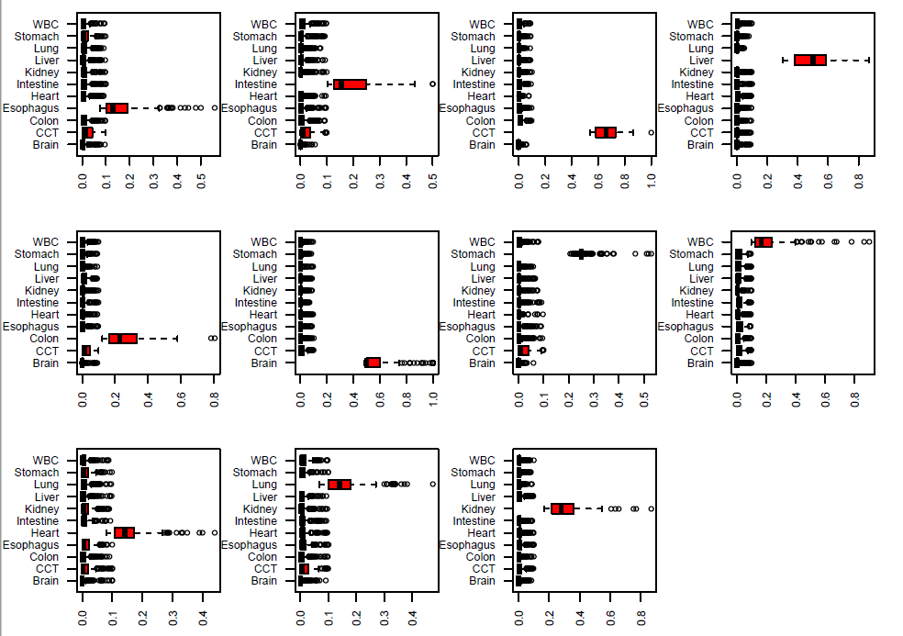
Mixture of CCT and WBC by the proportion from 0% to 50%
 | Brain | CCT | Colon | Esophagus | Heart | Intestine | Kidney | Liver | Lung | Stomach | WBC
CCTmix.0 | 0 | 0.019847 | 0 | 0.011495 | 0.000164 | 0.021862 | 0.007032 | 0.0097 | 0.003031 | 0 | 0.926869
CCTmix.1 | 0 | 0.030354 | 0 | 0.014651 | 0 | 0.023453 | 0.006483 | 0.006344 | 0 | 0 | 0.918714
CCTmix.5 | 0 | 0.071204 | 0.034579 | 0.032769 | 0 | 0.027641 | 0.00907 | 0 | 0 | 0 | 0.824737
CCTmix.10 | 0 | 0.116327 | 0.060918 | 0.045788 | 0.004902 | 0.0391 | 0.023757 | 0 | 0.008719 | 0.006389 | 0.6941
CCTmix.15 | 0.001929 | 0.160146 | 0.073312 | 0.059103 | 0.012127 | 0.043394 | 0.031295 | 0.003667 | 0.015585 | 0.01961 | 0.579832
CCTmix.20 | 0.020154 | 0.174151 | 0.091476 | 0.07485 | 0.015248 | 0.053728 | 0.041442 | 0.00821 | 0.018976 | 0.026839 | 0.474925
CCTmix.25 | 0.024133 | 0.203669 | 0.087981 | 0.078829 | 0.018679 | 0.061681 | 0.047911 | 0.017024 | 0.021328 | 0.034985 | 0.403779
CCTmix.30 | 0.028711 | 0.221089 | 0.106627 | 0.082556 | 0.024361 | 0.063544 | 0.047391 | 0.0146 | 0.035694 | 0.043022 | 0.332405
CCTmix.35 | 0.036967 | 0.227267 | 0.09886 | 0.086374 | 0.029415 | 0.071413 | 0.059522 | 0.022456 | 0.028891 | 0.051819 | 0.287017
CCTmix.45 | 0.035043 | 0.252815 | 0.113377 | 0.092535 | 0.027757 | 0.075837 | 0.061302 | 0.025137 | 0.035481 | 0.063062 | 0.217653
CCTmix.50 | 0.043872 | 0.263035 | 0.11649 | 0.088508 | 0.033814 | 0.077051 | 0.069519 | 0.026246 | 0.035367 | 0.058523 | 0.187574

Slide 22
Conclusion
We try to decomposition of cancer circulating plasma by WBC, primary normal and cancer tissues, we found the WBC were the predominant contributor with ~80% while primary cancer tissue and primary normal tissue contribute 9-11% and 2-5% which is not quite similar between different cancers.
Discussion
When we do reference based deconvolution (different tissues), collinearity problem will cause some bias. This problem does occur in blood deconvolution by difference B and T cells since they are more pure.

