Slide 1
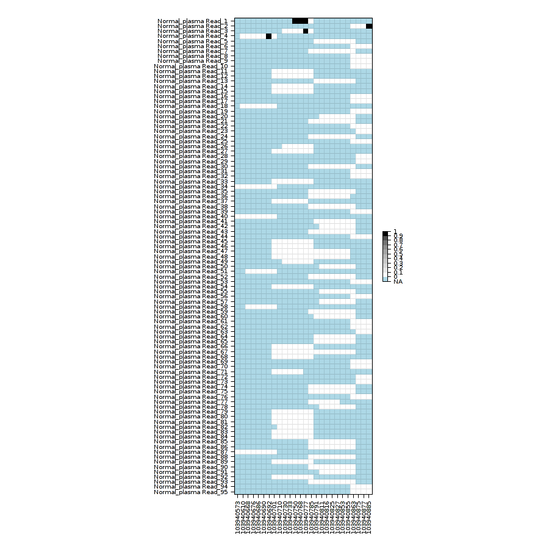
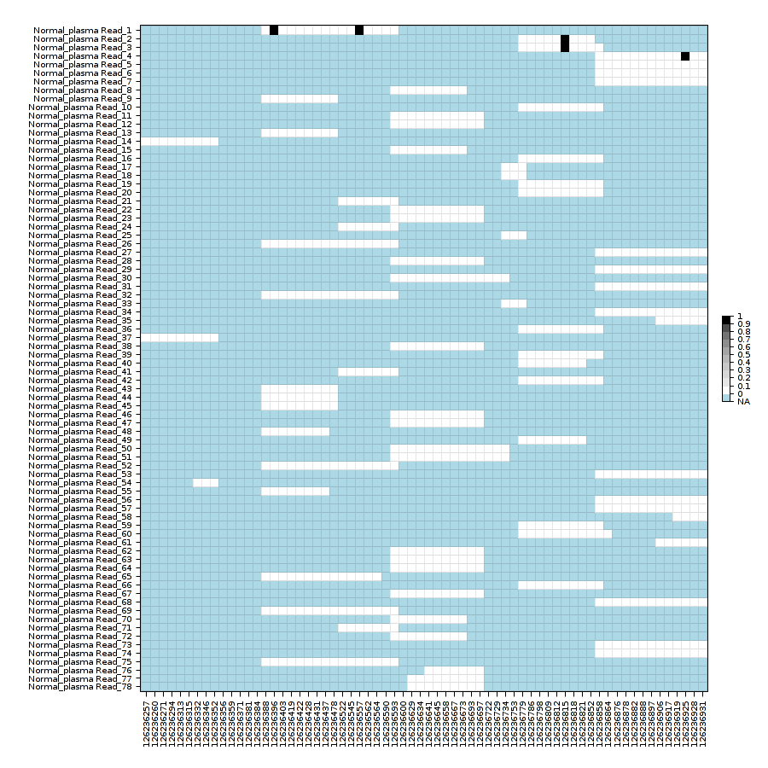
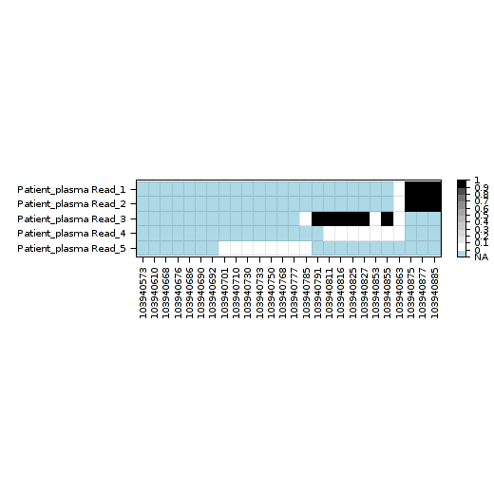
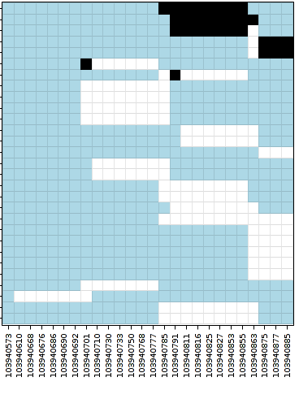
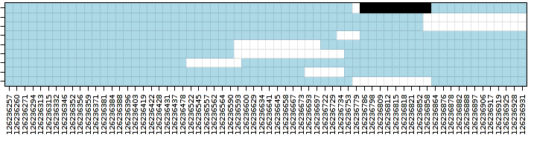
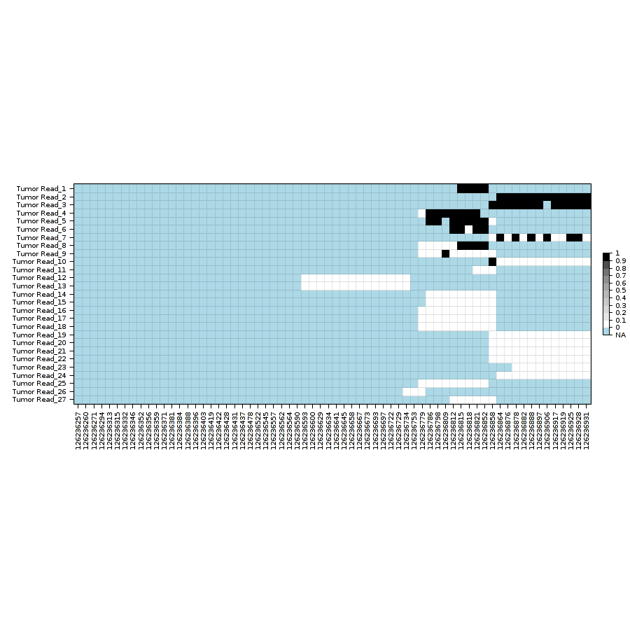
Mixture of the Methylation Haplotype in cancer plasmas
SLC9B1 FAT4
Chr4:103940573-103940885 chr4.126236257-126236931
1, the haplotypes in cancer plasma were exactly mixture from cancer tissues and normal plasma
2, 139 such kinds of regions were identified in 5 paired solid tissue, patients plasma and normal plasma
Upper panel indicates normal plasmas. Middle panel indicate patients plasma. Bottom panel indicate cancer tissue sample.
Black blocks represent methylated CpG. White blocks represent un-methylated CpG. Blue blocks represent missing status.

