Slide 1
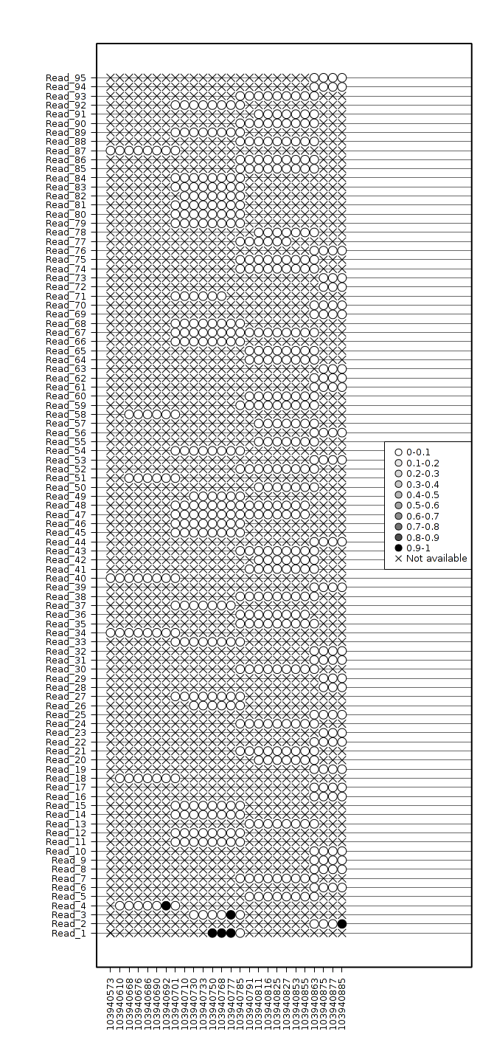
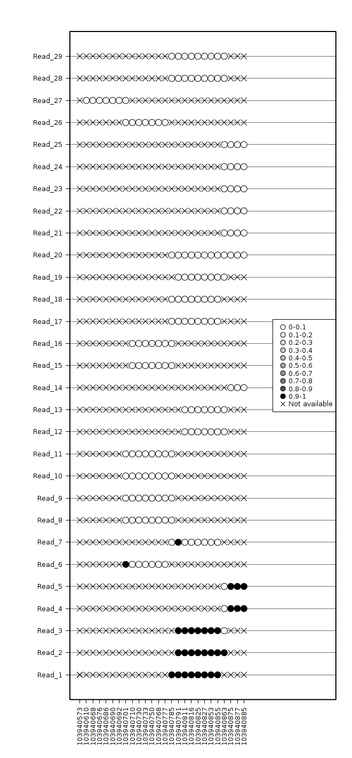
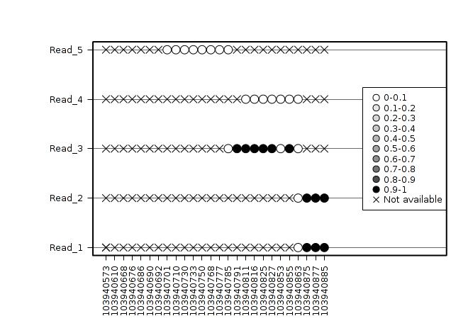
Mixture of the Methylation Haplotype in cancer plasmas
Normal Plasma（26 normal plasma）
Matched Cancer Tissue（6-T-1）
SLC9B1
Chr4:103940573-103940885
Cancer Plasma（6-P-1）
1, the haplotypes in cancer plasma were exactly mixture from cancer tissues and normal plasma
2, 23 such kinds of regions were identified for 6-P-1
3, more regions would be identified after I scan all the matched samples.

