Slide 1
MONOD: Methylation Haplotype in non-invasive Cancer Diagnosis and tissue mapping of plasma DNA
Shicheng Guo @ Zhang Lab
Dec 6 2015
Notes:
Hello, everyone, today I will introduce the progress of the mond project which is shorted for Methylation Haplotype in non-invasive Cancer Diagnosis

Slide 2
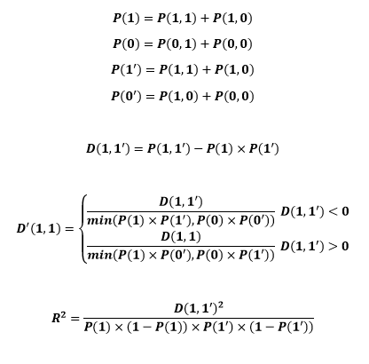
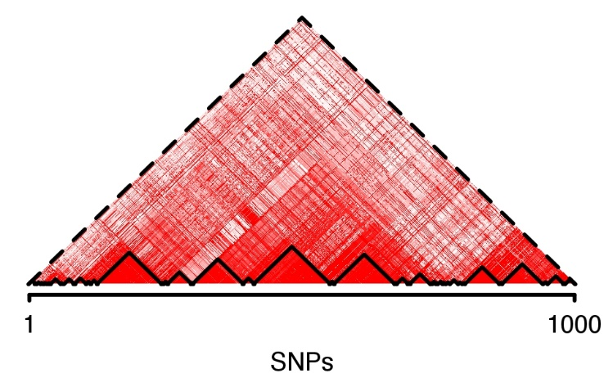
Methylation haplotype block in individual level
 |  | CpG B
 |  | Meth(1) | Unmeth(0)
CpG A | Meth(1) | P(1,1) | P(1,0)
 | Unmeth(0) | P(0,1) | P(0,0)
Bulk BS-Seq data
CTCTCTCTCTCTCTCTCT
CTCTTCTCTTCTCTTCTC
CTCTTTTCTTCTCTTCTT
TTTTTCTTTTCTCTTCTC
CTTTTTTCTTCTCTTCTC
R²
Methylations haplotype blocks

Slide 3
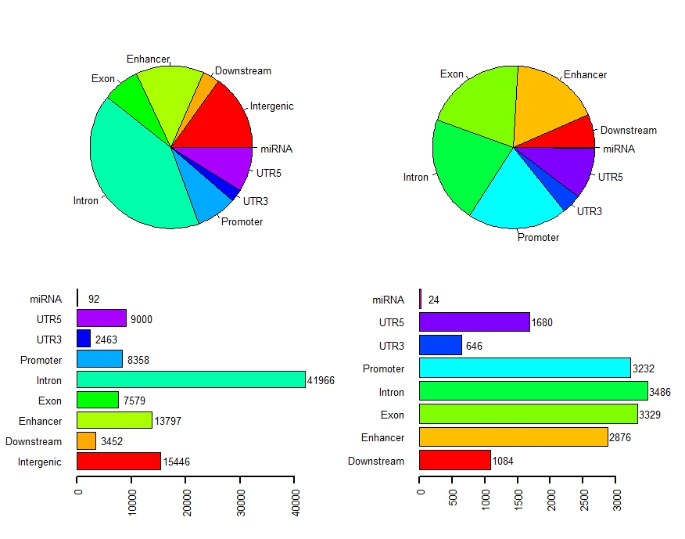
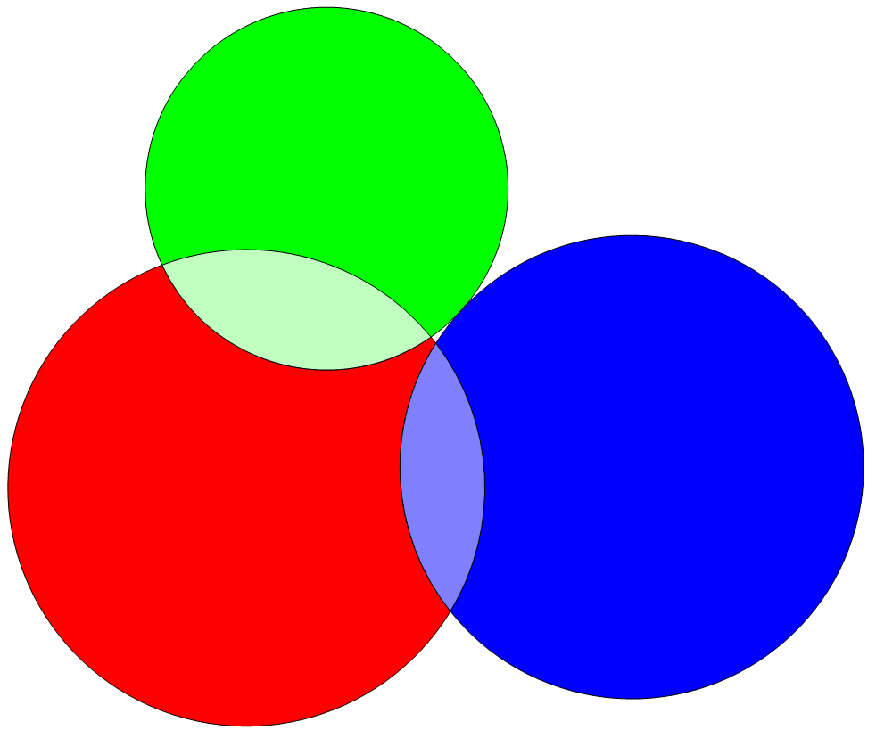
Distribution of Methylation block in human genomics
CpG island
16886
CpG Shore
16164
Methylation block
Methylation blocks widely disperse in human genome, especially in gene regulation and body region.

Slide 4
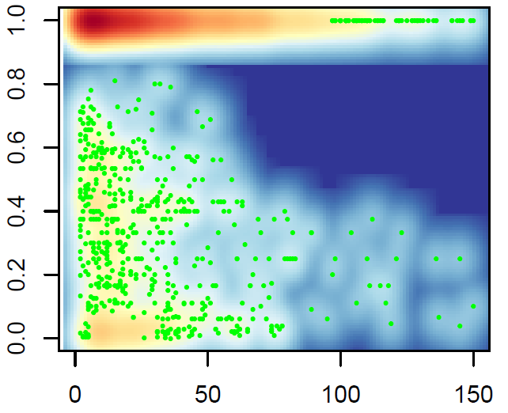
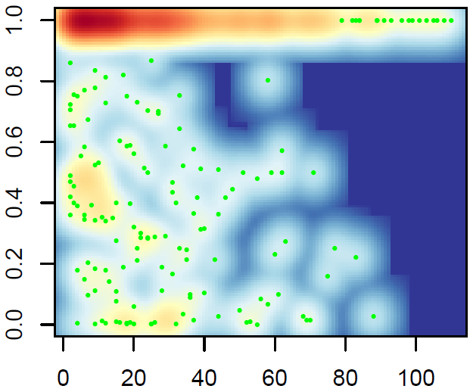
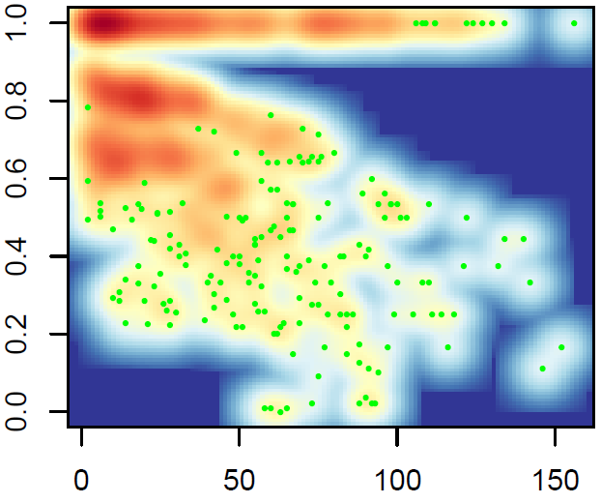
Relationship between R² and Absolute Distance Between Pair-wise CpGs
Coef= -0.00079
P-value= 8.39×10⁻¹³
Coef= -0.0011
P-value=3.4×10⁻³
Coef= -0.0016
P-value<2.0×10⁻¹⁶
Stem cells (H1)
Normal Tissue
Cancer
Linkage disequilibrium (R²) of methylation status between pair-wise CpG loci within the methylation blocks
Linkage disequilibrium (R²) for pair-wised CpG loci within the methylation blocks were calculated. There are two kinds of methylation block in human genomes,
1) low variation within the methylation block (92%)
2) high variation methylation block(8%)
Compared with the R2 decay trend, we can find cancer cells decay stronger than stem cell and normal cells.
In the next slice, we can also find cancer start to decay in nearby neighbor CpGs compared with normal and stem cell

Slide 5
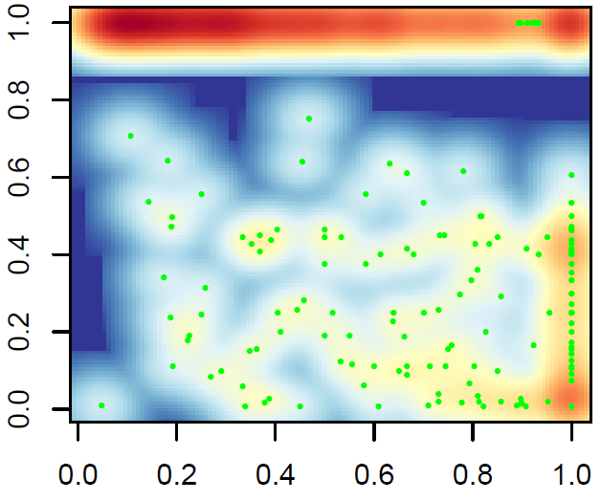
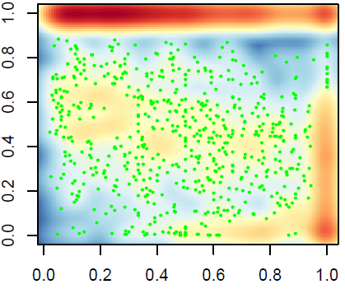
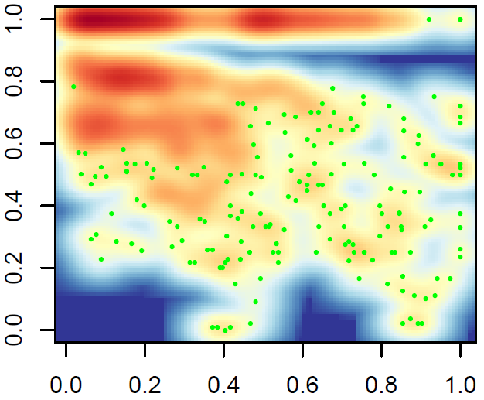
Relationship between R² and Relative Distance Between Pair-wise CpGs
(adjusted by length of MethyBlock)
Coef= -0.43
P-value<2.0×10⁻¹⁶
Coef= -0.25
P-value<2.0×10⁻¹⁶
Coef= -0.51
P-value<2.0×10⁻¹⁶
Stem cells (H1)
Normal Tissue
Cancer
We can find Linkage disequilibrium (R²) begins to decay from very nearby neighbor CpGs therefore the decay coefficient is large than normal and stem cells. In contrast, stem cell and normal seems to decay at far CpGs therefore the decay coefficient is smaller.

Slide 6
Methylation block: an independent function element
 | Observation | Expectation | Ratio | Fold change | P-value*
Virable methylation region (VMR) | 48 | 2 | 0.001 | 21.40 | < 1e-04
CpG island (CpGI) | 5845 | 379 | 0.118 | 15.43 | < 1e-04
Differentail Methylation Regions (DMR) | 2216 | 160 | 0.045 | 13.89 | < 1e-04
CpG shore (CpGsr) | 4269 | 1600 | 0.086 | 2.67 | < 1e-04
Hi-C common boundary (IMR90 and hESC) | 6322 | 4356 | 0.128 | 1.45 | < 1e-04
Hi-C topological.domain(IMR90) | 44794 | 41037 | 0.904 | 1.09 | < 1e-04
Hi-C topological.domain(hESC) | 44806 | 41808 | 0.904 | 1.07 | < 1e-04
Large organized chromatin K9 (LOCK) | 131 | 217 | 0.003 | 0.60 | < 1e-04
Lamina-associated domains (LAD) | 10639 | 18330 | 0.215 | 0.58 | < 1e-04
*Sampling 10,000 times and empirical P-value to show the significance.
Result:
Methylation block is significantly enriched in CpGI, Shore, VMR and DMR regions, while it is negatively correlated with LOCK and LAD regions. Widely correlation with all kinds of important biological function domains indicate the methylation block might play some roles in different functions.
Conclusion：
Methylation block might be an independent functional domain

Slide 7
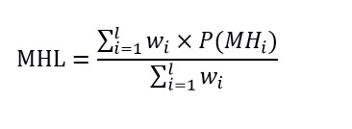
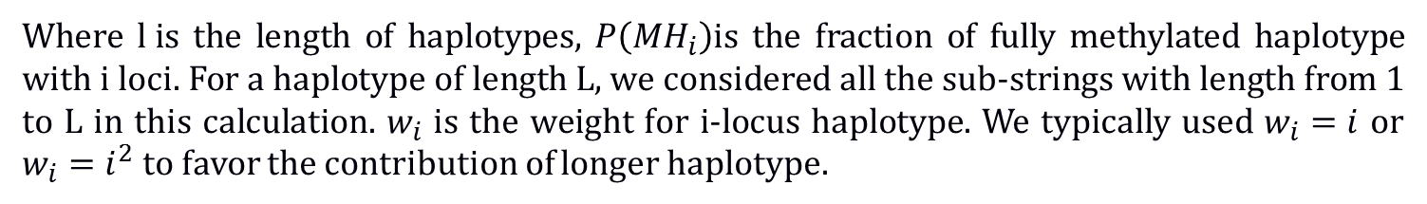
Quantitative measurement of DNA methylation level and complexity
1, Average methylation: Non-weighted average methylation values within a genomic region
2, Methylation entropy: measure the complexity of the DNA methylation within a genomic region
None any metric: Methylation Level and complexity
Give different weight to the CpG in each haplotype
Where $l i$s the length of haplotypes, $P\left({MH}_{i}\right)$is the fraction of fully methylated haplotype with i loci. For a haplotype of length L, we considered all the sub-strings with length from 1 to L in this calculation. $w_{i}$ is the weight for i-locus haplotype. We typically used $w_{i}=i$ or $w_{i}=i^{2}$ to favor the contribution of longer haplotype.

Slide 8

MHL : New proposed quantitation of DNA methylation
R²=1 R²=1 R²=1 R²=0 R²=-1
Methylation level
0% 100% 50% 50% 50%
Methylation entropy
0 0 0.25 1 0.25
1 1 2 16 2
0 1 0.5 0.1625 0.12
Haplotypes
MHL($w_{i}$ =$i$ )
Theoretically, MHL can detect each situation accurately
Long continuous methylated DNA fragment (LCMDF)

Slide 9
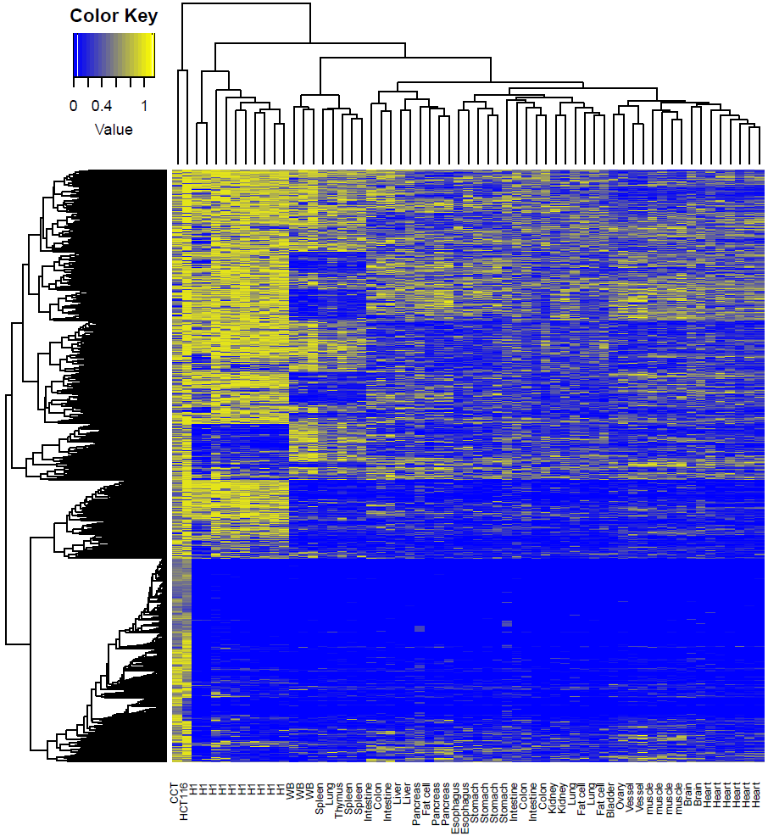
Genome-wide MHL could represent the tissue similarity
Tissues from same source cluster together
Tissue mapping
Cancer tissues and H1 cells have large number high MHL regions
Cancer diagnosis

Slide 10
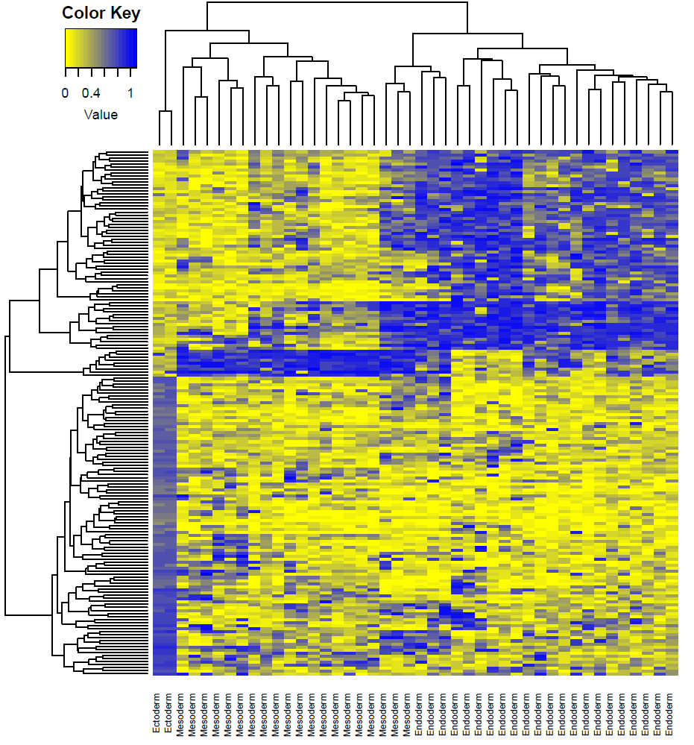
Methylation haplotype load distinguish the layer of the development
The development layers would be separated by layer specific methylation haplotype regions
Especially, ectoderm have completely different MHL regions compared with endoderm
ectoderm
Mesoderm
Endoderm

Slide 11
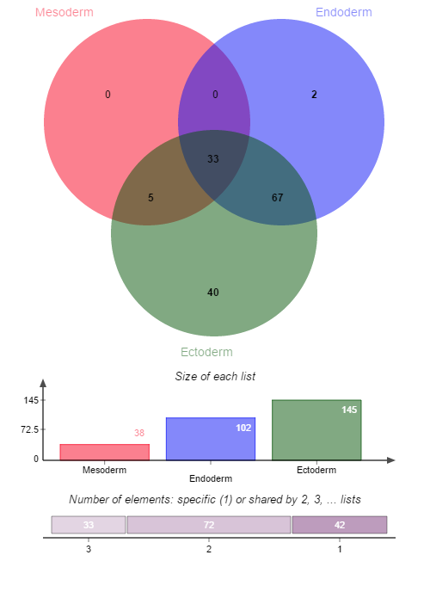
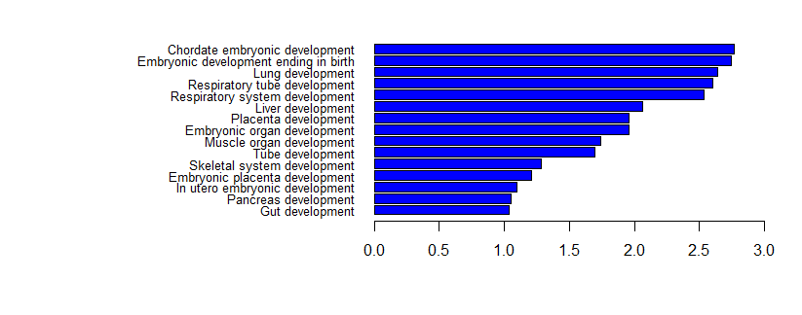
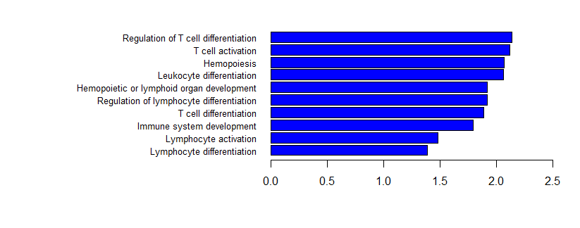
Function annotation to the Layer specific MHL regions
In the absence of Nanog, mouse embryonic stem cells differentiate into visceral/parietal endoderm.^{[1][2]}
Mesoderm and Endoderm shared hypo-MHL regions play the role to induce the development
ESRRA
NANOG
-log10(Benjamini P value)
Ectoderm specific hyper-MHL regions impress the immune system to
induce the ectoderm development
-log10(Benjamini P value)

Slide 12
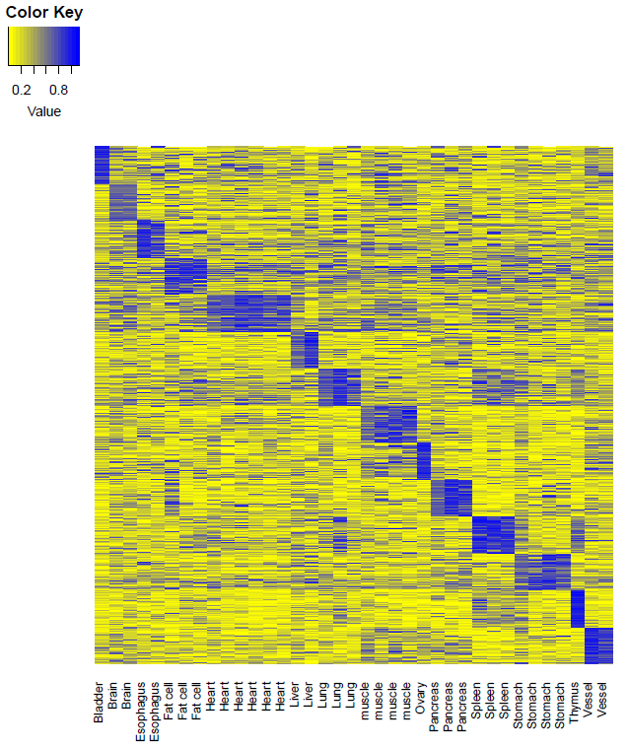
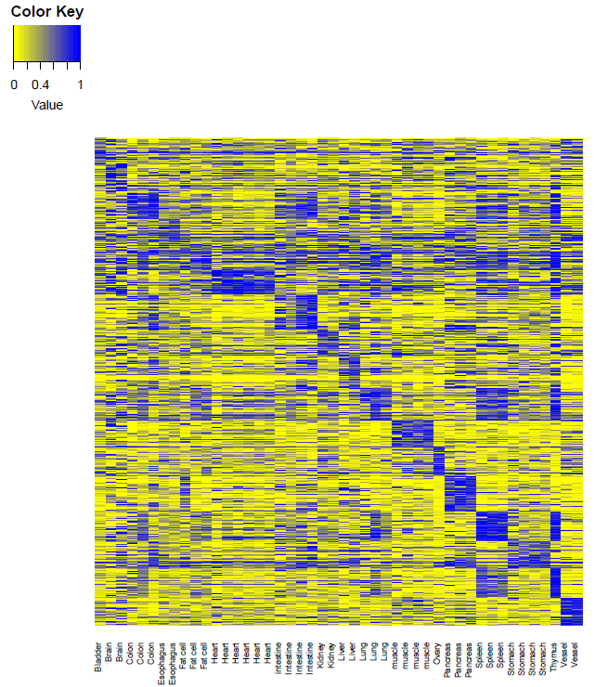
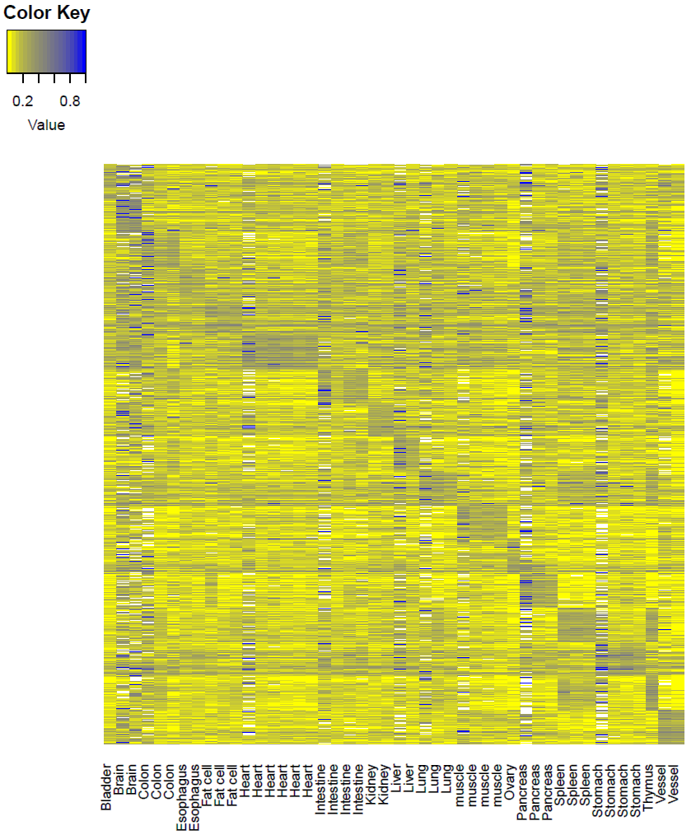
Tissue specific hyper-methylation haplotype regions to predict cancer origin
MFs
MHL
AMS
AMF
7539
1360
7647
Data extracting
Tissue specific value: 0.89 (95%CI: 0.84-0.93)
Background value: 0.29 (95%CI: 0.23-0.35)
Contrast: 0.60
Tissue specific value: 0.91(95%CI: 0.85-0.97)
Background value: 0.40 (95%CI: 0.32-0.48)
Contrast: 0.51
Tissue specific value: 0.64 (95%CI：0.55-0.73)
Background value: 0.32(95%CI: 0.29-0.35)
Contrast: 0.32
MHL was a stronger characteristic which can be applied for plasma DNA tissue mapping

Slide 13
Tissue specific hyper-methylation haplotype regions to predict cancer origin
RRBS dataset: 49 regions overlapped with high GSI regions
 | Colon | Lung | Pancrease | Normal Plasma
Colon | 7 | 1 | 2 | -
Lung | 1 | 8 | 1 | -
Pancrease | 2 | 1 | 7 | -
Normal Plasma | 1 | 0 | 0 | 8
Dataset 1
Sen: 70.0%
Sen: 80.0%
Sen: 70.0%
Random Forest： 500 tree, 447 predictors, diagonal
RRBS dataset: regions overlapped with high GSI regions
 | Colon | Lung | Pancrease | Normal Plasma
Colon
Lung
Pancrease
Normal Plasma
Sen:
Sen:
Sen:
Dataset 2
Random Forest:
Result: methylation haplotype load could be used for the mapping of the plasma DNA

