Slide 1
MONOD: Methylation Haplotype in non-invasive Cancer Diagnosis
Progress Report
Aug 17 2015
Notes:
Hello, everyone, today I will introduce the progress of the mond project which is shorted for Methylation Haplotype in non-invasive Cancer Diagnosis

Slide 2
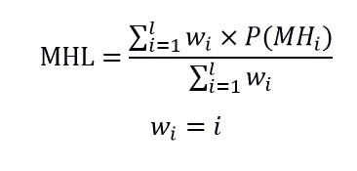
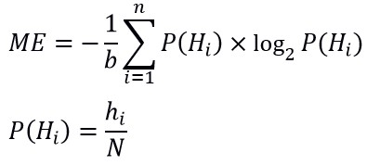
Definition of methylation haplotypes and methylation haplotype blocks
Methylation haplotype is collection of adjacent methylation status in specific genome region.
Methylation haplotype block is genomic region in which the methylation correlation between adjacent CpG loci were relatively higher compared with the expectation.
Methylation haplotype load is proposed to measure the methylation level for the methylation blocks which is weighted by the length of the haplotype.
Methylation entropy is a extent measurement to DNA methylation based on traditional Shannon entropy. It can be used to evaluate the epigenetic heterogeneity.
$w_{i}$ is to favor the contribution of longer haplotype

Slide 3

0% 100% 50% 50% 50% 50%
R²=1 R²=1 R²=1 R²=0 R²=-1 R²=1
Methylation haplotype
1 1 2 16 2 2
1 1 1 0.325 0.23 0.23
0 0 0.5 2 0.5 0
0 1 0.5 0.5 0.5 0.5
MHL($w_{i}$ =$i$ )
2 × Methylation entropy
Methylation level

Slide 4
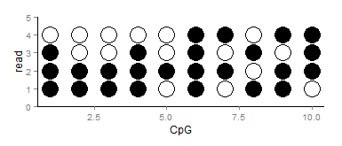
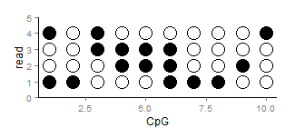

Slide 5
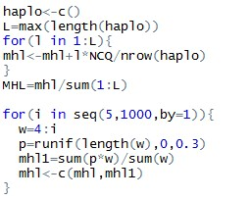
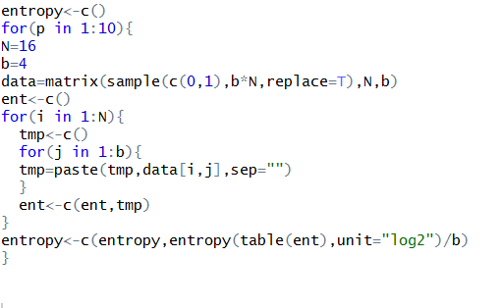
Methylation haplotype load implement in R and Perl
Methylation entropy implement in R and Perl

Slide 6
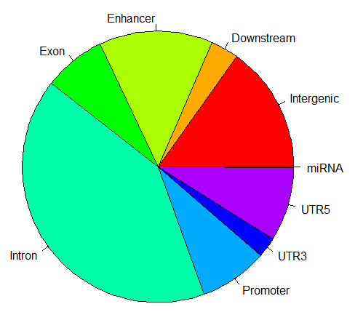
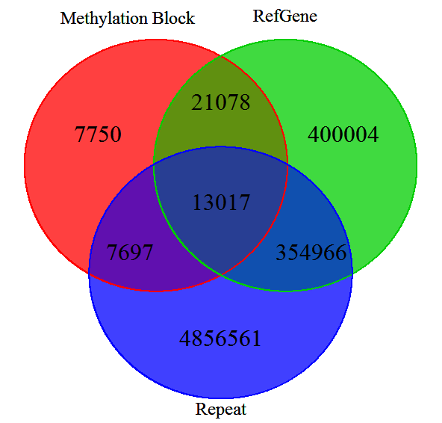
Distribution of Methylation block in human genomics
0.4%
7.0%
49,542 methylation blocks
(inferred from WGBS data of normal tissues)
Methylation blocks widely disperse in human genome, especially in gene regulation and body region.
Methylation blocks prefer non-repeat regions in human genome (mapping and functional reason)
Methylation blocks cover 0.4% repeat regions while RefGene cover 7.0% repeat region.

Slide 7
Methylation block inferred from microarray and RRBS dataset
Block: >=4 CpG loci and average correlation of the adjacent CpG among the region > 0.6
Methylation 450K Array
Encode
Symbol | Case | Control | Tissue types (Cancer types)
KIRC | 160 | 160 | Kidney
BRCA | 92 | 92 | Breast
THCA | 56 | 56 | Thyroid
HNSC | 50 | 50 | Head and Neck
PRAD | 49 | 49 | Prostate
LIHC | 49 | 49 | Liver
KIRP | 45 | 45 | Kidney
LUSC | 41 | 41 | Lung squamous cell
COAD | 39 | 39 | Colon
UCEC | 30 | 30 | Uterine Corpus Endometrial
LUAD | 26 | 26 | Lung
101 RRBS (bed files) were downloaded. 2,646,999 CpG loci were covered by 101 RRBS data while 866,979 CpG loci (32.8%) were detected in at least 80% samples.
How many kinds of cell?
mesoderm
ectoderm
Inner cell mass
Decidua
Epithelium
Blood
neurons
155 blocks
1885 blocks

Slide 8
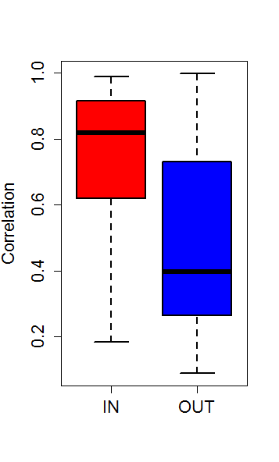
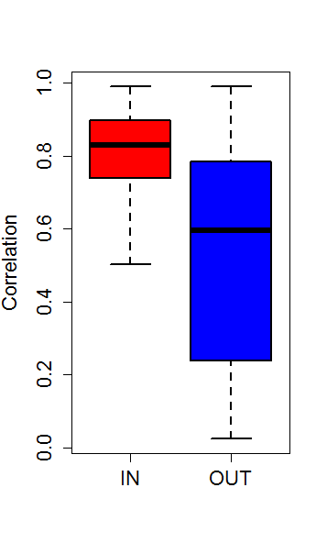
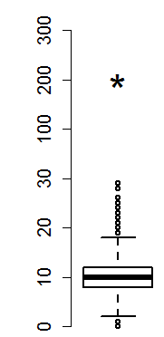
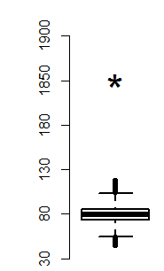
Array: Fold change: 23.4, P-value<1.0 × 10⁻⁶
RRBS: Fold change: 19.8, P-value<1.0 × 10⁻⁶
Array RRBS
P-value<2.2 × 10⁻¹⁶
P-value<2.2 × 10⁻¹⁶
Methylation block regions were significantly conserved in different dataset or platform
High CpG density regions within methylation block have significant higher correlation compared with regions without methylation block.

Slide 9
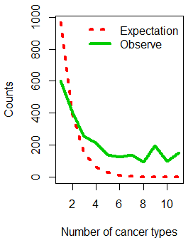
Methylation block conservation among 11 human normal tissues
2421 methylation block regions (59.97% in WGBS) were collected from 11 tissues. The probability of the number occurred in different tissues would be in a exponential decay as the red lines showed (P=0.4). However, we found a regions significantly deviate from the theoretical distribution (P<2.2 × 10⁻¹⁶,chi-square test) and therefore, the methylation block have strong conservation in different tissues.
Exponential decay
Conservation
P=length(blocks)/(length(uniqueblock)*event.time)
Notes:
Methylation block in human genome’s observation.

Slide 10
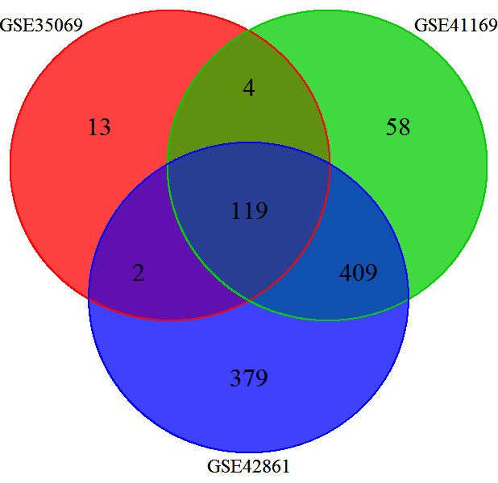
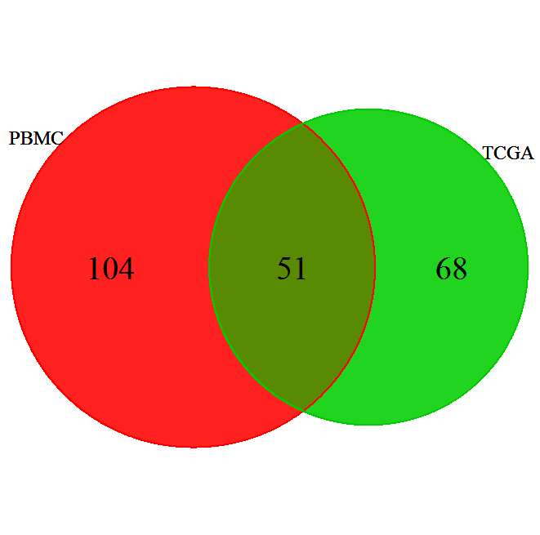
Methylation block conservation between different tissues: PBMC and solid tissues
TCGA
32.9%-41.9%
P<1.92× 10⁻⁹
GSE35069:Differential DNA Methylation in Purified Human Blood Cells (CD4+,CD8+,CD19+)
GSE41169:Blood DNA methylation profiles in a Dutch population (62 schizophrenia and 33 normal )
GSE42861:Differential DNA methylation in the PBMC from 354 Rheumatoid arthritis and 337 normal
Methylation blocks were conservative between PBMC and solid tissues. 32.9-41.9% regions were shared between PBMC and solid tissues. P<1.92× 10⁻⁹
Notes:
Remove the effect of the CpG Island
Gatk indel is better and samtools.

Slide 11
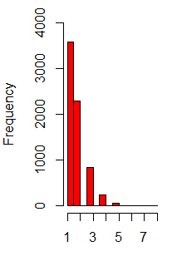
TCGA
68 51 104
984 blocks
2421 blocks
32.9%-41.9%
34 33 51
CpG Island
39.29%-49.29%
34 18 53
Non-CpG Island
18
O[984(52),2421(71)]
25.35%-34.61%
10,000 iterations, P<10⁻⁴

Slide 12
Methylation block difference between cancer and normal
Correlation between the high CpG region were significantly higher in cancer compared with normal tissues, especially
Here choose colon, lung and pancreatic cancer (no data)

Slide 13
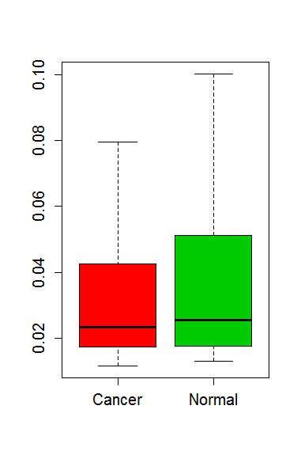


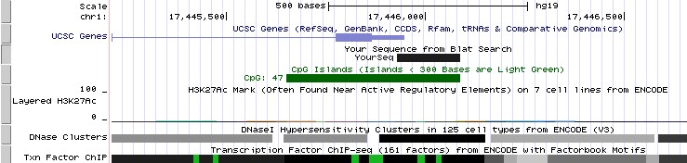
Methylation haplotype emergence in cancer genomes
Colon cancer Colon normal
PADI2
Notes:
chr1:2345333-2345410
load(file[j])
cancer<-substr(file[j],1,4)
data<-RawNARemove(data)
data<-impute.knn(data)$data
map<-map[map[,4] %in% rownames(data),]
newdata<-data[match(map[,4],rownames(data)),]
cor1<-mean(cor(t(newdata[rlt[j,1]:rlt[j,2],seq(1,ncol(newdata),by=2)]),use="complete.obs")) # cancer
cor2<-mean(cor(t(newdata[rlt[j,1]:rlt[j,2],seq(2,ncol(newdata),by=2)]),use="complete.obs")) # normal
tmp<-c(cor1,cor2)
cor<-rbind(cor,tmp)
load("COAD.mh.cor.RData")
load("COAD.mh.rlt.RData")
j<-match("chr1:17445929-17446087",rownames(rlt))
cor1<-cor(t(newdata[rlt[j,1]:rlt[j,2],seq(1,ncol(newdata),by=2)]),use="complete.obs") # cancer
cor2<-cor(t(newdata[rlt[j,1]:rlt[j,2],seq(2,ncol(newdata),by=2)]),use="complete.obs") # normal
M1<-rltt$cor1
M2<-rltt$cor2
M1[lower.tri(M1)] <- NA
M2[lower.tri(M2)] <- NA
col=colorRampPalette(c("white", "red"))(20)
pdf("figure.pdf")
image(M1,col =col,frame=F,xaxt="n",yaxt="n")
image(M2,col =col,frame=F,xaxt="n",yaxt="n")
dev.off()
library("grDevices")
plot(1:20,pch=20,col=col)
col=colorRampPalette(c("white", "red"))(20)
M <- matrix(runif(100),10,10)
M[lower.tri(M)] <- NA
image(M,col = col,frame=F,xaxt="n",yaxt="n")

Slide 14
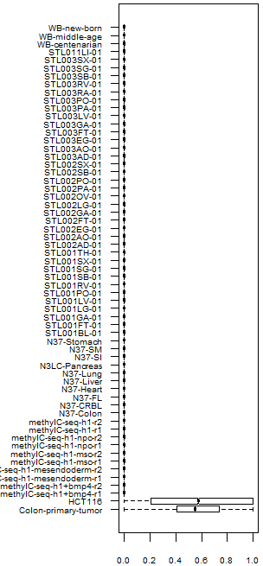
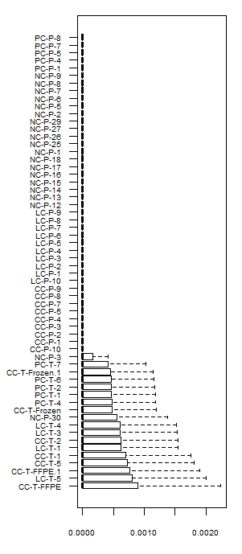
Significant Increasing of the methylation haplotype load in cancer tissues
WGBS
RRBS
Plasma
Methylation haplotype load showed significant large number of hyper-methylation regions in cancer tissues both in GWBS and RRBS dataset.
Cancer
Solid
Normal
Extract the regions of GWBS overlapped with RRBS and the distribution do not have dramatically change.
Methylation haplotype load
Methylation haplotype load

Slide 15
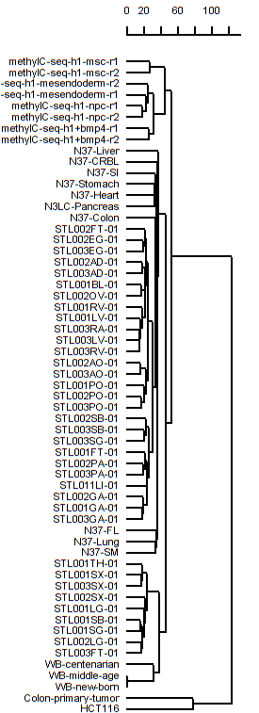
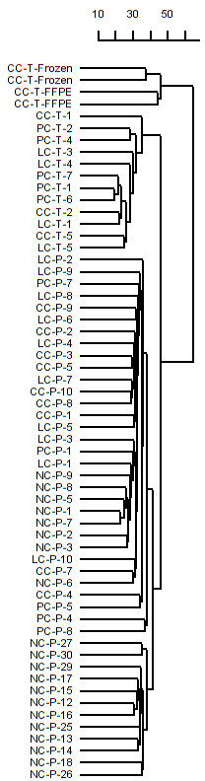
Methylation haplotype load in differential samples: Somatic, Stem, Plasma
Stem cell
Cancer tissue
Somatic cell
Cancer plasma
Cancer cell
Cluster analysis showed genome-wide MHL based on GWBS dataset could distinguish the samples with very high accuracy.
Cluster analysis were conducted with Euclidean distance and ward agglomeration.

Slide 16
Conclusion
Methylation haplotype block has strong conservation among different tissues and platforms.
Methylation haplotype load showed significant large number of hyper-methylation regions in cancer tissues both in Microarray, GWBS and RRBS dataset.
Cluster analysis showed genome-wide MHL based on GWBS dataset could distinguish the samples with very high accuracy.
Methylation haplotype based DNA methylation analysis would be useful method to discover the difference between disease status or development process.

Slide 17
Influence of biological variations to methylation haplotype load
For this analysis, 15 pairs of solid tissue and matching plasma samples were collected. The regions with higher MHL in solid tissues than plasma were defined as tissue-dominant MHL (T-MHL), and regions with higher MHL in plasma than in solid tissues were defined as plasma-dominant MHL (P-MHL). We assume that cell-free DNA typically come from apoptotic cells, and are in small fragments (Chan et al. 2004), while whole blood DNA typically have larger sizes (at least kilobases) even after DNA extraction. Therefore, we hypothesize that P-MHL is longer than T-MHL. The results showed that the length of P-MHL are significantly longer than T-MHL in all the sample sets.
MHL in Plasma
T-MHL: MHLs which Tissue >= Plasma
P-MHL: MHLs which Plasma > Tissue
Difference of the length MHL between T-MHL and P-MHL??

Slide 18
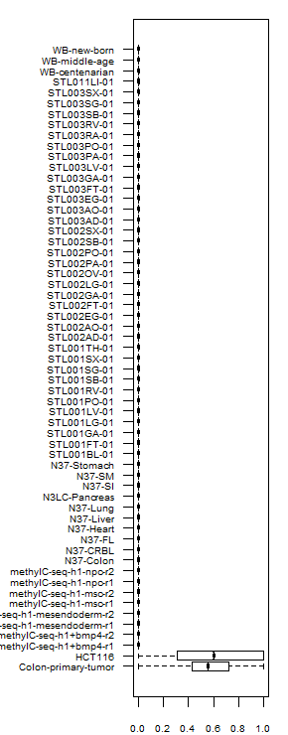

Slide 19
Significant difference of the length MHL between T-MHL and P-MHL
 | T-MHL(bp) | P-MHL(bp) | Fold-Change | Delta(bp) | P-value
6-P-1 | 138 | 164 | 1.19 | 26 | 1.43E-25
6-P-2 | 149 | 154 | 1.03 | 5 | 4.34E-02
6-P-3 | 146 | 159 | 1.09 | 13 | 1.69E-09
6-P-4 | 136 | 157 | 1.15 | 21 | 3.10E-19
6-P-5 | 135 | 166 | 1.23 | 31 | 6.94E-32
7-P-1 | 138 | 159 | 1.15 | 21 | 3.36E-23
7-P-2 | 137 | 169 | 1.23 | 32 | 5.64E-32
7-P-3 | 137 | 167 | 1.22 | 30 | 1.74E-31
7-P-4 | 139 | 158 | 1.14 | 19 | 1.63E-18
7-P-5 | 132 | 177 | 1.34 | 45 | 5.71E-66
PC-P-1 | 131 | 171 | 1.31 | 40 | 1.86E-45
PC-P-2 | 133 | 161 | 1.21 | 28 | 6.73E-37
PC-P-4 | 127 | 167 | 1.31 | 40 | 1.61E-62
PC-P-6 | 132 | 176 | 1.33 | 44 | 3.05E-66
PC-P-7 | 128 | 171 | 1.34 | 43 | 3.75E-63
Length of P-MHL are significantly longer than T-MHL in all the sample sets.
Notes:
For this analysis, 15 pairs of solid tissue and matching plasma samples were collected. The regions with higher MHL in solid tissues than plasma were defined as tissue-dominant MHL (T-MHL), and regions with higher MHL in plasma than in solid tissues were defined as plasma-dominant MHL (P-MHL). We assume that cell-free DNA typically come from apoptotic cells, and are in small fragments (Chan et al. 2004), while whole blood DNA typically have larger sizes (at least kilobases) even after DNA extraction. Therefore, we hypothesize that P-MHL is longer than T-MHL. The results showed that the length of P-MHL are significantly longer than T-MHL in all the sample sets.

Slide 20
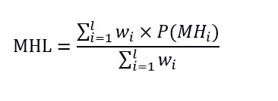
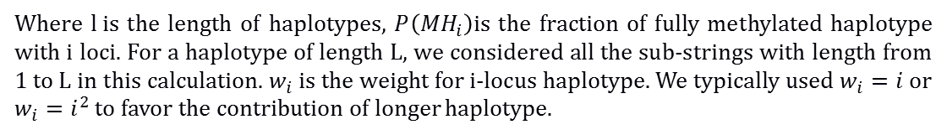
Methylated Haplotype Loading (MHL) for a genome region
Where $l i$s the length of haplotypes, $P\left({MH}_{i}\right)$is the fraction of fully methylated haplotype with i loci. For a haplotype of length L, we considered all the sub-strings with length from 1 to L in this calculation. $w_{i}$ is the weight for i-locus haplotype. We typically used $w_{i}=i$ or $w_{i}=i^{2}$ to favor the contribution of longer haplotype.
1, MHL is the unbiased estimate of methylation for a genome region
2, MHL ranges from 0 to1
Shoemaker R, Deng J, Wang W, Zhang K. Genome research. 2010;20(7):883-9
Notes:
MHL is the unbiased estimate of methylation for a genome region and MHL ranges from 0 to1

Slide 21
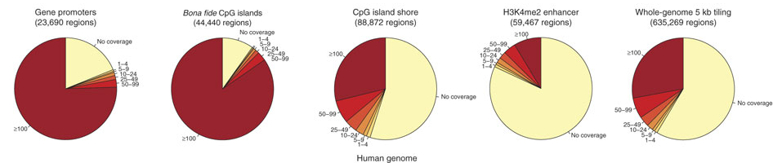
RRBS covered genomic regions

Slide 22
Description of methylation haplotypes and methylation haplotype blocks.
Systematic search of methylation haplotype blocks in the human genome.
Distribution of haplotype diversity across tissues and different methylation haplotype blocks.
Definition of methylated haplotype loads and estimation of tumor fraction using MHL.
Detection of tumor methylated haplotypes in plasma.

Slide 23
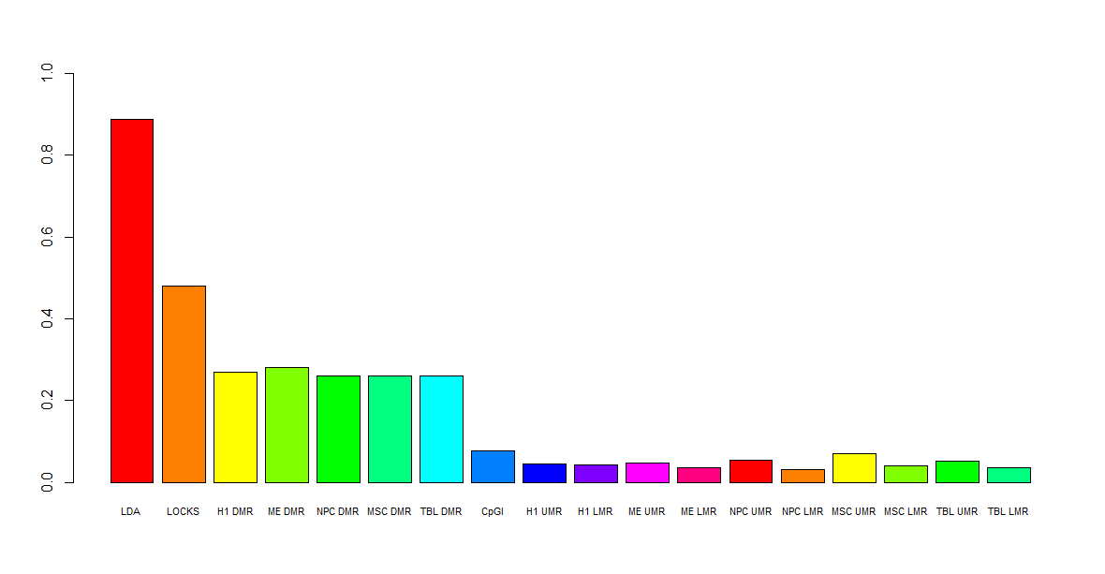
Relationship between Methylation haplotype block and important methylation features
88.8%
48%
27%
7.6% 5.4%
LAD: lamina-associated domains, gene silence, require the involvement of methylation blocks
LOCKS: phenotypic plasticity, partially (48%) require methylation blocks
DMV: DNA methylation valley, conserved, partially (27%) require methylation blocks
LMR: low methylation region, dynamic, do not require methylation blocks
UMR: low methylation region, dynamic, do not require methylation blocks
Methylation memory region (MMR): on the way…
Variably methylation region (VMR): implemented in CHARM, no genome-wide searching method
Hi-C : (Nature 485, 376–380): on the way…
Notes:
VMR: Nature 485, 376–380

Slide 24
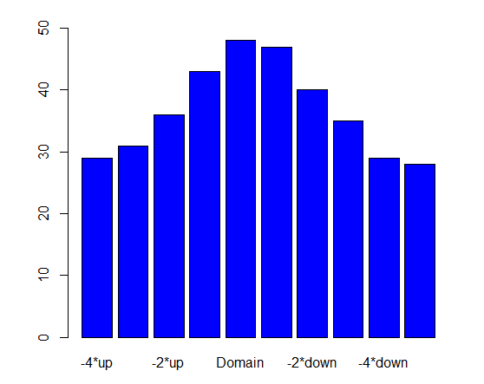
Methylation haplotype block regions enriched in Annotation regions
Ref | Observation | Expectation | Ratio | Fold Change | pvalue
VMR | 48 | 3 | 0.000969 | 20.4 | < 0.005
CpG Island | 5,845 | 379 | 0.117981 | 15.4 | < 0.005
CpG Shore | 4,269 | 1596 | 0.086169 | 2.6 | < 0.005
Hi-C Common Boundary | 6,322 | 4,357 | 0.127609 | 1.4 | < 0.005
Hi-C Topological Ddomain (IMR90) | 44,794 | 4,1041 | 0.904162 | 1.1 | < 0.005
Hi-C Topological Domain (hESC) | 44,806 | 4,1802 | 0.904404 | 1.1 | < 0.005
LOCK | 131 | 215 | 0.002644 | 0.6 | < 0.005
LAD | 10,639 | 18319 | 0.214747 | 0.6 | < 0.005
48
VMR

Slide 25
1, Remove H1, WBC
2, Just keep few H1, WBS specific hypermethylation regions
3, select classic specific genes for each tissue

Slide 26
Annotation enriched in Methylation haplotype block regions
ref | observation | expectation | ratio | Fold Change | P-value
VMR.charm.PMID20844285.hg19.bed | 21 | 2.03 | 0.092511013 | 10.34482759 | < 0.005
CpGI.hg19.bed | 2188 | 337.225 | 0.076260848 | 6.488249685 | < 0.005
CpG.Shore.hg19.bed | 3321 | 1324.01 | 0.070935771 | 2.508289212 | < 0.005
Hic.common.boundary.hESC.IMR90.hg19.bed | 1392 | 1108.33 | 0.804159445 | 1.255943627 | < 0.005
Hic.topological.domain.IMR90.hg19.bed | 2201 | 1937.2 | 0.961135371 | 1.136175924 | < 0.005
Hic.topological.domain.hESC.hg19.bed | 2915 | 2581.47 | 0.951992162 | 1.129201579 | < 0.005
LAD.hg19.bed | 1156 | 1046.99 | 0.887864823 | 1.104117518 | < 0.005
LOCK.hg19.bed | 32 | 32.175 | 0.484848485 | 0.994560995 | 0.425

Slide 27
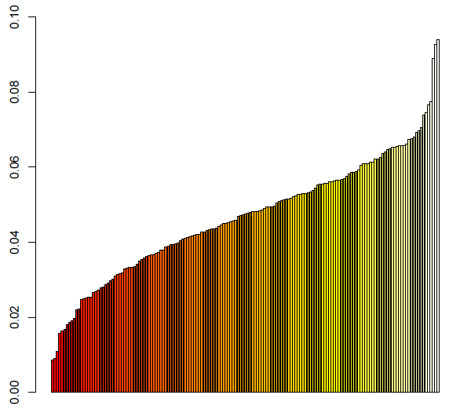
Relationship between methylation haplotype block with Transcriptional binding region of 161 TF from Encode Project
1, 0.085%-9.4% TFBR contain methylation haplotype block
2, lowest: POU5F1, FAM48A, BRF2, MAFF, SETDB1
3, highest: MTA3, IKZF1, SMARCC1, SMARCB1, NFATC1
methylation sensitive ?
Enrich fold= 2-45 X
proportion
161 Transcriptional Factors
Notes:
Significance of Overlap: For the intersections of more than two groups, we performed simulations to determine the empirical P-value. For each list, we randomly selected x number of null regions from the background set (x = observed size), and we determined the overlap size expected by chance from 10⁵ repetitions. The empirical P-value is calculated as the number of times the actual observed overlap is smaller than the null overlap divided by the total number of simulations.

Slide 28
False Positive Co-occurrences/Enrichment
1, CRG mapability : Mapability or Uniqueness of Reference Genome
22M genome postion were excluded.
DAC Blacklisted Regions: 11,588,272bp (anomalous, unstructured)
Duke Excluded Regions: 10,734,023bp (satellites and rRNA genes)
2. Haiminen N, Mannila H, Terzi E. Determining significance of pairwise co-occurrences of events in bursty sequences. BMC bioinformatics 2008;9:336.
3.Fu AQ, Adryan B. Scoring overlapping and adjacent signals from genome-wide ChIP and DamID assays. Molecular bioSystems 2009;5:1429-38.

Slide 29
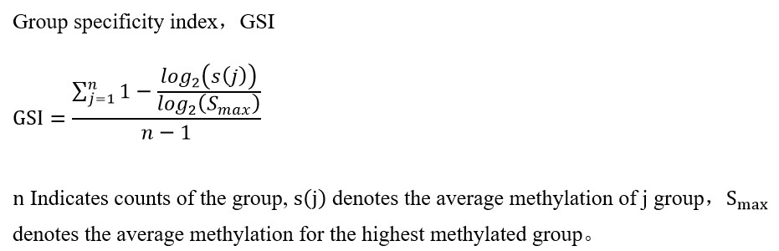
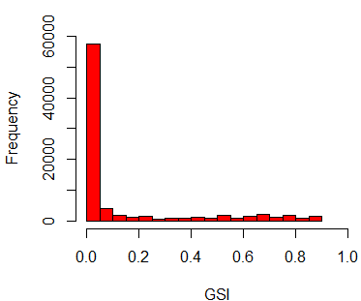
Tissue Specific Hypermethylated Methylation Haplotype Block Regions
 | Tissue | Freq
1 | Bladder | 1
2 | Brain | 2
3 | Colon | 3
4 | Esophagus | 2
5 | Fat cell | 3
6 | Gastric | 2
7 | Stem Cell | 10
8 | Heart | 6
9 | Intestine | 4
10 | Kidney | 2
11 | Liver | 2
12 | Lung | 3
13 | muscle | 4
14 | Ovary | 1
15 | Pancreas | 3
16 | Spleen | 3
17 | Stomach | 2
18 | Thymus | 1
19 | Vessel | 2
20 | WB | 3
 | Tissue | Sample Size | GSI>0.7 | GSI>0.8
1 | Bladder | 1 | 137 | 61
2 | Brain | 2 | 194 | 133
3 | Colon | 3 | 26 | 1
4 | Esophagus | 2 | 25 | 6
5 | Fat cell | 3 | 4 | 0
6 | Gastric | 2 | 15 | 2
7 | H1 | 10 | 1435 | 743
8 | Heart | 6 | 3 | 0
9 | Intestine | 4 | 12 | 1
10 | Kidney | 2 | 47 | 12
11 | Liver | 2 | 170 | 57
12 | Lung | 3 | 5 | 0
13 | muscle | 4 | 38 | 9
14 | Ovary | 1 | 194 | 78
15 | Pancreas | 3 | 111 | 24
16 | Spleen | 3 | 16 | 3
17 | Stomach | 2 | 19 | 5
18 | Thymus | 1 | 775 | 230
19 | Vessel | 2 | 140 | 57
20 | WB | 3 | 2440 | 1079
82347
5806
Group Specificity Index
Notes:
82347

Slide 30
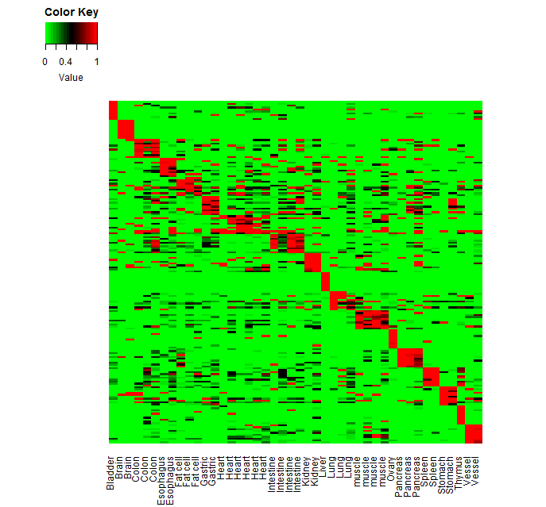
Detection power to plasma based on identified tissue signatures
WGBS
Validation dataset： RRBS (24 samples)
Criterion: >20% marker positive
1，lung cancer： 7/9=77.7%
2，colon cancer：6/10=60.0%
3，pancreatic cancer：5/5=100%
Validation dataset： BSPP (16 samples)
Criterion: >20% marker positive
1，lung cancer： 5/8=62.5%
2，colon cancer：6/8=75.0%

Slide 31
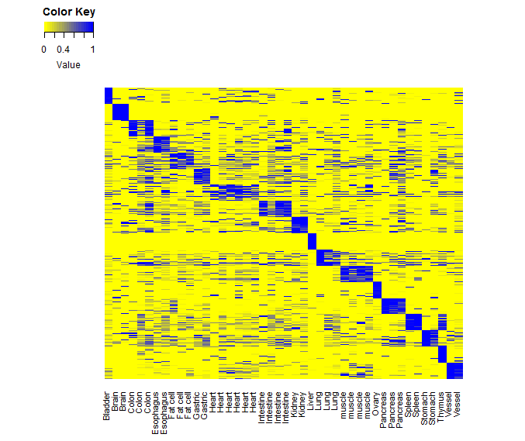
Detection power to plasma based on identified tissue signatures
Validation dataset： RRBS (24 samples)
Criterion:
1, mhl>0.2 (alpha)
2, > 3% marker positive (beta, 20 markers)
1，lung cancer： 9/9=100%
2，colon cancer：5/10=50.0%
3，pancreatic cancer：3/5=60%
4，Normal Plasma Error：7/20=35%
* 4/20=20% OR=36 P-value=3.1*10⁻⁴
* 2/20=5% OR= P-value=0.047
* 1/20=10% OR= P-value=0.025
GSI> 0.66, 0.75, 0.79
Validation dataset： BSPP (16 +17=33 samples)
GSI> 0.52, 0.75, 0.79
Criterion:
1, mhl> 0 (alpha)
2, > =1 marker positive
1，lung cancer： 6/8=75% 11 marker
2，colon cancer：5/8=62.5% 4 marker
3，Normal Plasma Error：3/16= 18.75%
Notes:
x<-y<-c()
z1<-z2<-z3<-z4<-z5<-c()
for(mhl in seq(0,0.3,by=0.01)){
for(ratio in seq(0,0.2,by=0.01)){
# assess the prediction performance to cancer orign
data.prediction.lung<-file1[match(cor.lung,rownames(file1)),c(grep("7-P",colnames(file1)))]
data.prediction.colon<-file1[match(cor.colon,rownames(file1)),c(grep("6-P",colnames(file1)))]
data.prediction.pancrease<-file1[match(cor.pancrease,rownames(file1)),c(grep("PC-P",colnames(file1)))]
x1<-apply(data.prediction.lung,2,function(x) sum(x>mhl)/length(x))
x2<-apply(data.prediction.colon,2,function(x) sum(x>mhl)/length(x))
x3<-apply(data.prediction.pancrease,2,function(x) sum(x>mhl)/length(x))
# assess the prediction performance with Normal plasma as control
data.prediction.lung<-file1[match(cor.lung,rownames(file1)),grep("NC-P",colnames(file1))]
data.prediction.colon<-file1[match(cor.colon,rownames(file1)),grep("NC-P",colnames(file1))]
data.prediction.pancrease<-file1[match(cor.pancrease,rownames(file1)),grep("NC-P",colnames(file1))]
# calculate marker postive incidence
y1<-apply(data.prediction.lung,2,function(x) sum(x>mhl)/length(x))
y2<-apply(data.prediction.colon,2,function(x) sum(x>mhl)/length(x))
y3<-apply(data.prediction.pancrease,2,function(x) sum(x>mhl)/length(x))
x<-c(x,mhl)
y<-c(y,ratio)
z1<-c(z1,sum(x1>ratio)/length(x1))
z2<-c(z2,sum(x2>ratio)/length(x2))
z3<-c(z3,sum(x3>ratio)/length(x3))
z4<-c(z4,(sum(y1>ratio)+sum(y2>ratio)+sum(y3>ratio))/(3*length(y1)))
z5<-c(z5,z1+z2+z3-z4)
}
}
rlt1<-data.frame(x,y,z1,z2,z3,z4,z5)
write.table(rlt1,file="gsi.prediction.paramter.txt",quote=F,sep="\t")

Slide 32
Detection power to plasma based on identified tissue signatures
Validation dataset： RRBS (24 samples)
Criterion:
1, mhl>0.2 (alpha)
2, > 3% marker positive (beta, 20 markers)
1，lung cancer： 9/9=100%
2，colon cancer：5/10=50.0%
3，pancreatic cancer：3/5=60%
4，Normal Plasma Error：7/20=35%
* 4/20=20% OR=36 P-value=3.1*10⁻⁴
* 2/20=5% OR=9 P-value=0.047
* 1/20=10% OR=27 P-value=0.025
GSI> 0.66, 0.75, 0.79
Notes:
x<-y<-c()
z1<-z2<-z3<-z4<-z5<-c()
for(mhl in seq(0,0.3,by=0.01)){
for(ratio in seq(0,0.2,by=0.01)){
# assess the prediction performance to cancer orign
data.prediction.lung<-file1[match(cor.lung,rownames(file1)),c(grep("7-P",colnames(file1)))]
data.prediction.colon<-file1[match(cor.colon,rownames(file1)),c(grep("6-P",colnames(file1)))]
data.prediction.pancrease<-file1[match(cor.pancrease,rownames(file1)),c(grep("PC-P",colnames(file1)))]
x1<-apply(data.prediction.lung,2,function(x) sum(x>mhl)/length(x))
x2<-apply(data.prediction.colon,2,function(x) sum(x>mhl)/length(x))
x3<-apply(data.prediction.pancrease,2,function(x) sum(x>mhl)/length(x))
# assess the prediction performance with Normal plasma as control
data.prediction.lung<-file1[match(cor.lung,rownames(file1)),grep("NC-P",colnames(file1))]
data.prediction.colon<-file1[match(cor.colon,rownames(file1)),grep("NC-P",colnames(file1))]
data.prediction.pancrease<-file1[match(cor.pancrease,rownames(file1)),grep("NC-P",colnames(file1))]
# calculate marker postive incidence
y1<-apply(data.prediction.lung,2,function(x) sum(x>mhl)/length(x))
y2<-apply(data.prediction.colon,2,function(x) sum(x>mhl)/length(x))
y3<-apply(data.prediction.pancrease,2,function(x) sum(x>mhl)/length(x))
x<-c(x,mhl)
y<-c(y,ratio)
z1<-c(z1,sum(x1>ratio)/length(x1))
z2<-c(z2,sum(x2>ratio)/length(x2))
z3<-c(z3,sum(x3>ratio)/length(x3))
z4<-c(z4,(sum(y1>ratio)+sum(y2>ratio)+sum(y3>ratio))/(3*length(y1)))
z5<-c(z5,z1+z2+z3-z4)
}
}
rlt1<-data.frame(x,y,z1,z2,z3,z4,z5)
write.table(rlt1,file="gsi.prediction.paramter.txt",quote=F,sep="\t")

Slide 33
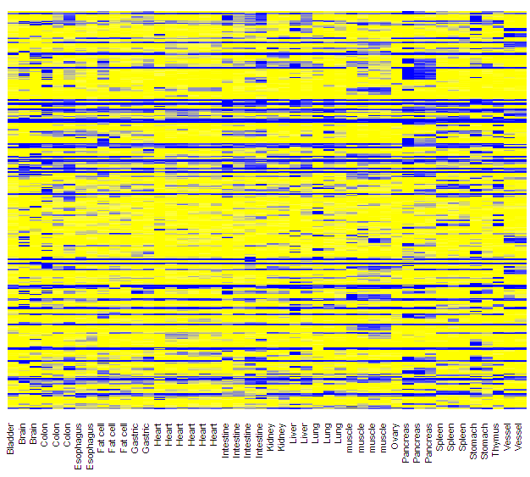
MHL Raw methylation Signal

Slide 34
Detection power to plasma based on Methylation Beta-Matrix
Heatmap
Raw Signal
Validation dataset： RRBS (24 samples)
Criterion:
?
1，lung cancer： ?
2，colon cancer： ?
3，pancreatic cancer： ?
4，Normal Plasma Error： ?
N37
27,835,889
49 sites
SALK
26,176,759

