Slide 1
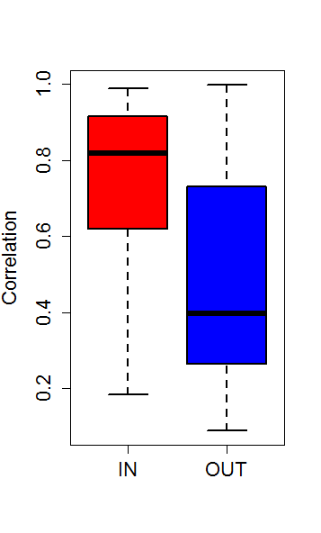
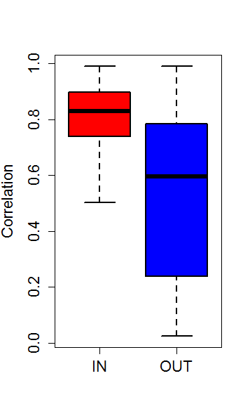
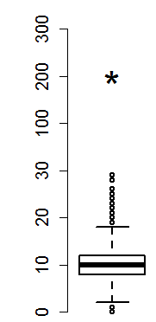
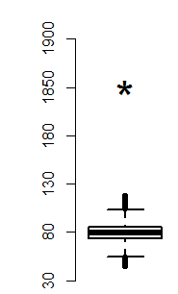

Slide 2
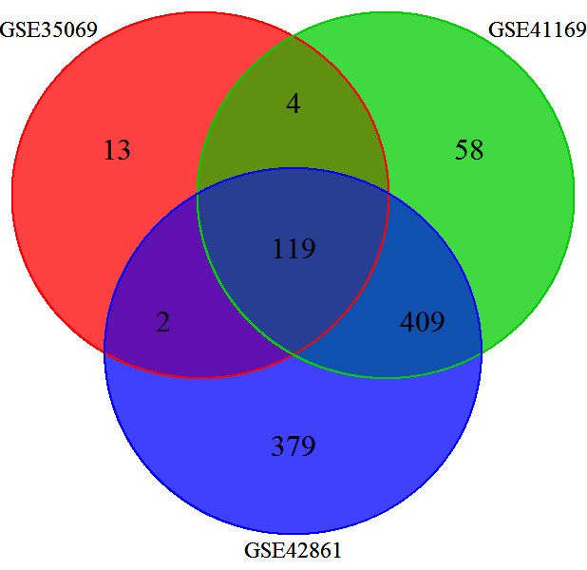
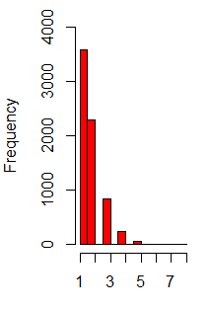
_{TCGA}
₆₈ ₅₁ ₁₀₄
_{32.9%-41.9%}
34 33 51
2421 blocks
CpG Island
984 blocks
39.29%-49.29%
34 18 53
18
Non-CpG Island
O[984(52),2421(71)]
25.35%-34.61%
10,000 iterations, P<10⁻⁴

