Slide 1
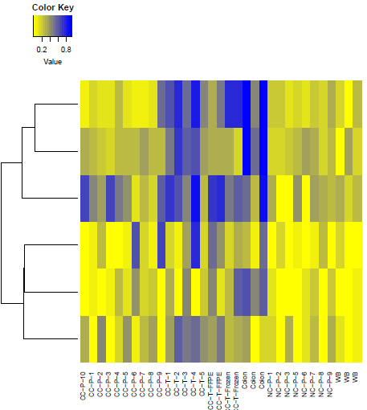
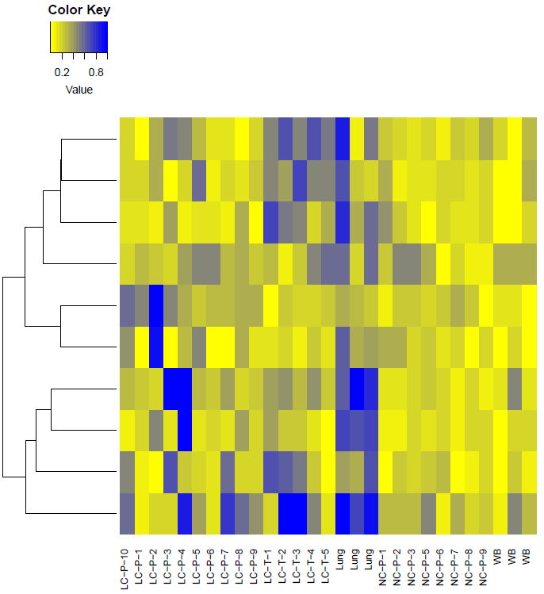
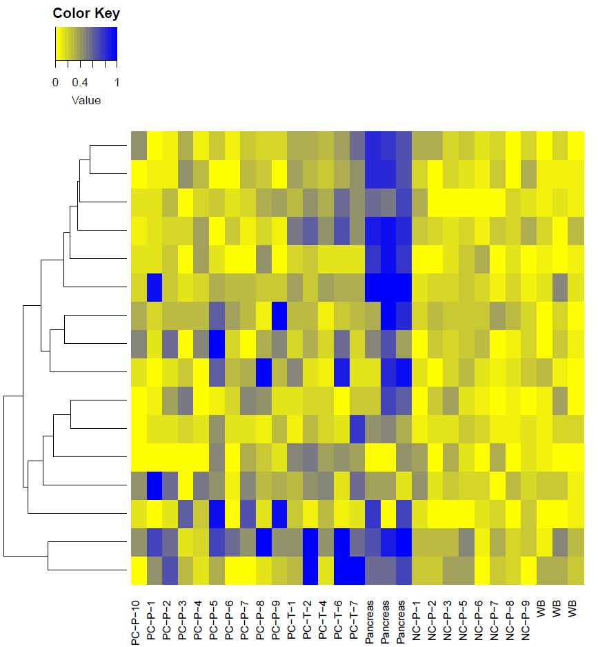
Colon cancer Normal colon WBC
Lung cancer Normal lung WBC
Pancreatic cancer Normal Pancreas WBC

Slide 2

Colon cancer Normal colon WBC
Lung cancer Normal lung WBC
Pancreatic cancer Normal Pancreas WBC

