Slide 1
Methylation Blocks were conserved in different dataset and cancers
Methylation Blocks screening in methylation 450K
1, compare with different cancers
2, compare with methylation block derived from WGBS

Slide 2
Figure 1. high density CpG regions in 450K array normal samples
Notes:
For different cancer dataset, the number of the high density CpG region (HDR) were slightly different because some probes might totally or majority missed in the dataset and these probes were removed and then to find the HDR. From the HDR analysis, you could find that there is not significant difference for the number of the HDR in different cancer dataset. the number of the HDR in all the 11 dataset ranged from 4858 to 5290. The average length of the HDR is 171bp (IQR=117bp) and the average distance between neighbor CpG site is about 27bp(IQR=13bp). the average number of the CpG site in the HDR is 6 (range from 5 to 50).

Slide 3
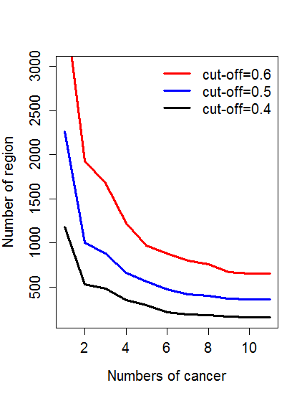
Methylation Blocks were conserved in different cancers and dataset
Total methylation block in meth450: 2421, 59.97% (maybe more with raw methylation regions)were occurred in WGBS methylation blocks (P<10⁻⁹, random shuffling), indicating these regions were conserved between methylation 450K and WGBS
Exponential decay was not found as the increase of the cancers
Notes:
【left】
number4<-c(3734,1926,1679,1220,965,878,795,755,665,654,654)
number5<-c(2260,999, 880, 655, 563,471,415,401,366,357,357)
number6<-c(1181,529, 480, 350, 291,211,184,176,164,155,155)
plot(number4,type="l",lwd=3,col="red",ylim=c(150,3000),xlab="Numbers of cancer",ylab="Number of region",cex.axis=1.25,cex.lab=1.25)
lines(number5,lwd=3,col="blue")
lines(number6,lwd=3,col="black")
legend("topright",legend=c("cut-off=0.6","cut-off=0.5","cut-off=0.4"),col=c("red","blue","black"),lwd=3,lty=1,bty="n",cex=1.25)
【Right】
number4<-rev(c(3734,1926,1679,1220,965,878,795,755,665,654,654))
number5<-rev(c(2260,999, 880, 655, 563, 471, 415, 401, 366, 357, 357))
number6<-rev(c(1181,529, 480, 350, 291, 211, 184, 176, 164, 155, 155))
number4<-rev(cumsum(number4)/sum(number4))
number5<-rev(cumsum(number5)/sum(number5))
number6<-rev(cumsum(number6)/sum(number6))
plot(number4,type="l",lwd=3,lty=2,col="red",ylim=c(0,1),xlab="Numbers of cancer",ylab="Number of region",cex.axis=1.25,cex.lab=1.25)
lines(number5,lwd=3,lty=2,col="blue")
lines(number6,lwd=3,lty=2,col="black")
legend("topright",legend=c("cut-off=0.6","cut-off=0.5","cut-off=0.4"),col=c("red","blue","black"),lwd=3,lty=3,bty="n",cex=1.25)

Slide 4
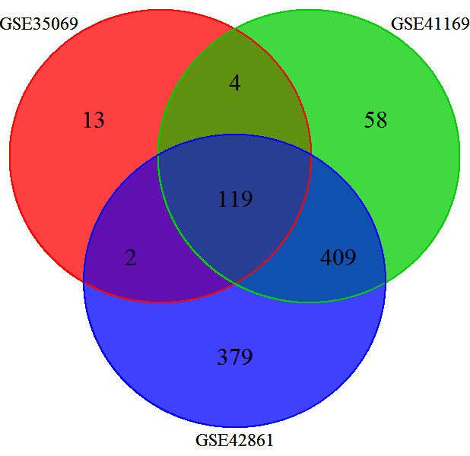
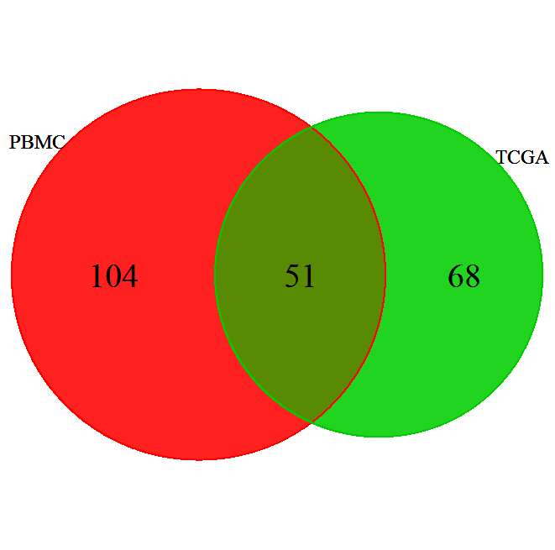
Methylation Blocks were conserved between PBMC and Tissues
TCGA
32.9%-41.9%
GSE35069:Differential DNA Methylation in Purified Human Blood Cells (CD4+,CD8+,CD19+)
GSE41169:Blood DNA methylation profiles in a Dutch population (62 schizophrenia and 33 normal )
GSE42861:Differential DNA methylation in the PBMC from 354 Rheumatoid arthritis and 337 normal
Note: GSE42861 need re-analysis after remove probes from ChrX and ChrY

Slide 5
More Cancer Specific Methylation regions were identified by methylation blocks
Figure 1. Comparison of the correlation for the high density CpG regions in 450K array between cancer and normals

Slide 6
Figure . Comparison of the correlation for the high density CpG regions in 450K array between cancer and normals

Slide 7
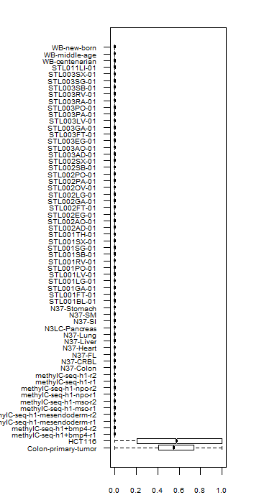
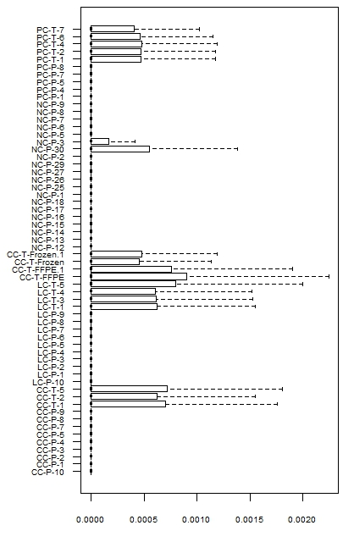
WGBS and RRBS also revealed large number hypermethylated regions
WGBS dataset
RRBS dataset

Slide 8
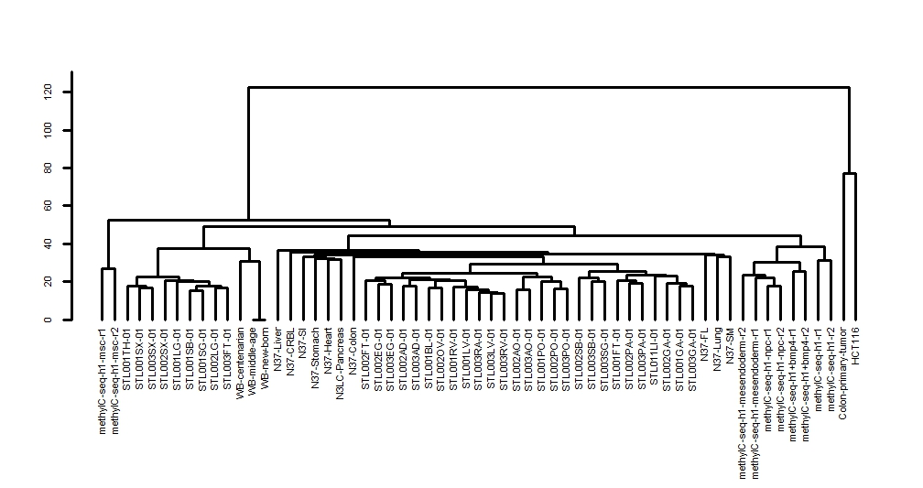
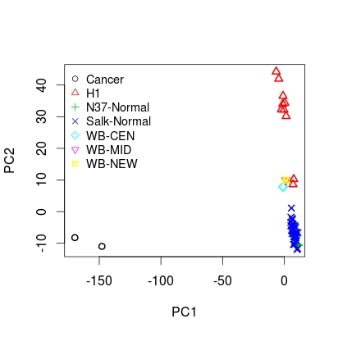
Relationship between samples based on GWBS dataset with PCA and Hierarchical Clustering

Slide 9
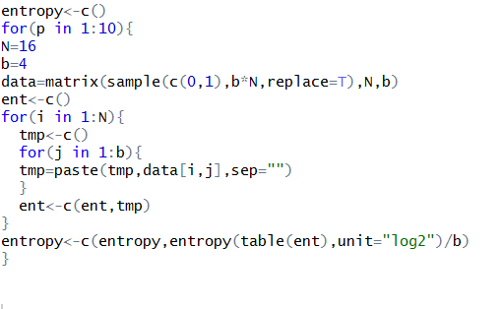
R Script for methylation entropy and simulation performance
ME=0 ME=0 ME=0.25 ME=1
Find a classic gene/region to show the difference between MHL and ME

Slide 11
Characteristic and genome distribution of Methylation block
Entropy calculation, Heterogeneity
Enhancer, promoter, exon, intron, 5-UTR, 3-UTR, miRNA, lncRNA and so on

Slide 12
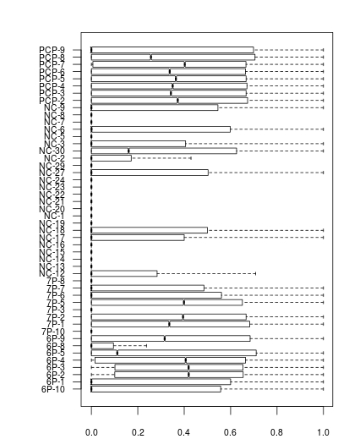
SeqCap dataset

