Slide 1


Identification of DNA methylation based GBM biomarker and validation with cfDNA MSRE-PCR
Dr. Shicheng Guo, Dr. Steven Schrodi
04/4/2019

Slide 2
 | GBM | Normal | Design
TCGA-LGG | 516 | 0 | Discovery
TCGA-GBM | 140 | 2 | Discovery
GSE103659 | 181 | 0 | Discovery
GSE114534 | 44 | 0 | Discovery
GSE66351 | 190 | 0 | Discovery
GSE41826 | 0 | 58 | Discovery
GSE89707 | 0 | 142 | Discovery
GSE74486 | 0 | 131 | Discovery
Sum | 1071 | 333
GSE36194 | 0 | 724 | Validation
GSE53229 | 145 | 0 | Validation
GSE50923 | 54 | 23 | Validation
GSE46015 | 3 | 0 | Validation
GSE22867 | 55 | 3 | Validation
GSE119774 | 39 | 0 | Validation
GSE116298 | 12 | 0 | Validation
Sum | 308 | 750
http://ftp.ncbi.nlm.nih.gov/geo/series/GSE36nnn/GSE36194/matrix/GSE36194_series_matrix.txt.gz
http://ftp.ncbi.nlm.nih.gov/geo/series/GSE53nnn/GSE53229/matrix/GSE53229_series_matrix.txt.gz
http://ftp.ncbi.nlm.nih.gov/geo/series/GSE50nnn/GSE50923/
http://ftp.ncbi.nlm.nih.gov/geo/series/GSE46nnn/GSE46015/
http://ftp.ncbi.nlm.nih.gov/geo/series/GSE22nnn/GSE22867/
http://ftp.ncbi.nlm.nih.gov/geo/series/GSE11nnn/GSE119774/
http://ftp.ncbi.nlm.nih.gov/geo/series/GSE11nnn/GSE116298/

Slide 3
Public Data Discovery Stage
GBM
VS
Control
Public Data Validation Stage
N=555 N=333
Batch effect checking
Cell type checking
Gender and Age checking
Differential methylation analysis
3024 CpG in 1389 genes
Marshfield Clinic Validation Stage
60,920 GBM methylation biomarkers
GBM
VS
Control
N=308 N=750
Marshfield Clinic GBM tissue
BUR checking
SNP checking
Delta Beta>0.2
Heatap checking
PCA checking
Tsne checking
ROC checking
PBMC
N=1198
Biomarker sensitivity validation
Biomarker specificity validation
Biomarker ROC/AUC validation
3688 GBM methylation biomarkers
215 GBM methylation biomarkers
TFBS region checking
H3K4Me1/Me3 region checking
H3K27ac region checking
Marshfield Clinic GBM cfDNA
cfDNA concentration in GBM
cfDNA concentration in treatment
Biomarker performance evaluation
3385 GBM methylation biomarkers
Pathway checking
Oncogene/TSG checking
Epigenetic factor checking
cfDNA from GBM high risk carrier
Biomarker frequency in HSC
3024 GBM methylation biomarkers

Slide 4
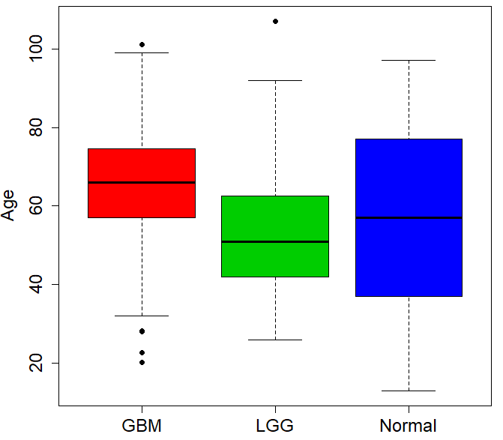
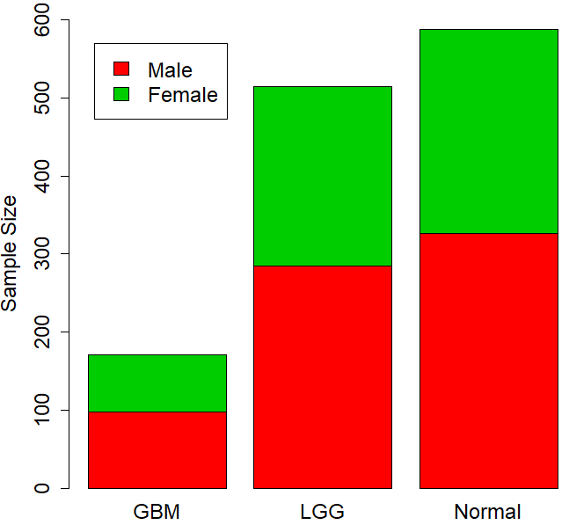

Slide 5
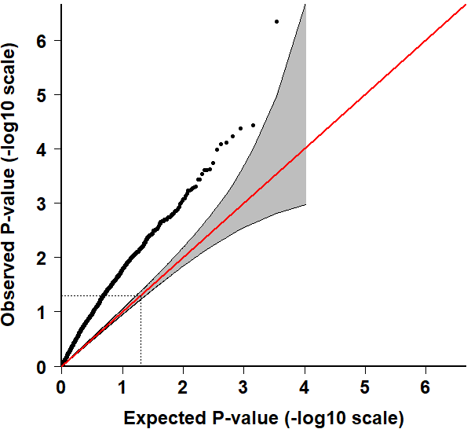
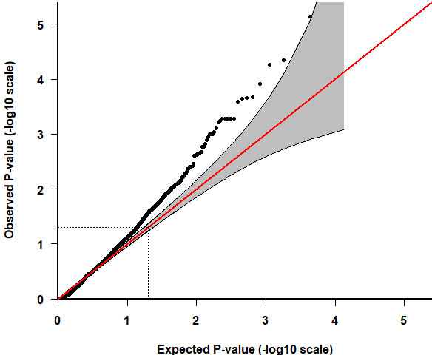

Slide 6
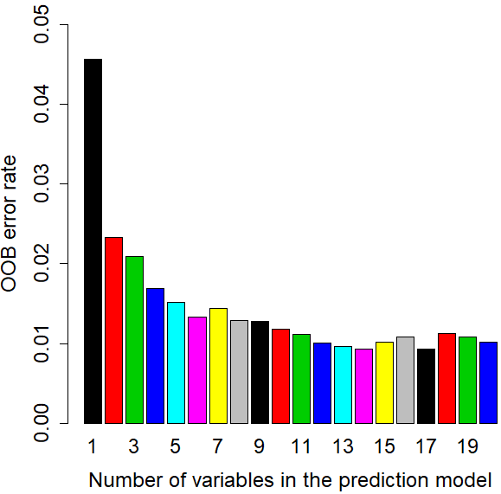
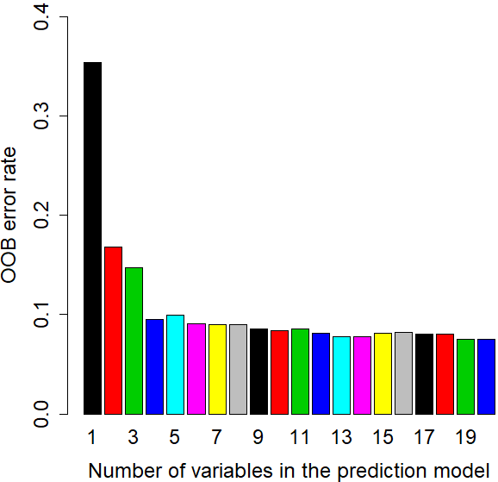

Slide 8
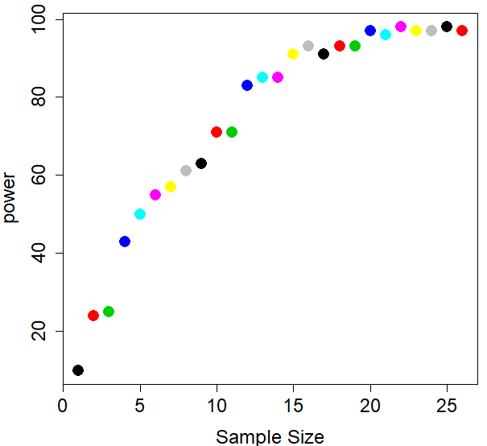
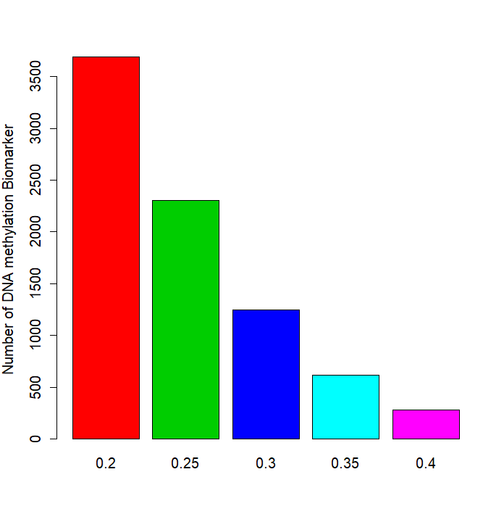
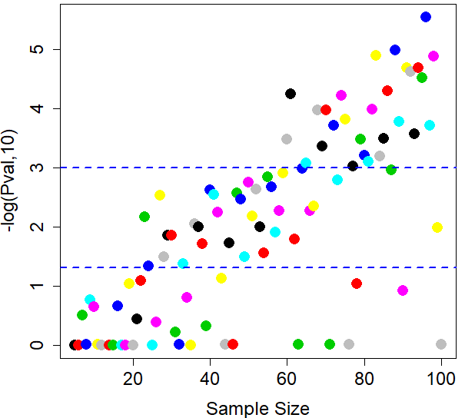

Slide 9
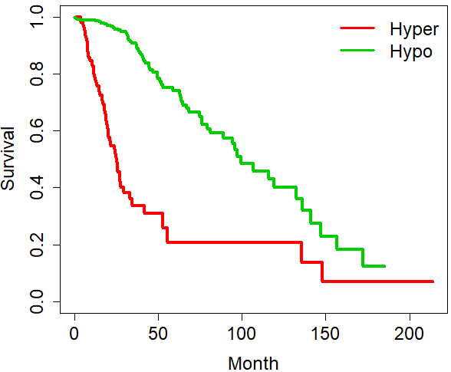
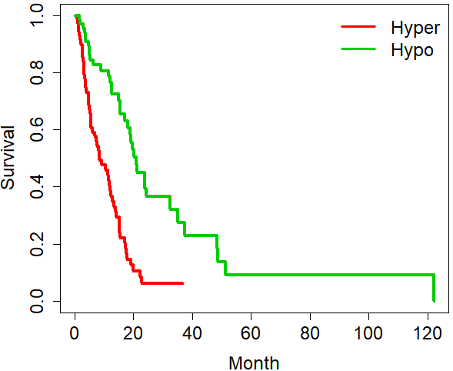

Slide 10
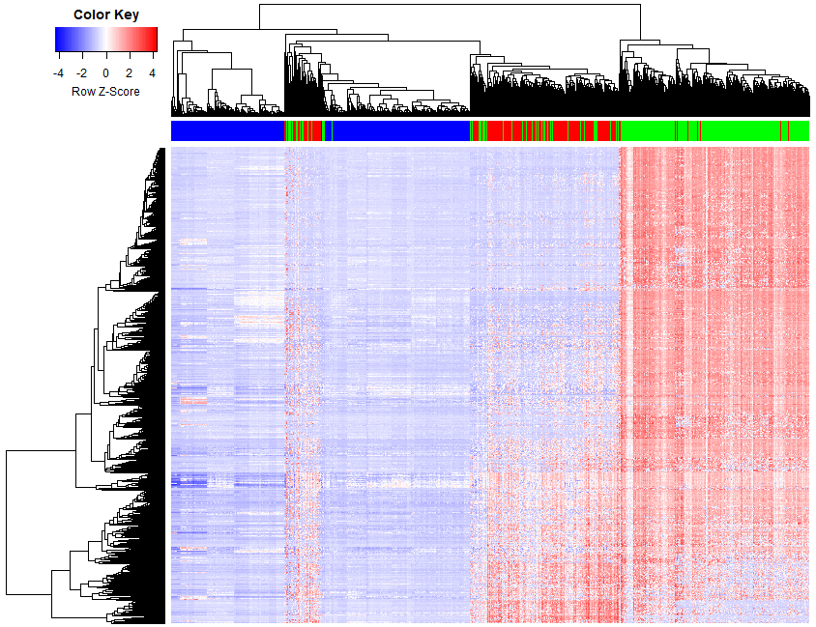

Slide 11
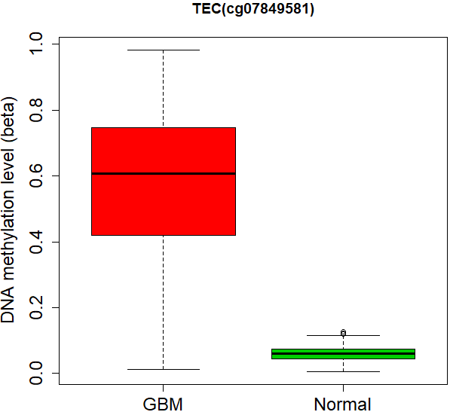
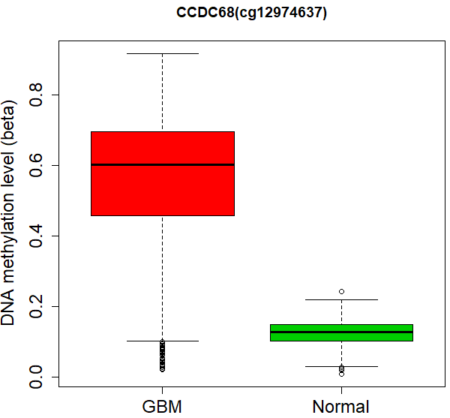

Slide 12
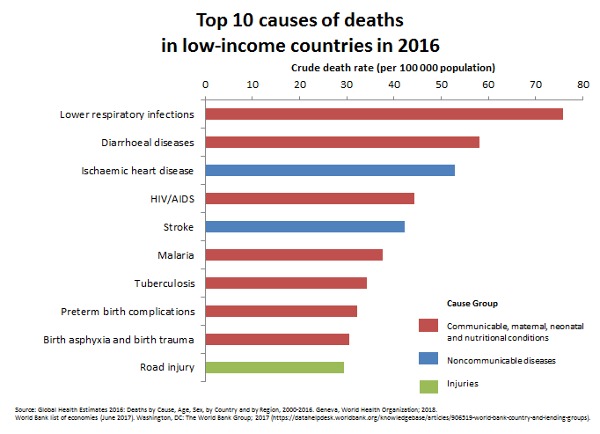
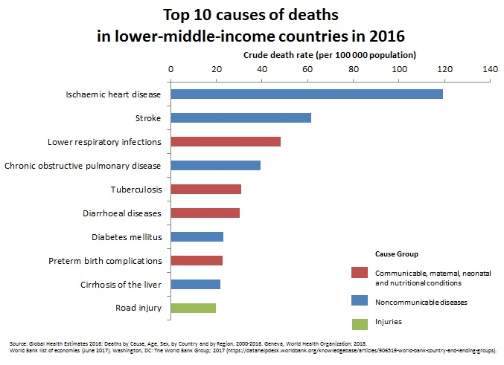
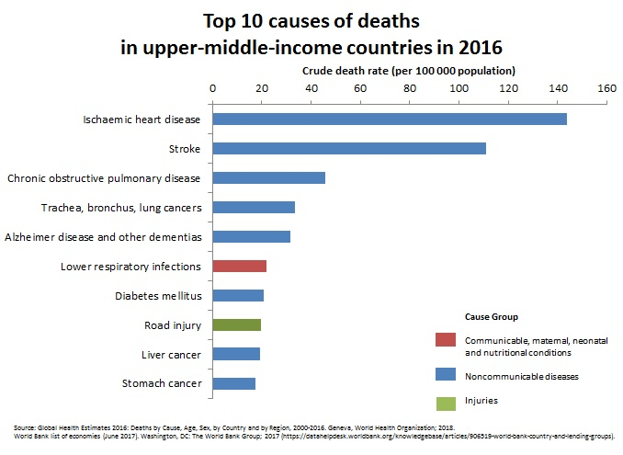
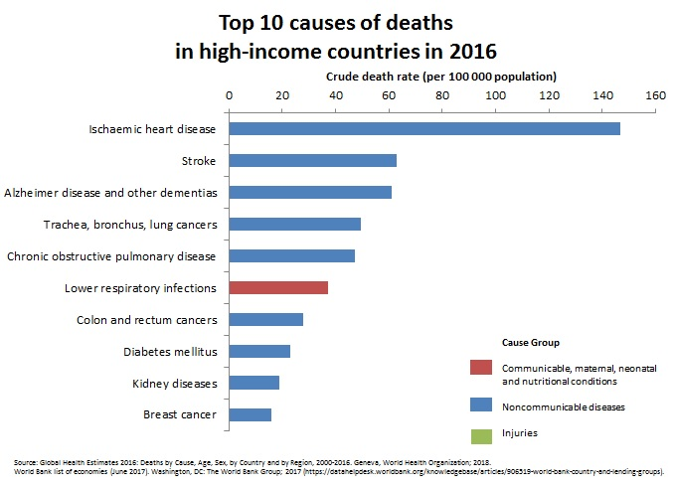

Slide 13
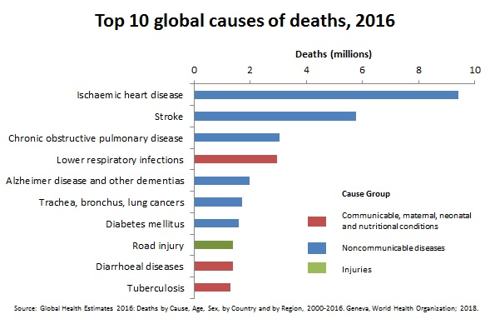

Slide 14
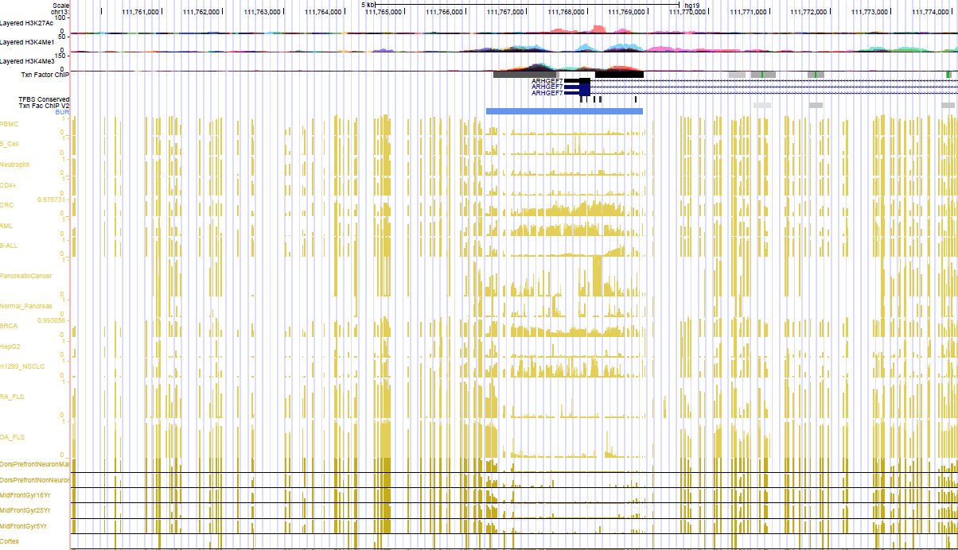
BLOOD
Normal Brain

Slide 16
astrocytic and oligocytic LGGs
astrocytic andoligodendroglial origin

