Slide 1
Long-Region Hypo-methylation in HBV Integration Regions Enhance HCC Non-invasive Surveillance by Low-pass Whole Genome-wide Bisulfite Sequencing

Slide 2
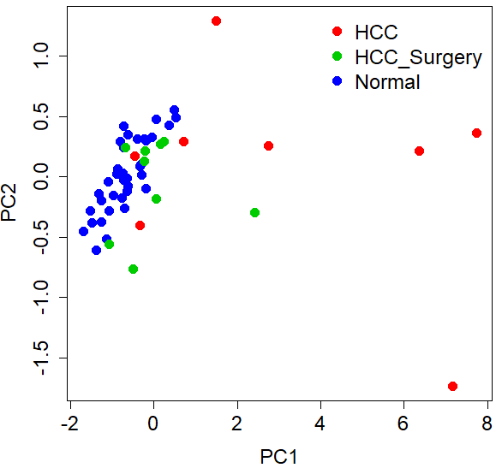
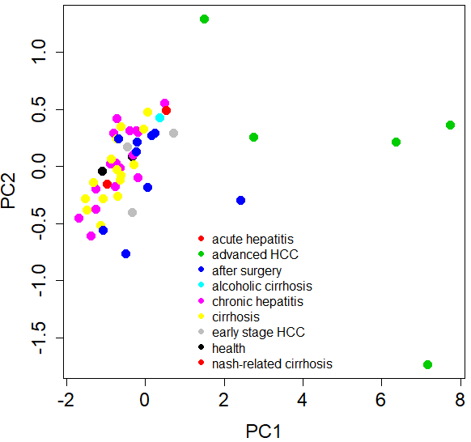
PCA analysis to genome-wide low-pass WGBS HCC dataset

