Slide 1
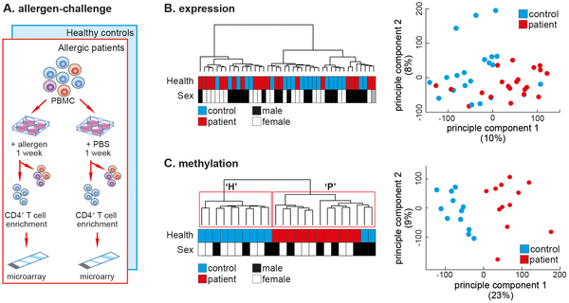

Figure 1. The DNA methylation profile of allergen-challenged CD4+ T-cells separates SAR patients from healthy controls.
Nestor CE, Barrenäs F, Wang H, Lentini A, Zhang H, et al. (2014) DNA Methylation Changes Separate Allergic Patients from Healthy Controls and May Reflect Altered CD4+ T-Cell Population Structure. PLoS Genet 10(1): e1004059. doi:10.1371/journal.pgen.1004059
http://127.0.0.1:8081/plosgenetics/article?id=info:doi/10.1371/journal.pgen.1004059

