Slide 1
DNA Methylation Signatures in MZ Twins Discordant for Smoking

Slide 2
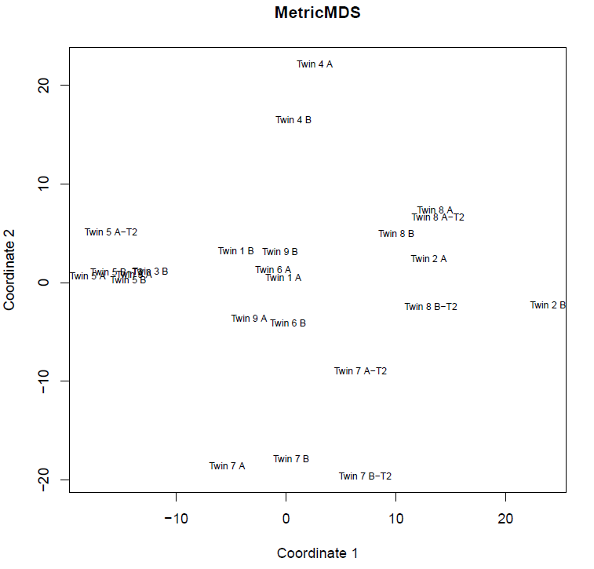
Multidimensional scaling to indicate relationship between samples
Dr. Zhang mention where these guy are living? Do they share same environment exposure?
That means can we make sure all the difference between these twin pairs is only smoking or not? And don’t have too much other difference?
Find the difference between Twin 2 and Twin 5
Find the difference between Twin 4 and Twin 7
Smoking caused variation is quite limited and twin samples have higher similarity
V2: the sample sample collected 5 years later.

Slide 3
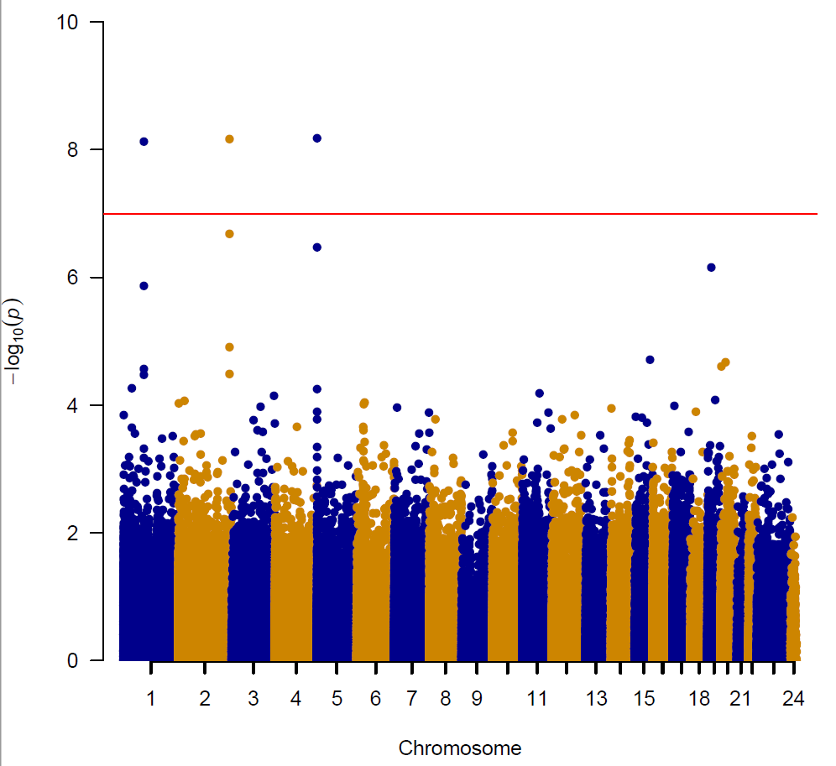
Significant methylation sites associated with smoking
ALPPL2
AHRR
GFI1
F2RL3

Slide 4
Advantage of the twins data to discover more significant CpGs
probeID | logFC | AveExpr | t | P.Value | adj.P.Val | B | CHR | MAPINFO | arm | gene | distancetoGene | feature | cgi | feat.cgi | conserved_tfbs | case_AVG | control_AVG | deltaBeta
cg05575921 | 0.2411208 | 0.6885523 | 8.8512739 | 6.61E-09 | 0.0011947 | 10.110199 | 5 | 373378 | p | AHRR | NA | Body | shore | Body - shore | NA | 0.5679919 | 0.8091127 | 0.2411208
cg21566642 | 0.1498157 | 0.3948443 | 8.8429944 | 6.72E-09 | 0.0011947 | 10.092857 | 2 | 233284661 | q | ALPPL2 | 13109 | IGR | island | IGR - island | NA | 0.3199365 | 0.4697522 | 0.1498157
cg09935388 | 0.1852224 | 0.7414533 | 8.7970852 | 7.38E-09 | 0.0011947 | 9.9965341 | 1 | 92947588 | p | GFI1 | NA | Body | island | Body - island | NA | 0.6488421 | 0.8340645 | 0.1852224
cg05951221 | 0.0949777 | 0.2785986 | 7.2570472 | 2.05E-07 | 0.0248819 | 6.6043459 | 2 | 233284402 | q | ALPPL2 | 12850 | IGR | island | IGR - island | NA | 0.2311098 | 0.3260875 | 0.0949777
cg23576855 | 0.2809509 | 0.5511716 | 7.0386967 | 3.37E-07 | 0.0327098 | 6.0985516 | 5 | 373299 | p | AHRR | NA | Body | shore | Body - shore | NA | 0.4106962 | 0.6916471 | 0.2809509
cg03636183 | 0.1869911 | 0.5739186 | 6.7319672 | 6.84E-07 | 0.0553339 | 5.3782253 | 19 | 17000585 | p | F2RL3 | NA | Body | shore | Body - shore | NA | 0.480423 | 0.6674141 | 0.1869911
cg12876356 | 0.103739 | 0.8195066 | 6.438389 | 1.36E-06 | 0.0944287 | 4.6785741 | 1 | 92946825 | p | GFI1 | NA | Body | island | Body - island | NA | 0.7676371 | 0.8713761 | 0.103739
cg01940273 | 0.1125923 | 0.5031854 | 5.5272337 | 1.23E-05 | 0.7445576 | 2.4527407 | 2 | 233284934 | q | ALPPL2 | 13382 | IGR | island | IGR - island | NA | 0.4468892 | 0.5594815 | 0.1125923
cg23161492 | 0.0601868 | 0.2026948 | 5.3466014 | 1.91E-05 | 0.9999925 | 2.0038733 | 15 | 90357202 | q | ANPEP | NA | 5'UTR | shore | 5'UTR - shore | NA | 0.1726014 | 0.2327882 | 0.0601868
cg12356107 | -0.050546 | 0.2461211 | -5.303167 | 2.13E-05 | 0.9999925 | 1.8956788 | 20 | 22567037 | p | FOXA2 | NA | TSS1500 | island | TSS1500 - island | NA | 0.2713939 | 0.2208483 | -0.050546
cg14176989 | 0.0952806 | 0.4635243 | 5.2520251 | 2.42E-05 | 0.9999925 | 1.7681719 | 20 | 3653877 | p | ADAM33 | NA | Body | island | Body - island | NA | 0.4158839 | 0.5111646 | 0.0952806
cg18146737 | 0.0488216 | 0.9322179 | 5.2062945 | 2.71E-05 | 0.9999925 | 1.6540616 | 1 | 92946700 | p | GFI1 | NA | Body | island | Body - island | NA | 0.9078071 | 0.9566287 | 0.0488216
cg03329539 | 0.0587177 | 0.2871325 | 5.1355822 | 3.23E-05 | 0.9999925 | 1.4774572 | 2 | 233283329 | q | ALPPL2 | 11777 | IGR | shore | IGR - shore | NA | 0.2577736 | 0.3164913 | 0.0587177
cg09662411 | 0.0692712 | 0.802774 | 5.1240906 | 3.32E-05 | 0.9999925 | 1.4487406 | 1 | 92946132 | p | GFI1 | NA | Body | island | Body - island | NA | 0.7681384 | 0.8374096 | 0.0692712
We identified more significant CpG sites with less samples
=> Sequencing data will have more powerful to identify more signficant sites

Slide 5
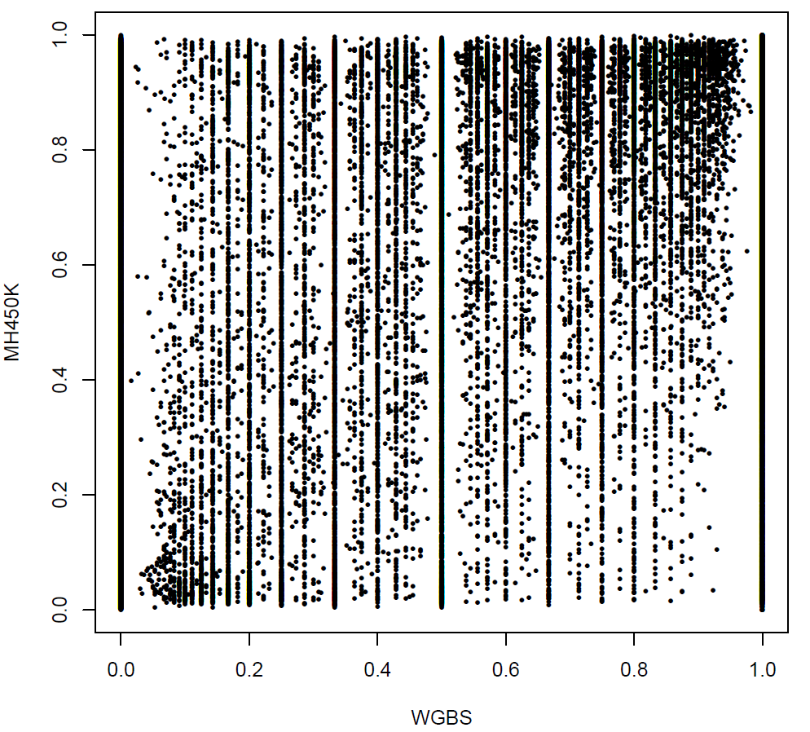
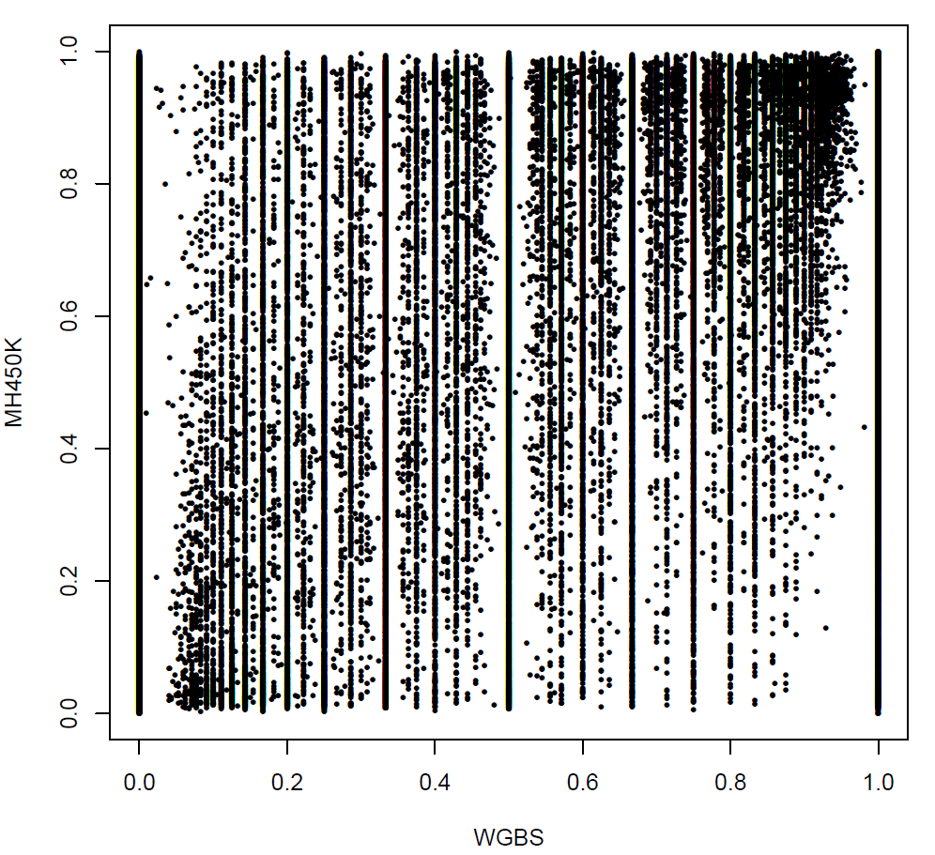
Correlation between MH450K and WGBS dataset
WGBS data: not filtering, coverage>=1
311,264 CpG site: 69.1% MH450K
Twin 4A
R2=0.83
R2=0.847

Slide 6
Aim:
Twins study design have more power to detected significant smoking related CpGs
WGBS data provide large number of Smoking interesting methylation CpGs

Slide 8
SampleID | DNAmAge | meanMethBySample | predictedGender
X9513149041_R01C01 | 60.640754 | 0.258773 | male
X9513149041_R01C02 | 61.652911 | 0.259366 | male
X9513149041_R02C01 | 66.391398 | 0.259491 | male
X9513149041_R02C02 | 64.561675 | 0.26409 | male
X9513149041_R03C01 | 63.802048 | 0.267538 | male
X9513149041_R03C02 | 60.095127 | 0.27072 | male
X9513149041_R04C01 | 64.530672 | 0.260301 | male
X9513149041_R04C02 | 61.999818 | 0.267411 | male
X9513149041_R05C01 | 68.808707 | 0.261204 | male
X9513149041_R05C02 | 65.134727 | 0.263889 | male
X9513149041_R06C01 | 64.193017 | 0.269559 | male
X9513149041_R06C02 | 71.437089 | 0.268652 | male
X9513149042_R01C01 | 57.738613 | 0.261657 | male
X9513149042_R01C02 | 74.145164 | 0.260697 | male
X9513149042_R02C01 | 71.522076 | 0.266667 | male
X9513149042_R02C02 | 66.130438 | 0.269433 | male
X9513149042_R03C01 | 62.231028 | 0.264925 | male
X9513149042_R03C02 | 65.782092 | 0.270608 | male
X9513149042_R04C01 | 68.935917 | 0.27079 | male
X9513149042_R04C02 | 62.68936 | 0.265295 | male
X9513149042_R05C01 | 59.679867 | 0.267897 | male
X9513149042_R05C02 | 66.58892 | 0.266598 | male
X9513149042_R06C01 | 63.061864 | 0.261028 | male
X9513149042_R06C02 | 62.887299 | 0.268489 | male

Slide 9
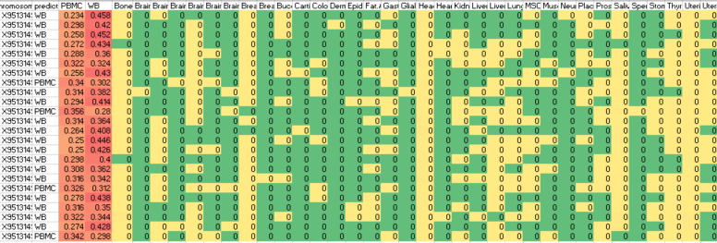
Deconvolution to Twin’s Methylation dataset
All of them were mapping to Blood (PBMC or WB)
It seems the proportion of the blood cell type have some difference
Cell heterogeneity

Slide 10
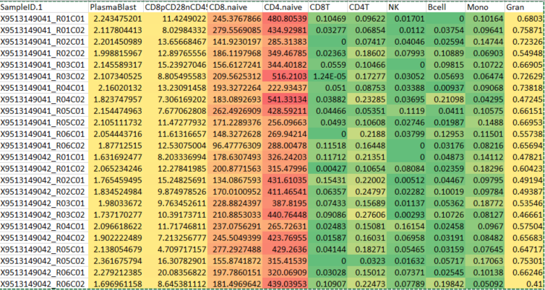
Estimate the abundance of cell-type for blood samples
(CD4-naïve > CD8-naïve) >> other cells
Multivariate Linear Regression Models

Slide 11
Methylation aging effected by smoking
PairID | Time | DNAmAge | title | Type | Age
Twin 3 B | V1 | 61.65291121 | case | 19097_case | 53
Twin 3 A | V1 | 68.80870686 | control | 19097_control | 53
Twin 7 B | V1 | 63.80204805 | case | 19152_case | 52
Twin 7 A | V1 | 66.58891969 | control | 19152_control | 52
Twin 1 B | V1 | 60.64075443 | case | 19225_case | 54
Twin 1 A | V1 | 59.67986749 | control | 19225_control | 54
Twin 8 A | V1 | 65.78209172 | case | 19642_case | 54
Twin 8 B | V1 | 64.56167459 | control | 19642_control | 54
Twin 6 B | V1 | 60.09512718 | case | 19817_case | 58
Twin 6 A | V1 | 62.6893601 | control | 19817_control | 58
Twin 2 A | V1 | 61.99981808 | case | 20114_case | 52
Twin 2 B | V1 | 62.8872985 | control | 20114_control | 52
Twin 5 A | V1 | 66.39139824 | case | 20150_case | 53
Twin 5 B | V1 | 65.13472745 | control | 20150_control | 53
 | V1 | 63.06186423 | case | 20659_case | 58
 | V1 | 68.9359166 | control | 20659_control | 58
Twin 4 A | V1 | 57.73861305 | case | 20876_case | 53
Twin 4 B | V1 | 62.23102771 | control | 20876_control | 53
 | V2 | 71.43708853 | case | 19152_case | 57
 | V2 | 71.5220764 | control | 19152_control | 57
 | V2 | 66.13043812 | case | 19642_case | 59
 | V2 | 64.19301655 | control | 19642_control | 59
 | V2 | 74.14516368 | case | 20150_case | 58
 | V2 | 64.53067245 | control | 20150_control | 58
Smoking decease methylation age (P<0.05)

Slide 12
Abstract: Smoking and methylation: 997 paper
Download Abstract and mapping to human concept database:
78 disease
18 drug
26 Human Metabolites
23 Gene ontology terms
3 pathway
70+ genes or proteins
17 tissues
14 SNPs
Only small subset of the smoking related concept since these are only included in Abstract rather than whole manuscript
GSE50660

