Slide 1
DNA Methylation Signatures in MZ Twins Discordant for Smoking

Slide 2
SampleID | DNAmAge | meanMethBySample | predictedGender
X9513149041_R01C01 | 60.640754 | 0.258773 | male
X9513149041_R01C02 | 61.652911 | 0.259366 | male
X9513149041_R02C01 | 66.391398 | 0.259491 | male
X9513149041_R02C02 | 64.561675 | 0.26409 | male
X9513149041_R03C01 | 63.802048 | 0.267538 | male
X9513149041_R03C02 | 60.095127 | 0.27072 | male
X9513149041_R04C01 | 64.530672 | 0.260301 | male
X9513149041_R04C02 | 61.999818 | 0.267411 | male
X9513149041_R05C01 | 68.808707 | 0.261204 | male
X9513149041_R05C02 | 65.134727 | 0.263889 | male
X9513149041_R06C01 | 64.193017 | 0.269559 | male
X9513149041_R06C02 | 71.437089 | 0.268652 | male
X9513149042_R01C01 | 57.738613 | 0.261657 | male
X9513149042_R01C02 | 74.145164 | 0.260697 | male
X9513149042_R02C01 | 71.522076 | 0.266667 | male
X9513149042_R02C02 | 66.130438 | 0.269433 | male
X9513149042_R03C01 | 62.231028 | 0.264925 | male
X9513149042_R03C02 | 65.782092 | 0.270608 | male
X9513149042_R04C01 | 68.935917 | 0.27079 | male
X9513149042_R04C02 | 62.68936 | 0.265295 | male
X9513149042_R05C01 | 59.679867 | 0.267897 | male
X9513149042_R05C02 | 66.58892 | 0.266598 | male
X9513149042_R06C01 | 63.061864 | 0.261028 | male
X9513149042_R06C02 | 62.887299 | 0.268489 | male

Slide 3
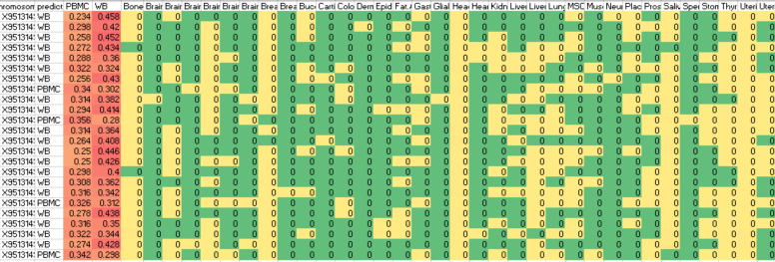
Deconvolution to Twin’s Methylation dataset
All of them were mapping to Blood (PBMC or WB)
It seems the proportion of the blood cell type have some difference
Cell heterogeneity

Slide 4
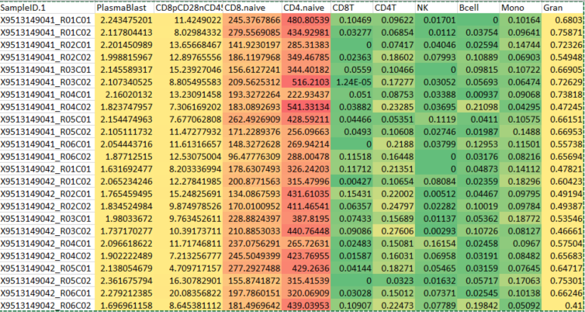
Estimate the abundance of cell-type for blood samples
(CD4-naïve > CD8-naïve) >> other cells
Multivariate Linear Regression Models

Slide 5
Methylation aging effected by smoking
PairID | Time | DNAmAge | title | Type | Age
Twin 3 B | V1 | 61.65291121 | case | 19097_case | 53
Twin 3 A | V1 | 68.80870686 | control | 19097_control | 53
Twin 7 B | V1 | 63.80204805 | case | 19152_case | 52
Twin 7 A | V1 | 66.58891969 | control | 19152_control | 52
Twin 1 B | V1 | 60.64075443 | case | 19225_case | 54
Twin 1 A | V1 | 59.67986749 | control | 19225_control | 54
Twin 8 A | V1 | 65.78209172 | case | 19642_case | 54
Twin 8 B | V1 | 64.56167459 | control | 19642_control | 54
Twin 6 B | V1 | 60.09512718 | case | 19817_case | 58
Twin 6 A | V1 | 62.6893601 | control | 19817_control | 58
Twin 2 A | V1 | 61.99981808 | case | 20114_case | 52
Twin 2 B | V1 | 62.8872985 | control | 20114_control | 52
Twin 5 A | V1 | 66.39139824 | case | 20150_case | 53
Twin 5 B | V1 | 65.13472745 | control | 20150_control | 53
 | V1 | 63.06186423 | case | 20659_case | 58
 | V1 | 68.9359166 | control | 20659_control | 58
Twin 4 A | V1 | 57.73861305 | case | 20876_case | 53
Twin 4 B | V1 | 62.23102771 | control | 20876_control | 53
 | V2 | 71.43708853 | case | 19152_case | 57
 | V2 | 71.5220764 | control | 19152_control | 57
 | V2 | 66.13043812 | case | 19642_case | 59
 | V2 | 64.19301655 | control | 19642_control | 59
 | V2 | 74.14516368 | case | 20150_case | 58
 | V2 | 64.53067245 | control | 20150_control | 58
Smoking decease methylation age (P<0.05)

Slide 6
Abstract: Smoking and methylation: 997 paper
Download Abstract and mapping to human concept database:
78 disease
18 drug
26 Human Metabolites
23 Gene ontology terms
3 pathway
70+ genes or proteins
17 tissues
14 SNPs
Only small subset of the smoking related concept since these are only included in Abstract rather than whole manuscript
GSE50660

