Slide 1
A DNA methylation microarray-based study identifies severail genes commonly methylated in NSCLC
Speaker ： Shicheng Guo
Supervisor： JiuCun Wang & Li Jin

Slide 2
1，Background
Molecular diagnosis
2) Larger Number of Array Datasets in public Database
3) Thousands of Methylation association Study in Cancer Diagnosis

Slide 3
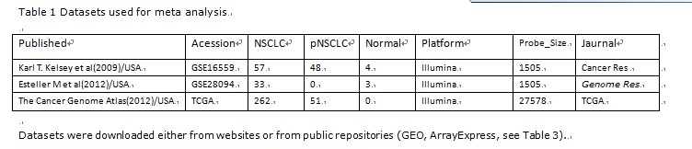
Data Collection and Integration
400 samples: 294 lung cancer,99 para-cancer,7 normal lung tissue.
400 samples: 294 lung cancer,99 para-cancer,7 normal lung tissue.
400 samples: 294 lung cancer,99 para-cancer,7 normal lung tissue.
TCGA
GSE22874
GSE16559
GSE28094
112
27577 probes
GoldenGate
Methylation 27K
1505 probes
There are 112 probes shared by these two type of MicroArray

Slide 4
Great batch effect exist in independent Data and are eliminated after Combat adjustment
Conclusion:
Combat effect elimination method can remove the dataset bias very efficiently

Slide 5
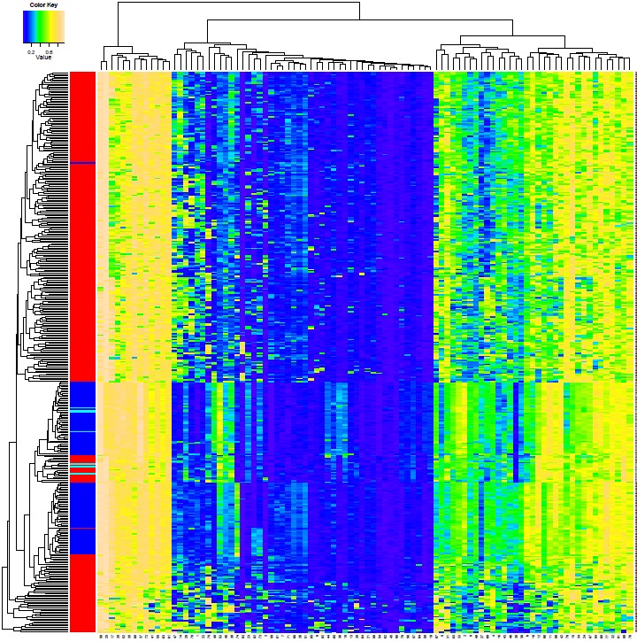
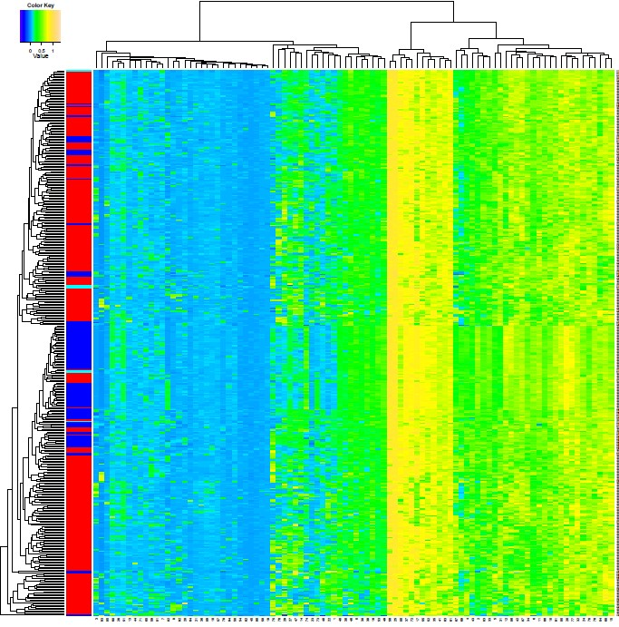
Bilogical information are preserved after Batch effect elimination, desipte with decrease of distinguish ability

Slide 6
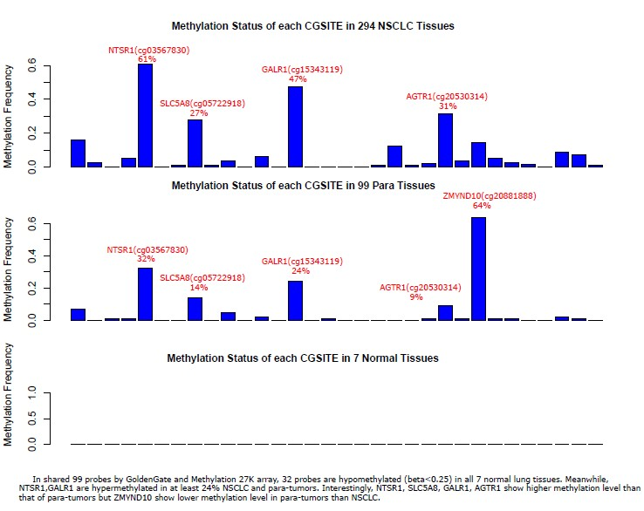
NTSR1，GALR1，AGTR1,SLC5A8 frequently methylated in NSCLC than Para-tumor
ZMYND10 are more frequently methylated in para-tumor than NSCLC

Slide 7
NTSR1，GALR1，AGTR1,SLC5A8 frequently methylated in NSCLC than Para-tumor
ZMYND10 are more frequently methylated in para-tumor than NSCLC
Symbol | Tumor | Para | Normal | Dist_to_TSS | CpG_island
NTSR1 | 61% | 32% | 0 | -318 | Y
GALR1 | 47% | 24% | 0 | 52 | Y
AGTR1 | 31% | 9% | 0 | -154 | Y
SLC5A8 | 27% | 14% | 0 | 60 | Y
ZMYND10 | 12% | 64% | 0 | 77 | Y
DAB2IP | 0.071429 | 0.010101 | 0 | -9 | Y
KIT | 0.057823 | 0.010101 | 0 | -405 | Y
PTGS2 | 0.044218 | 0.010101 | 0 | -524 | Y
MLLT3 | 0.040816 | 0 | 0 | 93 | Y
ETS1 | 0.037415 | 0.020202 | 0 | 253 | Y
DDB2 | 0.030612 | 0.020202 | 0 | -613 | Y
NQO1 | 0.020408 | 0 | 0 | -345 | N
RBL2 | 0.017007 | 0 | 0 | -250 | Y
ZNF264 | 0.017007 | 0 | 0 | 48 | Y
PTPRG | 0.013605 | 0 | 0 | 40 | Y
GSTP1 | 0.013605 | 0.010101 | 0 | 322 | Y
GRB10 | 0.013605 | 0.020202 | 0 | -260 | Y
TFRC | 0.013605 | 0 | 0 | -414 | Y
ITGA2 | 0.010204 | 0 | 0 | -26 | Y
EPHA3 | 0.010204 | 0 | 0 | 156 | Y
BMP2 | 0.006803 | 0 | 0 | -1201 | Y
MCM2 | 0.003401 | 0 | 0 | -260 | Y
ABCC5 | 0.003401 | 0 | 0 | -444 | Y
APBA1 | 0.003401 | 0 | 0 | 99 | Y
MYCL1 | 0.003401 | 0 | 0 | -502 | Y
Neurotensin receptor 1 determines the outcome of non-small cell lung cancer(Clin Cancer Res, 2010). Inhibition of neurotensin receptor 1 selectively sensitizes prostate cancer to ionizing radiation(Cancer Res, 2011).The neurotensin receptor-1 promotes tumor development in a sporadic but not an inflammation-associated mouse model of colon cancer(Int J Cancer, 2012). The potential use of the neurotensin high affinity receptor 1 as a biomarker for cancer progression and as a component of personalized medicine in selective cancers(Biochimie, 2011).
Galanin receptor 1 has anti-proliferative effects in oral squamous cell carcinoma. Journal of Biological Chemistry, 2005. 280(24): p. 22564-71.
FGF9 | 0 | 0 | 0 | -862 | Y
ACVR1C | 0 | 0 | 0 | -363 | Y
DNMT1 | 0 | 0 | 0 | -100 | Y
TUBB3 | 0 | 0 | 0 | -721 | Y
PXN | 0 | 0 | 0 | -308 | Y
MYB | 0 | 0 | 0 | -673 | Y
CAV2 | 0 | 0 | 0 | 33 | Y
Notes:
2. Misawa, K., Y. Ueda, T. Kanazawa, Y. Misawa, I. Jang, J.C. Brenner, T. Ogawa, S. Takebayashi, R.A. Grenman, J.G. Herman, H. Mineta, and T.E. Carey, Epigenetic inactivation of galanin receptor 1 in head and neck cancer. Clinical Cancer Research, 2008. 14(23): p. 7604-13.
3. Kanazawa, T., P.K. Kommareddi, T. Iwashita, B. Kumar, K. Misawa, Y. Misawa, I. Jang, T.S. Nair, Y. Iino, and T.E. Carey, Galanin receptor subtype 2 suppresses cell proliferation and induces apoptosis in p53 mutant head and neck cancer cells. Clinical Cancer Research, 2009. 15(7): p. 2222-30.
Henson, B.S., R.R. Neubig, I. Jang, T. Ogawa, Z. Zhang, T.E. Carey, and N.J. D'Silva, Galanin receptor 1 has anti-proliferative effects in oral squamous cell carcinoma. Journal of Biological Chemistry, 2005. 280(24): p. 22564-71.
Neurotensin receptor 1 determines the outcome of non-small cell lung cancer[2]. Inhibition of neurotensin receptor 1 selectively sensitizes prostate cancer to ionizing radiation[3].The neurotensin receptor-1 promotes tumor development in a sporadic but not an inflammation-associated mouse model of colon cancer[4]. The potential use of the neurotensin high affinity receptor 1 as a biomarker for cancer progression and as a component of personalized medicine in selective cancers[5].

Slide 8
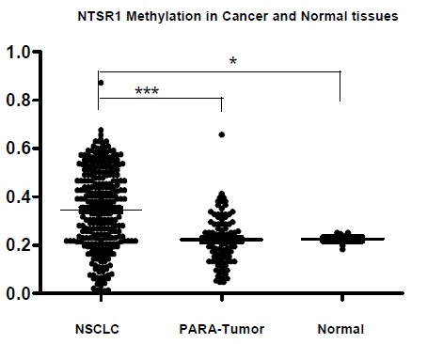
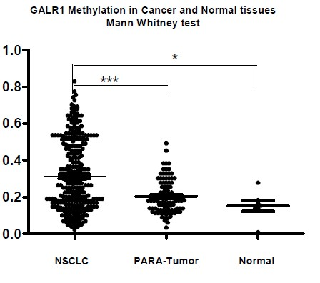
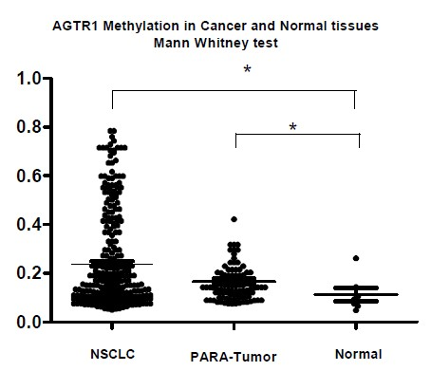
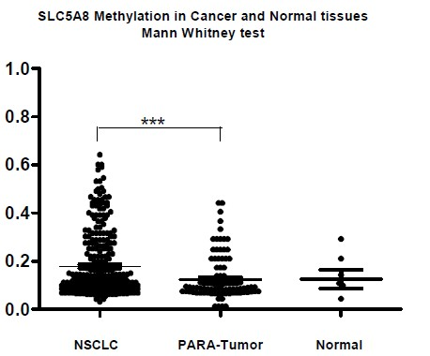
NTSR1，GALR1，AGTR1,SLC5A8 frequently methylated in NSCLC than Para-tumor

Slide 9
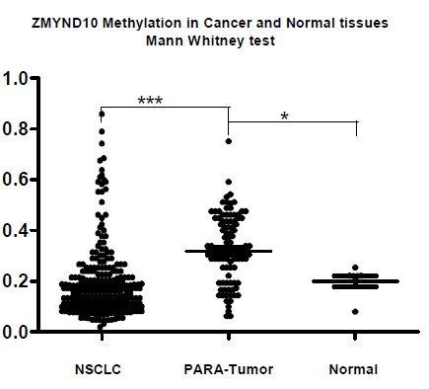
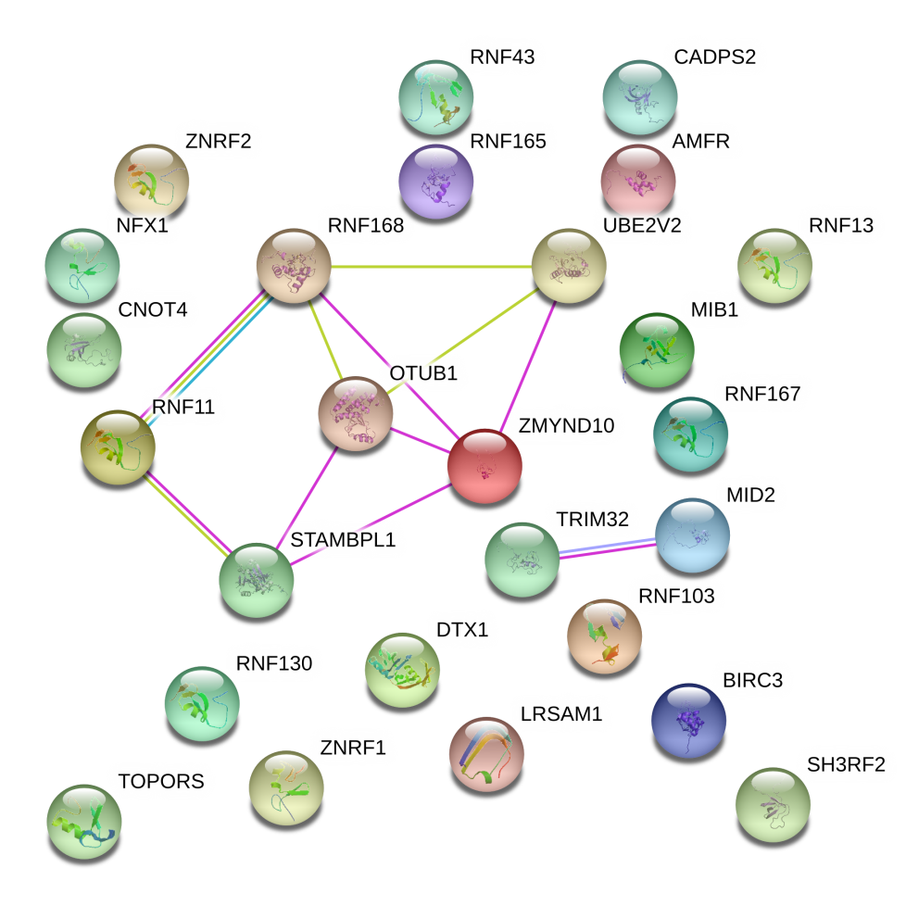
ZMYND10 are more frequently methylated in para-tumor than NSCLC
Epigenetic inactivation of the candidate 3p21.3 suppressor gene BLU in human cancers.
Oncogene 22 (10): 1580–8
promoter region hypermethylation in 19% NSCLC
Cancer Invest. 2010 Jul;28(6):642-8.
High-resolution melting analysis of BLU methylation levels in gastric, colorectal, and pancreatic cancers.

Slide 10
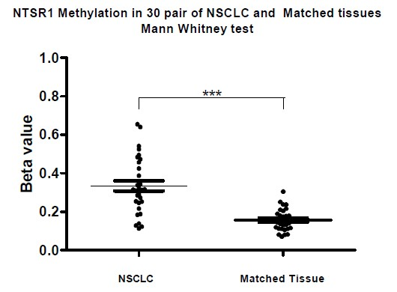
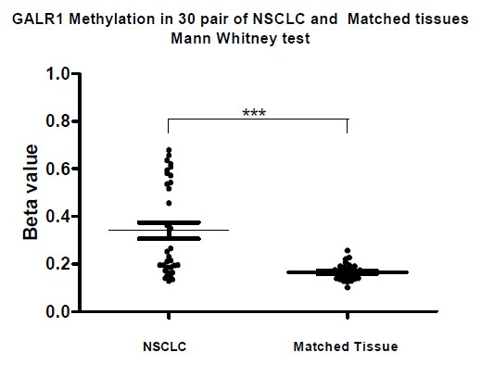
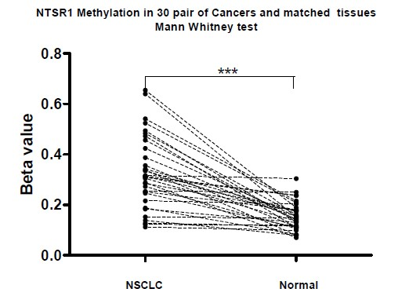
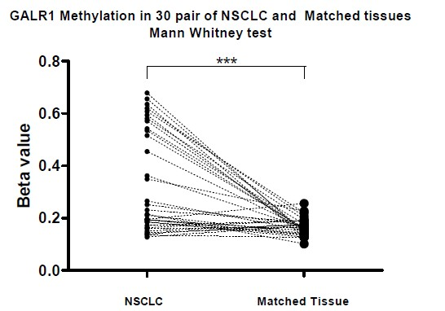
ZMYND10 are more frequently methylated in para-tumor than NSCLC

Slide 11
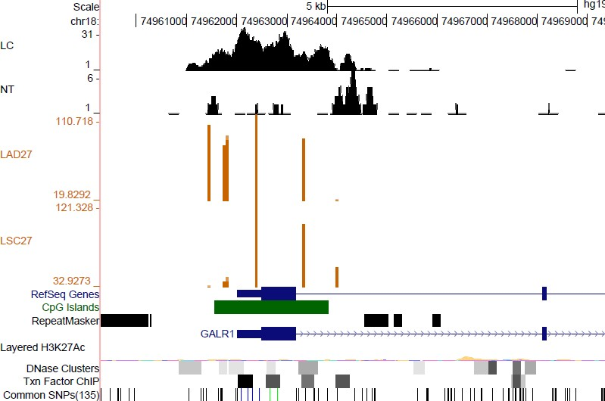
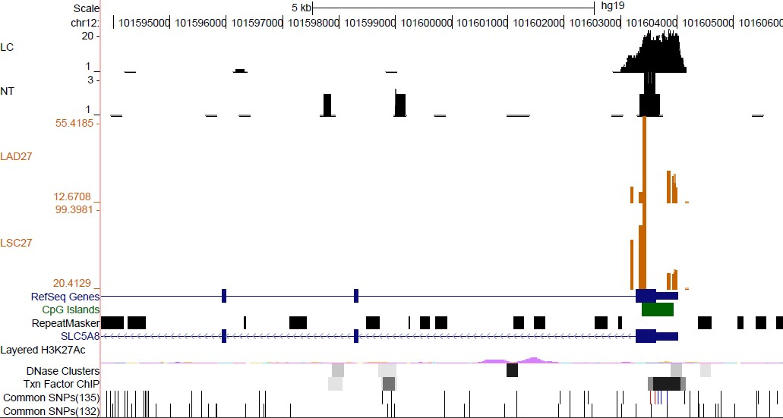
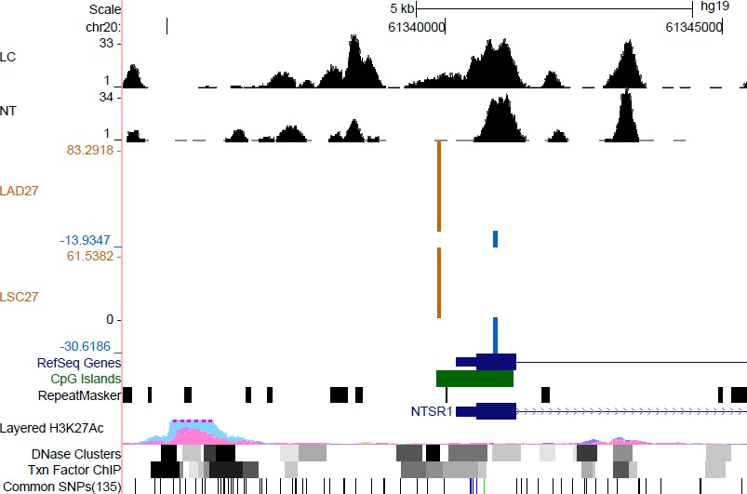
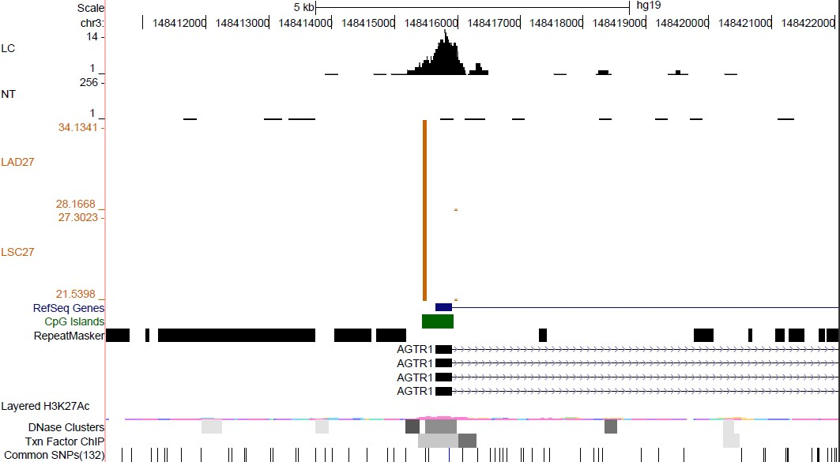
Probes of GALR1 and SLC5A8 are also hypermethylated in NSCLC
Probes of NTSR1and AGTR1 are not consistent with each other.

Slide 12
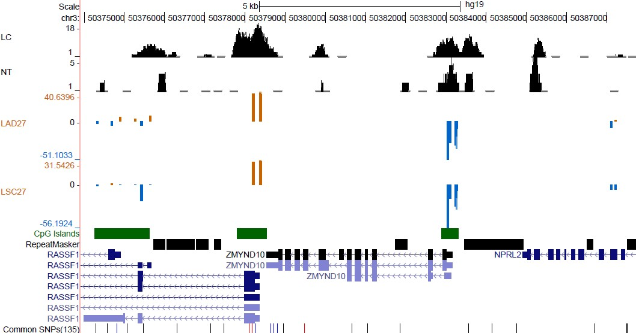
ZMYND10 are more frequently methylated in Para-tumor than
NSCLC in some other probes

Slide 13
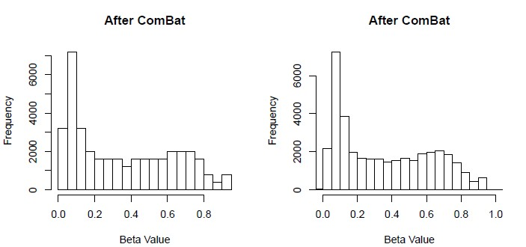

Slide 14
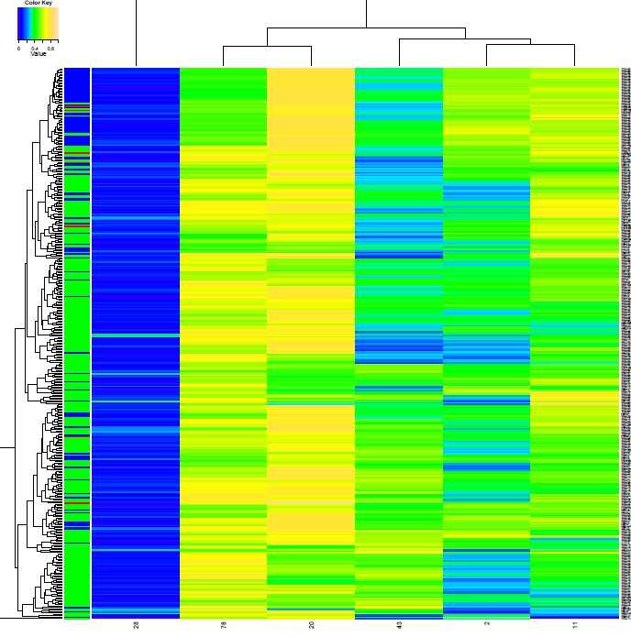

Slide 15
DNA Methylation Analysis In our independent samples
1， Gene：GALR1，SLC5A8, ZMYND10
2，Primer： same to probe location
3，in our 200 NSCLC tissue（100 cancers vs 100 para cancers）

Slide 16
Thanks,Questions

Slide 17
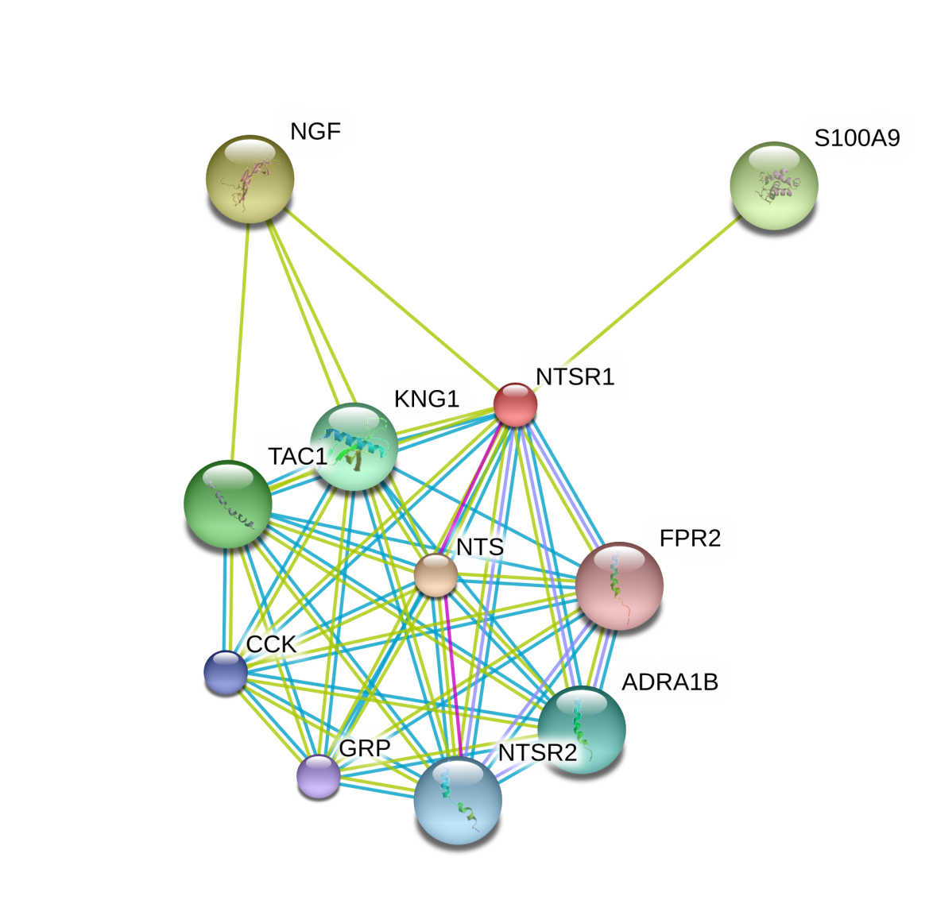
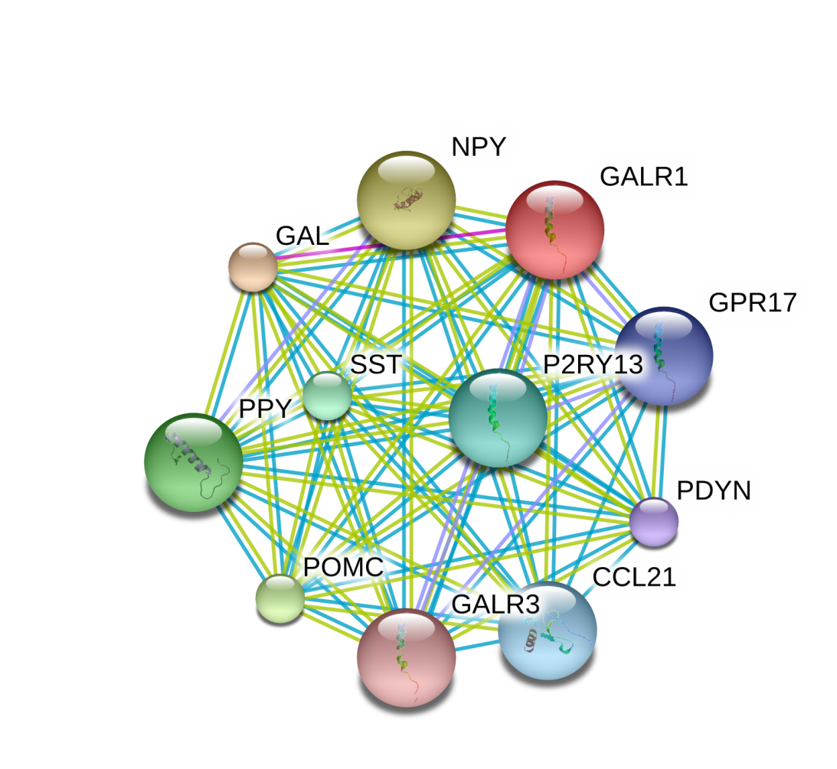
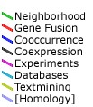
Protein-protein interactions shows NTSR1 and GALR1
Huamn network of protein interactions linked to NTSR1 and GALR1 inferred by STRING
S100A9 S100 calcium binding protein A9
ADRA1B adrenergic, alpha-1B-, receptor
CCK cholecystokinin
FPR2 formyl peptide receptor 2
GRP gastrin-releasing peptide
KNG1 kininogen 1
NGF nerve growth factor (beta polypeptide)
NTS neurotensin
NTSR2 neurotensin receptor 2
TAC1 tachykinin, precursor 1
CCL21 chemokine (C-C motif) ligand 21
GAL galanin prepropeptide
GALR3 galanin receptor 3
GPR17 G protein-coupled receptor 17
NPY neuropeptide Y
P2RY13 purinergic receptor P2Y, G-protein coupled, 13
PDYN prodynorphin
POMC proopiomelanocortin
PPY pancreatic polypeptide
SST somatostatin

Slide 18
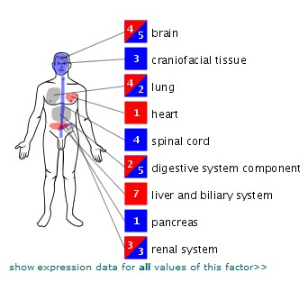
AGTR1 (angiotensin II receptor type 1)
They are located primarily in the liver, kidney, adrenal gland and lung where they play a role in vasoconstriction, aldosterone and vasopressin release, salt and water retention, cell proliferation and migration and sympathetic stimulation

Slide 19
and confirmed the microarray results by real time-PCR. Western Blotting confirmed induction at the protein level of AGTR1, the most highly induced gene in both control and fibrotic lung fibroblasts among genes encoding for signal transduction molecules. Upregulation of AGTR1 occurred through the MKK1/MKK2 signalling pathway. Immunohistochemical staining showed AGTR1 expression by lung fibroblasts in fibroblastic foci within biopsies of idiopathic pulmonary fibrosis. Conclusions: This study identifies several novel TGFβ targets in lung fibroblasts, and confirms with independent methods the induction of angiotensin II receptor type 1, underlining a potential role for angiotensin II receptor 1 antagonism in the treatment of lung fibrosis.

