Slide 1
Genome-wide DNA methylation analysis uncovers novel epigenetic changes in human atrial fibrillation
Dr. Michael Caldwell
Dr. Ingrid Glurich
Dr. Steven Schrodi
Dr. Shicheng Guo
Center for Precision Medicine Research
Marshfield Clinic Research Institute
07/19/2019
Notes:
Hi Everyone, Good Afternoon. Please first let me say thank to give me an opportunity to share the works what I have done in the past 10 years since my PhD training. This Aim of this presentation is to let know what I have done. What I am interested. What project I have charged or participated and played important roles in data analysis and manuscript preparation. It is not a easy job for me to give a comprehensive and detailed explanation for all the methods and conceptions. So when you listen to this presentation, try to capture the big pictures, try to capture the stories.

Slide 2
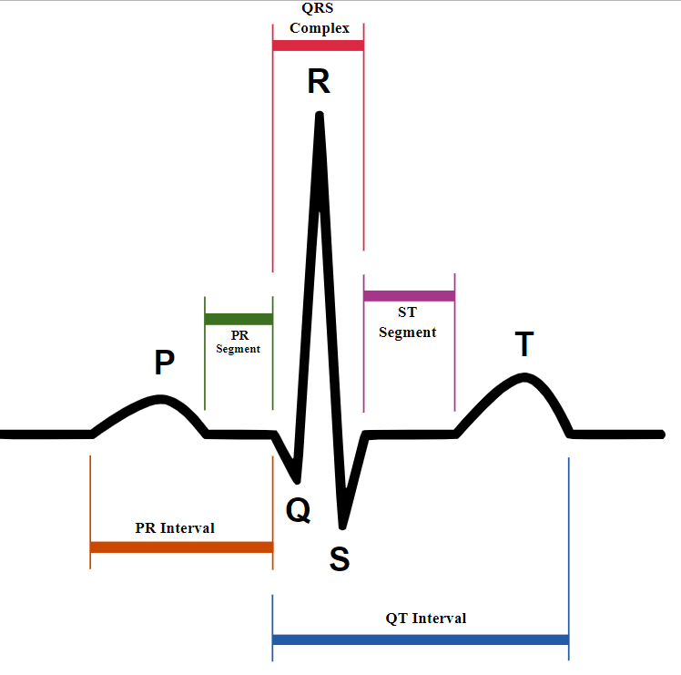
Genetic and Epigenetic of Human Atrial Fibrillation
29 significant SNPs were identified based on GWAS studies
However, predictive value of genetic variant to AF is very limited
Very difficult to translate genetic risk scores into clinical practice
To identify AF related methylation changes in heart
DNA methylation‑mediated epigenetic regulation may serve an role in AF pathogenesis, and susceptible CpG-SNPs may be involved in the initiation of AF

Slide 3
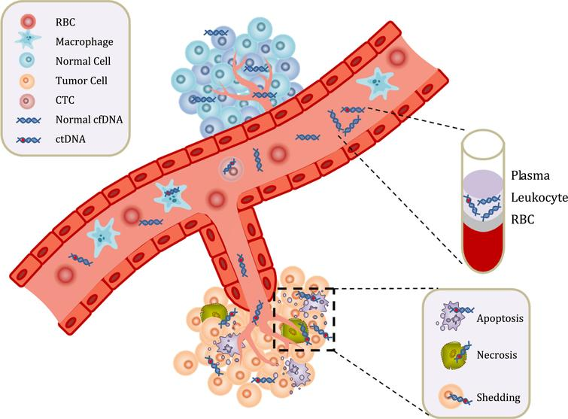
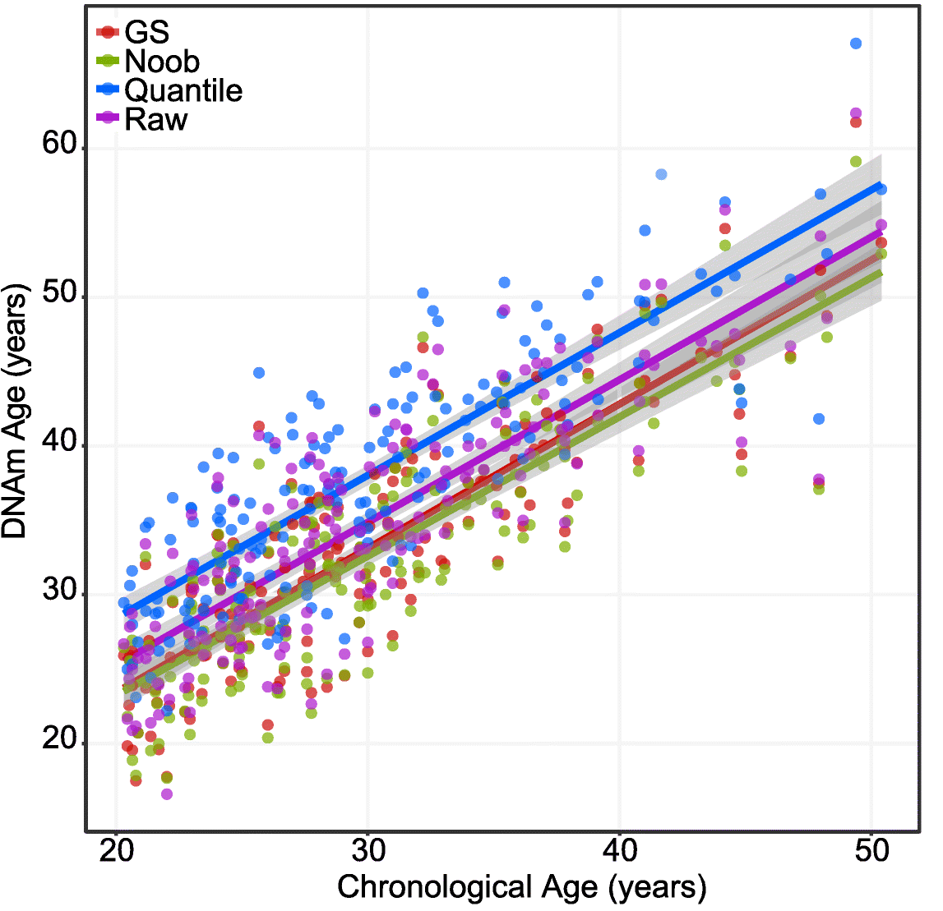
DNA methylation and human diseases
DNA methylation shows different patterns in human diseases: cancer and autoimmune diseases
DNA methylation shows strong tissue specificity: different tissues have different methylation patterns
DNA methylation age vs chronological age: not always same

Slide 4
Computational analysis strategy in different scenario
24 vs 24
24 vs 4

Slide 5
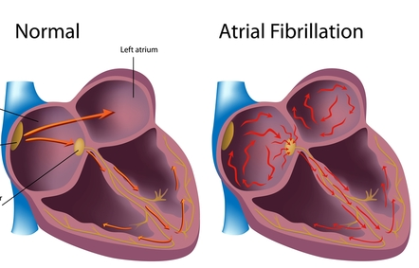
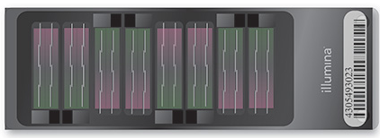
Blood Cell Correction
Cell Type Estimation
DMC/DMR/Manhattan/Q-Qplot
Quality Control
Gene Set Enrichement Analysis(GSEA)
Batch Effect Detection
DMC-PPI Enrichment Analysis
BMIQ Normalization
CNV Detection
Methylation Age Estimation (MAE)

Slide 6
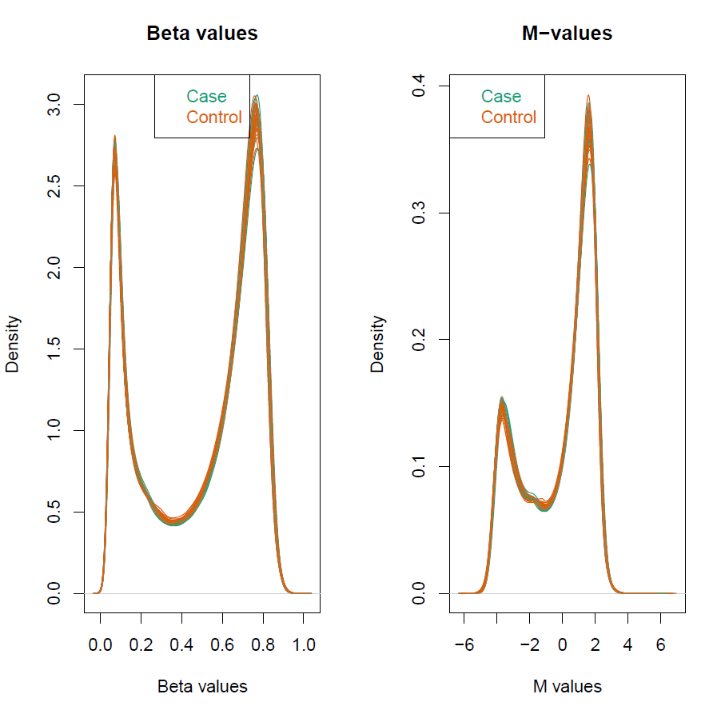
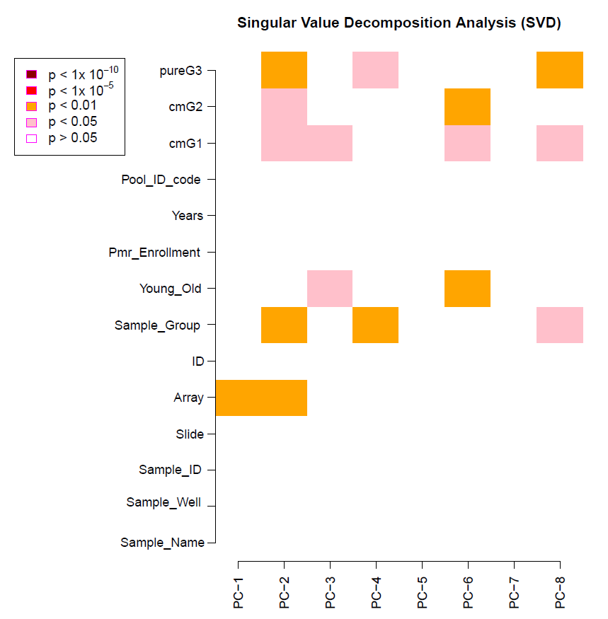
DNA methylation microarray quality control

Slide 7
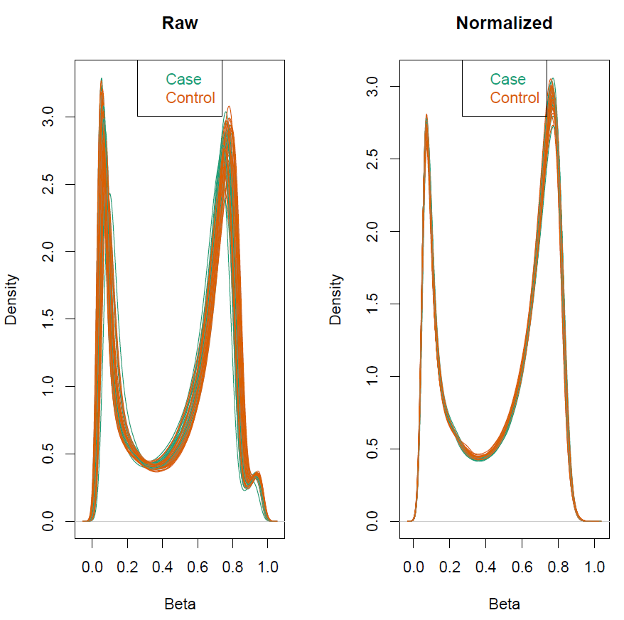
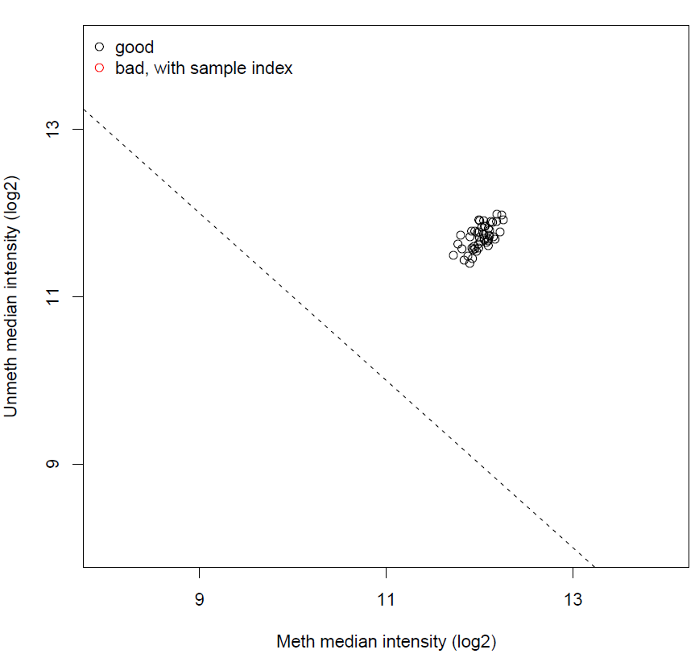
DNA methylation microarray data normalization

Slide 8
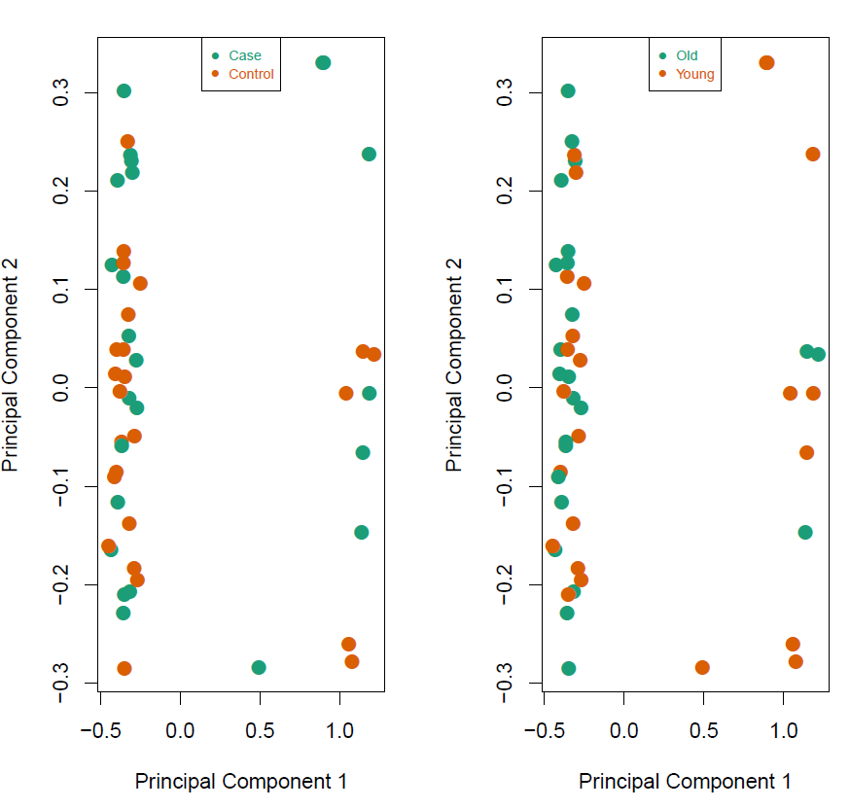
PCA analysis to reveal the data structure (variations)

Slide 9
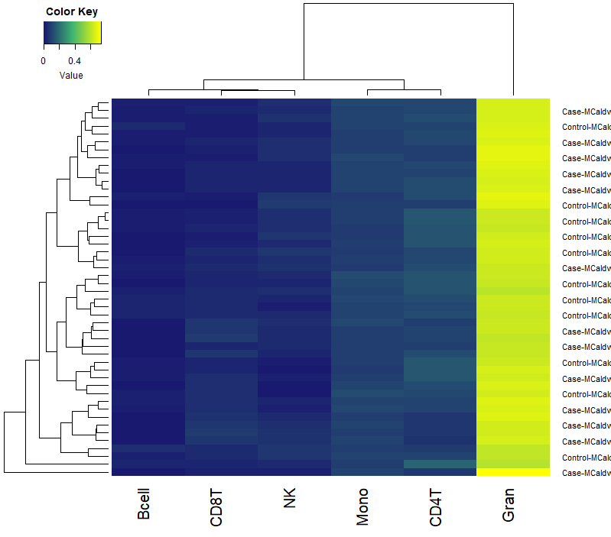
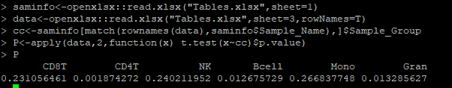
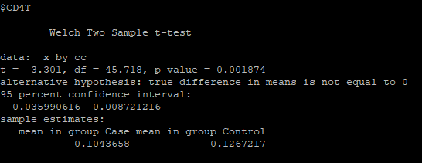
Blood cell deconvolution based on DNA methylation
Gran cell is the dominant cell type (~64%)
CD4T, B-cell, Gran

Slide 10
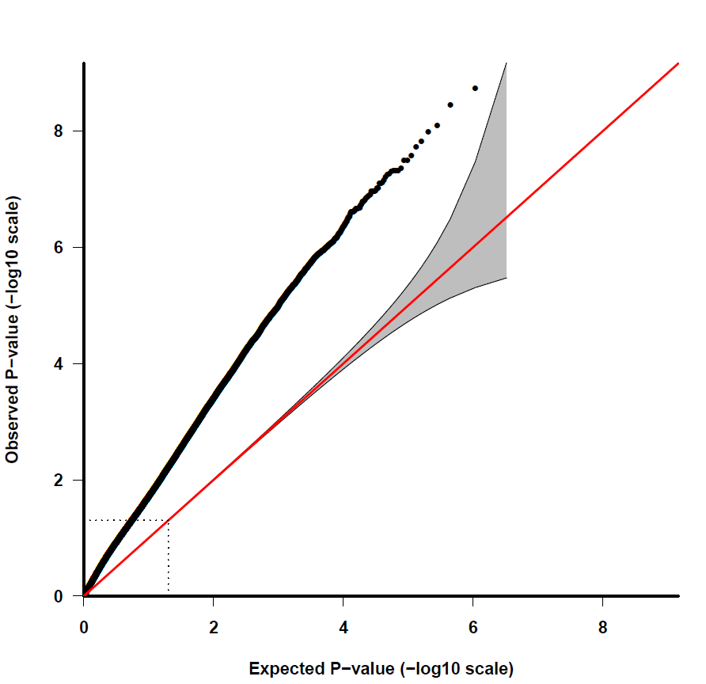
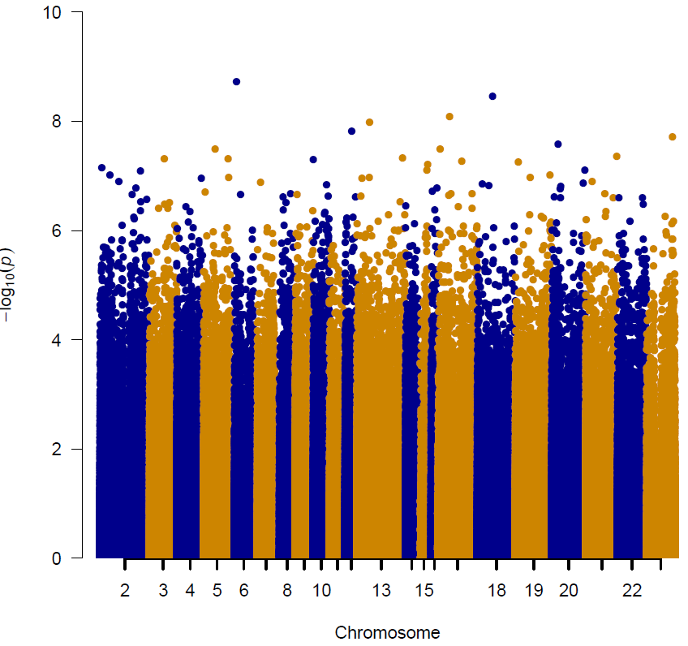
Genome-wide DNA methylation analysis between AF and normal control

Slide 11
Table 1. Significant differential methylation loci between 24 case and 24 control

Slide 12
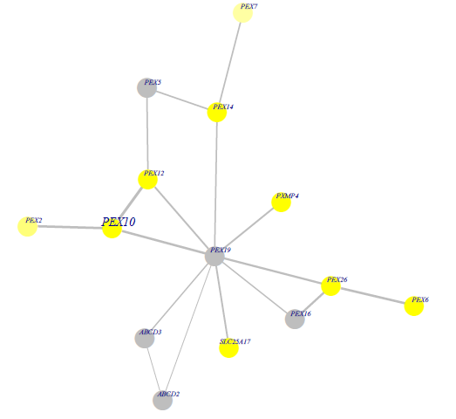
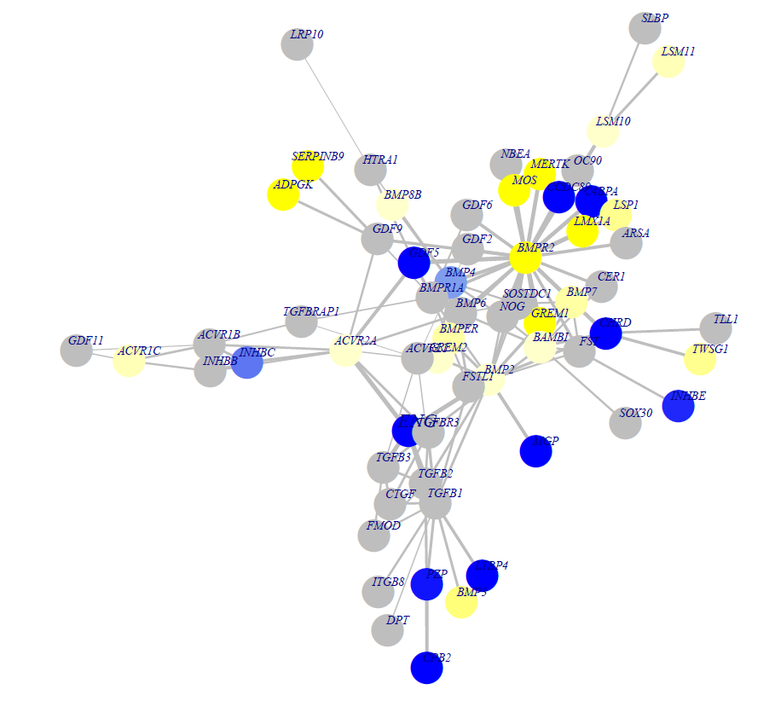
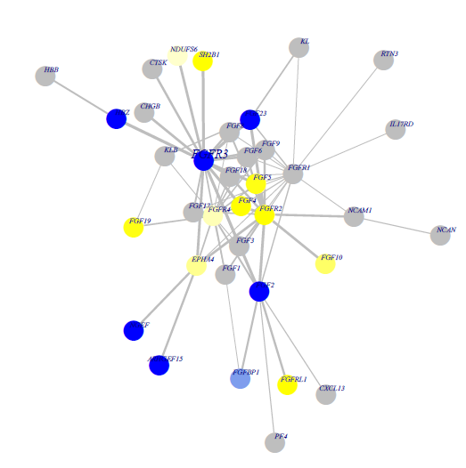
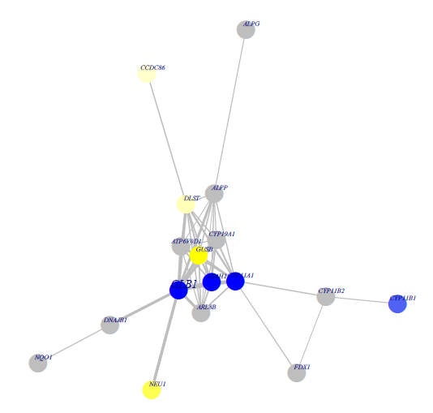
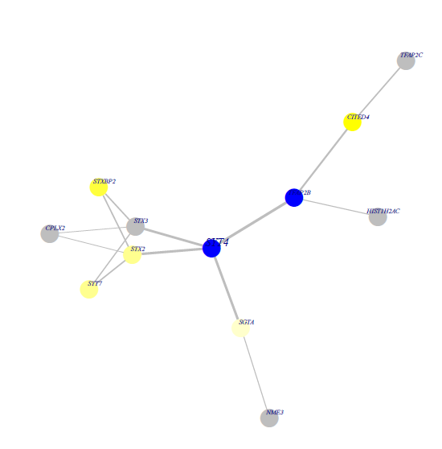
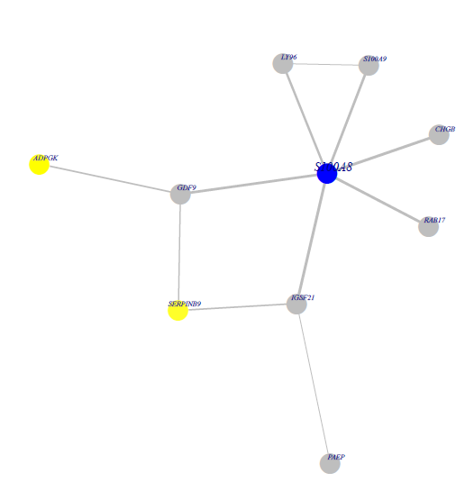
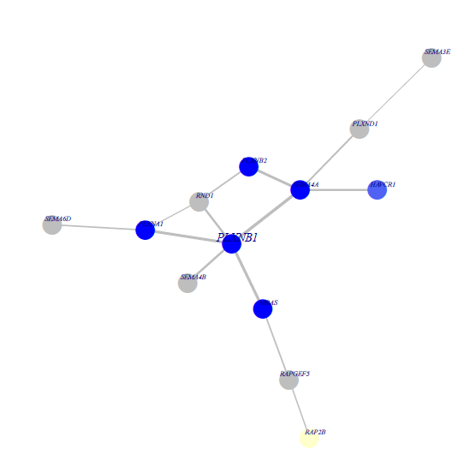
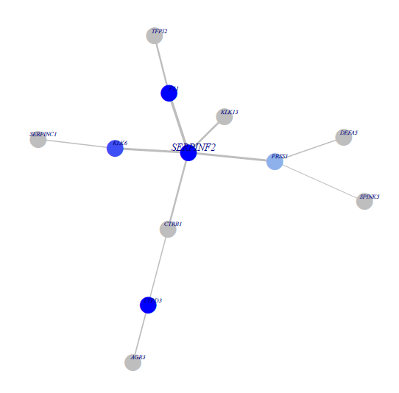
Genome-wide DNA methylation analysis uncovers novel Interaction Hotspots in human atrial fibrillation
ENG
FGFR3
GLB1
PEX10
PLXNB1
S100A8
SERPINF2
SYT4

Slide 13
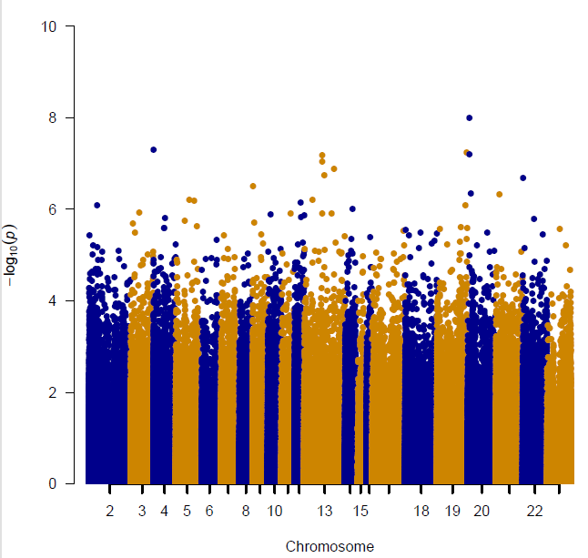
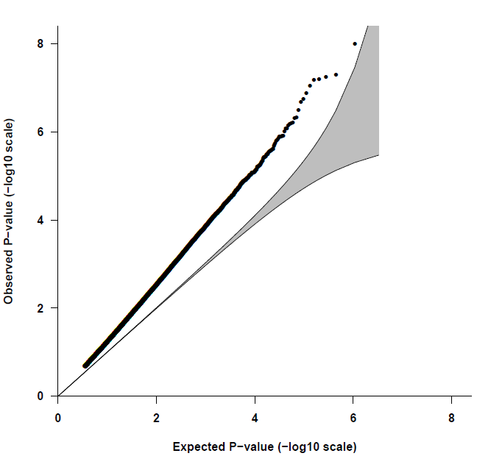
Genome-wide DNA methylation analysis between younger and older samples
238 DMC

Slide 14
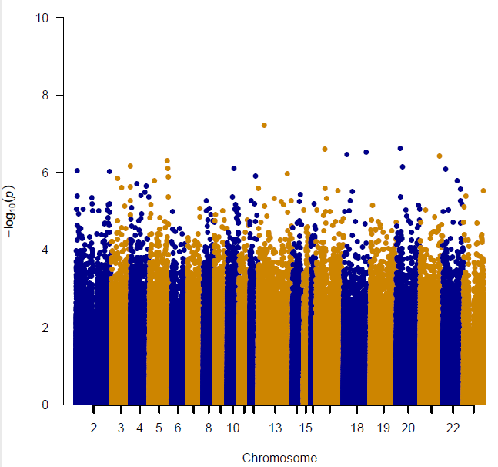
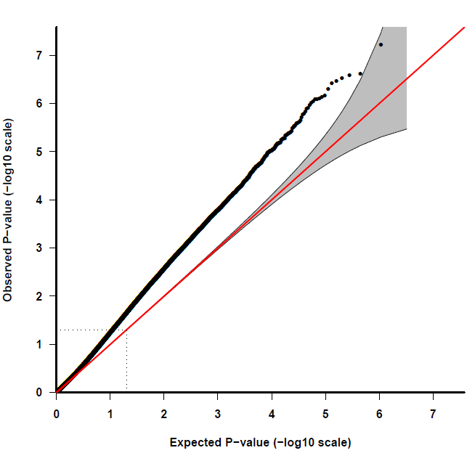
Genome-wide DNA methylation analysis between old case and old control
6 DMC

Slide 15
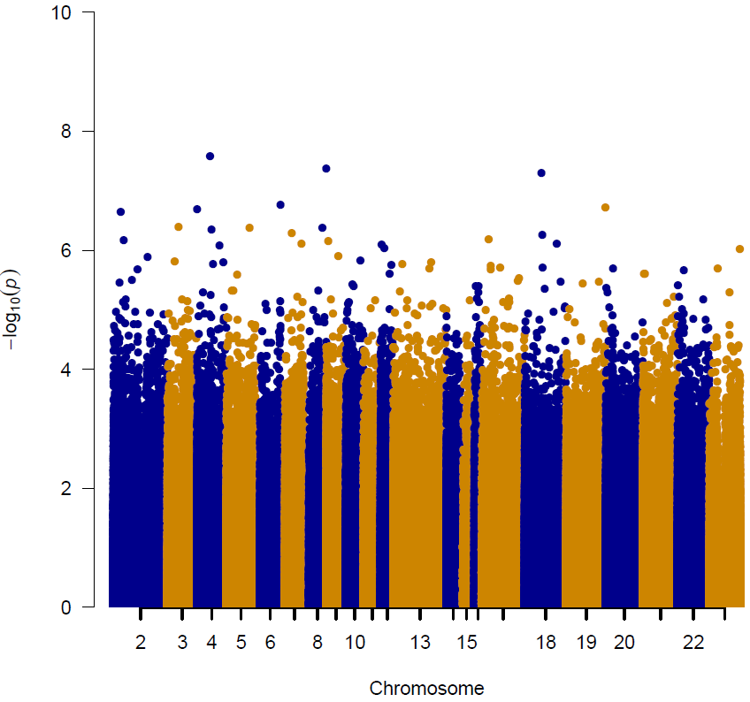
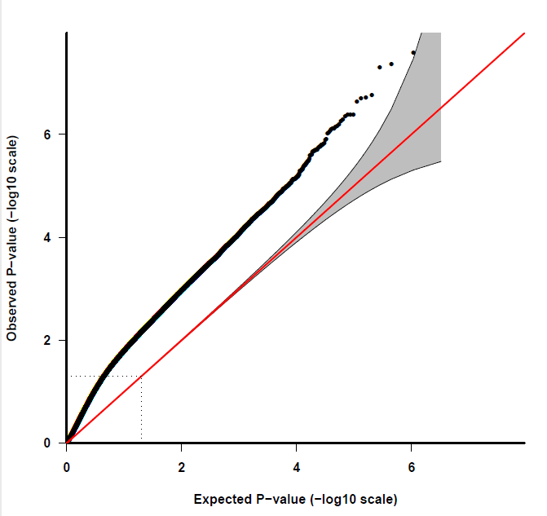
Genome-wide DNA methylation analysis between young-case and young-control
45 DMC

Slide 16
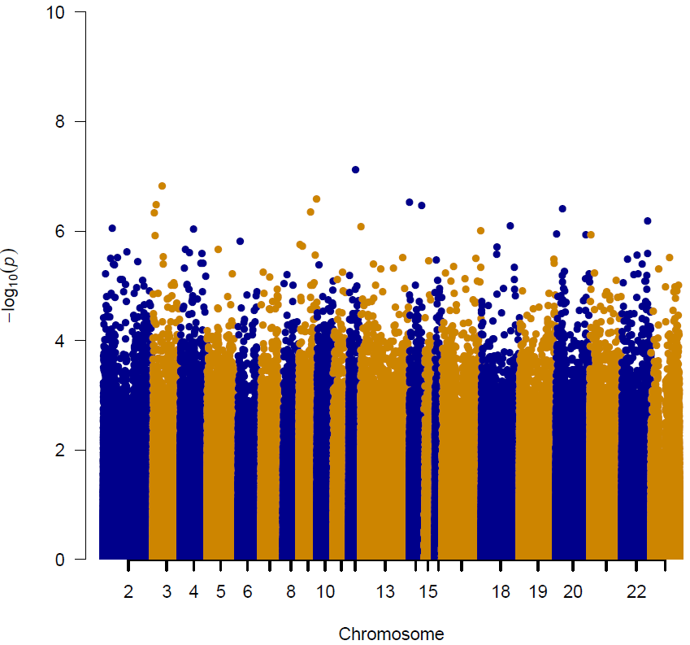
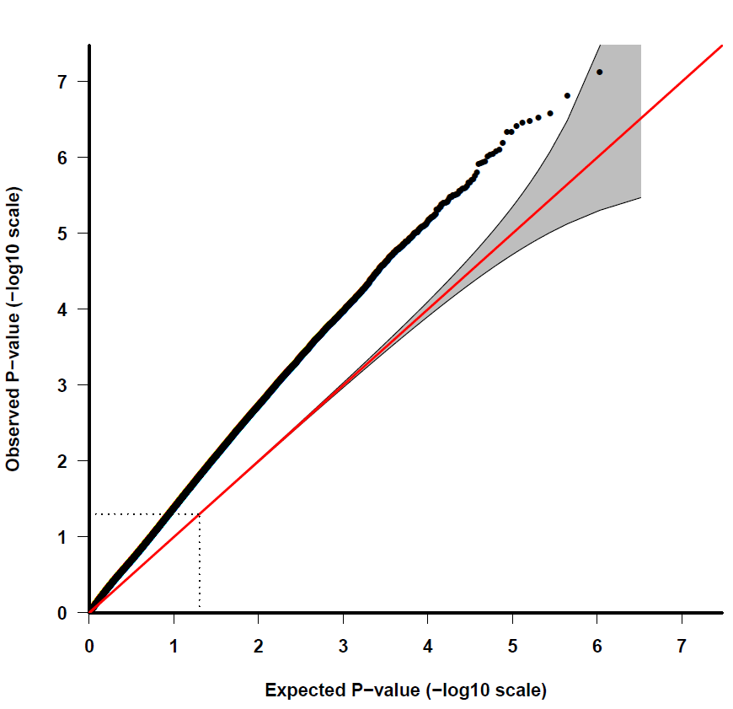
Genome-wide DNA methylation analysis between case-before and control-before
19 DMC

Slide 17
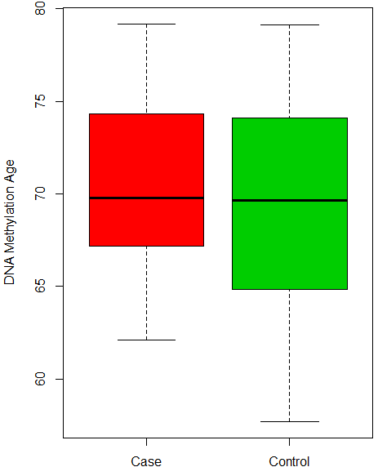
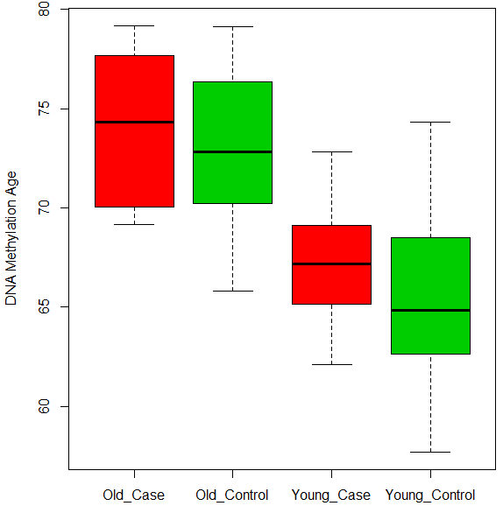
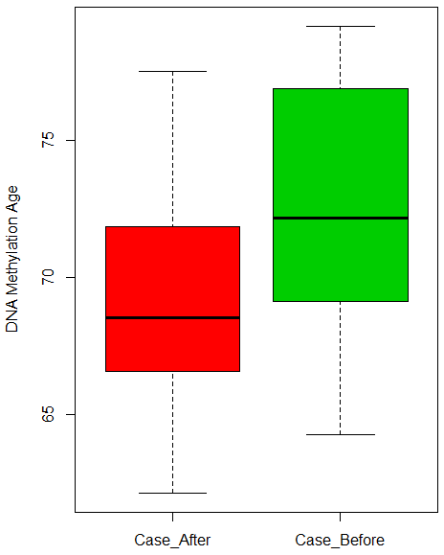
Methylation age estimation reveals accelerated aging of atrial fibrillation
Kruskal-Wallis rank sum test data: DNAmAge_Norm by cmG1 Kruskal-Wallis chi-squared = 24.028, df = 3, p-value = 2.47x10⁻⁵

