Slide 1
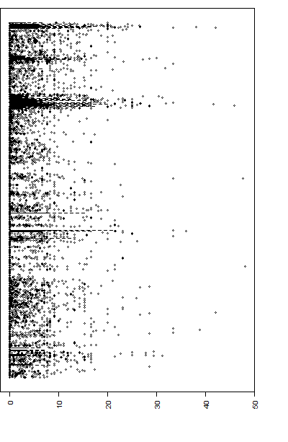
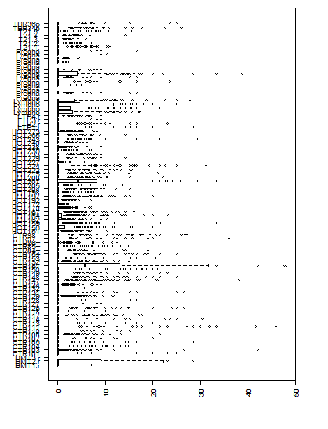
Figure 1. Variation of DNA methylation in mitochondrial genome (%)
Variation of DNA methylation in each CpG site of mitochondrial genome.
B) Variation of DNA methylation in different individual of mitochondrial genome.
Shihcheng.Guo@gmail.com

