Slide 1



Identification of DNA methylation based cholangiocarcinoma biomarker and validation with cfDNA MSRE-PCR
Dr. Shicheng Guo, Dr. Minghua Wang, Dr. Steven Schrodi
04/4/2019

Slide 2
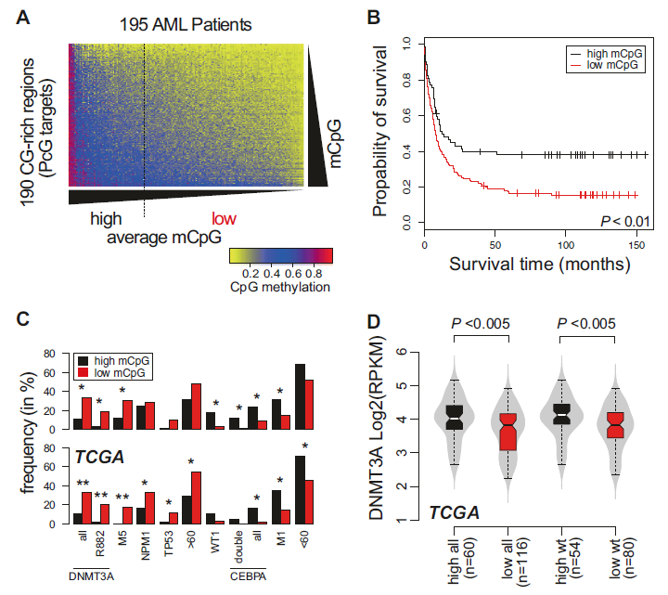

Slide 3
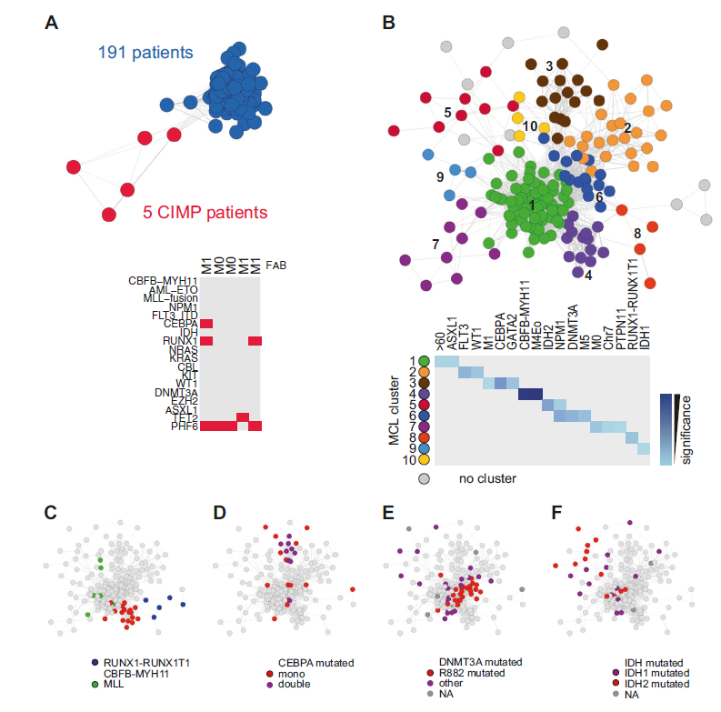

Slide 4
GBM
VS
Control
N=555 N=333
Batch effect checking
Cell type checking
Gender and Age checking
Differential methylation analysis
2154 GBM methylation biomarkers
PBMC
BUR checking
SNP checking
N=1198
215 GBM methylation biomarkers
TFBS region checking
H3K4Me1/Me3 region checking
H3K27ac region checking
25 GBM methylation biomarkers
Pathway checking
Oncogene/TSG checking
Epigenetic factor checking
15 GBM methylation biomarkers

Slide 5
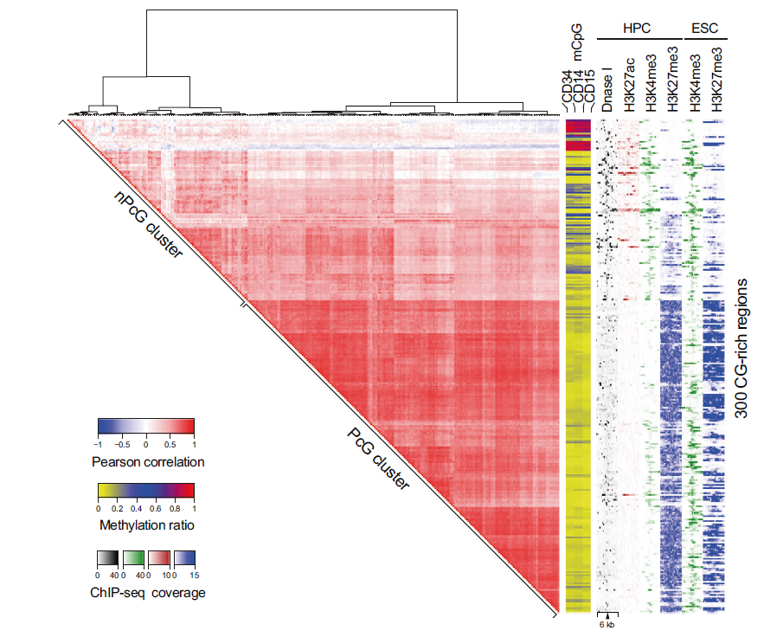

Slide 6
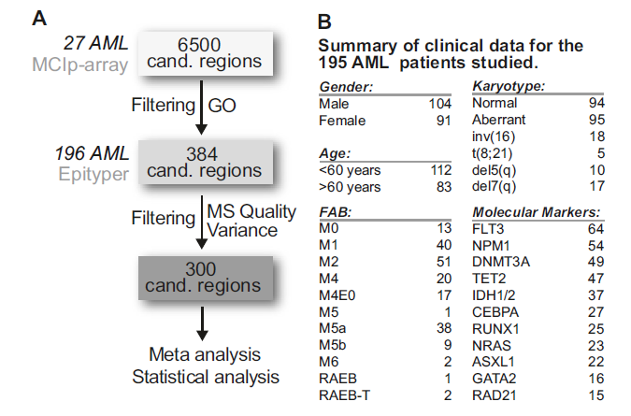

Slide 7
 | LGG/GBM | Normal | Beadchip | Design
TCGA-LGG | 516 | 0 | HM450K | Discovery
TCGA-GBM | 140 | 2 | HM450K | Discovery
GSE103659 | 181 | 0 | HM450K | Discovery
GSE114534 | 44 | 0 | HM450K | Discovery
GSE66351 | 190 | 0 | HM450K | Discovery
GSE41826 | 0 | 58 | HM450K | Discovery
GSE89707 | 0 | 142 | HM450K | Discovery
GSE74486 | 0 | 131 | HM450K | Discovery
Sum | 1071 | 333
GSE36194 | 0 | 724 | HM27K | Validation
GSE53229 | 145 | 0 | HM27K | Validation
GSE50923 | 54 | 23 | HM27K | Validation
GSE46015 | 3 | 0 | HM27K | Validation
GSE22867 | 55 | 3 | HM27K | Validation
GSE119774 | 39 | 0 | HM850K | Validation
GSE116298 | 12 | 0 | HM850K | Validation
Sum | 308 | 750

Slide 8
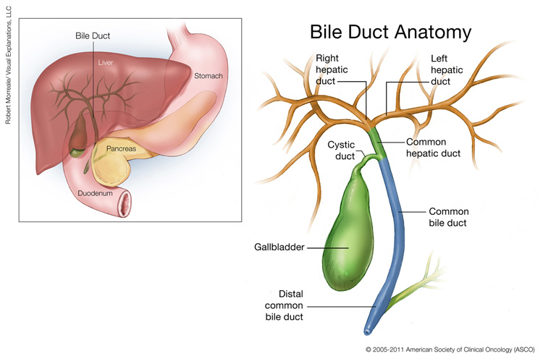
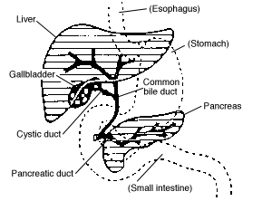
http://www.cancer.net/cancer-types/bile-duct-cancer-cholangiocarcinoma/medical-illustrations

Slide 9
1. Do you want to stimulate a) PBMC b) CD8+/CD4+ T cells ?
2. Do you want to stimulate Antigen-specific ?

Slide 10
DNA methylation Microarray Dataset (GEO/ArrayExpress/TCGA)
Combination
107 genes in 458 samples
GSE16559 (57 NSCLC and 52 Normal)
GSE28094 (33 NSCLC and 3 Normal)
TCGA Lung (262 NSCLC and 51Normal)
Normalization
Discovery Stage
Batch effect elimation
ComBat method
Feature selection
Best biomarkers/features combination
NTSR1, SLC5A8, GALR1, AGTR1 and ZMYND10
150 NSCLC and 150 adjacent Normal
MSD-SNuPE
Multi-loci quantitative methylation detection
Logistic regression model
Decision tree
Random forest
Support vector machine (SVM)
Neural network
Bayes tree
Validation Stage
Model Building
Model Evalution
Five-fold cross-validation
Sensitivity, Specificity, Accuracy and AUC

