Slide 1
CSE-EPI 8803
Leveraging
Internet Data and
Deep Learning Method
for COVID-19 Case Prediction
in California
Tongzhou Yu, Siyan Cai, Shichen Li
2021/12/02

Slide 2
O1
Introduction & Motivation
O2
Data
Tweet Data Collection, Other Data Sources
CONTENTS
O3
Approach
Overview, Tweet Feature Engineering-NLP, LSTM
O4
Experiment & Results
LSTM Results, Feature Importance
O5
Conclusion

Slide 3
Introduction & Motivation
/01

Slide 4
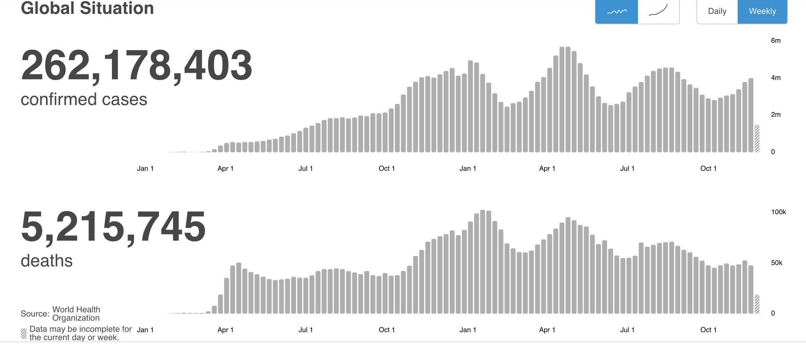
Introduction – COVID19
Global COVID-19 data from WHO as of December 1st , 2021
It’s a natural idea to predict COVID’s future development.
01

Slide 5
Motivation – Why forecasting?
COVID prediction can be very useful
01
02
03
Respond with Appropriate Policies
Allocate Medical Resources
Public Awareness
Public health: Mandatory masks, social distancing, curfews, quarantine
Socioeconomic: financial aid
…
Ventilators, ICU beds
Doctors, nurses
… …
02

Slide 6



Motivation – Why deep learning and why social media?
Deep learning is flexible, scalable and efficient technology.
Data on social media is easy to get and may reflect the spread of COVID
03

Slide 7
Data
/02
Tweet Data Collection, Other Data Sources

Slide 8
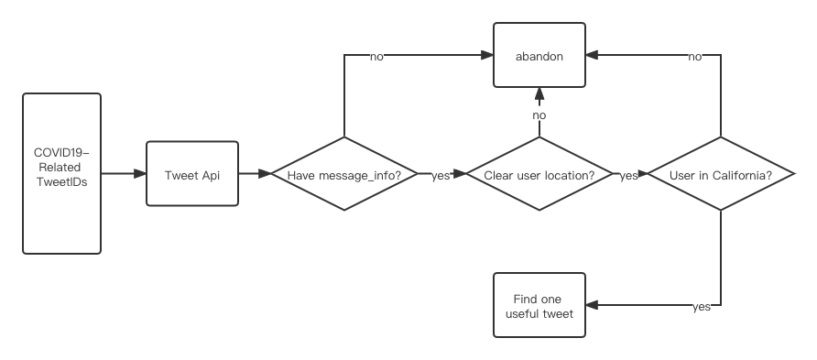
Tweet Data Collection
Time Range: 2020-08-01 to 2020-11-30
Quantity: ~1,500 useful tweets per hour; 36,000 per day
04

Slide 9
Other Data Sources
Data name | Data description | Data Source
Covid data | Confirmed, Death, Recoverd cases number in California each day | https://github.com/CSSEGISandData/COVID-19/tree/master/csse_covid_19_data (by JHU)
Google Trend | Google search times for ageusia and anosmia | https://delphi.cmu.edu/covidcast/export/?sensor=fb-survey-smoothed_wcovid_vaccinated_appointment_or_accept (by CMU DELPHI group)
Facebook survey | Facebook survey on covid-like symptoms (% of people answers that they have covid-like symptoms in the survey)
05

Slide 10
Approach
/03
Overview, Tweet Feature Engineering-NLP, LSTM

Slide 11
Approach Overview
Raw Tweets
Text Cleaning
Cleaned Tweets
NLP
Technique
Twitter Features
Past COVID Data
LSTM Models
Future COVID Cases
Google Search Features
Evaluate & Retrain
Facebook Survey Features
Train of 4 months (Aug-Nov 2020)
Test of 1 month (Dec 2020)
06

Slide 12
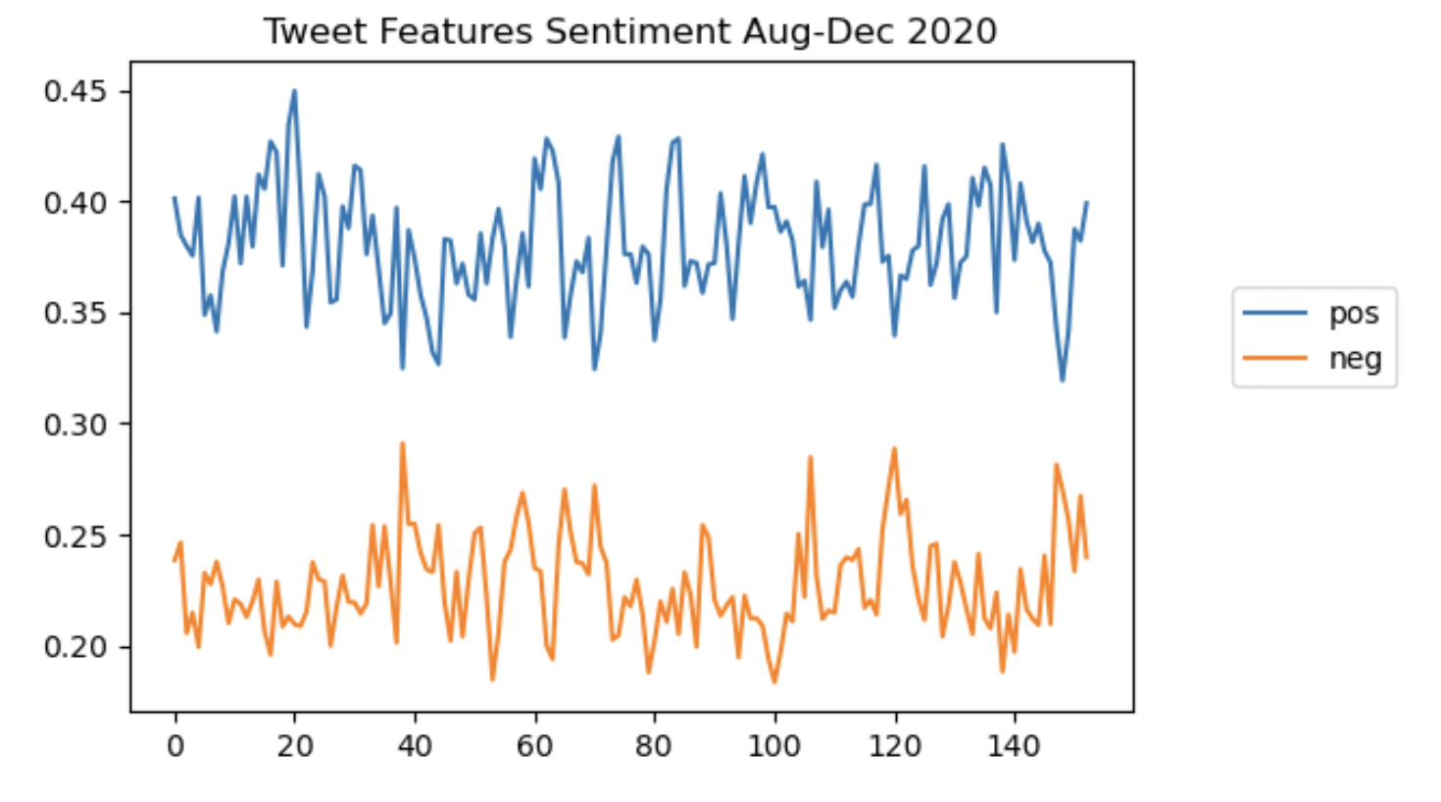
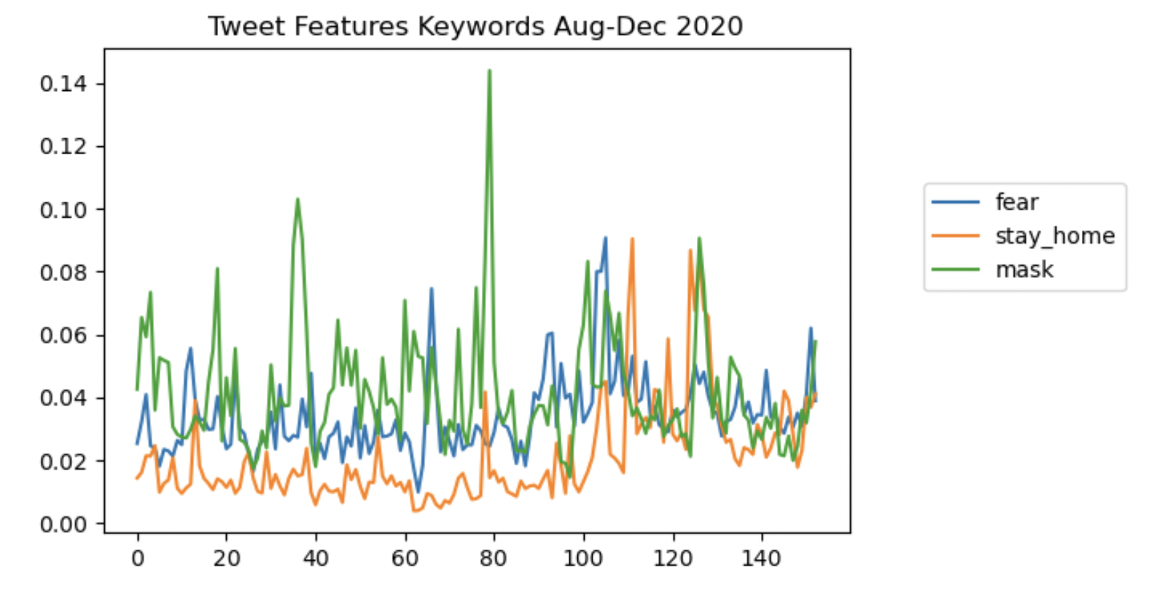
Twitter Feature Engineering – NLP
01
Data Cleaning
Remove unnecessary information like urls, mentions;
Replace emojis with definitions
Tokenization, lemmatization, remove stop words
02
Sentiment Analysis: Positive/negative
Textblob package’s polarity [-1, 1]
Calculated daily pos/neg tweets percentage
03
Keyword Counts: fear, stay, mask
3 categories based on previous literature
Calculated daily keyword tweets percentage
Category | Keywords
Fear | Afraid, fear, worry, nervous, dread, scare, terrify, lockdown
Stay home | Stayhomechallenge, stayathome, stayhome
Mask | Mask
07

Slide 13
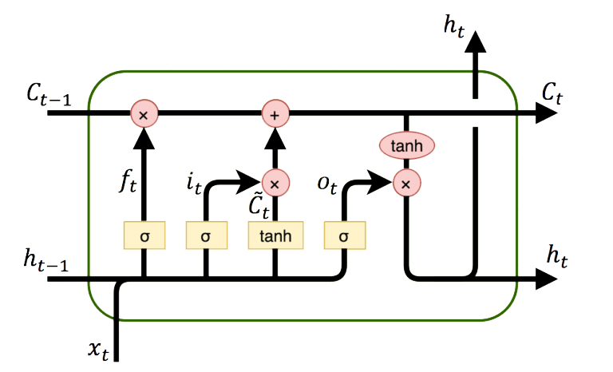
Long Short-Term Memory Network Model
Type of Recurrent Neural Network (RNN)
keeps track of arbitrary LT/ST dependencies
Efficient in Time Series Prediction
Model # | COVID Data | Twitter Features | Google Features | Facebook Features
1 (baseline) | √
2 | √ | √
3 | √ |  | √
4 | √ |  |  | √
5 | √ | √ | √
6 | √ |  | √ | √
7 | √ | √ |  | √
8 | √ | √ | √ | √
3 sets of features to test
Full-factorial experiments to compare model performance
08
https://apmonitor.com/do/index.php/Main/LSTMNetwork

Slide 14
Experiment & Results
/04
LSTM Results, Feature Importance

Slide 15
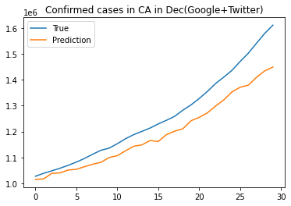
Results of LSTM Models
Evaluation Metric: NRMSE
NRMSE of Model Predictions in the Short and Long Term
Features | Long-term (1 month) | Short-term (5 days)
Baseline (COVID only) | 0.154 | 0.043
Twitter-only | 0.134 | 0.022
Google-only | 0.084 | 0.016
Facebook-only | 0.169 | 0.046
Twitter+Google | 0.059 | 0.013
Twitter+Facebook | 0.154 | 0.029
Google+Facebook | 0.130 | 0.030
All-feature | 0.113 | 0.026
Most internet-informed models performed better
Short-term predictions showed better results
The Facebook feature (COVID-like symptoms) though seems closely related, does not perform as well
09

Slide 16
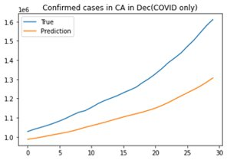
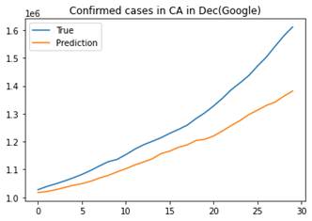
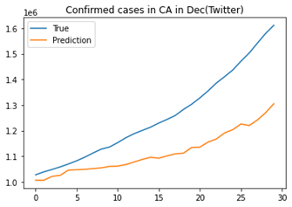
Results of LSTM Models
Out of the single models, Google’s features provided the most information and produced best results
Inspiringly, the model performs even better when combining both Google and Twitter features.
10

Slide 17
Feature Importance – Sensitivity Analysis
Method:
Sensitivity analysis, i.e., add a small perturbation to each feature and see how much the prediction is perturbed.
Observations:
Except for COVID features, Google search features turn out to be the most influential ones. Though dominated by Google search features, the model performs much better than the Google-only case.
11

Slide 18
Conclusion
/05

Slide 19
Conclusion and Discussion
01
02
03
Conclusion
Limitation
Future Work
Internet information helps greatly in COVID-19 prediction, especially in short-term
Seemingly close relations doesn’t always result in better performance.
Combining features together may improve prediction accuracy
Volume of existing internet data is way beyond our capability, very possible loss of uncaptured information in our approach
Discover other types of internet data, such as Amazon purchases/searches of common medical items
12

Slide 20
Q & A Thank you!

