Slide 1
Documentation:
in-text citation
After-text reference / bibliography
Why documentation:
avoid plagiarism!

Slide 2
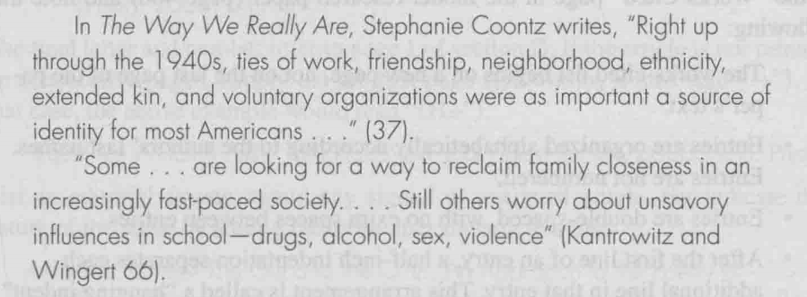
Direct Quotation & Indirect Quotation
Samples of direct quotation from p. 387
When author’s names are mentioned in text (下文中的段1）
When author’s names are not mentioned (下文中的段2）

Slide 3
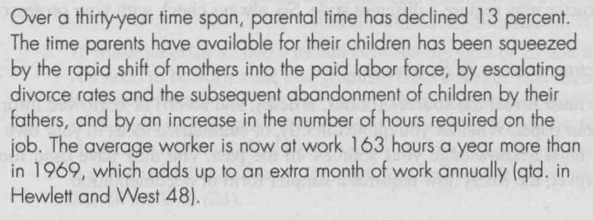
In-text Citation: 书上p. 387 MLA model
When author’s names are mentioned in text
When author’s names are not mentioned
When quoting a material from an anthology

Slide 4
Reference or bibliography after text
书上p. 389 以及那个【】究竟出在文末参考文献中每个条目里哪个位置的说明
Book / monograph
Journal article
Edited works / Translated works
Online resources
双半角空格仅用于 作者/作品/出版信息三个板块彼此之间！

Slide 5
Format of reference
Book / Monograph:
姓，名. 书名. 出版地: 出版社, 出版年代.
Bambrough, Renford. The Philosophy of Aristotle. New York: The New American Library, 1963.
姓，名, 名姓, 名姓, and 名姓. 书名. 出版地: 出版社, 出版年代.
Horton, Rod W., and Herbert W. Edwards. Backgrounds of American Literary Thought. New York: Appleton-Century-Crofts, Inc., 1952.

Slide 6
Format of reference
2. Journal Articles:
文章作者姓, 名. “文章标题.” 杂志名称 卷号. 期号 (出版年代): 起始页码.
Maguire, James H. “The Canon and the 'Diminished Thing.” American Literature 60 (1988): 645-52.
Davis, Sherri Heckler. “The Zen Art of Prewriting.” New Mexico English Journal 12. 1 (1988): 21-23.

Slide 7
Format of reference
3. Edited:
姓, 名, ed. 书名. 出版地: 出版社, 出版年.
Frye, Northrop, ed. Romanticism Reconsidered. New York: Columbia University Press, 1963.
姓, 名, and 名姓, eds. 书名. 出版地: 出版社, 出版年.
Glotfelty, Cheryll, and Harold Fromm, eds. The Ecocriticism Reader: Landmarks in Literary Ecology. Atherns: The University of Georgia Press, 1966.

Slide 8
Format of reference
3. Edited by many:
第一编者姓, 名, et al. 书名. 出版地: 出版社, 出版年.
Donadio, Stephen, et al., eds. Emerson and His Legacy. Carbondale: Southern Illinois University Press, 1986.
3. Translated:
原作者姓, 名. 书名. Trans. 译者名姓. 出版地: 出版社, 出版年.
Freud, Sigmund. Civilization and Its Discontents. Trans. James Strachey. New York: Norton, 1961.

Slide 9
Format of reference
4. Online resources:
作者/机构名. “网页标题.” <网址>. 网页制作日月年. （若无，用n. d.）访问日月年.
{各个部分之间的空格都是默认空出两个半角空格}

Slide 10
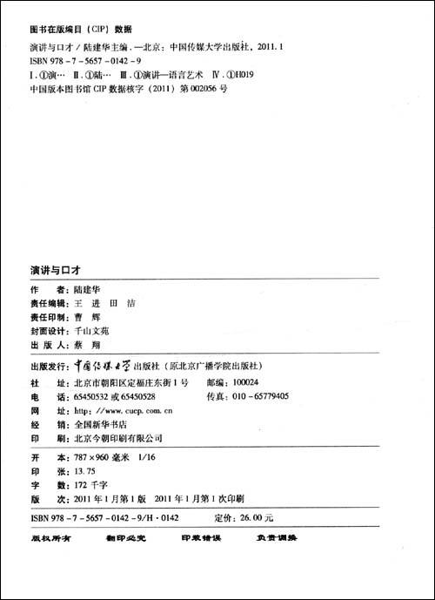
Practice Time for documentation: create in-text citation & reference entry for the following 4 publications

Slide 11
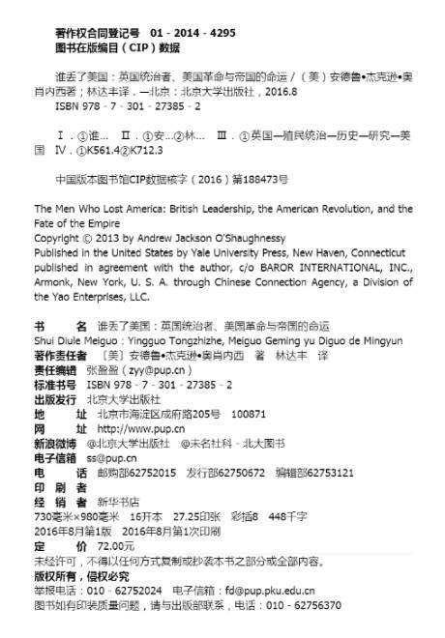
Practice Time for documentation

Slide 12
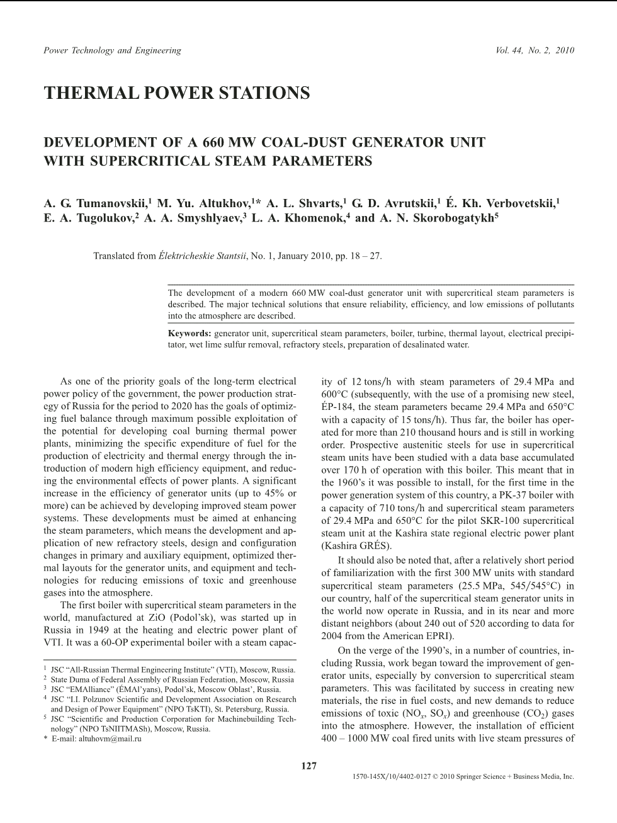
Practice Time for documentation

Slide 13
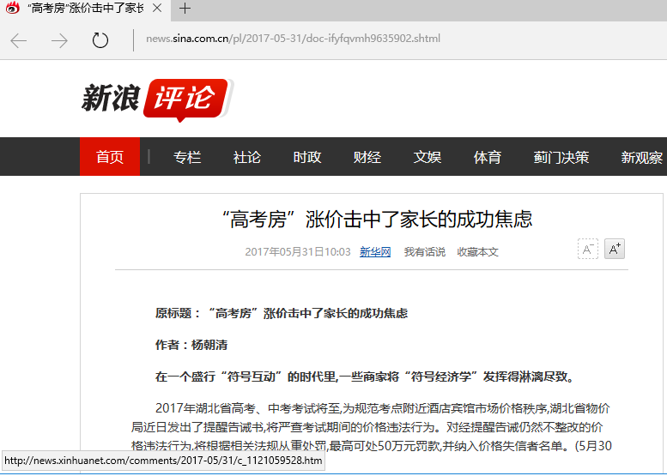
Practice Time for documentation

