Slide 1

SMART INDIA HACKATHON 2026
SOS-SafeOrbitForSatellites
Problem Statement ID – SIH028
Problem Statement Title- Space Situational Awareness & Autonomous Satellite Collision Avoidance System
Theme- Space Technology
PS Category- Software
Team ID-
Team Name (Registered on portal)- SixthSense
Project- SOS (Safe Orbit for Satellites)
Tagline- Autonomous SSA & Collision Avoidance Flight Director Console

Slide 2
IDEA TITLE
SixthSense
SOS — Safe Orbit for Satellites | Full-stack SSA & autonomous collision avoidance for LEO satellites
Key Features
3D Orbital Digital Twin: WebGL Earth globe (Three.js) with real Keplerian propagation (ECI frame) — actual orbits, not animations.
Conjunction Detection: Screens ~21,430 tracked objects; computes TCA, miss distance & Pc via Foster 2D Gaussian integrator (B-plane).
AI Flight Director: Generates burn epoch, ΔV vector, risk class & telecommand checklist; deterministic astrodynamics fallback.
Maneuver Planner & Sim Lab: Candidate burns (prograde/retrograde/radial/cross-track), Tsiolkovsky propellant cost, 72h post-burn re-screen.
Autonomous Autopilot: Closed-loop auto-burn when Pc exceeds threshold; 5-stage pipeline (sign → slew → burn → orbit det. → re-screen).
Live SGP4 Tracking: Real TLEs from CelesTrak; ISRO fleet tracking via satellite.js.
CCSDS CDM Exporter: XML/JSON/KVN (CCSDS 508.0-B-1) for inter-agency coordination.
How It Addresses the Problem
Problem: 21,000+ debris objects in LEO; Kessler risk rising. Tools are fragmented & manual — warnings without burn plans.
Solution: One console that detects → assesses (real physics) → recommends burn (AI) → executes autonomously. Response time: hours → minutes.
Innovation
Real astrodynamics (Keplerian propagation, RK4, golden-section TCA, Foster Pc) live in browser; AI + deterministic fallback never goes dark; B-plane visualization with covariance ellipses; end-to-end autonomy from detection to execution to verification.

Slide 3
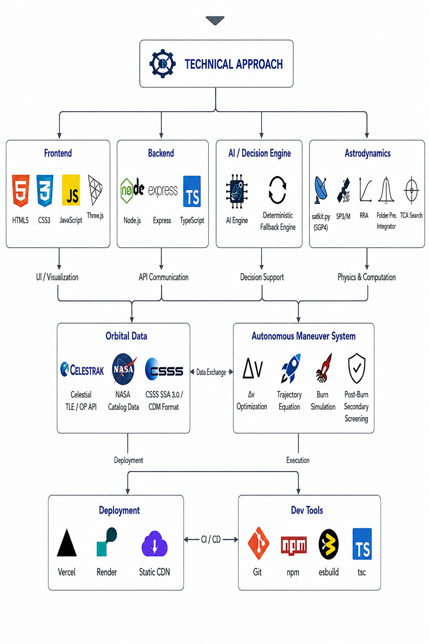
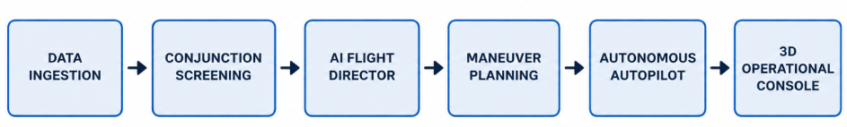
TECHNICAL APPROACH
Sixth
Sense
Technologies Used
Layer | Technology
Frontend | HTML5, CSS3, Vanilla JS (ES6+), Three.js, Canvas 2D
Backend | Node.js, Express, TypeScript, REST API
AI / LLM | AI Engine + deterministic fallback
Astrodynamics | satellite.js (SGP4), custom Keplerian/RK4, Foster Pc
Orbital Data | CelesTrak TLE/GP API, CCSDS 508.0-B-1 CDM
Deployment | Vercel, static CDN
Dev Tools | Git, npm

Slide 4
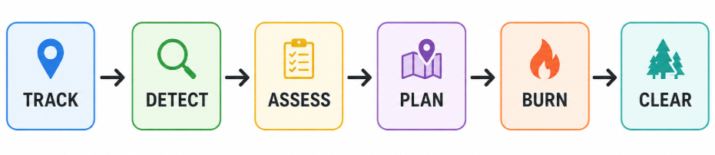
FEASIBILITY AND VIABILITY
Sixth Sense
Feasibility
Technical — PROVEN: working prototype, Express/TS backend, Three.js globe, live SGP4, AI Engine
Data — SOLVED: free CelesTrak GP/TLE API + offline snapshot
Deployment — READY: static frontend + serverless, no special hardware
Scalability — DESIGNED: TLE cache (6h refresh); horizontal scaling
Strategies
Dual-mode AI — rich reasoning + deterministic fallback; never goes dark
CCSDS compliance — interoperable with ISRO, NASA CARA, ESA
Layered autonomy — STANDBY → DRY RUN → ARMED
72h forward screening — prevents burns creating new conjunctions
Challenges & Mitigations
Challenge | Mitigation
TLE accuracy (~1 km uncertainty) | Use latest CDM; show covariance ellipses
AI API rate limits | Deterministic astrodynamics fallback guarantees uptime
Catalog growth (~10%/yr) | Parallel screening; per-pair cache; Pc threshold pruning
Real-burn safety | 72h re-screen gate; operator sign-off; DRY RUN mode
Space weather (drag) | F10.7/Kp/drag multiplier feed covariance model

Slide 5
IMPACT AND BENEFITS
Sixth
Sense
Impact on Audience
Audience | Impact
ISRO, NSIL | Response time hours → minutes; lower satellite loss risk
Mission control | One console replaces fragmented tools
Space traffic agencies | CCSDS CDM export enables inter-agency coordination
Constellation operators | Fleet-wide autonomous clearance in one click
Orbital environment | Prevents debris-generating collisions; fights Kessler Syndrome
Benefits
Social: Protects satellite services millions depend on (weather, disaster warning, NavIC, EOS); prevents Kessler Syndrome from rendering LEO unusable.
Economic: One satellite = ₹200–₹2,000 crore; avoiding one collision saves the full asset + revenue; one console replaces 5+ tools, cutting cost.
Environmental: Each avoided collision prevents thousands of long-lived debris fragments; preserves LEO for future missions & human spaceflight.
Technological: First Indian SSA console integrating AI Engine with real astrodynamics; open, extensible architecture; live SGP4, not a simulation.

Slide 6
RESEARCH AND REFERENCES
Sixth
Sense
Standards & Methodologies
Data Sources
Reference | Description
CCSDS 508.0-B-1 | CDM standard for inter-agency conjunction warnings
NASA CARA | Pc threshold framework (Critical ≥ 1×10⁻⁴, High ≥ 1×10⁻⁵)
Foster, J. L. (1992) | 2D Gaussian Pc integration method used in engine
Bate, Mueller & White | Fundamentals of Astrodynamics — Keplerian propagation
Vallado, D. | SGP4/SDP4 propagation, frame conversions
Tsiolkovsky equation | Δm = m₀(1 − e^(−ΔV/(Isp·g₀))
Source | Use
CelesTrak | Real TLE/GP for ISRO fleet (free, no key)
Space-Track | Catalogued object data (supplementary)
NOAA SWPC | Space weather (F10.7, Kp)
Technology References
Technology | Use
Three.js | WebGL 3D rendering
satellite.js | SGP4 propagation
AI Engine | AI Flight Director + fallback
Express.js | REST API backend
Project Links
Source code | https://github.com/ShickenShawarma20/SOS-SafeOrbitForSatellites

