Slide 1
Monopoly
Team no: 157
Praneet Vibhu 140070045
Shievani Upadhyay 140040015
Arushi Poddar 140040055
Gaurav Sharma 140070026

Slide 2
Problem Statements
We intended to make a computer based version of the classic board game-Monopoly. It’s a four player business/arcade game.
Enabling the players to enter and view their details.
Displaying board, colour coded moving pieces and enabling the interface through clickable buttons for ex. Dice Roll.

Slide 3
Problem Statements
Enabling buying, selling and renting of property.
Making various types of cells-Purchasable cells, Go to Jail cell, Go cell, Community Chest etc.
Making functions for randomly picking up chance and community cards, and following the instructions on them

Slide 4
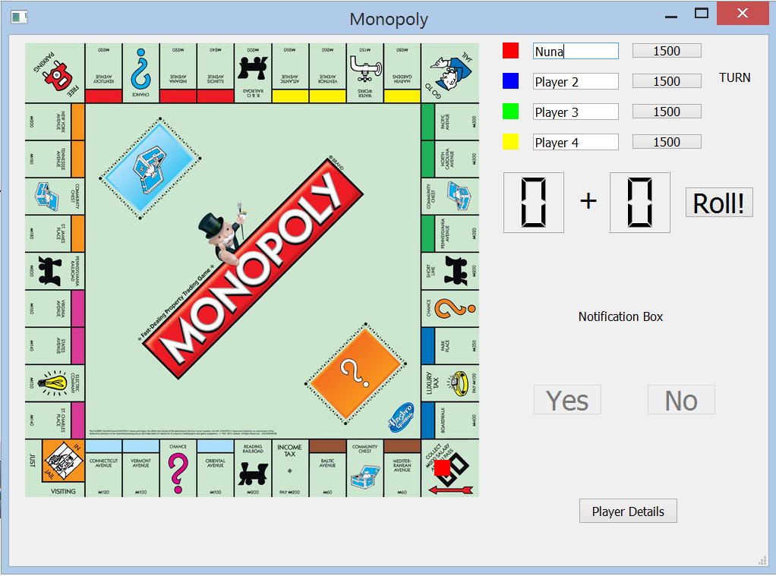
Implementation
Initial screen:
Players can choose their pointer colours and enter their name against the colour.
The initial amount in each player’s account is displayed against the name.
When this window is closed and openend again, all these previously filled details are wiped out.

Slide 5
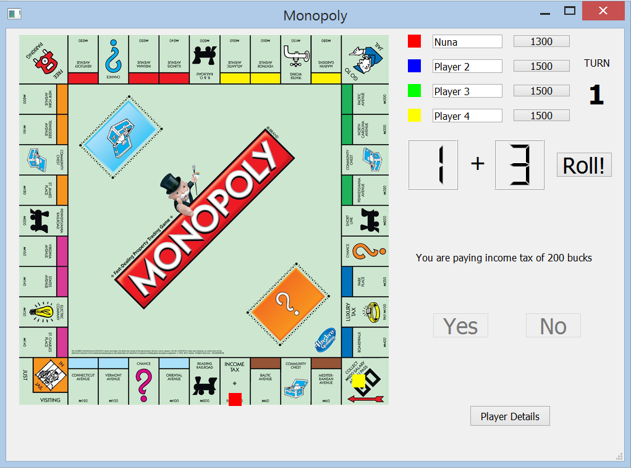
Implementation
On clicking the roll button, two randomly generated numbers are displayed on the two dies. Player in turn, moves accordingly. The position of players is displayed by colored pointers.

Slide 6
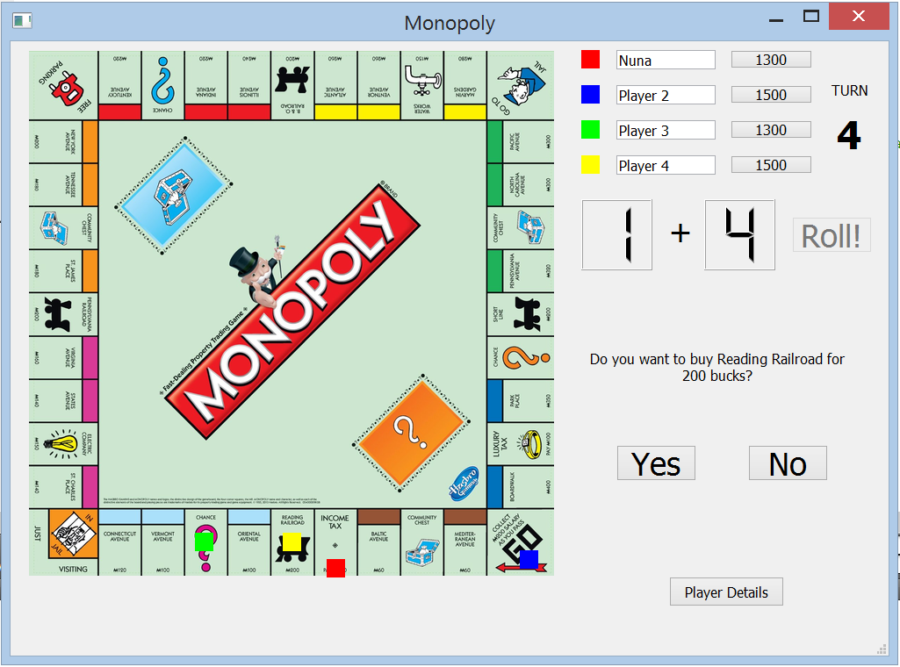
Implementation
When a player lands on a purchasable cell, notification confirming the purchase is displayed. The Roll button gets deactivated and Yes and No buttons are activated.

Slide 7
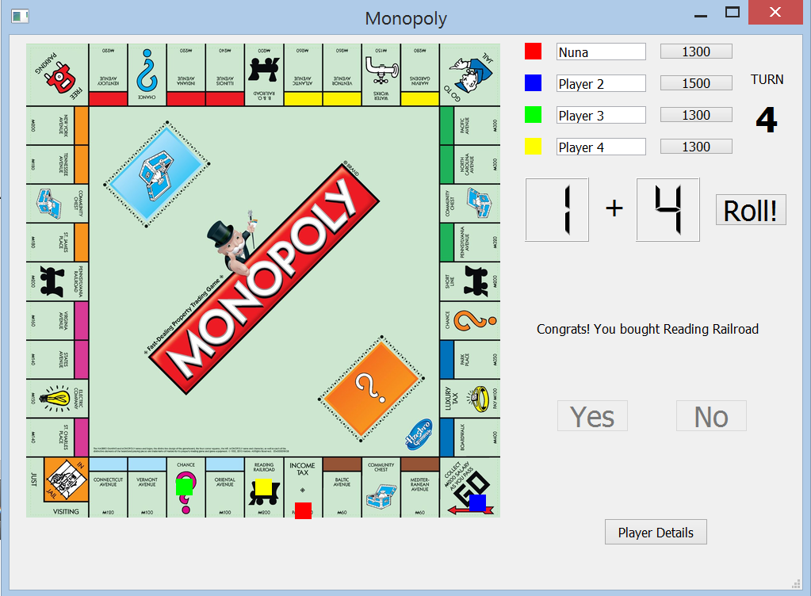
Implementation
If cell is bought, amount is deducted and updated in account automatically.

Slide 8
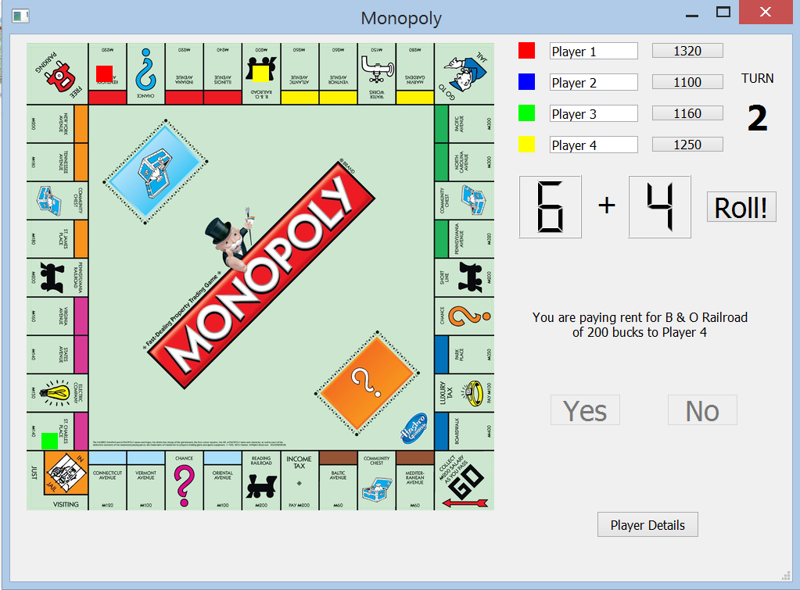
Implementation
If a player lands on already bought cell, rent is deducted from his/her account and added to the owner’s account.

Slide 9

Implementation
When a player lands on a Chance block, a Chance card is randomly selected and the instruction is implemented.

Slide 10
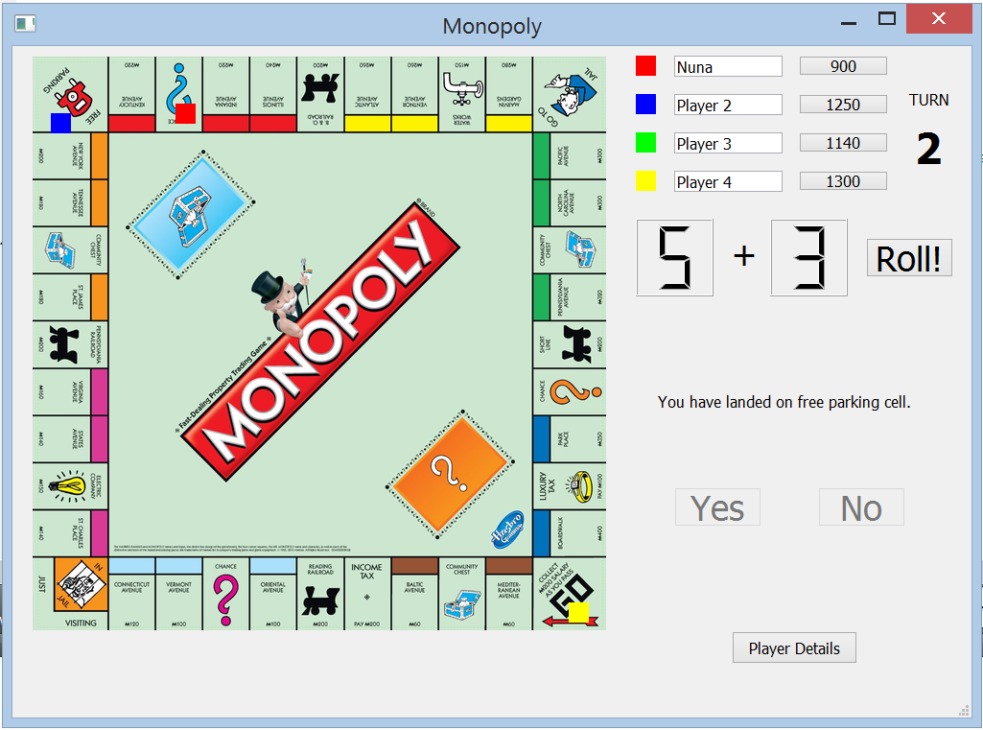
Implementation
Free parking cell- nothing happens.

Slide 11
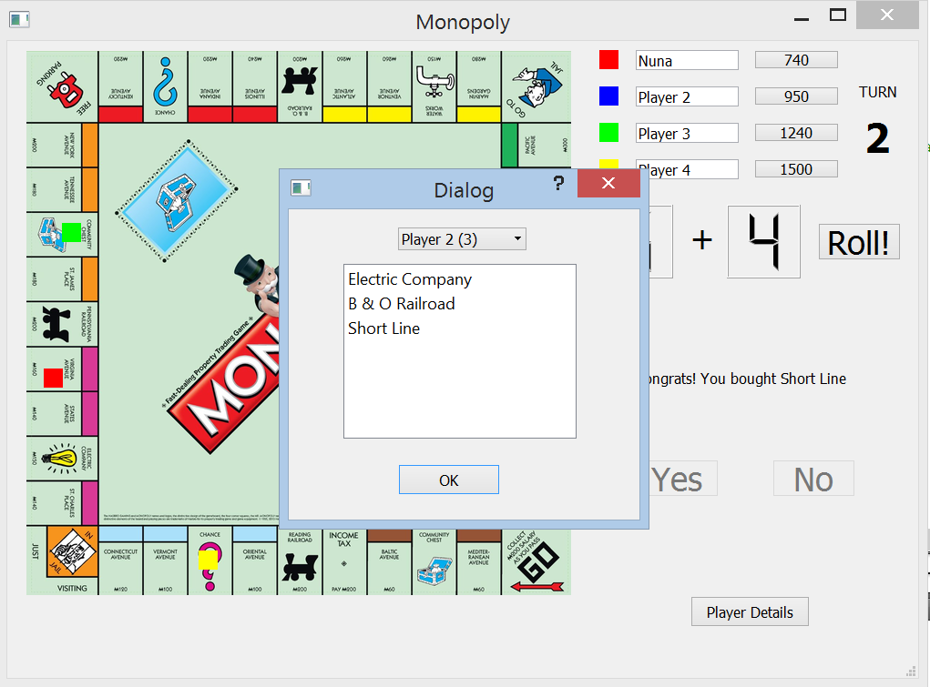
Implementation
On clicking the Player Details button, a dialog box opens up, showing the purchase details of each player, i.e. the property owned by each player.

Slide 12
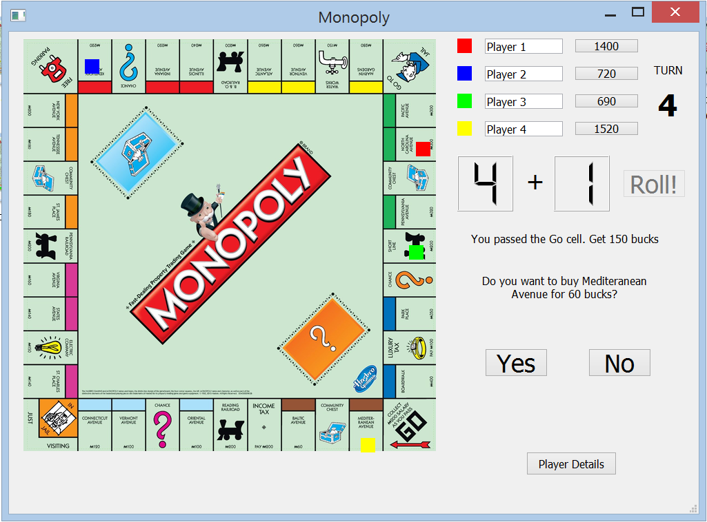
Implementation
On completing one full round of the board and passing th e Go cell, 150 bucks are added to the player’s account.

Slide 13
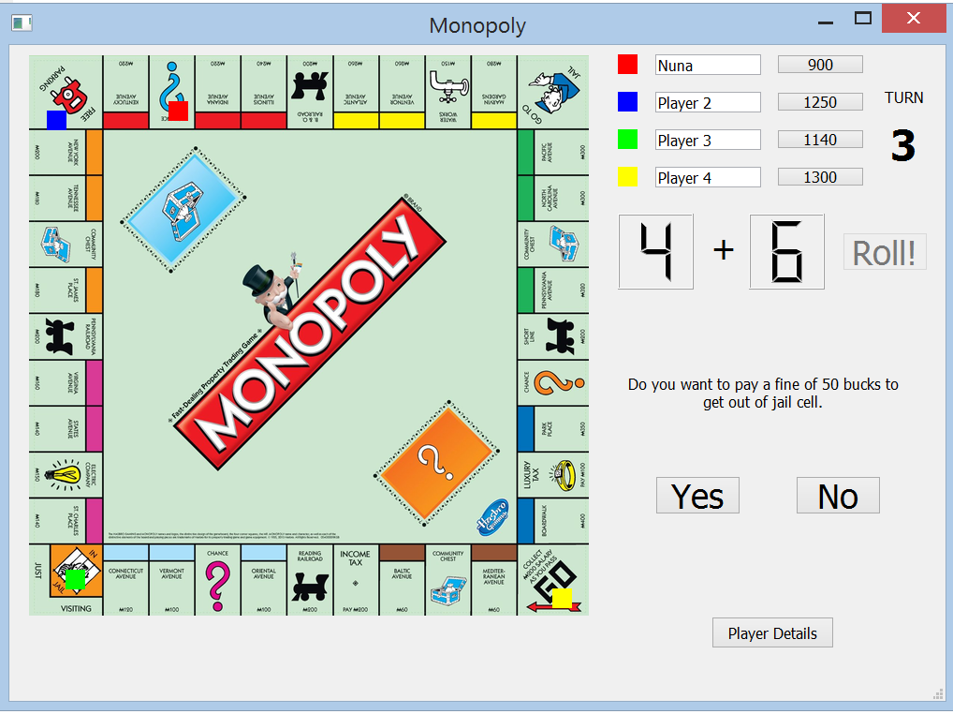
Implementation
When a player lands on the Jail cell, a notification asking to pay fine appears. Roll button gets deactivated and Yes and No buttons are activated.

Slide 14
Challenges
Linking the entire code to graphics and making it interactive.
Updating the ownership of the cities(purchasable cells).
The function to pay fine to get out of the Jail.
Linking the player details button to the dialog box displaying the information.
Notes:
Random function-pehle same same number aa rahe the baad me time se initialise kiya
City ko sell karne me owner ko update karna
Graphics se link karna
Dialog box had se zyada pain hai.link nahi ho raha tha player setails wale button se link karna was ufffff..
Pay fine to get out of jail was a pain….

Slide 15
Future Work
Extending the game, so that it can be played over a network. (Would require further study of how to create servers and the networking libraries.)
Improvisations on game rules-like enabling bidding of property to other players instead of simply selling it to bank.
Make the game visually more appealing by introducing animations and sounds.

