Slide 1

Interdisciplinary Insights and Practices for Sustainable Growth
(I3PSG 2026)
Organized by
Shivajirao S. Jondhale College of Engineering, Dombivli(East)
2 nd April, 2026
PrepSmartly: Multimodal AI-Powered Interview Simulation System with Real-Time Feedback and Adaptive LLM Evaluation
Anmol Mahanty
Rohan Katakdhond
Mohammad Mulla
Prof. Deveshree Wankede
Affiliation of Presenting Author : Shivajirao S. Jondhale College of Engineering ,Dombivli (E)

Slide 2

INDEX
Abstract ……………………..3
Introduction ……………………..4
Literature Review ……………………..5
Research Gaps ……………………..6
Proposed Methodology ……………………..7
Results & Discussion ……………………..8
Comparative Analysis ……………………..9
Conclusion & Future Work …………………..10
References ……………………..11

Slide 3
ABSTRACT
Modern interviews evaluate technical knowledge, communication, confidence, and behavior.
Traditional tools rely on static questions with generic and delayed feedback, lacking real-time adaptability.
They fail to simulate dynamic, real-world interview conditions, reducing preparation effectiveness.
PrepSmartly is an AI-based multimodal interview simulation platform designed to overcome these limitations.
It integrates speech analysis, facial recognition, and live coding evaluation for realistic assessment.
A Dual-LLM architecture enables adaptive questioning and real-time evaluation.
Provides real-time micro-feedback and detailed post-interview analysis covering technical, communication, and non-verbal aspects.

Slide 4
INTRODUCTION
Interviews are a critical step for jobs, higher education, and career advancement.
They assess both technical knowledge and communication skills.
Many candidates underperform due to nervousness, lack of confidence, and poor response structuring.
Existing platforms rely on static Q&A formats and fail to simulate real interview scenarios.
They ignore speech tone, facial expressions, and live coding abilities, leading to incomplete evaluation.
PrepSmartly addresses these gaps by providing a realistic, adaptive, AI-driven interview simulation environment.

Slide 5
LITERATURE REVIEW
Table No :1 Summary of Literature Review
Sr.no | Title | Methodology | Advantage | Limitation
1. | AI-Based Mock Interview Simulation System for Job Preparation [1] (May 2025) R. Shirbhate, H. Kulkarni, N. Bidaye, and S. Kangude | Generative AI (Gemini), multimodal analysis (video + sentiment) | Personalized, domain-specific Qs, holistic feedback (verbal + non-verbal) | Dependence on cloud AI models, high resource requirement
2. | The Future of Multimodal AI Models for Integrating Imaging and Clinical Metadata [2] (Jul. 2025) B. D. Simon, B. Ozyoruk, D. G. Gelikman, S. A. Harmon, and B. Türkbey | Multimodal AI (Transformers, GNNs, fusion techniques) | Improves diagnostic accuracy, integrates diverse data | Data scarcity, bias, taxonomy issues
3. | Advances in Facial Expression Recognition: Survey of Methods, Benchmarks, Models, and Datasets [4] (2024) T. Kopalidis, V. Solachidis, N. Vretos, and P. Daras, “Advances | Survey of FER (traditional → DL, CNN, RNN, GANs, Transformers) | Comprehensive taxonomy, 21 datasets, evaluation of 60+ models | Dataset bias, overfitting, limited real-world robustness
4. | AI Interviewer Chatbot for Technical and Hr Brilliance: A Tool for Upskilling Candidate [5] (2024) K. K. Jain, R. S. R., G. R. S. Charan, and V. A. Narayana | Parses resumes to generate tailored interview questions | Relevant interview questions based on user profile and background | May struggle with unconventional profiles

Slide 6
LITERATURE REVIEW
Table No :1 Summary of Literature Review
Sr.no | Title | Methodology | Advantage | Limitation
5. | Generative Ai-based Interview Simulation and Performance Analysis [6] (2024)S. Mahajan, N. Sonawane, R. Bagal, S. Kulkarni, A. Suryawanshi, and Y. Mhaisne | Scrapes questions and answers from web sources for AI training | Up-to-date and diverse content | Legal and ethical concerns with data scraping
6. | Facial Expression and Sound Analysis for Interview Assessment: AI-Based Application (August 2024) [3] D. Anwat, P. Derle, P. Nagare, and H. R. Agashe | Virtual recruiter + facial & voice analysis + STT | Real-time feedback (expressions, speech, reaction time), progress tracking | Limited to controlled scenarios, initial stage system
7. | AI Based Mock Interview Evaluation and Analysis: to Analyze Emotion, Confidence, and Knowledge [8] (2023) H. R. Agashe, D. Anwat, P. Derle, P. Nagare, and S. Dhavale | Uses CNN to assess facial expressions, gestures, and responses via video/audio | Comprehensive feedback on body language, tone, and clarity | May provide overwhelming feedback; cannot replicate real interview nuances
8. | Facial Expression Recognition: A Review of Trends and Techniques.[7] (2021) T. Kopalidis, V. Solachidis, N. Vretos, and P. Daras | FER using SLL, MLL, LDL + ML & DL models | Covers FER applications (medicine, HCI, security) | Challenges: occlusion, pose, age, illumination

Slide 7
LITERATURE REVIEW
Table No :1 Summary of Literature Review
Sr.no | Title | Methodology | Advantage | Limitation
9. | Subjective Answer Evaluation using Natural Language Processing and Machine Learning [9] (2021) A. Girkar, M. Khambayat, A. Waghmare, and S. Chaudhary | Handles audio file slicing, merging, and conversion | Efficient audio handling for processing speech responses | Basic audio analysis only; requires integration with other libraries
10. | Speech-to-Text and Speech-to-Speech Summarization of Spontaneous Speech [10] (2020) S. Furui, T. Kikuchi, Y. Shinnaka, and C. Hori | Converts speech to Name text and analyzes content using NLP | Detailed evaluation of clarity and relevance; assesses emotional tone and knowledge | Accuracy depends on speech recognition; lacks human spontaneity

Slide 8
RESEARCH GAPS
Lack of integrated multimodal systems (voice + facial + NLP + coding not combined)
No real-time adaptive feedback during interviews
Generic question generation, poor personalization using resume/context
Incomplete emotion & behavioral analysis
Dependence on static datasets
Absence of realistic interview simulation (no human-like interaction)
Weak fallback mechanisms (fails in mic-off / unexpected scenarios)

Slide 9
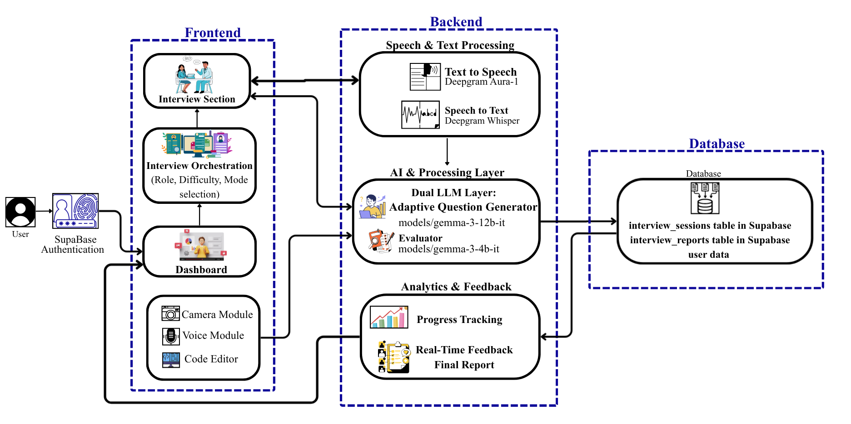
PROPOSED METHODOLOGY
Fig 1: Architecture of PrepSmartly

Slide 10
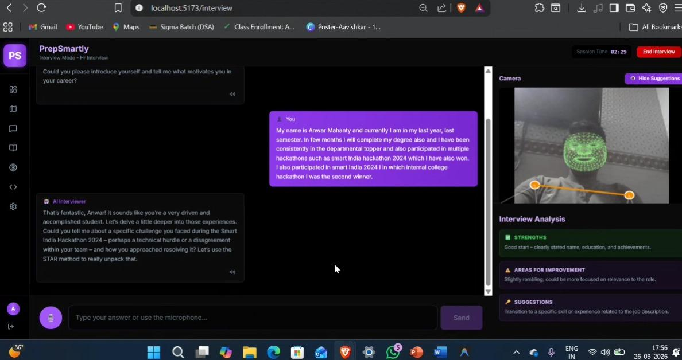
RESULTS AND DISCUSSION
Fig 2: Live Interview

Slide 11
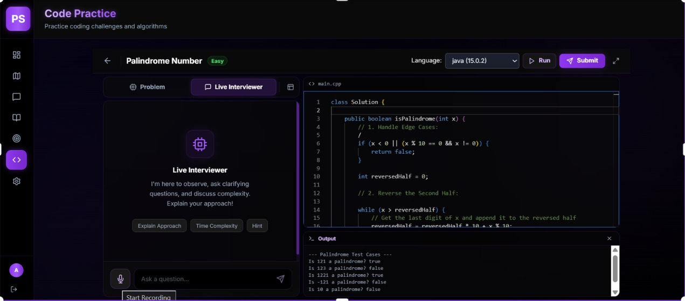
RESULTS AND DISCUSSION
Fig 3: Live Coding

Slide 12
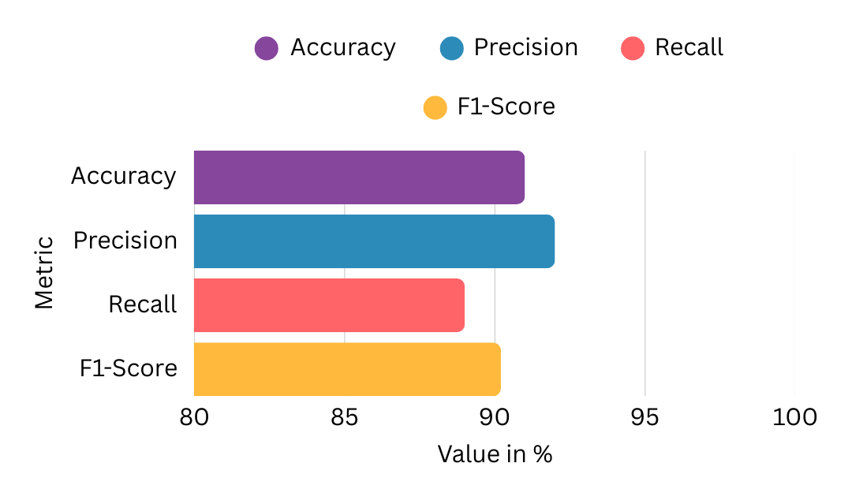
COMPARATIVE ANALYSIS
Table 2 - Confusion Matrix Analysis of Behavioral Expression Classification
Actual \ Predicted | Confident | Nervous | Hesitant
Confident | 112 | 3 | 4
Nervous | 4 | 109 | 6
Hesitant | 3 | 7 | 102
Neutral | 5 | 7 | 4
Fig.4 Facial Expression Model Performance Metrics

Slide 13
CONCLUSION AND FUTURE WORK
PrepSmartly overcomes the limitations of traditional interview preparation by providing a realistic and adaptive AI-driven simulation system. It combines real-time feedback, dual LLM evaluation, and multimodal analysis using technologies like MediaPipe and Deepgram to assess candidates across technical, communication, and behavioral aspects, while ensuring data privacy through a secure architecture.
In the future, the system can be enhanced with more advanced AI models for better question generation and evaluation, along with improved multimodal analysis such as posture and gesture tracking. It can also include personalized learning recommendations, multilingual support, job portal integration, and immersive technologies like Virtual Reality to create a more effective and realistic interview experience.

Slide 14
REFERENCES
[1] R. Shirbhate, H. Kulkarni, N. Bidaye, and S. Kangude, AI-Based Mock Interview Simulation System for Job Preparation, International Research Journal, 2025, pp. 858–863.
[2] B. D. Simon, B. Ozyoruk, D. G. Gelikman, S. A. Harmon, and B. Türkbey, The Future of Multimodal Artificial Intelligence Models for Integrating Imaging and Clinical Metadata: A Narrative Review, Journal of Multimodal AI Research, 2025, pp. 303–312.
[3] D. Anwat, P. Derle, P. Nagare, and H. R. Agashe, Facial Expression and Sound Analysis for Interview Assessment: An AI-Based Application, International Journal Publication, 1st Edition, 2024, pp. 269–278.
[4] T. Kopalidis, V. Solachidis, N. Vretos, and P. Daras, Advances in Facial Expression Recognition: A Survey of Methods, Benchmarks, Models, and Datasets, IEEE Transactions on Affective Computing, 2024, pp. 1–61.
[5] K. K. Jain, R. S. R., G. R. S. Charan, and V. A. Narayana, AI Interviewer Chatbot for Technical and HR Brilliance: A Tool for Upskilling Candidate, International Journal of Engineering Research & Technology (IJERT), 2024.
[6] S. Mahajan, N. Sonawane, R. Bagal, S. Kulkarni, A. Suryawanshi, and Y. Mhaisne, Generative AI-Based Interview Simulation and Performance Analysis, International Research Journal of Modernization in Engineering Technology and Science, 2024, pp. 2623–2629.

Slide 15
REFERENCES
[7] O. S. Ekundayo and S. Viriri, Facial Expression Recognition: A Review of Trends and Techniques, IEEE Journal, 2023, pp. 44–73.
[8] H. R. Agashe, D. Anwat, P. Derle, P. Nagare, and S. Dhavale, AI-Based Mock Interview Evaluator and Analysis: To Analyse Emotion, Confidence, and Knowledge, International Journal of Advanced Research in Science, Communication and Technology (IJARSCT), 2023, pp. 273–276.
[9] A. Girkar, M. Khambayat, A. Waghmare, and S. Chaudhary, Subjective Answer Evaluation using Natural Language Processing and Machine Learning, International Research Journal of Engineering and Technology (IRJET), 2021, pp. 5040–5043.
[10] S. Furui, T. Kikuchi, Y. Shinnaka, and C. Hori, Speech-to-Text and Speech-to-Speech Summarization of Spontaneous Speech, IEEE Transactions on Speech and Audio Processing, 2020, pp. 401–408.
[11] H. Ahlawat, N. Aggarwal, and D. Gupta, Automatic Speech Recognition: A Survey of Deep Learning Techniques and Approaches, International Journal of Cognitive Computing in Engineering, vol. 6, 2025, pp. 201–237.
[12] R. Sapkota, S. Raza, M. Shoman, A. Paudel, and M. Karkee, Multimodal Large Language Models for Image, Text, and Speech Data Augmentation: A Survey, ACM Computing Surveys, 2025, pp. 1–52.

