Slide 1

By
Ahmad Fraij Obada al-radawneh shefaa alrababah
Jan2022

Slide 2

Auction
supervised by :
Eng. Dana Kannan

Slide 3
Project Idea
Project Aims and Objectives
Project Scope
01.
Introduction

Slide 4
Project Idea
This platform contributes to collecting Antiques
and buyers, and facilitating the buying and selling process.
Enable antique owners to find buyers for their antiques and get the best price
The admin will also be able to perform several operations to manage the store

Slide 5
Project Scope
 | Customer
 | add antiques
 | Send Feedback Place Order
 | Search for antiques
 | Admin
 | Mange Store
 | Manage account
 | View Orders View financial reports
Available in all devices

Slide 6
Project Scope
 | Employee
 | receives the tasks assigned to him and works to solve them
 | Accountant
 | Doing financial matters
 | Create monthly and annual reports

Slide 7
Project Aims and Objectives
01
Making the shopping experience for the customers easier
02
It aims to helping Antiques owner to gain reputation and increase their work.
The environment that we offer is secure, safe and friendly to be used by all people from different backgrounds.
03

Slide 8
System Architecture
Auction
02.
Architecture

Slide 9
System Architecture
01
Client-Server: Where the client is the web browser application, and our system is on the server as a back-end
02
Core -API Architecture
These are the basic functionalities. More functionalities will be discussed in Requirement Analysis section.

Slide 10
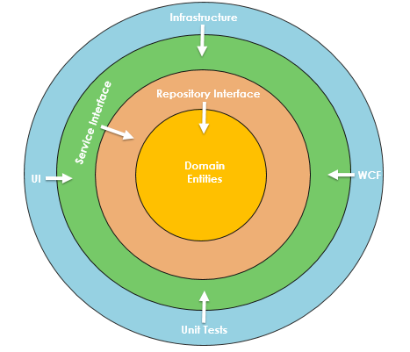
System Architecture
Onion Architecture
These are the basic functionalities. More functionalities will be discussed in Requirement Analysis section.

Slide 11
Implementation plan
Auction
Used Technologies
03.
Implementation

Slide 12
Implementation plan
Implement all functionalities described in the use case section for the website.
Writing clean, well-documented and easy to understand code
The project implementation must be done according to project document.

Slide 13
Used Technologies
Front-End
Back-End
Database
• Angular: platform and framework
• Bootstrap4: Styling for website
• HTML5: Structure of the website
• CSS4: Styling of the website.
• JS+ts : To make the website interactive.
• ASP.NET API: Used to apply many APIs , each API is responsible to
manage the requests of the user
• SQL used to store the data
.

Slide 14
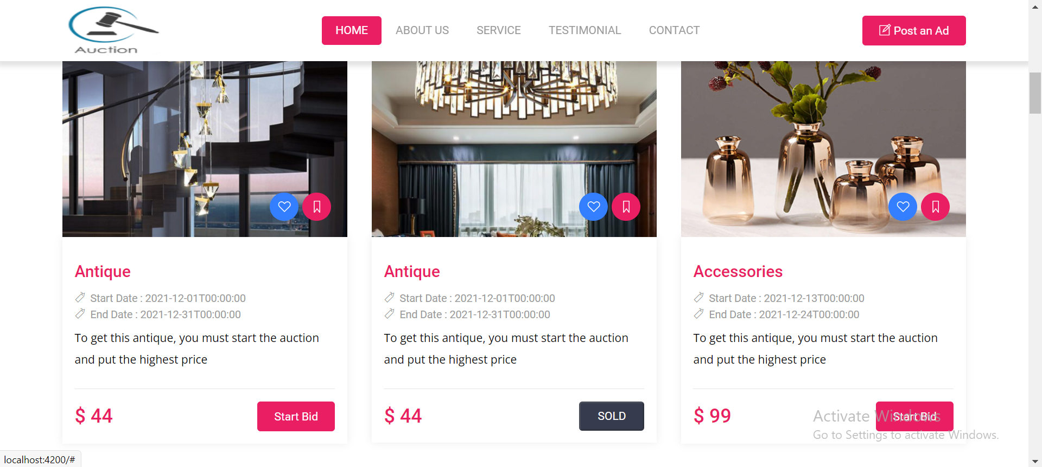
Home Page
.

Slide 15
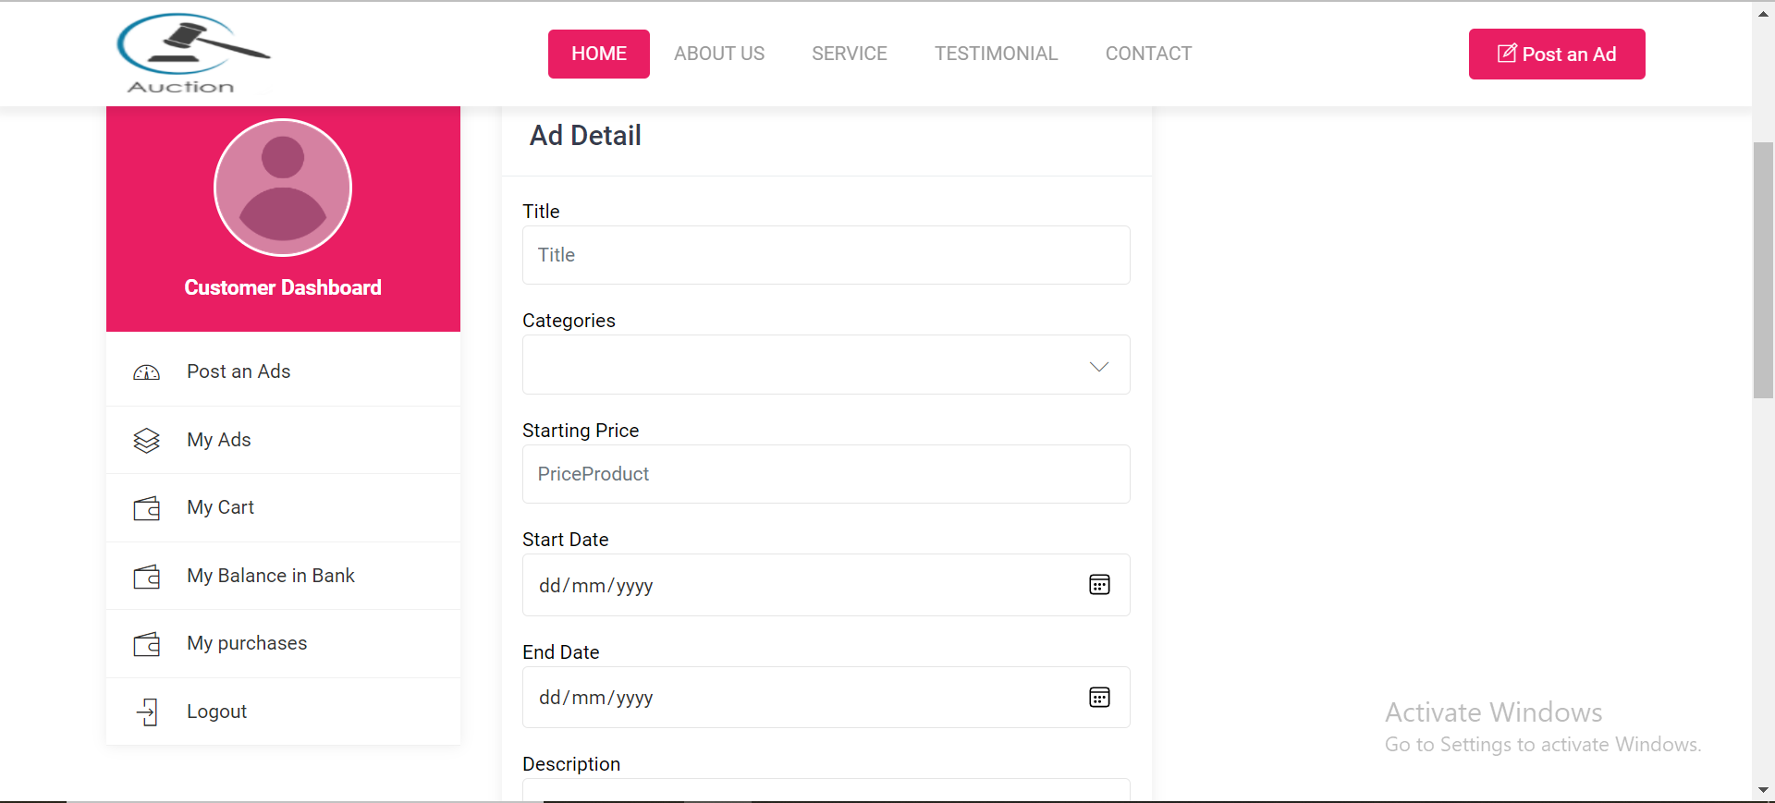
Customer Dashboard
.

Slide 16
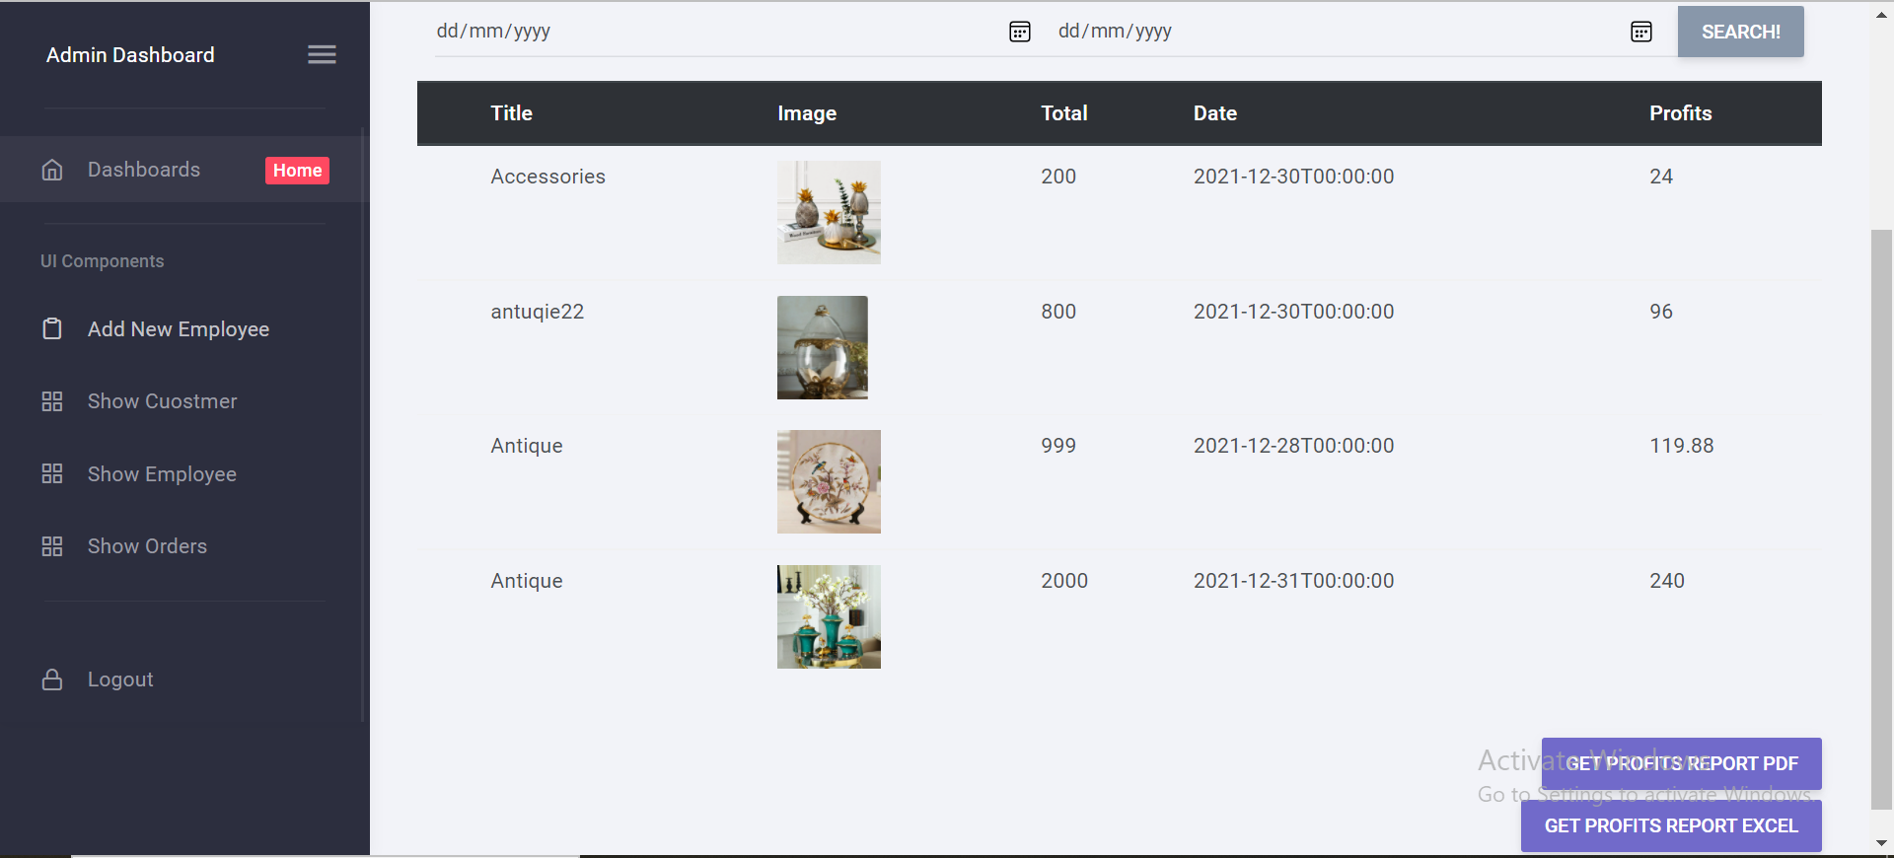
Admin Dashboard
.

Slide 17
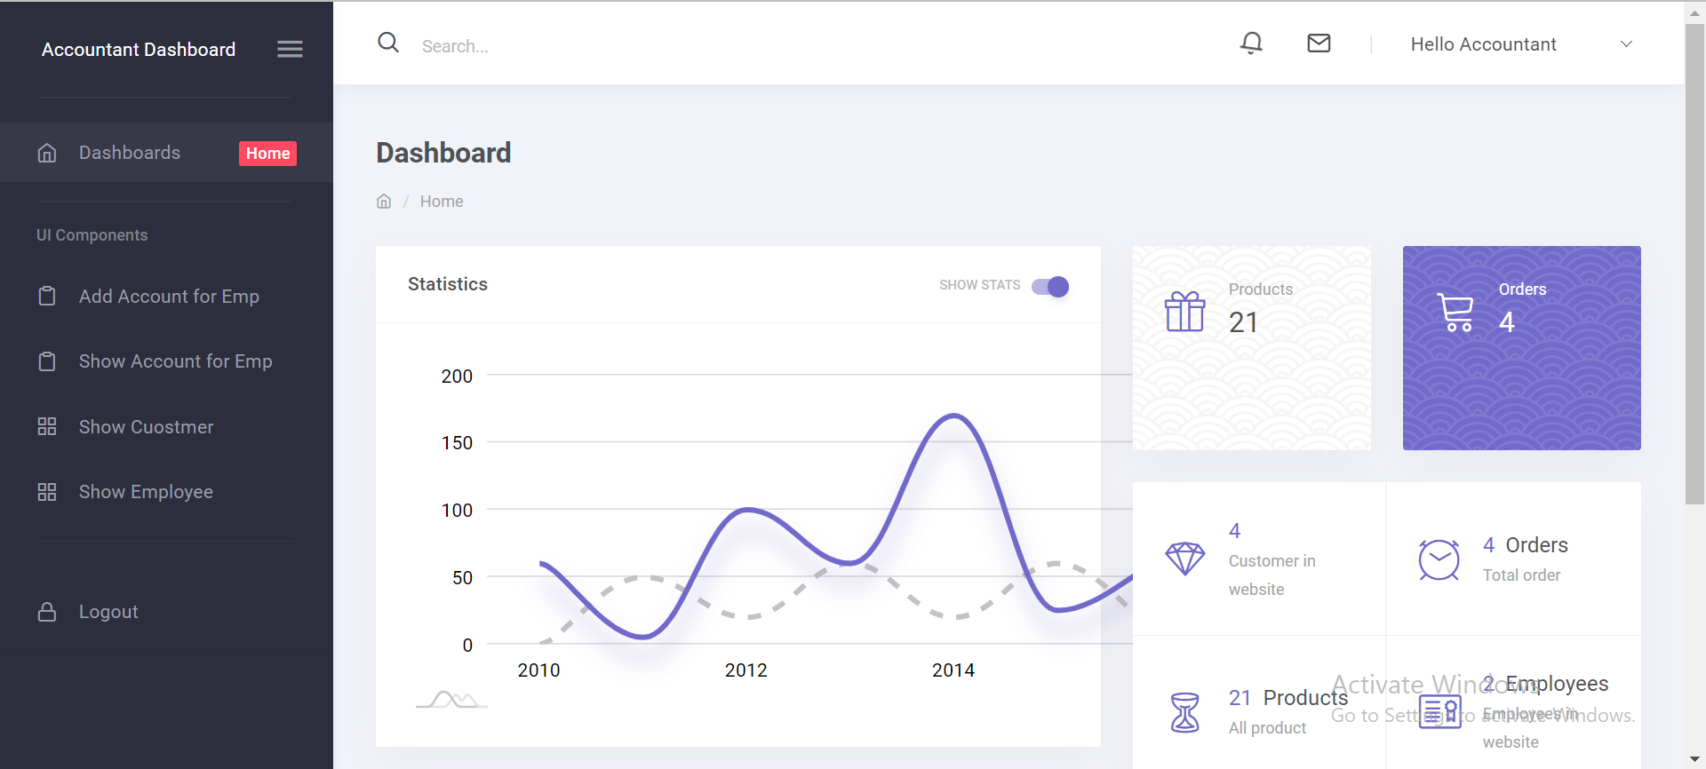
Accountant Dashboard
.

Slide 18
THANK YOU
Insert the Subtitle of Your Presentation

