Slide 1
HAPPINESS
TS- WEB/CC/AI TRACK CAPSTONE PROJECT
Presented By:
1. Miss J.Faritha Beham – B.sc Computer Science
2. Miss S.Shifa parveen – B.sc Computer Science
3. Miss S.Shifana Begum – B.sc Computer Science
4. Miss N.Meena – B.sc Computer Science
5. Miss P.Preethika-BCA(Computer Application)
Guided By:
Track Name: Deep Drive
Trainer Name: Mayank Shrivastava

Slide 2
OUTLINE
Abstract
Problem Statement
Aims , Objective & Proposed System/Solution
System Design
System Development Approach(Technology Used)
Algorithm & Deployment
Conclusion
References
Future Scope

Slide 3
Abstract
It is mainly expressed individual’s own feeling that is a sensational state of a person
It is all about what we imagine, feel, assume and how do we perform in harmony.
Nowadays, there is a rising trend of measurement of happiness amongst government all over the world to determine their people’s well-being.

Slide 4
Problem Statement
The Happiness Problem shows that this way of thinking is too simplistic and can even be harmful: no matter how much progress we make, we will still be vulnerable to disappointment, loss and suffering.
The things we do to make ourselves happy are merely the tip of the iceberg.

Slide 5
proposed solution
A “happiness project” is an approach to changing your life.
First is the preparation stage, when you identify what brings you joy, satisfaction, and engagement, and also what brings you guilt, anger, boredom, and remorse

Slide 6
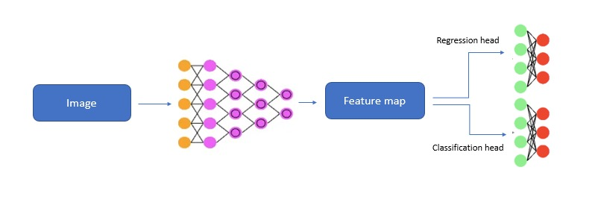
System Architecture

Slide 7
System Deployment Approach
Python: Python is a popular programming language for developing Al applications, with many powerful libraries for data analysis, machine learning, and visualization.Google Colab:Colaboratory, or “Colab” for short, is a product from Google Research.
Colab allows anybody to write and execute arbitrary python code through the browser, and is especially well suited to machine learning, data analysis and education..
Scikit-learn: Scikit-learn is a Python library that provides simple and efficient tools for data mining and data analysis, including machine learning algorithms for classification, regression,and clustering

Slide 8
Algorithm & Deployment
Numpy
Pandas
Seaborn
Matplotlib.pyplot

Slide 9
THANK YOU

