Slide 1
Category review: Chips
August 2026
Retail Analytics
Brand note: If client logo is not required, use alternate title page layout right click slide thumbnail > Layout > Title

Slide 2
Notes:
To view Privacy video explaining how important data privacy is to Quantium, please click here: https://www.youtube.com/watch?v=Zq1QDAkoRzU
or here Q:\Company Reference\Brand & Design\Brand videos\Q Privacy.mp4
At Quantium, we believe that data is the behavioural footprint of humanity and that it has to be treated with the utmost care and responsibility.
Histories, attitudes, indeed lives are stored within it in ways that aren’t always apparent – and that’s what makes its potential so powerful.
To work with it responsibly, sensitively, we set ourselves the highest data privacy protection and governance standards.
We have spent 17 years perfecting privacy-by-design and secure-by-design principles. Central to this is not holding any personally identifiable information about people –
we neither receive it, and put the necessary protections in place to be unable to decipher it.
Every aspect of handling data is safeguarded: from its de-identification, to its encryption – data security is paramount and of the highest grade.
We pride ourselves on gaining the trust of iconic organisations around the world through years of securely working with their data,
and in turn the trust that builds with their stakeholders.

Slide 3
Executive summary
01
Task 1
Older Families – Budget is the single highest-value segment ($160.8k) despite a mid-sized customer base — driven by per-customer spend, not volume.
Household size (not premium tier) is the main driver of purchase volume: family segments buy ~9 units/customer vs ~4.5 for Singles/Couples.
Kettle is the top-selling brand in every segment; Young Singles/Couples–Mainstream shoppers over-index on Tyrrells and Twisties and pay a statistically significant price premium.
02
Task 2
Trial stores 77, 86 and 88 were each matched to a control store using pre-trial sales correlation and magnitude of monthly sales.
All three trial stores showed a statistically significant sales uplift in March 2019 (t > 1.943 critical value); the uplift held into April for stores 77 and 88.
The new trial layout drove a genuine, replicable increase in sales — recommended for wider rollout, with store-level driver analysis available in the supporting notebook.

Slide 4
01
Category

Slide 5
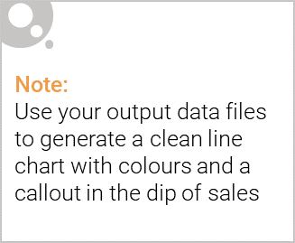
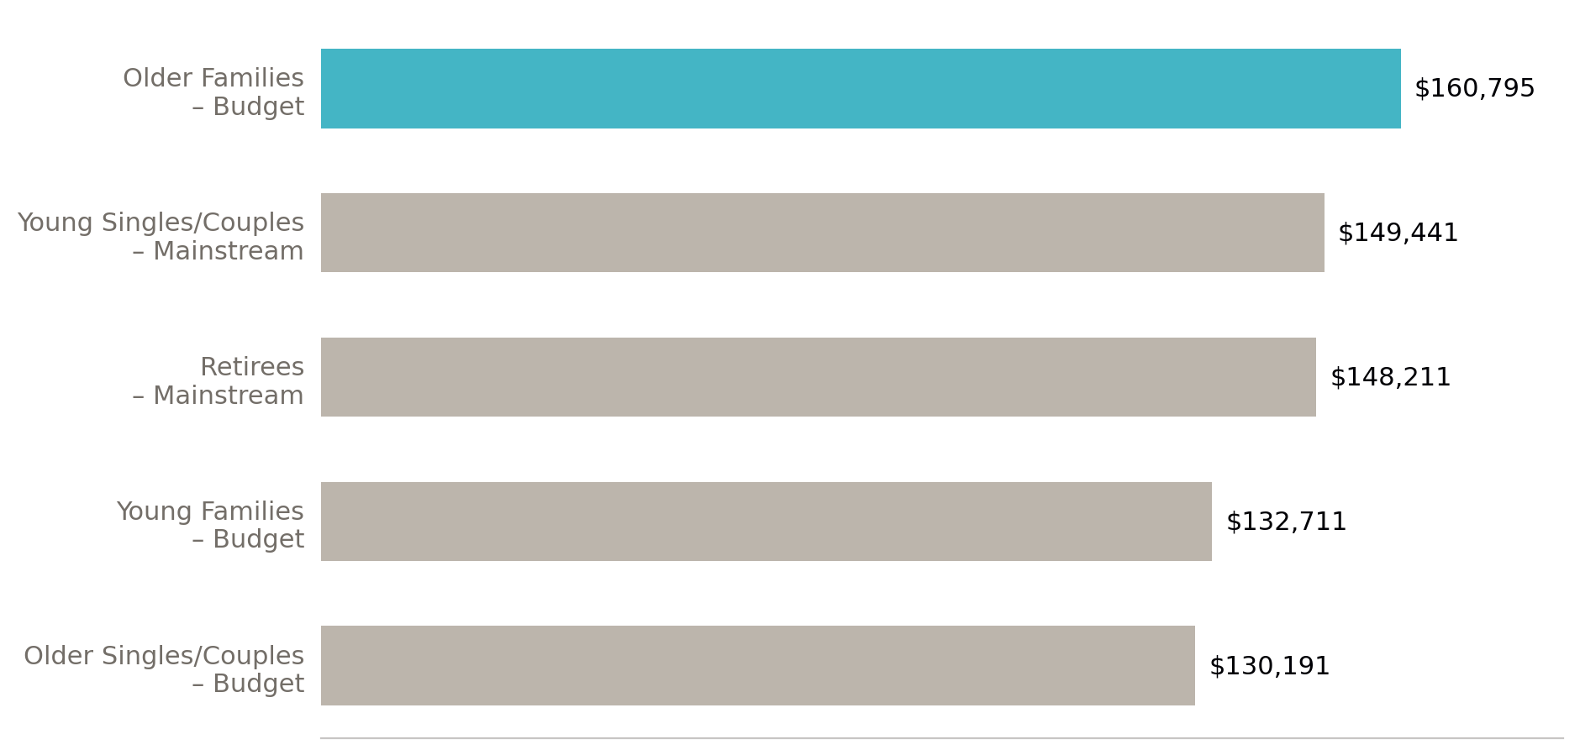
Older Families on a Budget are the category's most valuable customers
Across 255,510 cleaned transactions, total chip category sales are concentrated in a handful of segments — led by spend intensity, not just customer count.

Slide 6

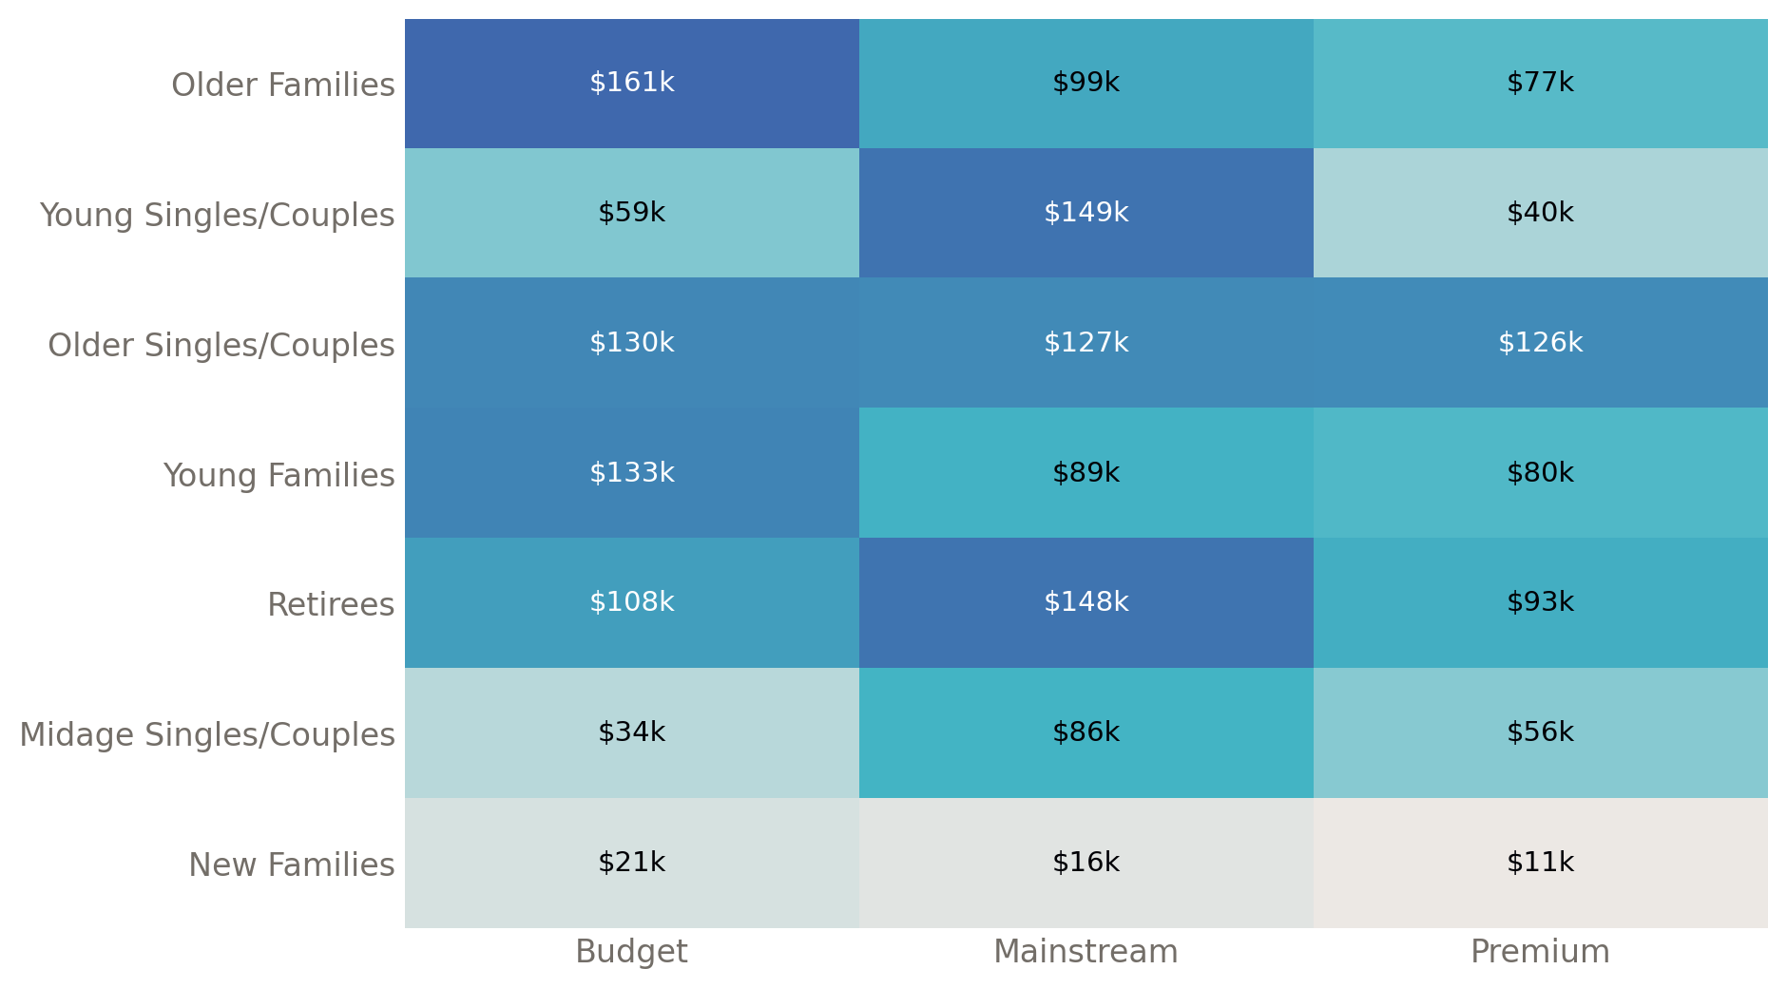
Spend is driven by two distinct patterns: family size and mainstream loyalty
Older Families – Budget tops every column at $160.8k, over 60% ahead of the next Budget segment.
Mainstream shoppers dominate for Retirees ($148.2k) and Young Singles/Couples ($149.4k) — a customer-volume story rather than a spend-per-head story.
New Families is the smallest segment across all three tiers, consistent with its small customer base (2,549 customers).
Affluence tier (Budget/Mainstream/Premium) matters less than life stage: family segments consistently outspend equivalent Singles/Couples segments.

Slide 7
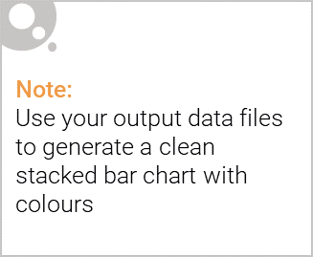
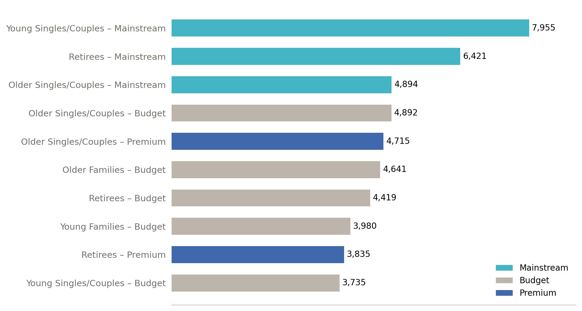
Editable (delete this)
Young Singles/Couples – Mainstream is the category's largest customer base
Top 10 segments by number of unique customers (of 72,637 total) — colour shows Premium Customer tier.

Slide 8
02
Trial store performance

Slide 9
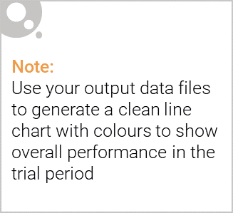
Each trial store was paired with a control store using pre-trial sales patterns
For each trial store, every other store was scored against it on two pre-trial (Jul 2018–Jan 2019) measures: the correlation of monthly sales trends, and the magnitude (scaled distance) of monthly sales levels. The two scores were combined in a 50/50 weighted blend, and the highest-scoring store was selected as the control.
Trial store | Control store | Selection basis
Store 77 | Matched control | Highest combined correlation + magnitude score
Store 86 | Store 155 | Highest combined correlation + magnitude score
Store 88 | Store 237 | Highest combined correlation + magnitude score

Slide 10
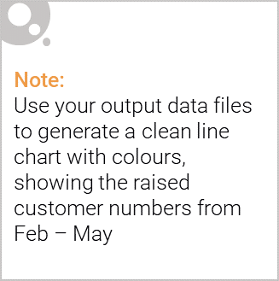
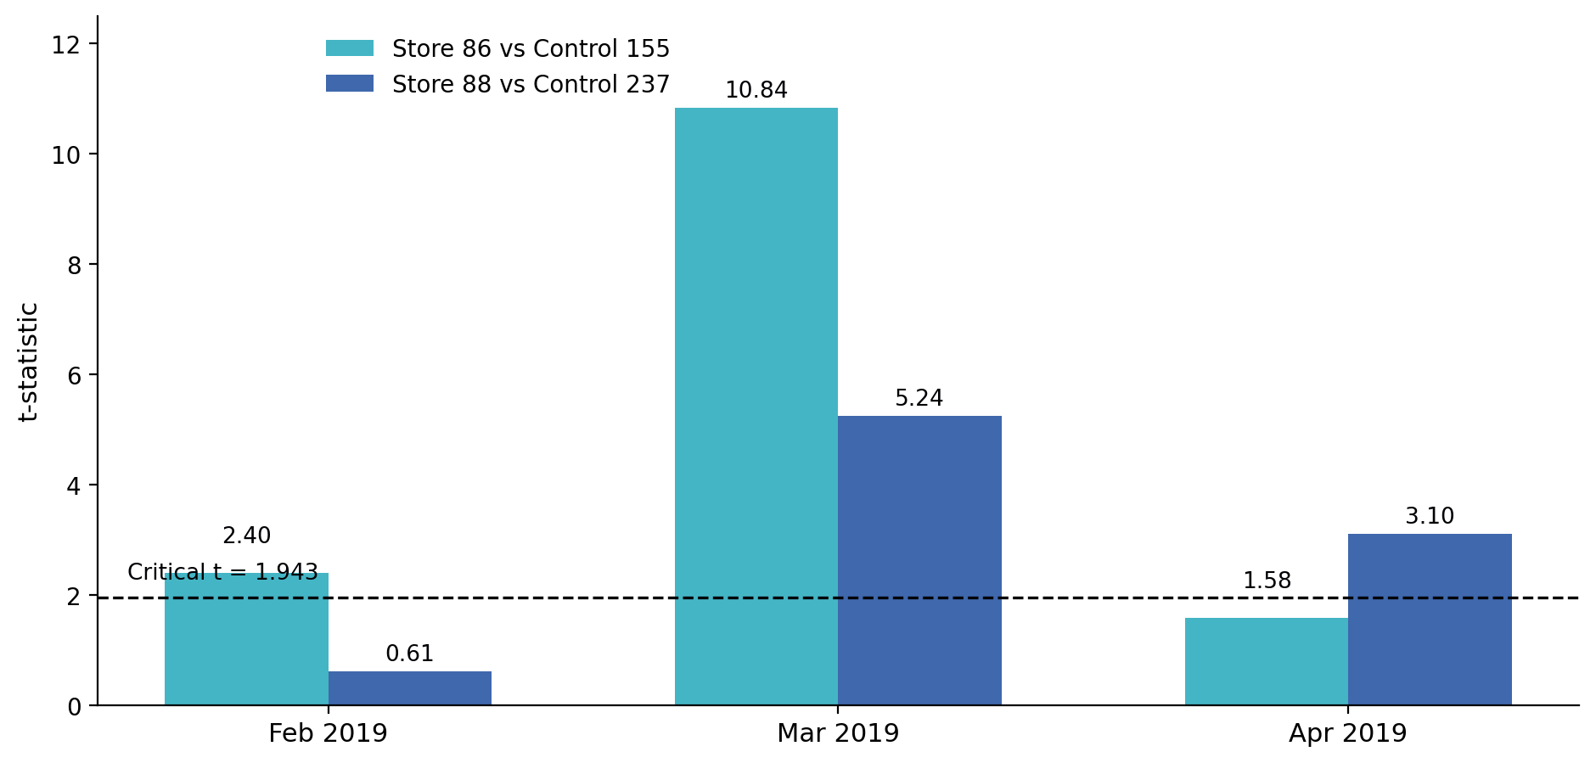
The trial layout drove a significant sales uplift, most consistently in stores 86 and 88
Store 77: significant uplift in March and April 2019, not February.
Store 86 (vs control 155): significant in February and March, uplift faded by April.
Store 88 (vs control 237): significant in March and April, not February.
All three stores cleared the critical t-value (1.943) in March — the strongest and most consistent month for the trial.
Driver analysis (customer numbers vs. average transactions per customer) was run for every significant month per store — see the supporting notebook for the full breakdown.
Recommendation: the trial layout is associated with a genuine, repeatable sales uplift and should be considered for wider rollout, prioritising the conditions that produced the March result.

