Slide 1

Financial Analysis Dashboard An Insightful Overview Using Power BI Presented by: Shifana K S Date: August 2025

Slide 2

AGENDA
Objective
To analyze financial performance data using Power BI
To gain insights into regional sales, profit distribution, and product category trends
To support strategic business decisions with data-driven visuals

Slide 3

Dataset Description Total Records: 700 rows Time Period: 2013 – 2014 Purpose: Track financial KPIs across regions and products

Slide 4

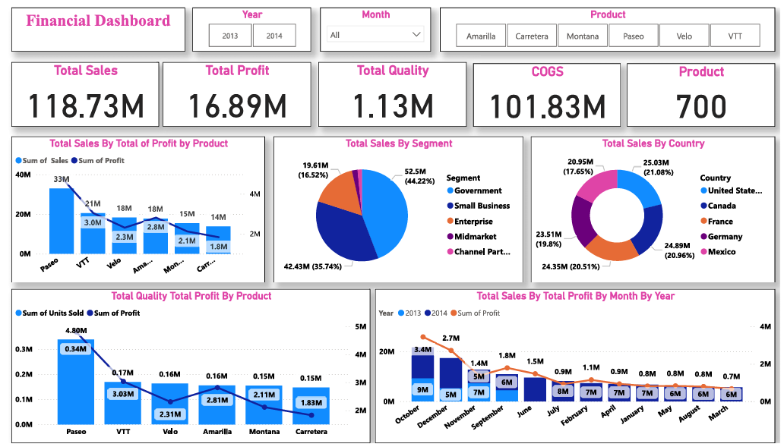
Dashboard Summary
Built using Power BI
Interactive charts, filters, and visual KPIs
Focused on sales, profit, and category-level trends

Slide 5
Key Performance Indicators
Total Sales: $118.73M
Total Profit: $16.89M
Total Quantity Sold: 1.13M units
Cost of Goods Sold (COGS): $101.83M
Total Product Records: 700

Slide 6
Sales and Profit by Product
Top Performing Product: Paseo with $33M in sales and $3M in profit
Other High Performers:
VTT: $21M sales, $2.3M profit
Velo: $18M sales, $2.3M profit
Products like Carretera and Montana have lower profits (< $2.1M)

Slide 7
Total Quality vs Profit by Product
Highest Quantity Sold: Paseo (0.34M units)
Lowest Quantity Sold: Carretera (0.15M units)
Even with low quantity, products like Montana and VTT contribute significant profit

Slide 8
Sales by Customer Segment
Small Business leads with $52.5M (44.22%)
Followed by Midmarket: $42.43M (35.74%)
Government and Enterprise contribute smaller shares

Slide 9
Sales by Country
Top 3 Countries:
United States: $25.03M (21.08%)
Germany: $24.89M (20.96%)
France: $24.35M (20.51%)
Lowest Contributor: Mexico at $20.95M

Slide 10
Monthly Sales and Profit Trend
Highest Profit Month: December 2014 ($2.7M)
Sales Peaks:
October 2013: $13.4M
December 2013: $9M
December 2014: $5M
Profit and sales generally decline in the first half of the year

Slide 11
Conclusion
The financial dashboard reveals that Paseo is the top-performing product in both sales and profit, while Small Business and the United States lead in customer segment and region-wise sales respectively.
Seasonal trends show peak sales and profits in October to December, suggesting strong year-end performance.
These insights can guide product focus and timing for strategic marketing and sales efforts.

Slide 12

THANK YOU

