Slide 1

KHULNA UNIVERSITY OF ENGINEERING & TECHNOLOGY · CSE 4102
Sentinel
A Fully Procedural Game Engine
and Open-World Military Shooter
Nothing is loaded from a model, image or sound file:
everything is generated from code and a seed.
Md. Shifat Hasan
Roll 2107067 · 4th Year 1st Term
Instructors: Md Tajmilur Rahman, Md. Mubtashim Abrar Nihal
Computer Graphics and Image Processing Laboratory · October 7, 2026

Slide 2

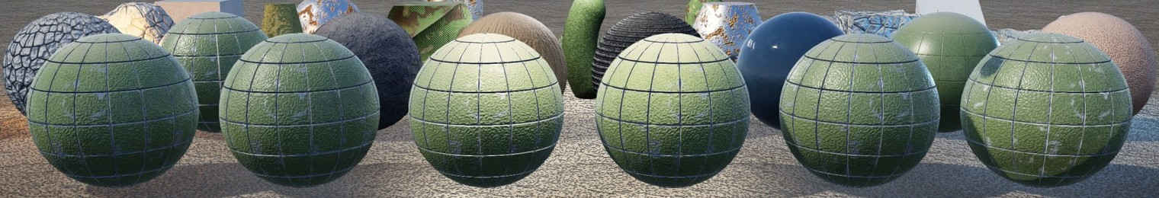
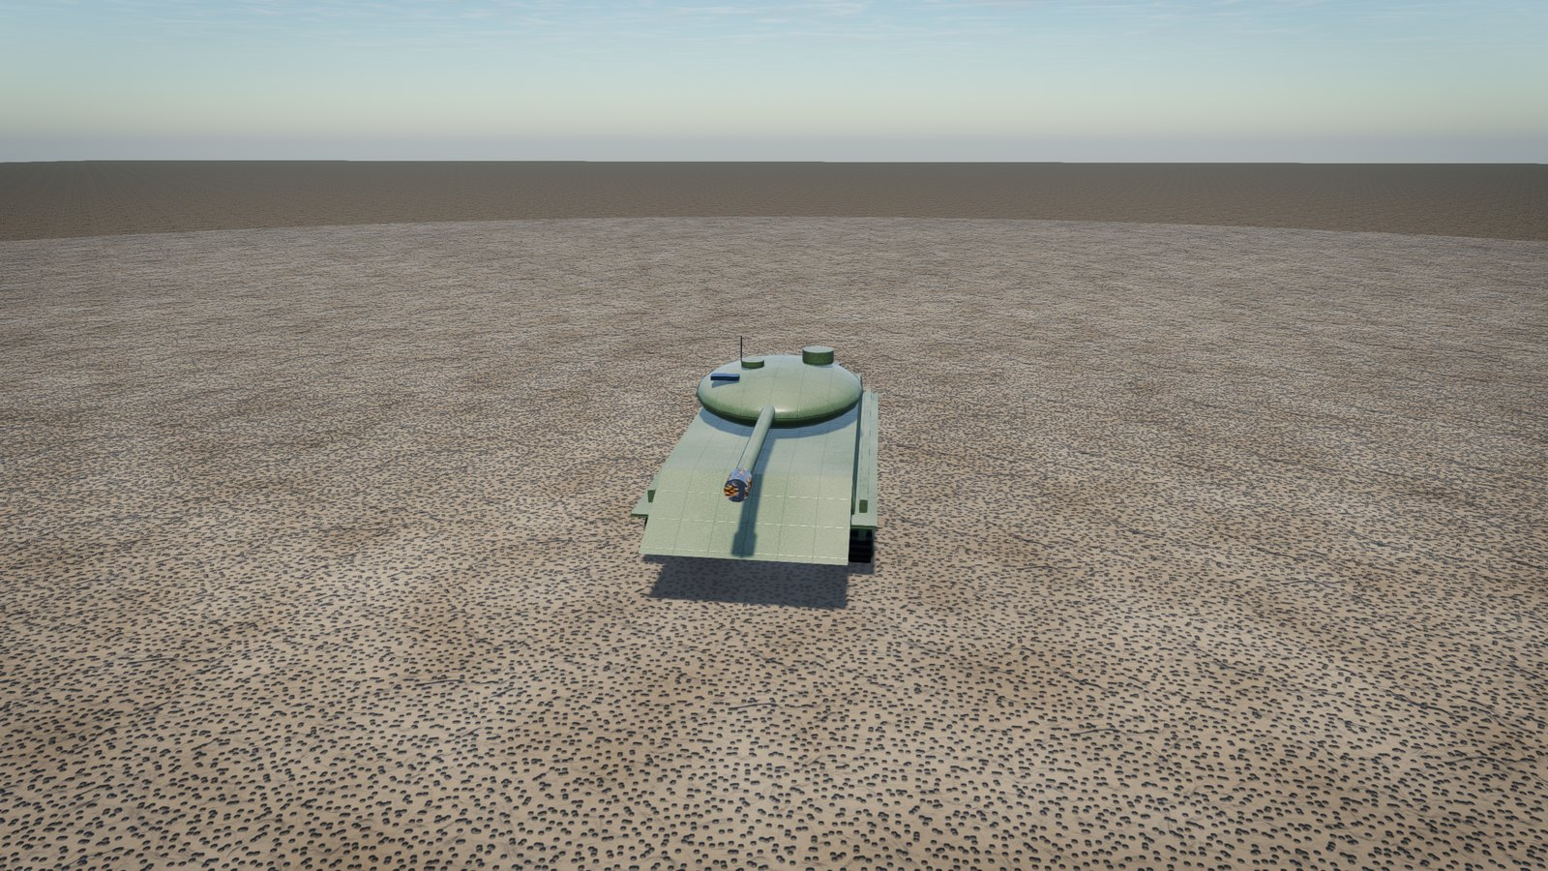
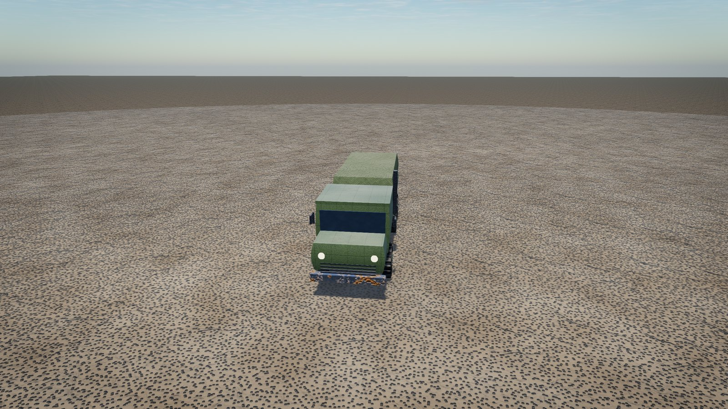
Outline
1
Problem, objectives and architecture
2
Procedural shapes and textures
Six illumination models, one sphere each
3
Transformations: creating and combining objects
4
Illumination models and light sources
5
The rendering pipeline: shadows, ambient, tone map
Objects are transformed primitives
6
Results, verification and a bug fixed
7
Video tour of the project
2 / 10

Slide 3
1. Problem, objectives and architecture
Can a complete, playable 3D game be made by code alone on a student laptop?
Game: mission, AI, vehicles, sound
Render: deferred, lights, sky, post
Two hard limits
No model, image or precomputed data file
macOS OpenGL 4.1: no compute shaders
World: collision, terrain
Procedural: noise, textures
Objectives
Layered engine, downward dependencies
All content from code and seeds
Modern renderer and a playable game
Verified by tests and a 16.7 ms budget
GPU: shaders, buffers
Platform: window, input
A lower layer never knows a higher one.
The game: jeep, truck, carrier, tank and a helicopter you can drive; ladders and doors; stealth enemies; a five-objective mission (hack, destroy, rescue, extract); all sounds synthesised.
3 / 10

Slide 4

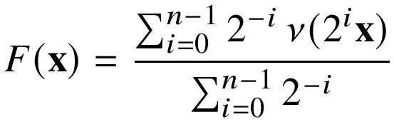
2. Procedural shapes and textures
gradient, fractal, warped, ridged and cellular noise
Fractal noise (tiles exactly)
18 recipes → 22 materials, baked once at 1024²
Scharr filter turns height into bumps; crevices darken
Objects are tables of primitives plus noise deformers
Soldiers: skeletons with two-bone IK legs
Vertex push by a noise deformer
4 / 10

Slide 5
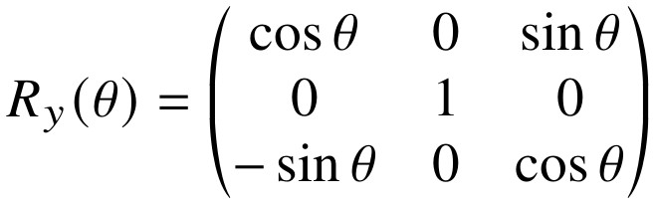
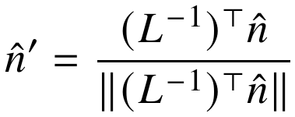

3. Transformations: creating and combining objects
Primitive
mesh
Deformers
(own space)
M_part
scale, turn, move
Merge by
material
M_world
instances
V then P
to screen
One part: scale, then turn, then move
Rotation about y
Matrices act right to left: the brick is stretched, turned about its own centre, and moved last.
(1,0,0) → S(2,1,1) → R_y 90° → T(5,0,0) = (5, 0, −2)
Hierarchy: products down the chain
Normals use the inverse transpose
Turning the hull carries turret and gun
stays perpendicular after a stretch
World to screen
S = diag(2,1,1): correct (0.447, 0.894, 0); naive (0.894, 0.447, 0) is wrong
5 / 10

Slide 6
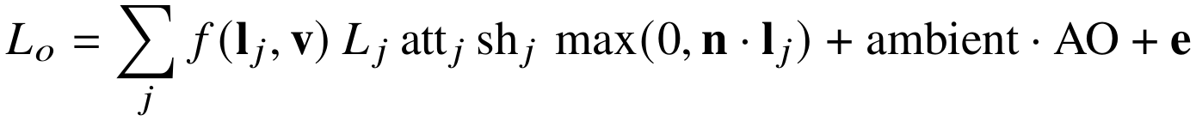
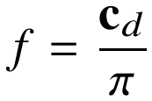
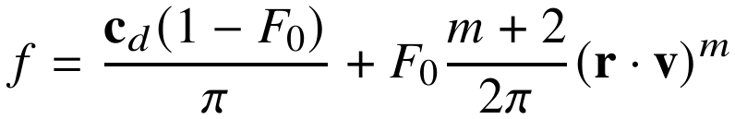
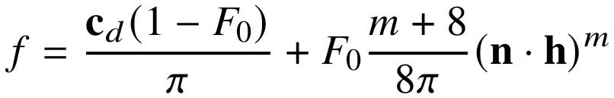
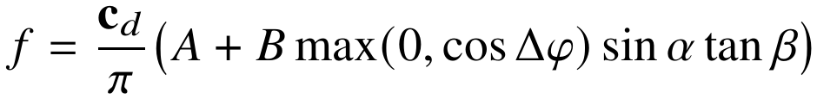
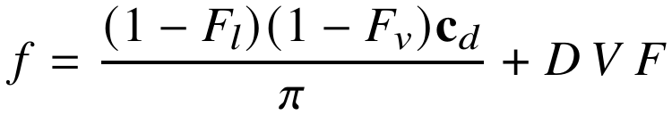
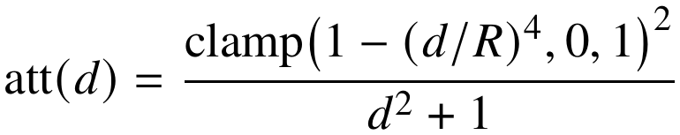
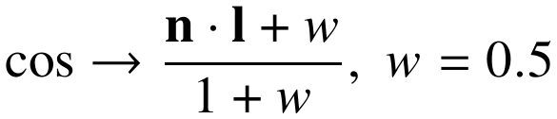
4. Illumination models and light sources
f = model, att = falloff, sh = shadow
Lambert
Phong
Six models, one sphere each
Light sources
Blinn–Phong
Directional: sun, moon
Point: lamps, flashes
Spot: floodlights (cone)
Area: 4×4 point samples
Oren–Nayar
Cook–Torrance
Subsurface
6 / 10

Slide 7
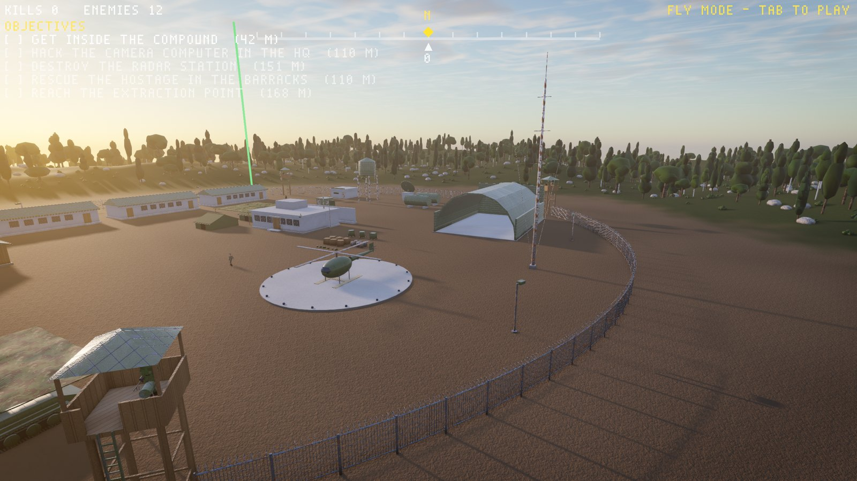
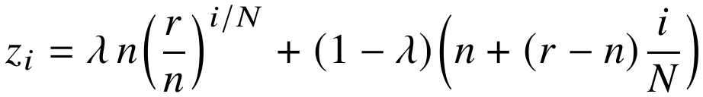
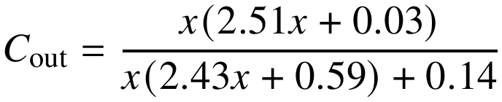
5. The rendering pipeline: shadows, ambient, tone map
Sky
table
Shadows
3 cascades
Geometry
G-buffer
SSAO
Lighting,
reflect, fog
Smoke,
fire
Bloom, ACES,
FXAA
Deferred shading: store colour, normal, shininess and depth first, then light each pixel once.
Cascaded shadow maps (λ = 0.75, N = 3, n = 0.1, r = 100 m)
Cuts at 9.1, 24.2, 100 m; normal-offset lookup, 8 rotated PCF taps
Fog and tone map
Dusk: sun, sky, haze, shadows
Sun, moon, lamps, cascaded shadows, SSAO, screen-space reflections, bloom and FXAA
Ambient = sky diffuse + split-sum specular, times SSAO
7 / 10

Slide 8
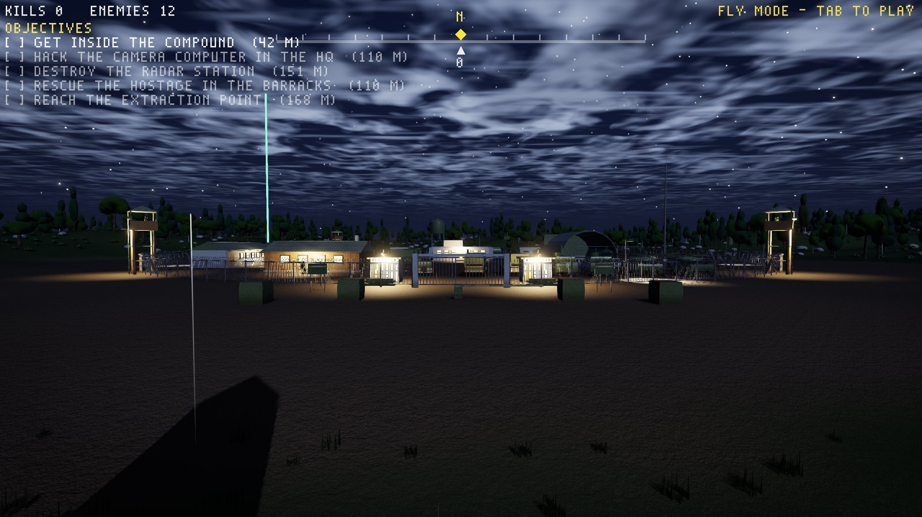
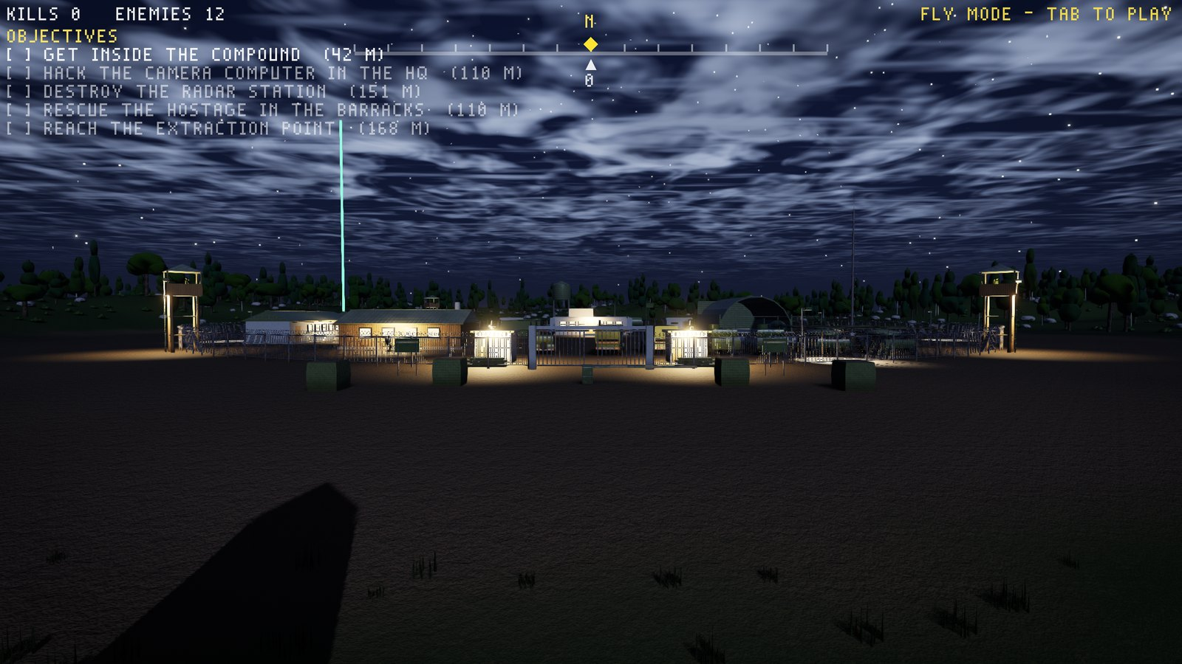
6. Results, verification and a bug fixed
Bug: a vertical line at night. Fog sampled the whole sky, so one horizon star streaked a column. Fix: fog uses the smooth atmosphere only.
10.9 ms of the 16.7 ms budget at 1080p
Before
After
Verification | Count
Unit tests (13 packages) | 281
TextureCheck (exact tiling) | 8,318
RenderCheck (lighting probes) | 318,567
GpuCheck | 30
Playthroughs, 5/5 objectives | 2
Limits and future work
Blocky primitive models; no true global illumination; lumpy foliage
Leaf cards, screen-space GI, point-light shadows, multiplayer, compute port
Take-away: most "art" is a few simple ideas, applied consistently and tested
8 / 10

Slide 9
7. Video tour of the project
9 / 10

Slide 10
References
[1] K. Perlin, "Improving noise," ACM TOG, 21(3), 2002.
[2] S. Worley, "A cellular texture basis function," SIGGRAPH, 1996.
[3] R. Cook, K. Torrance, "A reflectance model for computer graphics," ACM TOG, 1(1), 1982.
[4] B. Walter et al., "Microfacet models for refraction through rough surfaces," EGSR, 2007.
[5] B. Karis, "Real shading in Unreal Engine 4," SIGGRAPH Course, 2013.
[6] S. Hillaire, "A scalable and production ready sky and atmosphere rendering technique," CGF, 39(4), 2020.
[7] R. Dimitrov, "Cascaded shadow maps," NVIDIA, 2007.
[8] M. Oren, S. Nayar, "Generalization of Lambert's reflectance model," SIGGRAPH, 1994.
[9] K. Narkowicz, "ACES filmic tone mapping curve," 2016.
[10] J. Jimenez, "Next generation post processing in Call of Duty: Advanced Warfare," SIGGRAPH, 2014.
[11] T. Lottes, "FXAA," NVIDIA, 2009.
[12] M. Segal, K. Akeley, The OpenGL Graphics System, v4.1, Khronos, 2010.
[13] I. Quilez, "Domain warping," iquilezles.org.
[14] S. Hargreaves, M. Harris, "Deferred shading," NVIDIA, GDC 2004.
[15] H. Scharr, "Optimal operators in digital image processing," Ph.D., Heidelberg, 2000.
[16] T. Akenine-Möller et al., Real-Time Rendering, 4th ed., CRC Press, 2018.
Thank you
Questions are welcome
Md. Shifat Hasan · Roll 2107067
10 / 10

