Slide 1


Cow at Large
Analysis by David Yang

Slide 2
Statement Summary
We’re given a tree with N<=1e5 nodes
Bessie is starting from node K
Find the minimum amount of farmers that you need to block off Bessie.

Slide 3







Sample Input
1 2
1 3
3 4
3 5
4 6
5 7

Slide 4









Sample Input
1 2
1 3
3 4
3 5
4 6
5 7

Slide 5





Sample Input
1 2
1 3
3 4
3 5
4 6
5 7

Slide 6






Sample Input
1 2
1 3
3 4
3 5
4 6
5 7

Slide 7
Analysis of Sample
We see that Bessie is able to travel to 3 distinct leaf nodes
Therefore, we must deploy 3 farmers
What if we had a different sample?

Slide 8
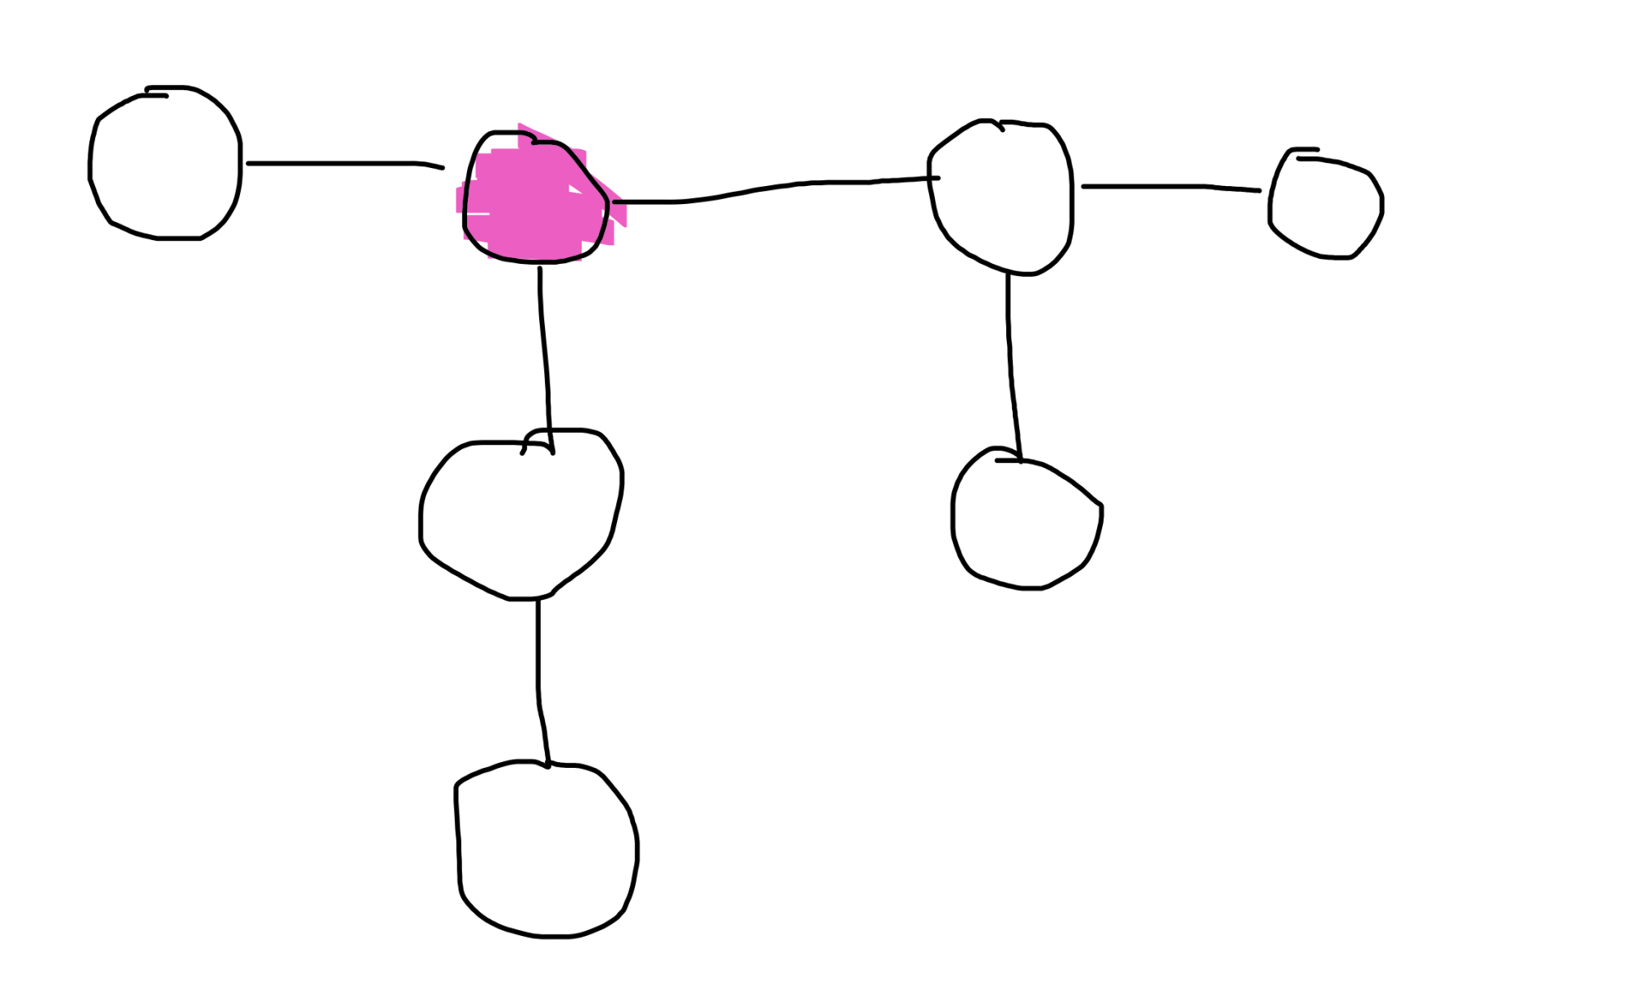
Our Own Case

Slide 9




Our Own Case

Slide 10
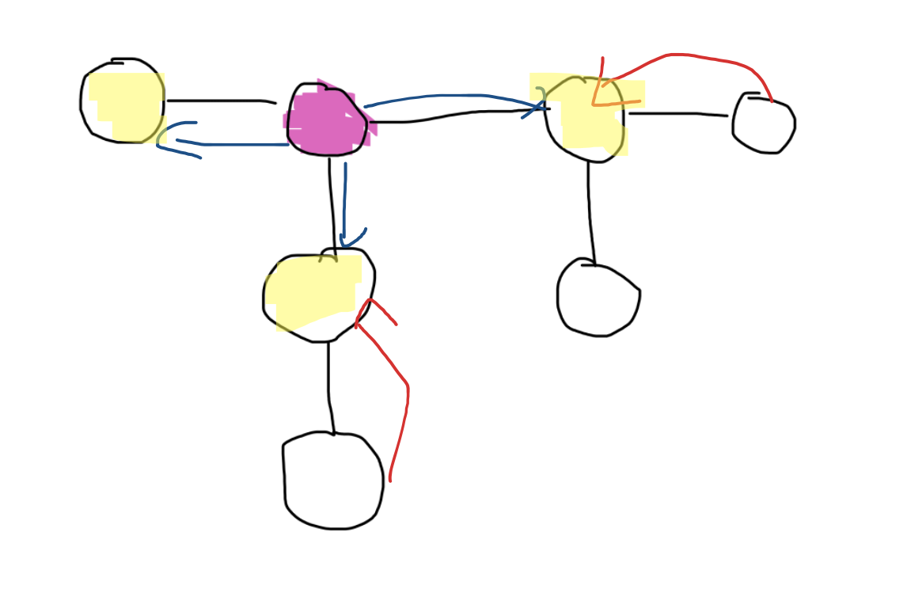
Analysis of our case
In our case, we can see that we need…
1 Farmer for Left. 1 Farmer for Right. 1 Farmer for Below.
You can see that you save 1 farmers, because you can block off each highlighted exit with exactly 1 farmer.

Slide 11
Key Observations
Since this is a tree, Bessie will only ever go in 1 direction. IE: She will not go back
The answer is the sum of highlighted nodes, or blocked off exits.
We can block off an exit if the minimum distance from a leaf is smaller than the minimum distance from bessie

Slide 12
How to Code?
3 Parts.
Find minimum distance for Bessie to get from node K to all other nodes.
Find minimum distance from any node to a leaf
Final DFS to get the solution.

Slide 13
DFS for Bessie
static void dfsBessie(int cur, int par){
for(int next: adj[cur]){
if(next==par) continue;
bessieDist[next]= bessieDist[cur]+1;
dfsBessie(next, cur);
}
}

Slide 14
DFS for Farmer
static void dfsFarmer(int cur, int par){
for(int next: adj[cur]){
if(next==par) continue;
dfsFarmer(next, cur);
farmerDist[cur]= Math.min(farmerDist[next]+1, farmerDist[cur]);
}
if(adj[cur].size()==1) farmerDist[cur]=0;
}

Slide 15
Final DFS
static void dfsSolve(int cur, int par){
if(bessieDist[cur]>=farmerDist[cur]){
res++; return;
}
for(int next: adj[cur]){
if(next==par) continue;
dfsSolve(next, cur);
}
}

