Slide 1


Dishwashing
Analysis by David Yang

Slide 2
Sample
5
4 5 2 3 1

Slide 3





Slide 4
Step 1
Put the 4 onto a new stack
Why: Only choice

Slide 5






Slide 6
Step 2
Put 5 onto a new stack
Why: You cannot put a 5 on a 4
Since you keep track of the max of numbers on the Elsie Stack
-> You don’t want to add more plates than necessary

Slide 7

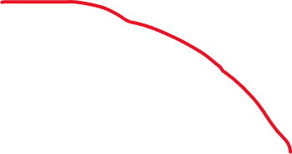

Slide 8
Step 3
Put 2 on top of 4 stack
Why: You can’t put it on top of 5 or on a new stack

Slide 9




Slide 10
Step 4
Move 2 to Elsie Stack
Why: Make room for the 3

Slide 11



Slide 12



Slide 14
Step 5
Move the 3 on top of the 4 stack
Why: because you can’t put it on the 5 or on a new stack
And you don’t have to move 4/5 on Elsie, so don’t

Slide 15



Slide 16
STOP
2 is on the Elsie Stack
1 is our current number
1 < 2, therefore
we will never have a solution if we decided to take 1
so we quit

Slide 17


Slide 18






Slide 19
Implementation Details
Casework:
Put current node on stack
Move node to Elsie
Delete nodes

Slide 20
Put node on stack
What stack should we put it on?
Only 1 will work
How to pick?
You can just iterate/binary search

Slide 21
Move node to Elsie
Just do min(curnode, minnode)
You actually do not have to store Elsie’s stack
All that matters is the minnode

Slide 22
Deleting Nodes
We have to delete starting from the leftmost stack (think about this)
And to delete we do the operations listed in previous slide

Slide 23
Coding Nuances
Determining the stack to place on
Storing a pointer to the leftmost stack
Dealing with adjacency lists

